Slide 1
Wyoming’s Natural Resources

Slide 2
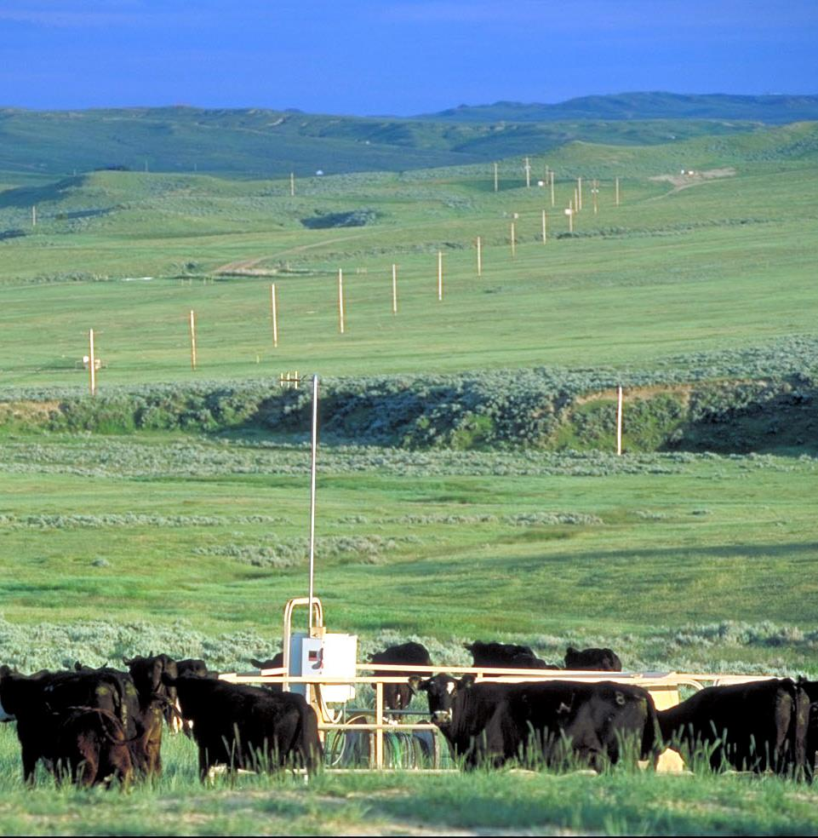
Wyoming has many energy and mineral resources that can be found in several areas of our state. Energy is usable power that we get from natural resources.
Photo courtesy of the Wyoming Petroleum Association

Slide 3
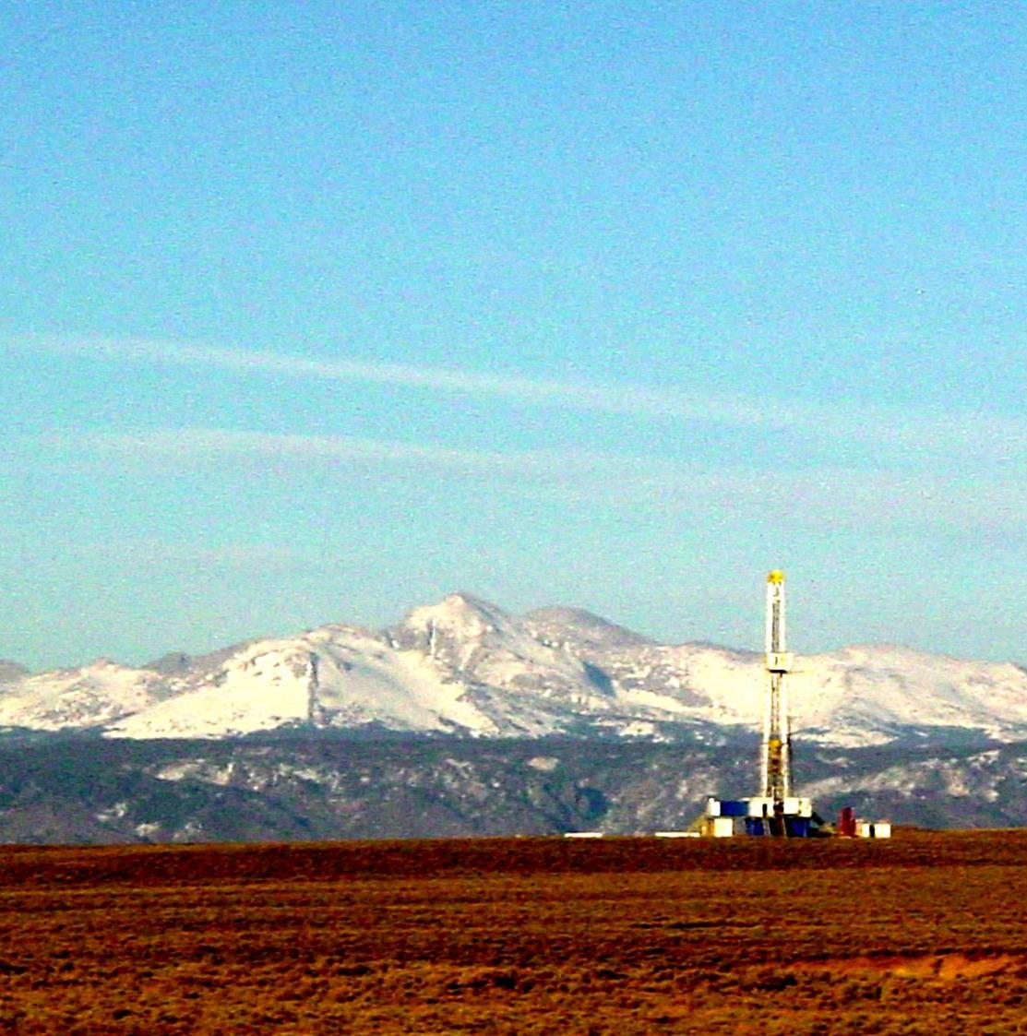
Oil, natural gas, coal, and uranium are used to produce energy that provides electricity, heat, and fuel to move machines. We get most of our energy through the use of these natural resources.
Photo courtesy of the Wyoming Petroleum Association

Slide 4
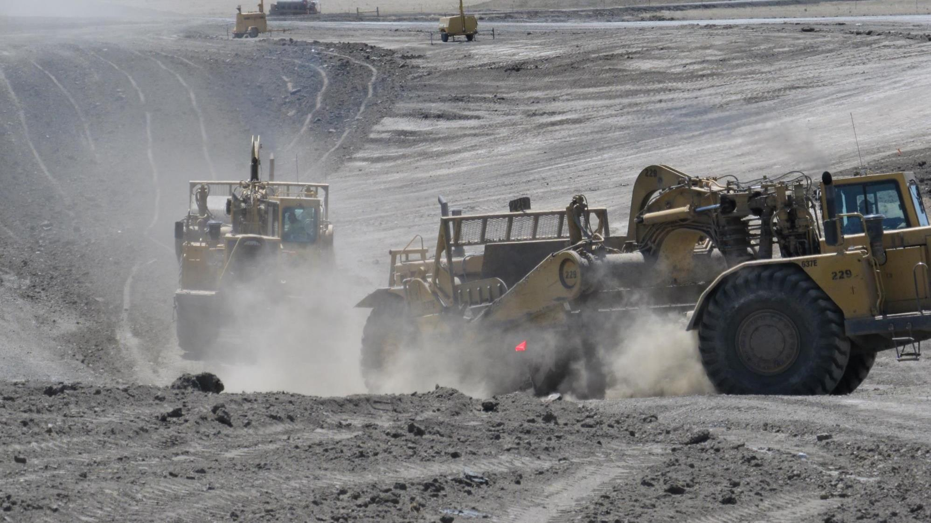
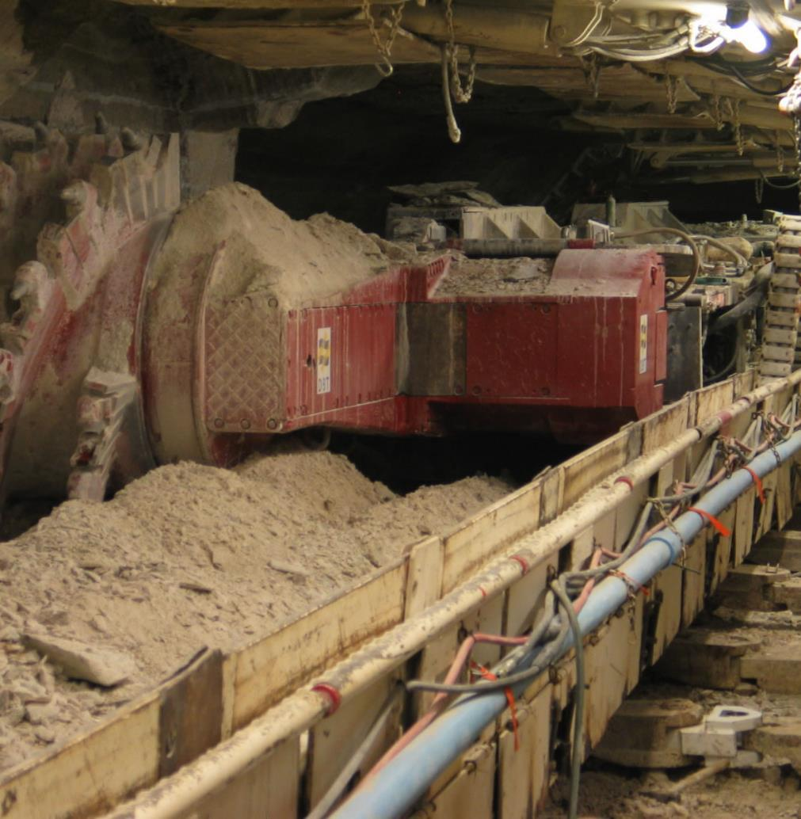
Trona, Bentonite, and Rare Earths are mineral resources found in Wyoming that are in many of the products Americans use every day.
Photos courtesy of the Wyoming Mining Association

Slide 5
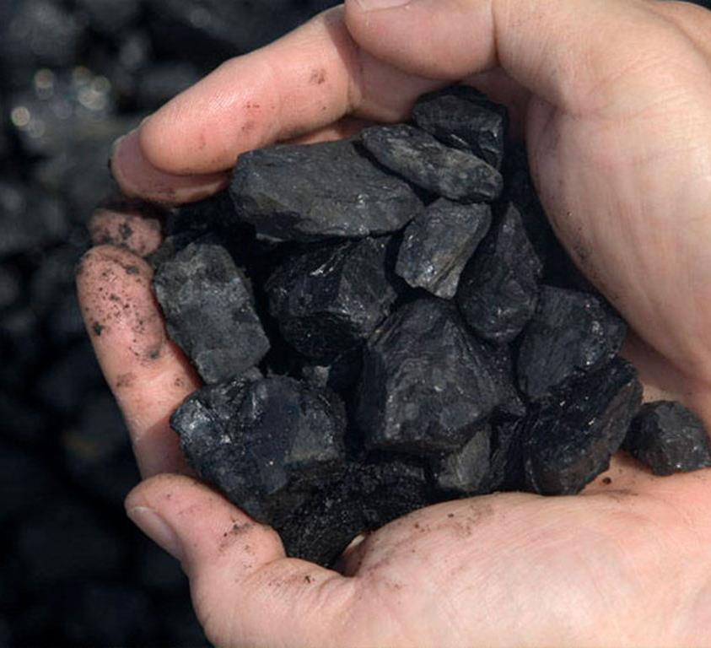
These resources have been made over millions of years because of changes that have happened on and in the earth. Changes in pressure and temperature of decaying plants and animals have caused these natural resources to form.
Photo courtesy of the Wyoming Mining Association

Slide 6
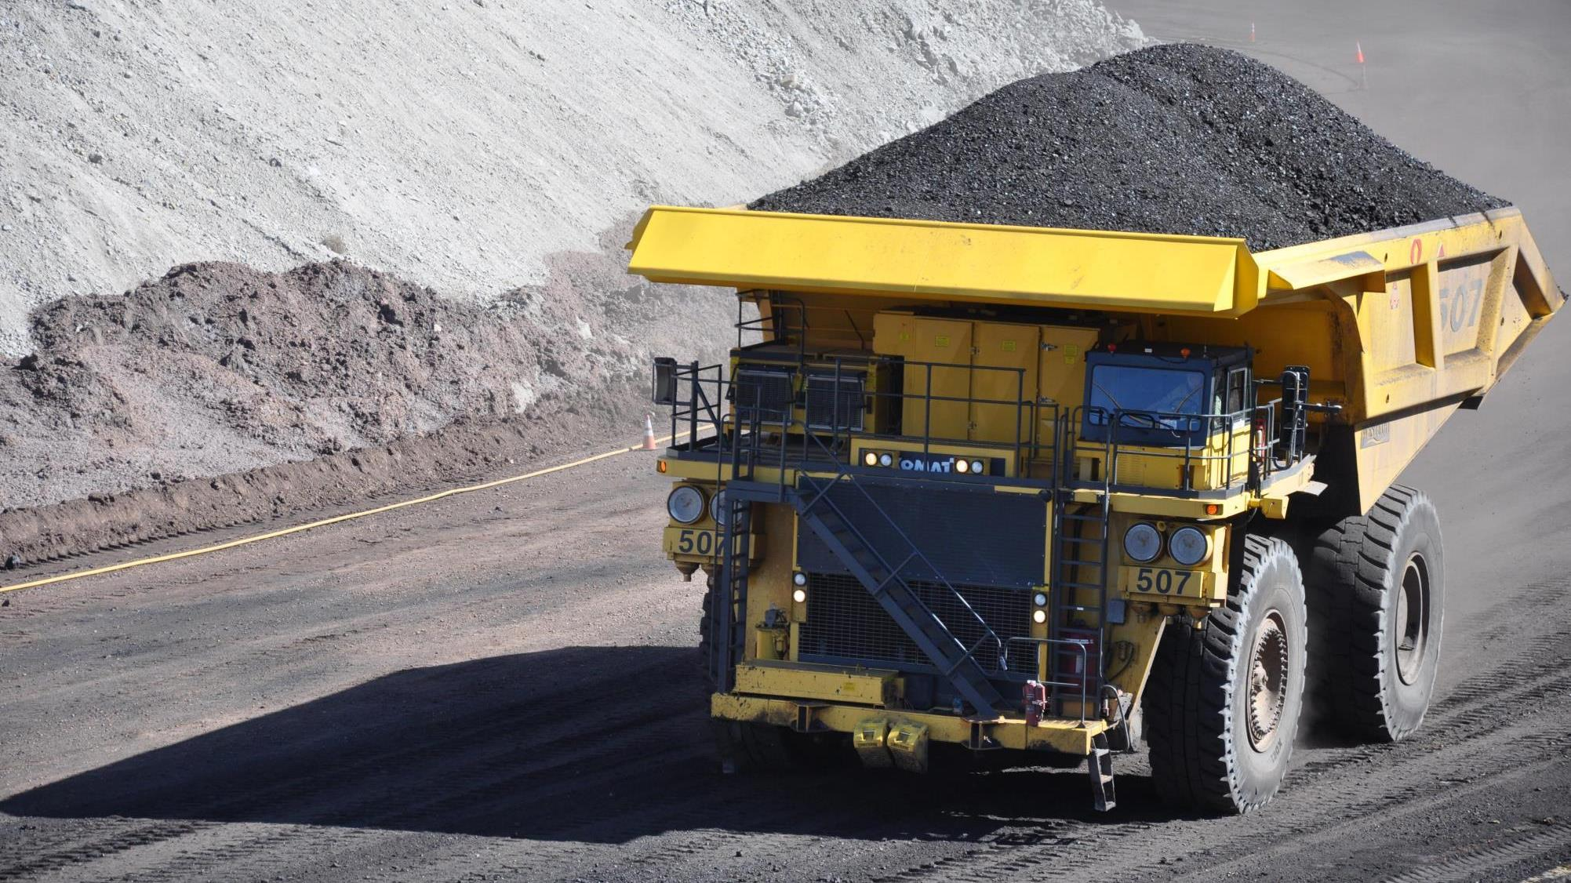
We mine the earth to get these resources. When we mine the earth to get these resources, it takes millions of years for them to replenish. Because they take such an incredibly long time to form, we call them nonrenewable resources.
Photo courtesy of the Wyoming Mining Association

Slide 7
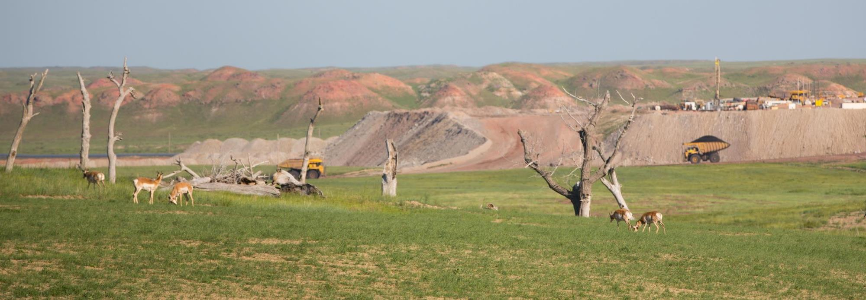
Since we know these resources are limited, it is important that we manage the supply of these nonrenewable resources. This is called conservation.
Photo courtesy of Cloud Peak Energy

Slide 8
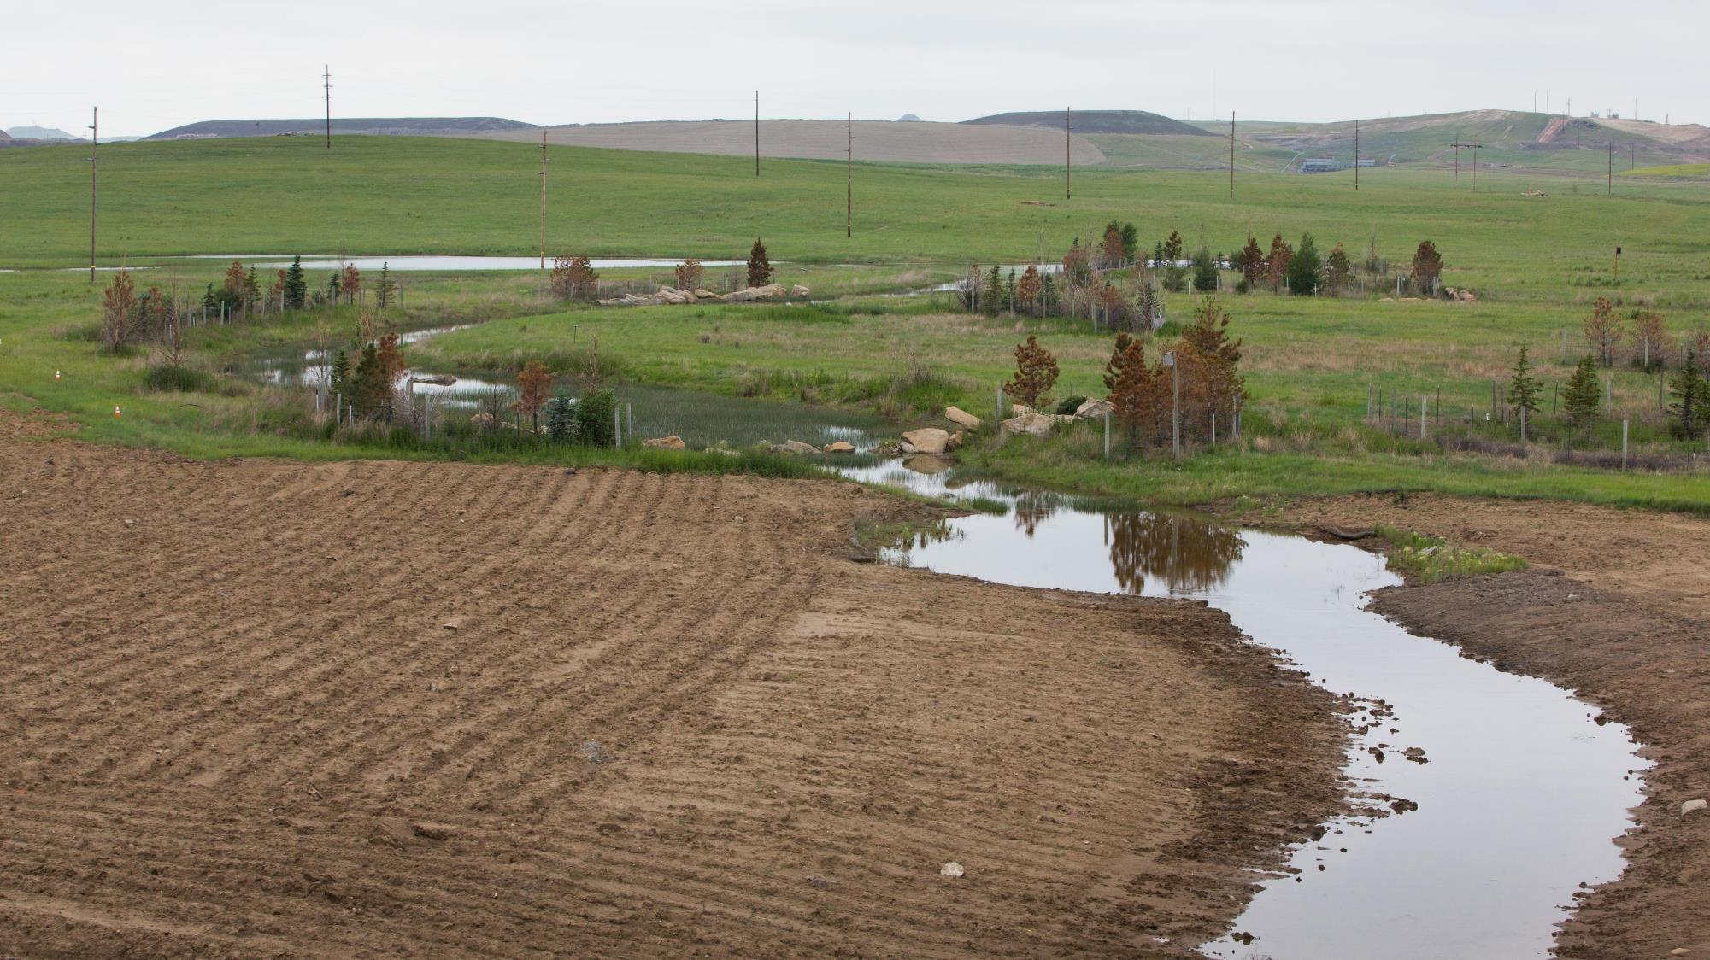
Reclamation is a process that occurs after mining. Mining can cause significant disturbance to the land. Reclamation is the process of making repairs to the land after mining. Reclamation is used to get the land close to its original state. It is an important part of being a good steward of Wyoming's land.
Photo courtesy of Cloud Peak Energy

Slide 9
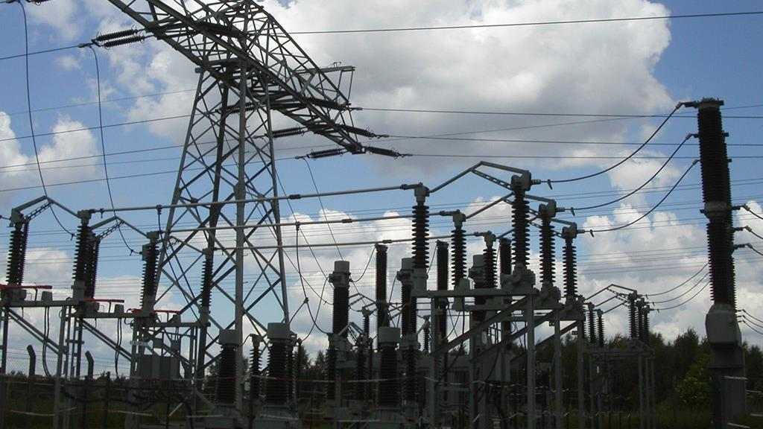
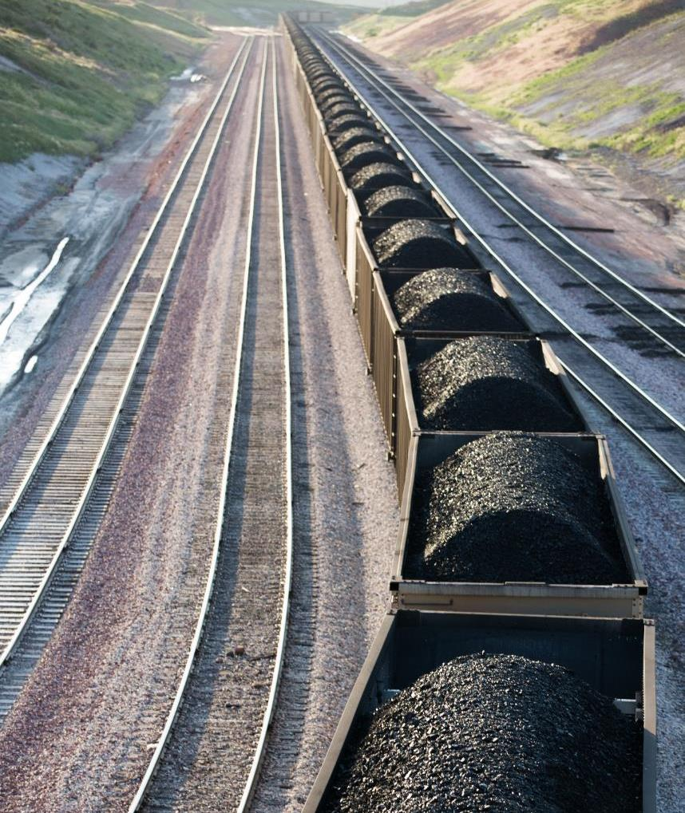
Wyoming is unique
because much of its energy comes from products within Wyoming. In fact, Wyoming not only helps power itself, but the nation, as well.
Photos courtesy of Cloud Peak Energy
and the Wyoming Mining Association

Slide 10
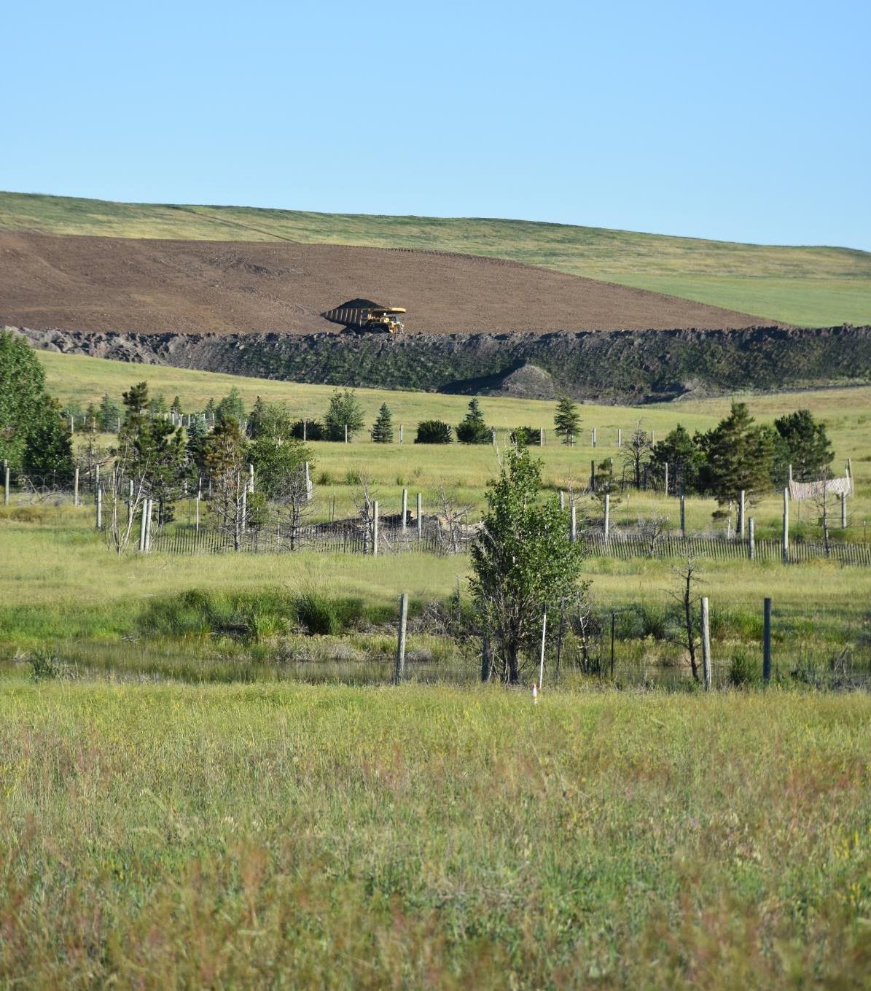
We can be stewards of Wyoming’s natural resources by working to conserve the energy we use, mining responsibly, not over mining, and using reclamation efforts to restore the land.
Photo courtesy of Cloud Peak Energy

