Slide 1
Careers on Public Lands

Slide 2
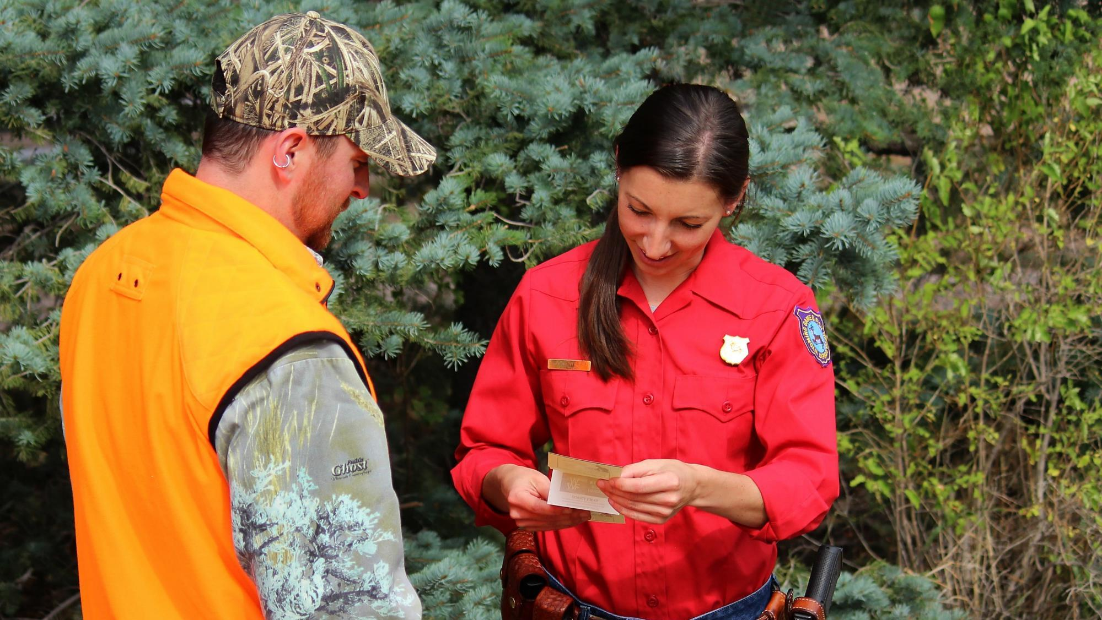
Game Warden
Photo courtesy of Wyoming Game and Fish

Slide 3
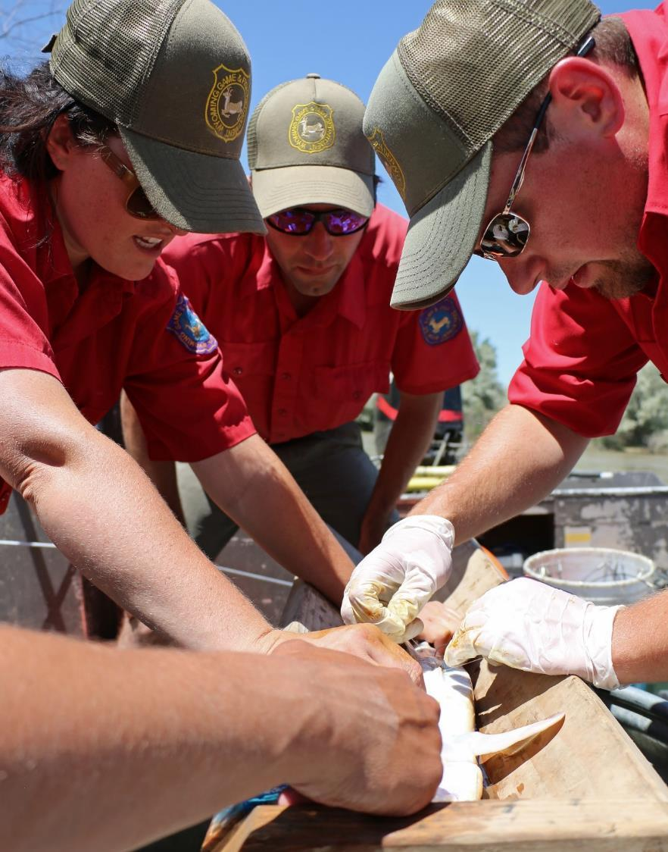
Wildlife/Aquatic Biologist
Photo courtesy of Wyoming Game and Fish

Slide 4
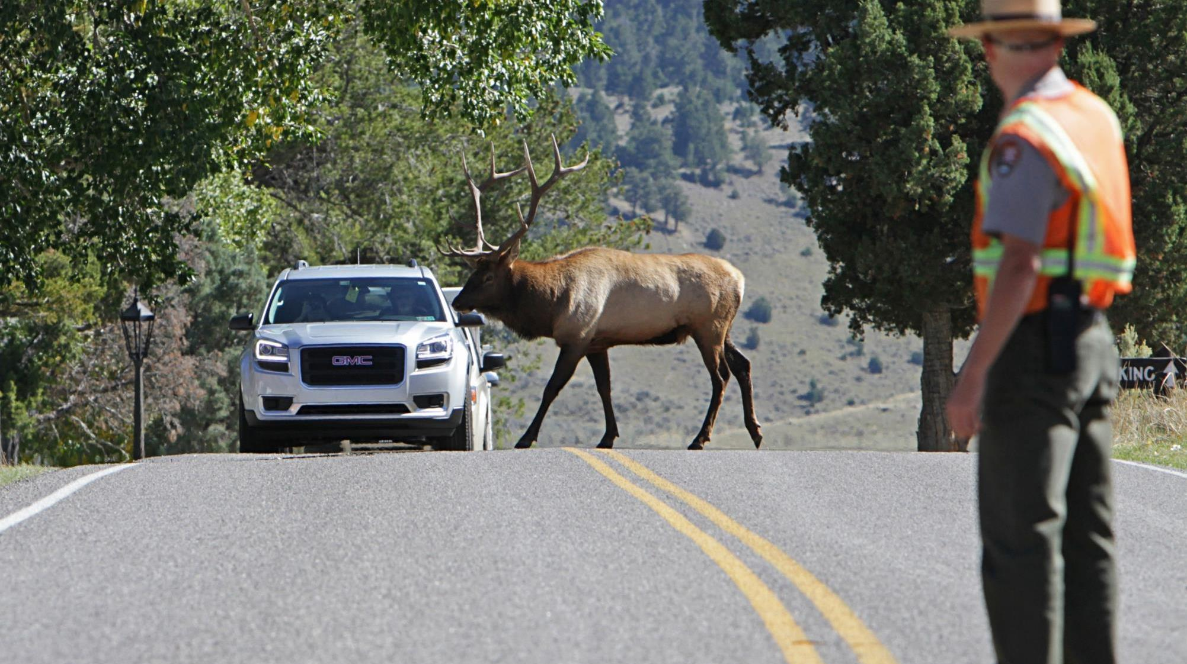
Park Ranger
Photo courtesy of National Park Service

Slide 5
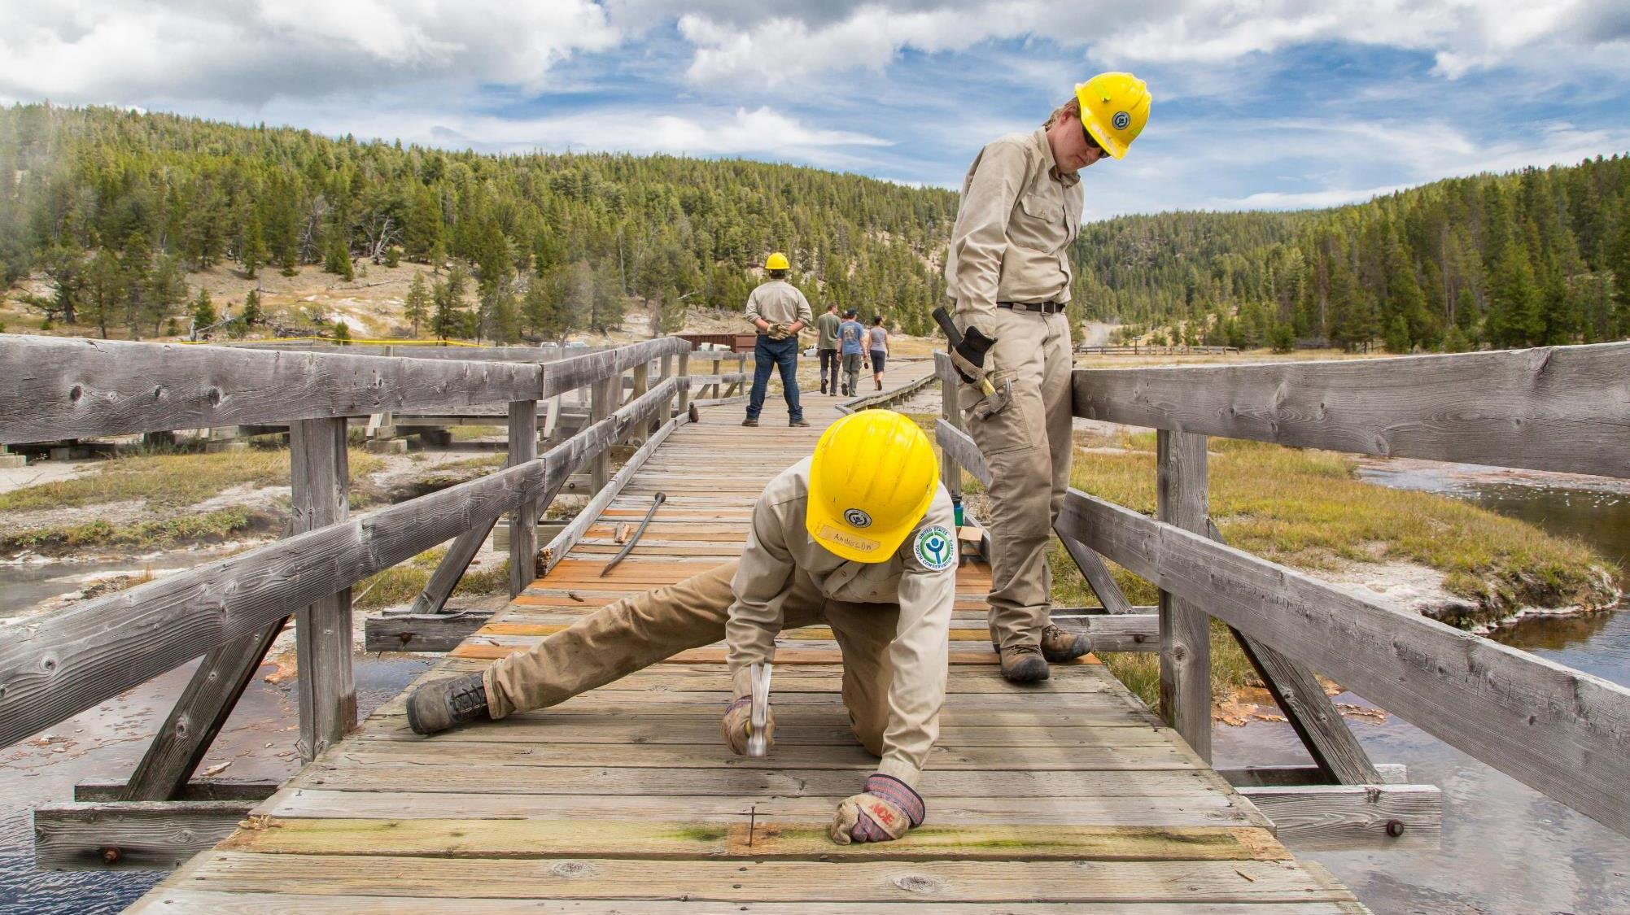
Maintenance Worker
Photo courtesy of National Park Service

Slide 6
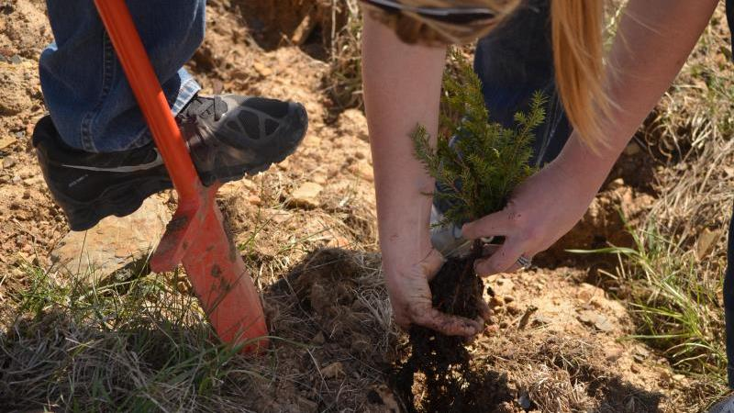
Forester
Photo courtesy of National Park Service

Slide 7
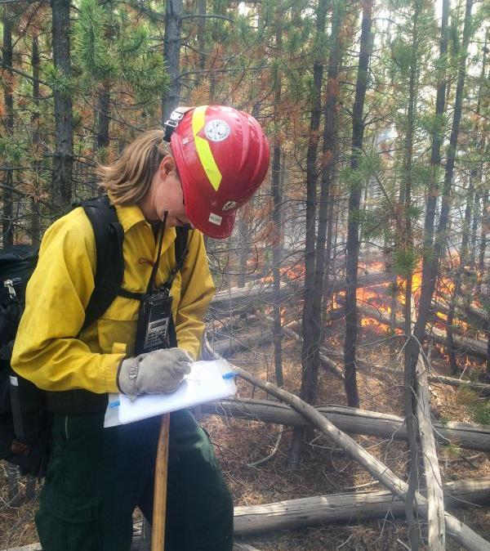
Wildland Firefighter

