Slide 1
Reclaiming Mine Sites

Slide 2
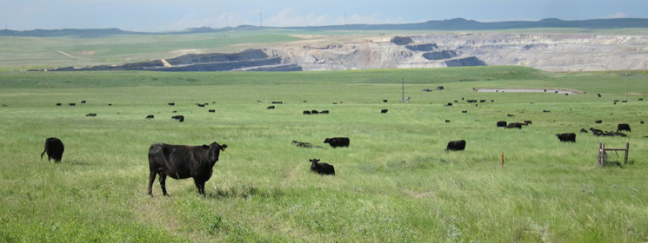
Cattle graze on land that's been reclaimed after mining at Peabody Energy's Caballo mine in northeast Wyoming.
http://www.wyofile.com/blog/feds-question-peabodys-mine-reclamation-bonding-in-3-states/

Slide 3
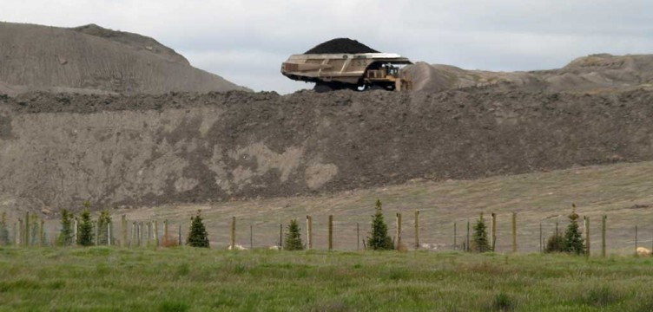
Once active mining is finished, topsoil is added, and native grasses, trees, and shrubs are planted. The foreground of this picture is reclaimed mine land, with the active coal mine behind.
Wyoming Mining Association

Slide 4
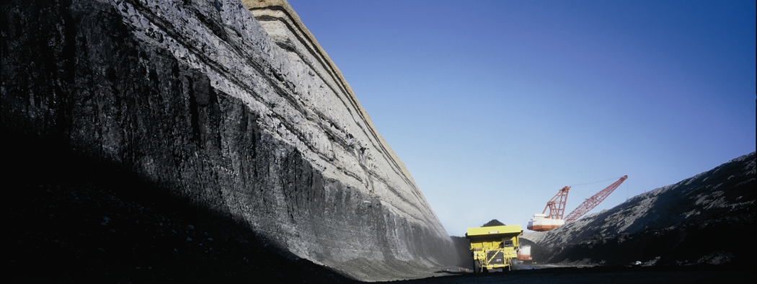
An active coal mine in Wyoming.
Wyoming Mining Association

Slide 5
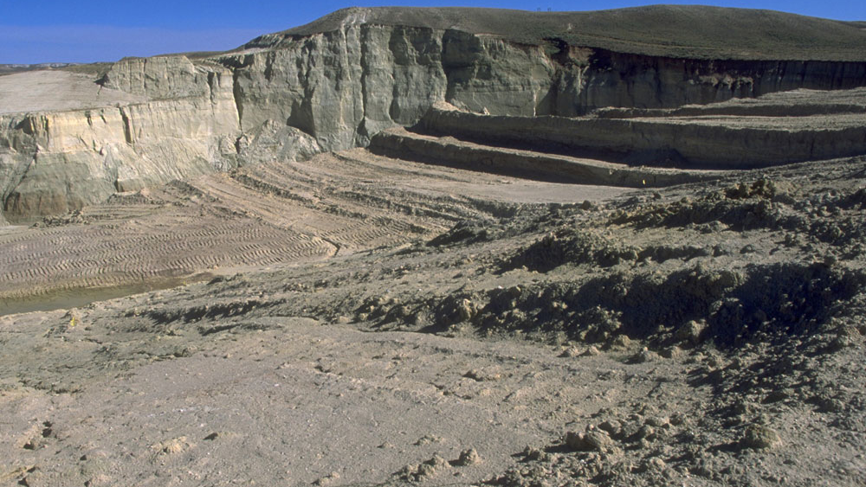
Abandoned mine land at Gas Hills in Wyoming
http://www.wyofile.com/13963/

