Slide 1
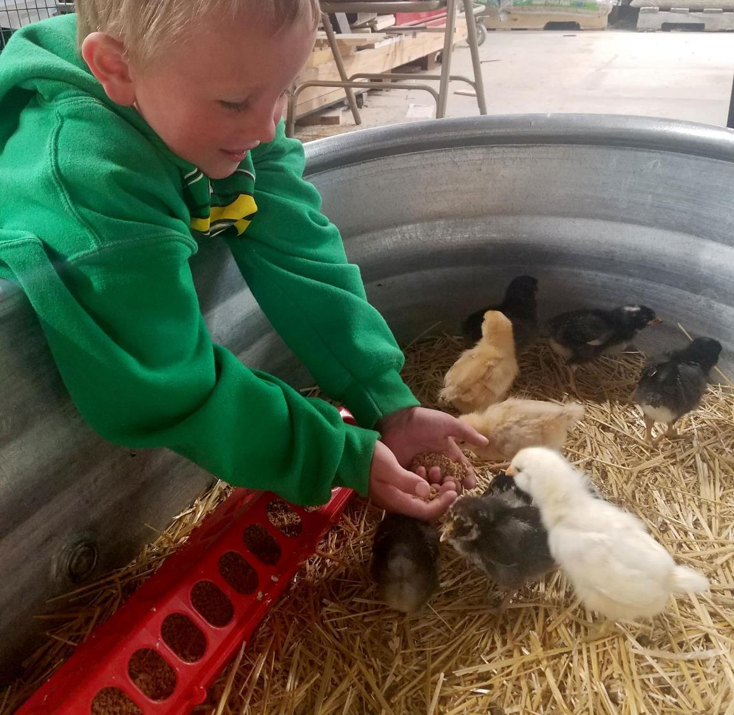
Agriculture
2nd grade
Lesson 3:
East or West – Where do Crops Grow Best?
Notes:
Name of the lesson is a link to the website where the lesson plan can be viewed or downloaded.

Slide 2
Today’s Challenge
Students will:
Identify which crops are grown in different areas of the state.
Explain why certain crops grow better in different areas.
Photo by Liz Lauck
Notes:
This is the focus of today’s lesson.

Slide 3
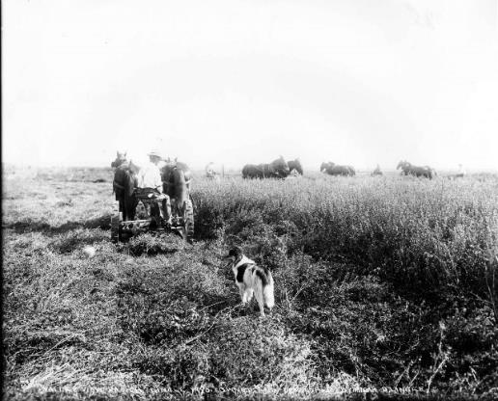
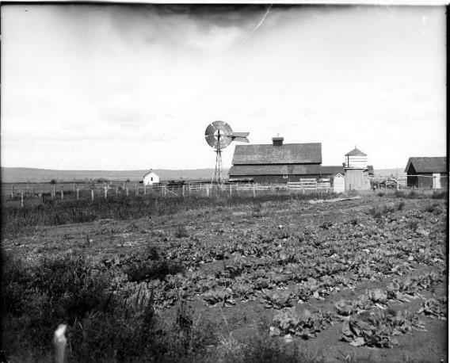
Think Back:
The Homestead Act
Crops grown in Wyoming
Farmers as good stewards of the land.
Highlights from our last lesson
What did you learn from yesterday’s challenge?
Wyoming State Archives – Stimson Collection
Notes:
Look back on the previous lesson and review the key ideas.

Slide 4
Hypothesis – an idea or theory that is not proven but leads to further study or discussion.
Hypothesize – to suggest an idea or theory
Irrigation – the process of delivering water to crops
Precipitation – the amount of water an area receives through weather, example: rain and snow.
Elevation - the distance above sea level or ground level; the height of the land
Vocabulary
Notes:
These are the new vocabulary words for this lesson. You may need to adjust this list according to the needs of your students.

Slide 5
Link: Blank Wyoming Map
Notes:
Please see “Teacher Note” 1st page of Lesson 3. The map is a live link to the map resources.

Slide 6
Why are crops grown in different areas of Wyoming?
This Photo by Unknown Author is licensed under CC BY-SA
Notes:
Procedure #1: Please refer to “Teacher Note” for procedure #1 & #2.

Slide 7
Wyoming Agriculture Map
What do you notice about crops and water availability in a given area?
How does elevation affect how crops grow?
Why are crops grown in some areas but not in others?
Notes:
Procedure #2: To begin, you can choose the county where you live or a county the students choose. Refer to Teacher Note in the lesson for additional suggestions.

Slide 8
Irrigation Map
What do you notice about crops and water availability in a given area?
How does elevation affect how crops grow?
Why are crops grown in some areas but not in others?
Notes:
Procedure #2

Slide 9
Elevation Map
What do you notice about crops and water availability in a given area?
How does elevation affect how crops grow?
Why are crops grown in some areas but not in others?
Notes:
Procedure #2

Slide 10
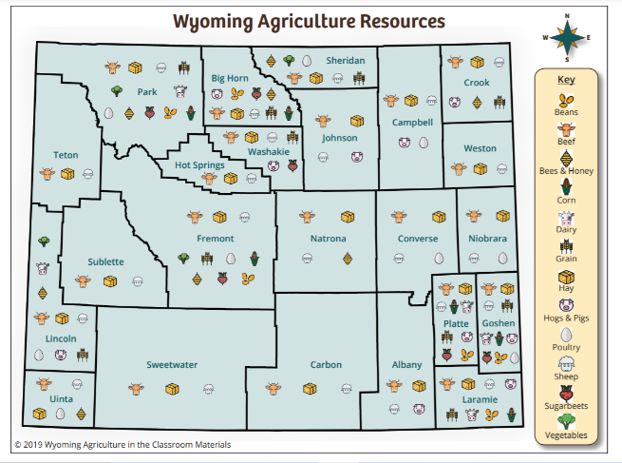
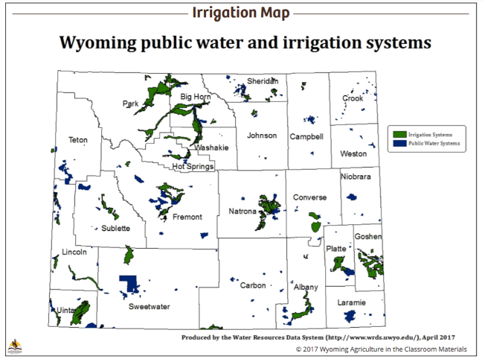
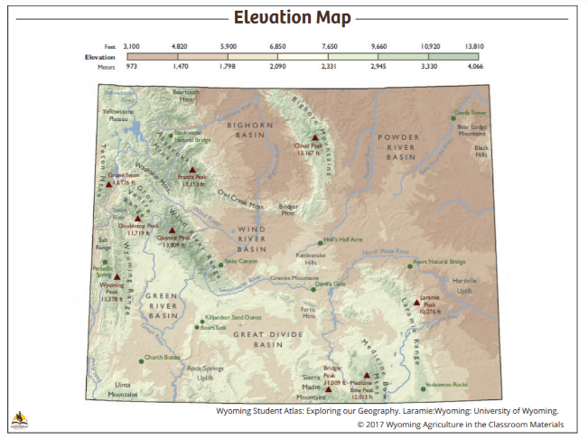
Map Observations Make a hypothesis about why crops grow in some locations and not others.
Notes:
Assessment: You can add a slide to record student thinking.

Slide 11
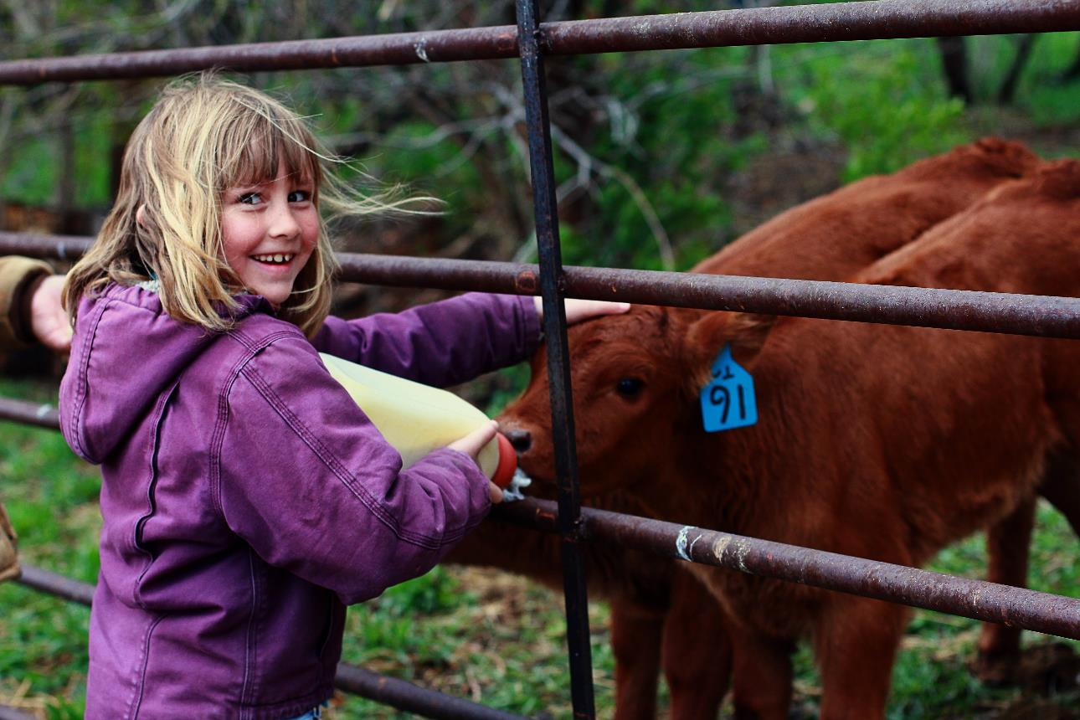
What did we learn from today’s challenge?
Notes:
Provide the students an opportunity to explain their learning.

