Slide 1
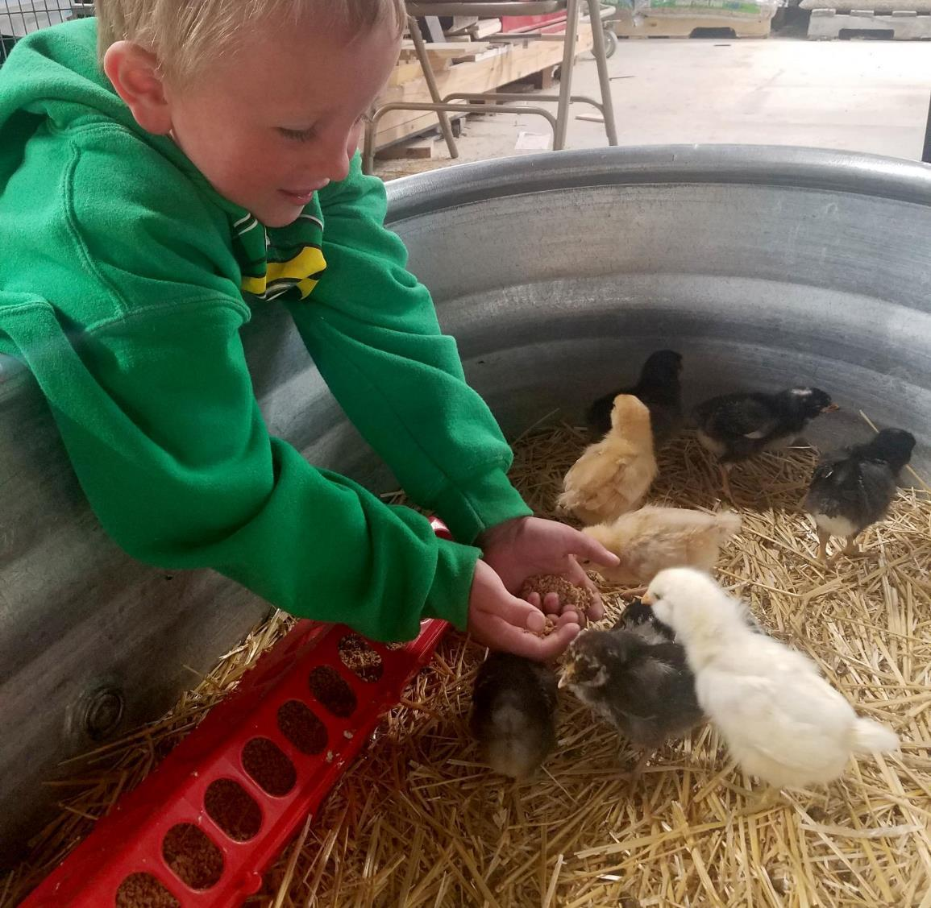
Agriculture
2nd grade
Lesson 8:
Super Stewards
Notes:
Name of the lesson is a link to the website where the lesson can be viewed or downloaded.

Slide 2
Today’s Challenge
Students will explain the role of stewardship in Wyoming agriculture.
Notes:
This is the focus of today’s lesson.

Slide 3
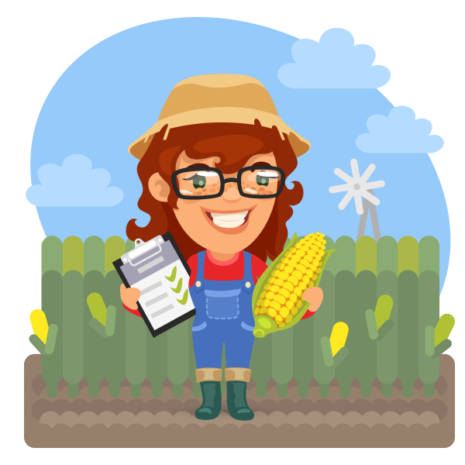
Think back on:
How farming has changed over time
How technology enhances the tools that farmers use enabling them to be even better stewards of the land
Highlights from our last lesson
What did you learn from yesterday’s challenge?
Notes:
Look back on the previous lesson and review the key ideas.

Slide 4
Conservation – the careful utilization of a resource in order to prevent waste and leave some for future generations
Stewardship – As Wyoming citizens, we are stewards entrusted with the responsible development, care, and use of our resources to benefit current and future generations.
Vocabulary
Notes:
These are the new vocabulary words for this lesson. You may need to adjust this list according to the needs of your students.

Slide 5
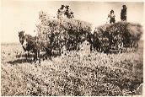
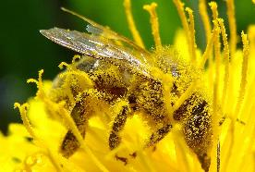
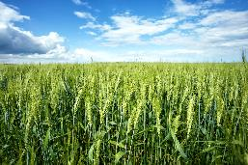
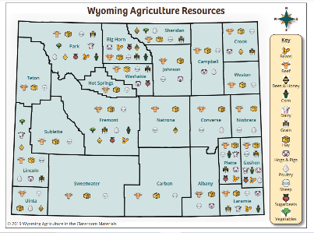
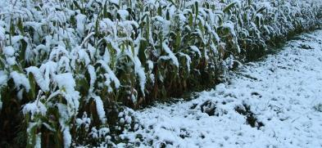
Reviewing what we learned
This Photo by Unknown Author is licensed under CC BY-SA
Notes:
Procedure #1: There are multiple questions in this lesson.

Slide 6
Our Final Project
Create an advertisement to encourage people to be good stewards of Wyoming Agriculture.
This Photo by Unknown Author is licensed under CC BY-SA
Notes:
Procedure #2

Slide 7
Information to include:
Why being a steward of agriculture is important
The ways farmers are good stewards
Pictures to show my ideas
The definition of stewardship
Rubric link
Notes:
Procedure #3, & #4

Slide 8
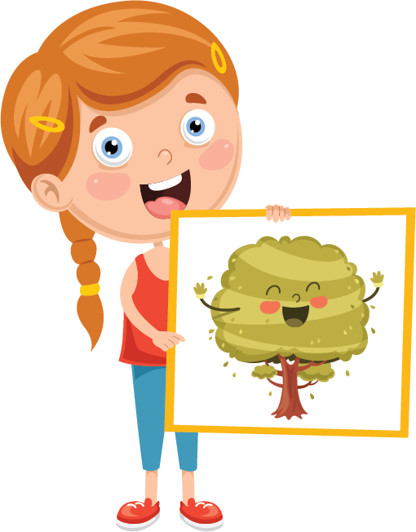
Present your advertisement!
Notes:
Procedure #5

Slide 9
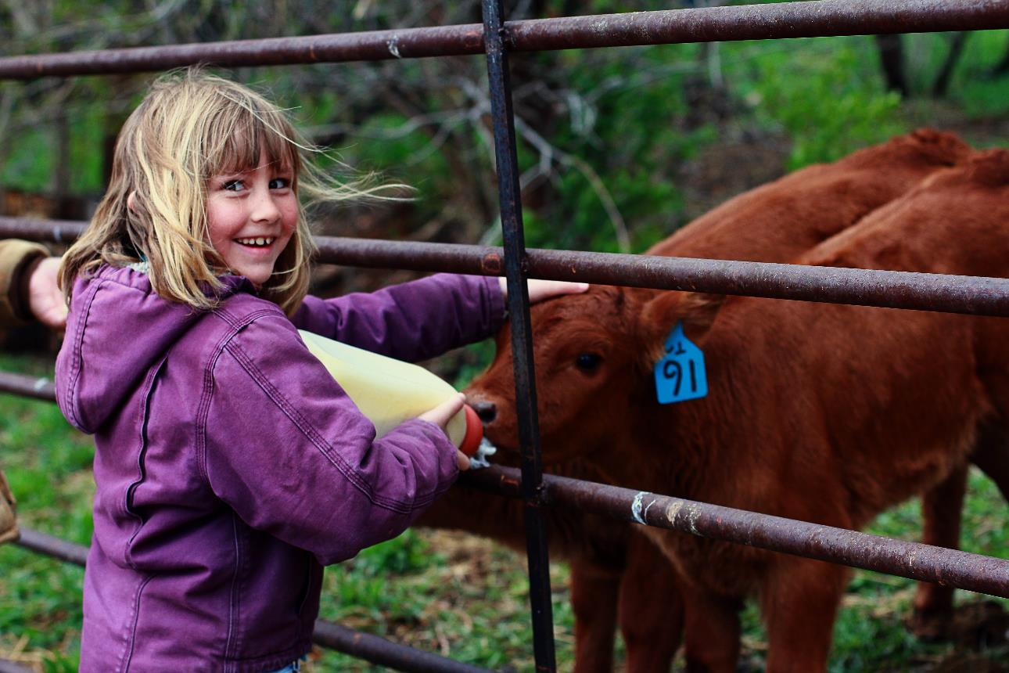
What did we learn from today’s challenge?
Notes:
Provide the students an opportunity to explain their learning.

Slide 10
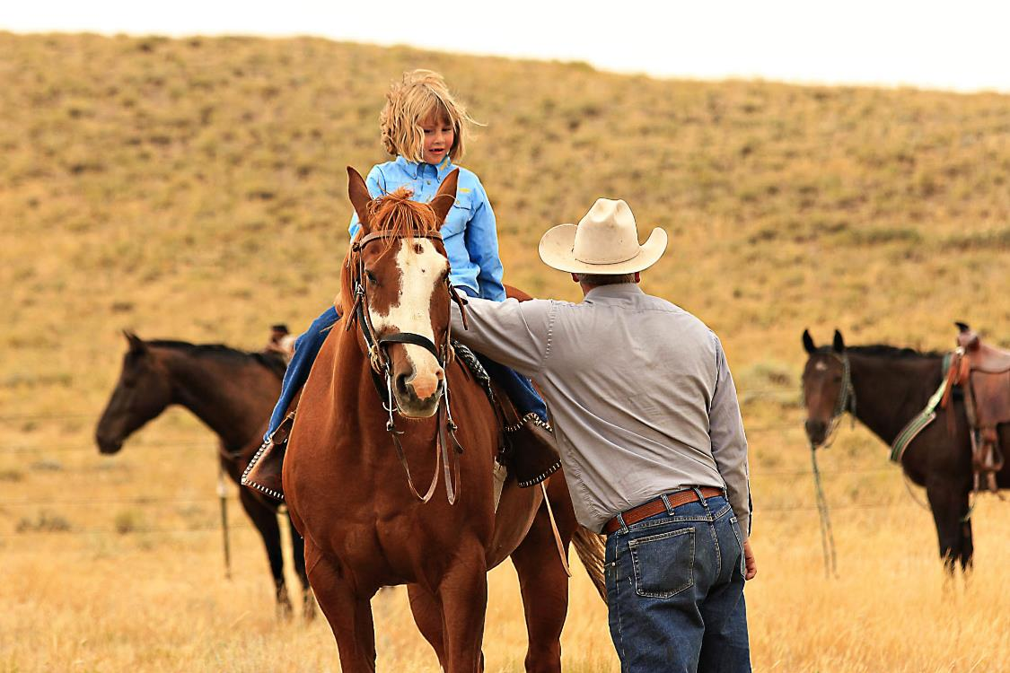
How can we be stewards of Wyoming’s agriculture to benefit current and future generations?
Essential Question
Notes:
This is a chance to take students back to the Essential Question for this unit and discuss their role as stewards of Wyoming’s agriculture.

Slide 11
We need your help!
Wyoming Ag in the Classroom is a non-profit organization. Through the generosity of donors and grant providers, we can provide our programs free of charge. For us to continue, we need data from you that we can share with our donors and grant providers.
How you can help:
After completing a unit, please complete our questionnaire:
Feedback Questionnaire
Our way to say thanks:
Once you and your students complete the questionnaire, you will be sent a package with a fun reward for your class.

