Slide 1
Minerals & Energy 2nd Grade Lesson 2: Resource Responsibility
Notes:
The name of the lesson is a link to the Wyoming Agriculture in the Classroom website where the lesson can be downloaded.

Slide 2
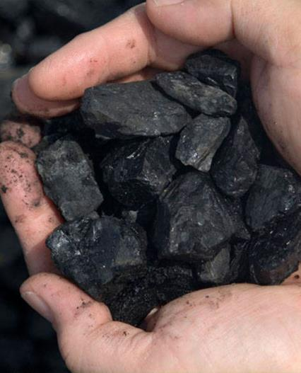
Today’s Challenge
Students learn that nonrenewable natural resources are limited and must be conserved because consumption and distribution can impact current and future generations.
Notes:
This is the focus of today’s lesson.

Slide 3
• Conservation – the careful utilization of a resource in order to prevent waste and leave some for future generations.
• Energy – power derived from the utilization of natural resources, especially to provide light and heat or to power machines, usable power
• Nonrenewable resources – resources that cannot be replenished (made again) in a short period of time
• Reclamation – the act of returning something to its former or better state
• Renewable resources – resources that are capable of being replenished
Vocabulary
Notes:
These are the new vocabulary words for this lesson. You may need to adjust this list according to the needs of your students.

Slide 4
Think back on:
Generations
Stewardship
Highlights from our last lesson:
What did you learn from yesterday’s challenge?
Notes:
Look back on the previous lesson and review the key ideas.

Slide 5
Wyoming’s Natural Resources
Notes:
Procedure#1: Wyoming Natural Resources PowerPoint
The link to download the original PowerPoint presentation is in the name on this slide. It is embedded in this PPT for your convenience.

Slide 6
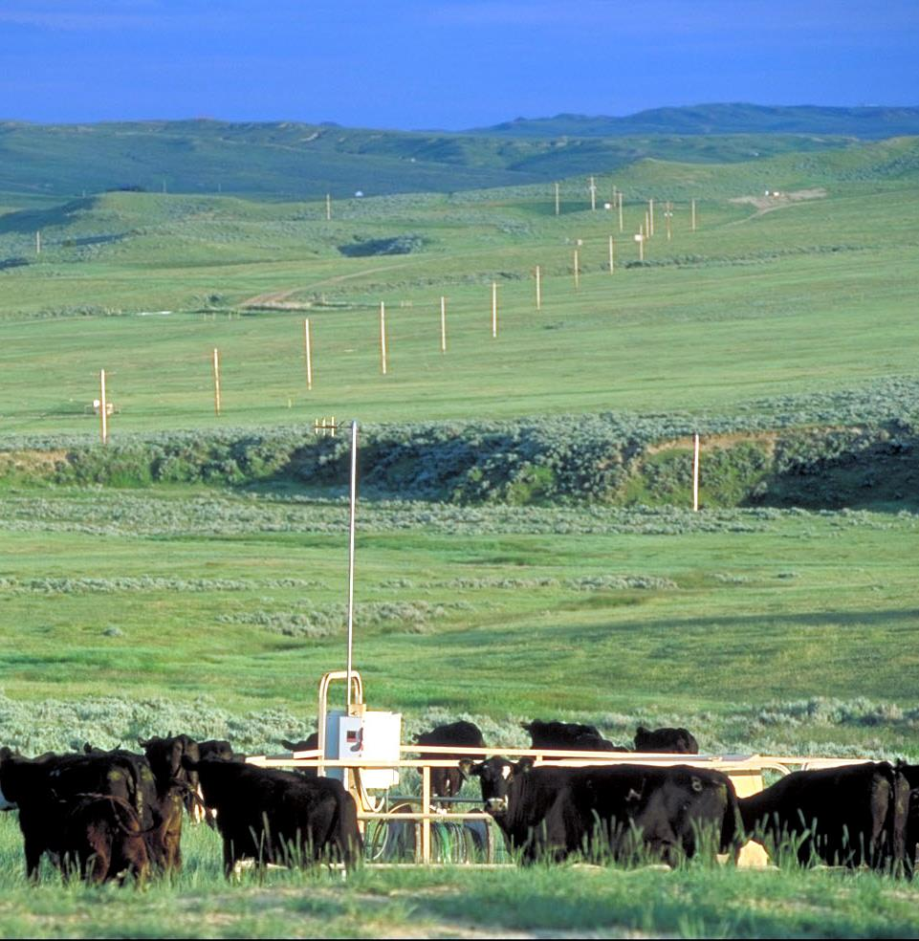
Wyoming has many energy and mineral resources that can be found in several areas of our state. Energy is usable power that we get from natural resources.
Photo courtesy of the Wyoming Petroleum Association
Notes:
Wyoming Natural Resources PowerPoint

Slide 7
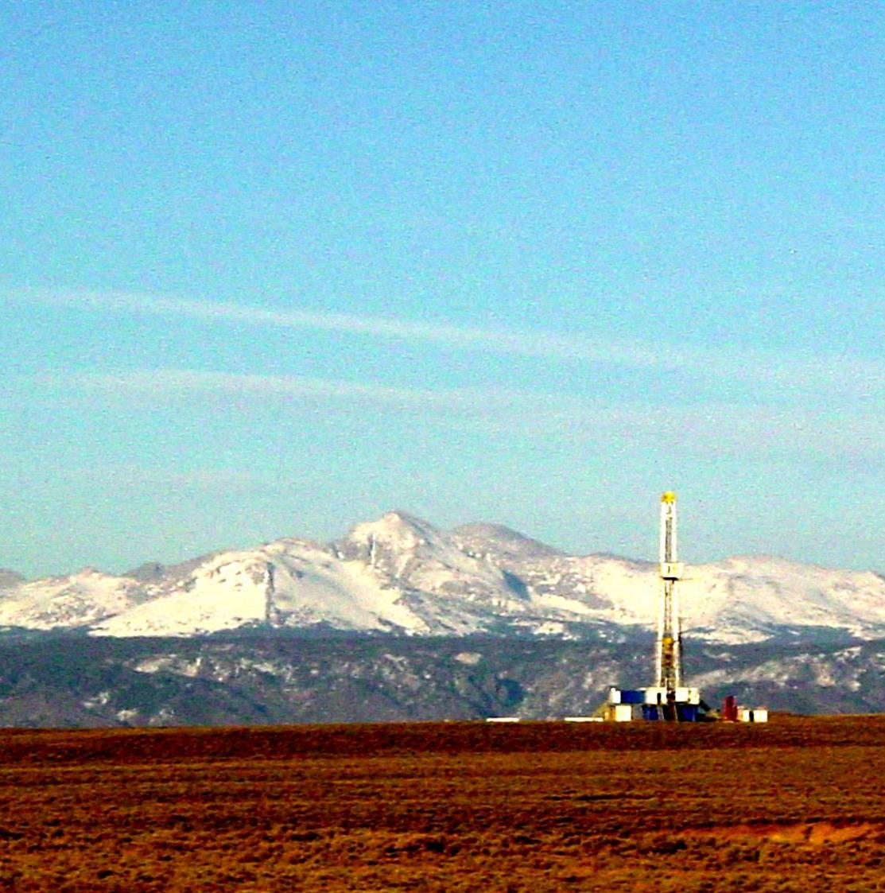
Oil, natural gas, coal, and uranium are used to produce energy that provides electricity, heat, and fuel to move machines. We get most of our energy through the use of these natural resources.
Photo courtesy of the Wyoming Petroleum Association
Notes:
Wyoming Natural Resources PowerPoint

Slide 8
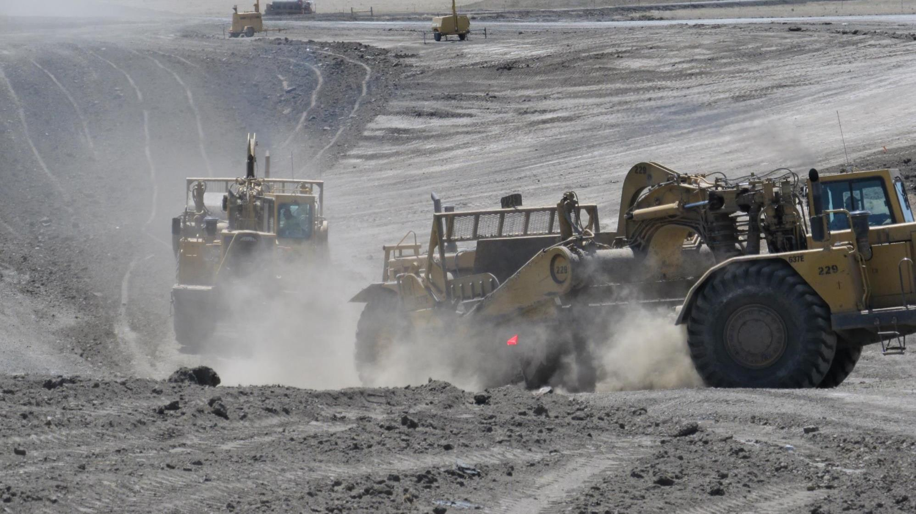
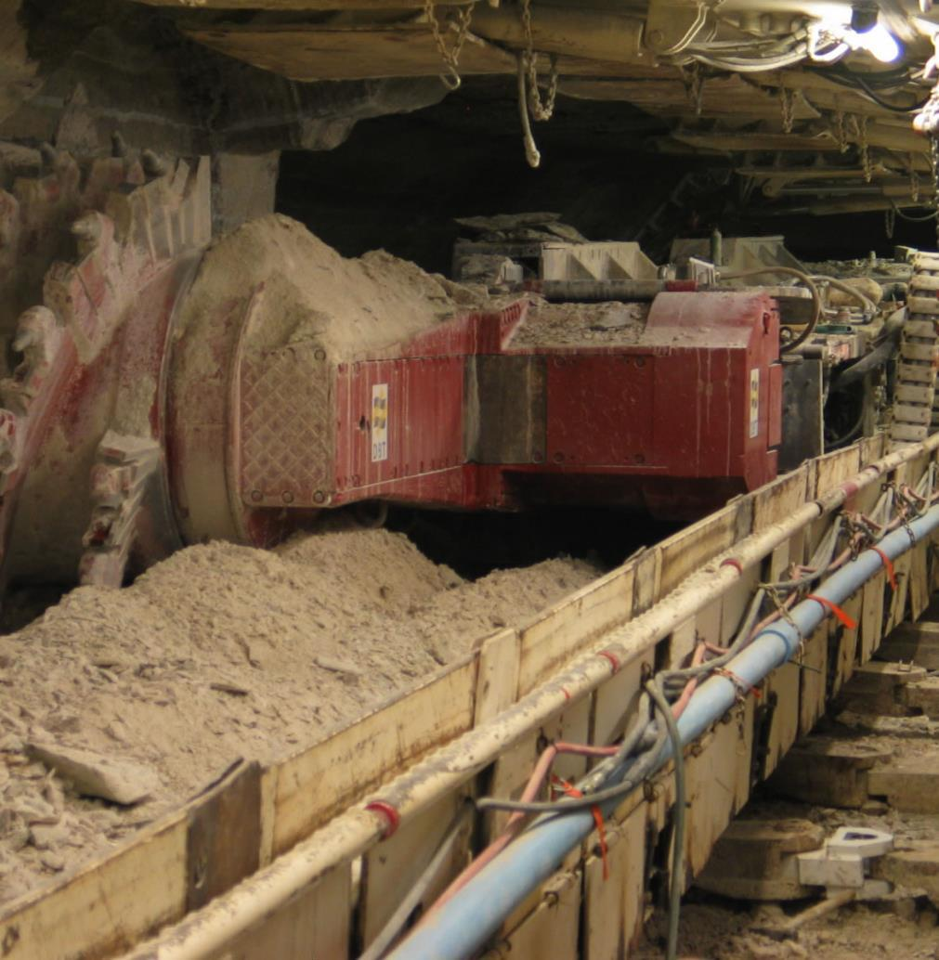
Trona, Bentonite, and Rare Earths are mineral resources found in Wyoming that are in many of the products Americans use every day.
Photos courtesy of the Wyoming Mining Association
Notes:
Wyoming Natural Resources PowerPoint

Slide 9
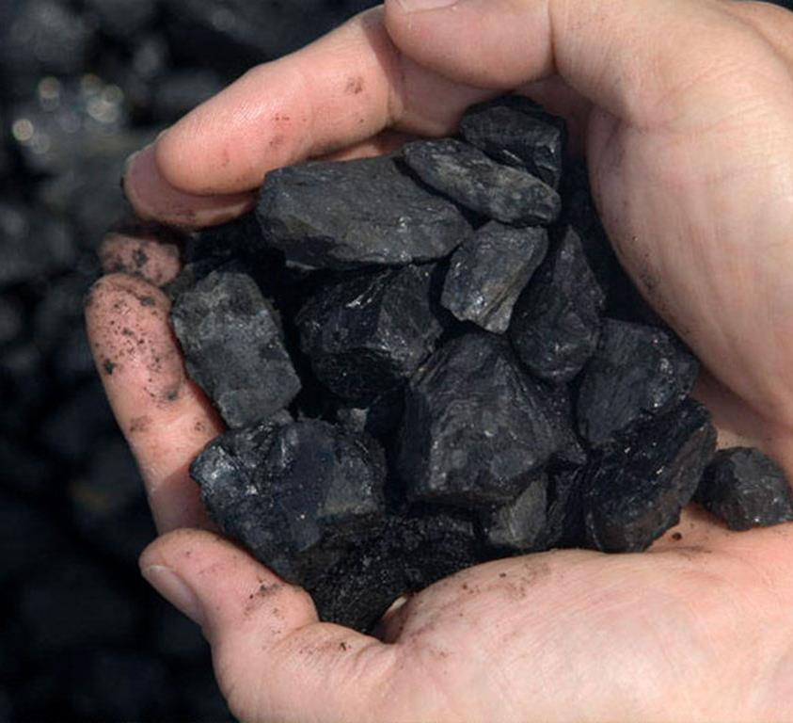
These resources have been made over millions of years because of changes that have happened on and in the earth. Changes in pressure and temperature of decaying plants and animals have caused these natural resources to form.
Photo courtesy of the Wyoming Mining Association
Notes:
Wyoming Natural Resources PowerPoint

Slide 10
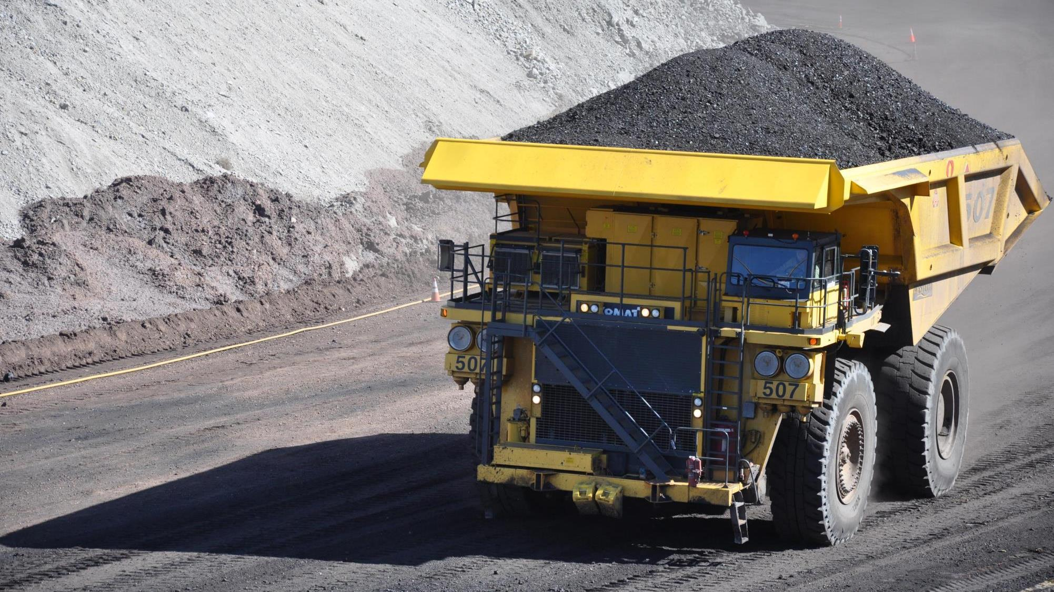
We mine the earth to get these resources. When we mine the earth to get these resources, it takes millions of years for them to replenish. Because they take such an incredibly long time to form, we call them nonrenewable resources.
Photo courtesy of the Wyoming Mining Association
Notes:
Wyoming Natural Resources PowerPoint

Slide 11
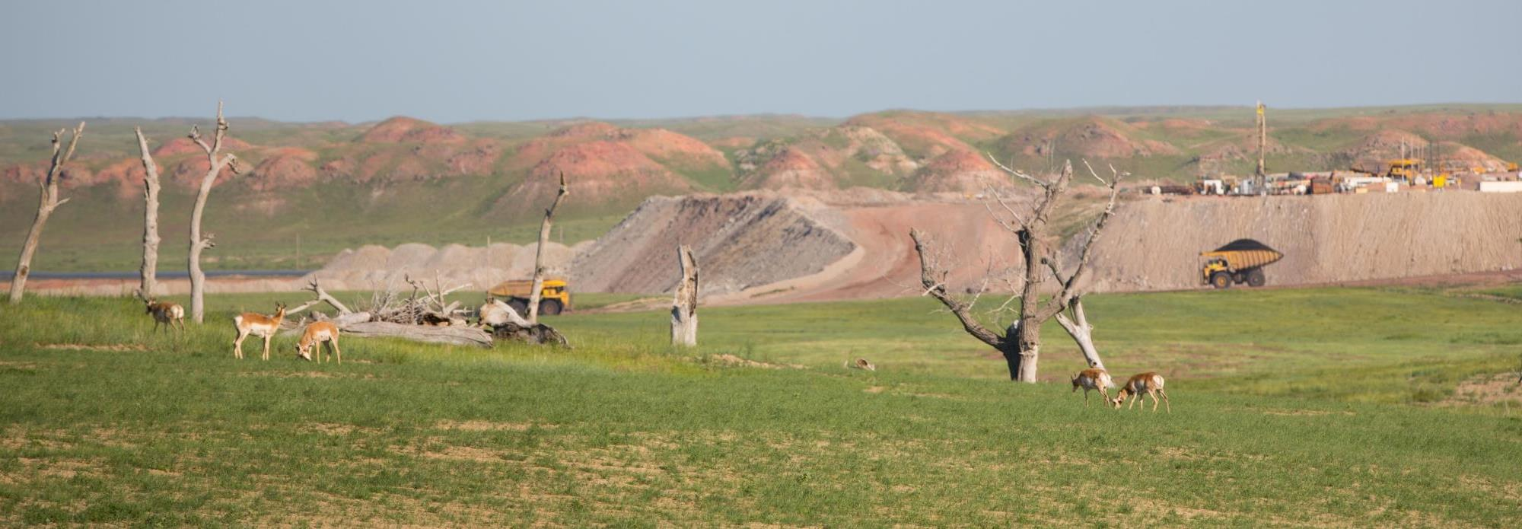
Since we know these resources are limited, it is important that we manage the supply of these nonrenewable resources. This is called conservation.
Photo courtesy of Cloud Peak Energy
Notes:
Wyoming Natural Resources PowerPoint

Slide 12
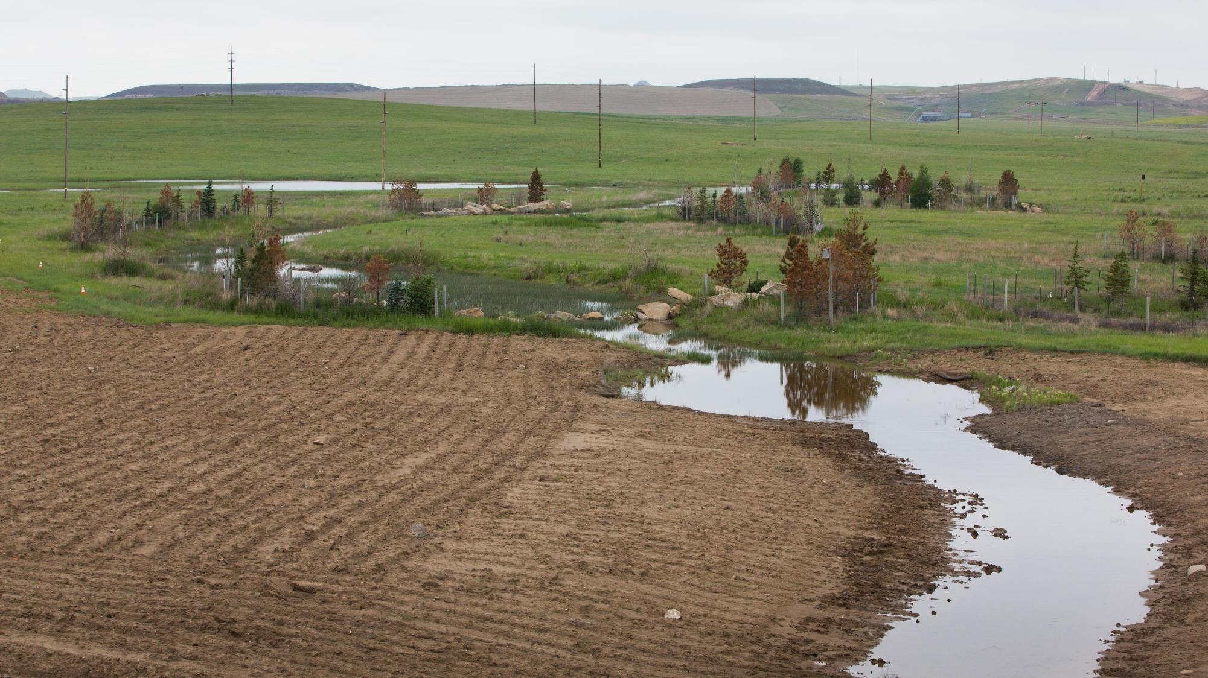
Reclamation is a process that occurs after mining. Mining can cause significant disturbance to the land. Reclamation is the process of making repairs to the land after mining. Reclamation is used to get the land close to its original state. It is an important part of being a good steward of Wyoming's land.
Photo courtesy of Cloud Peak Energy
Notes:
Wyoming Natural Resources PowerPoint

Slide 13
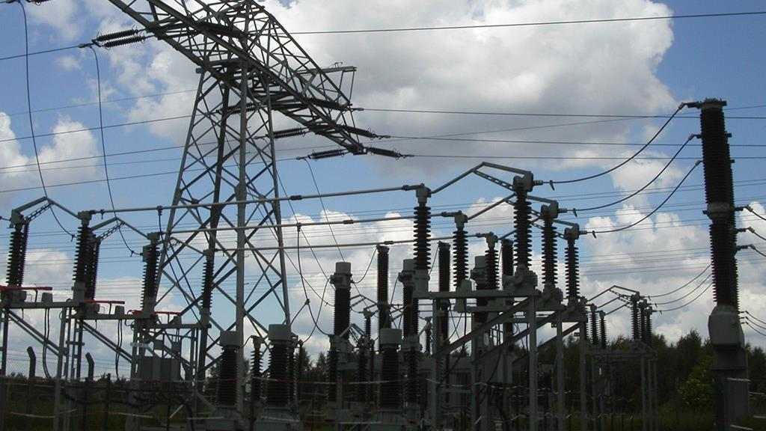
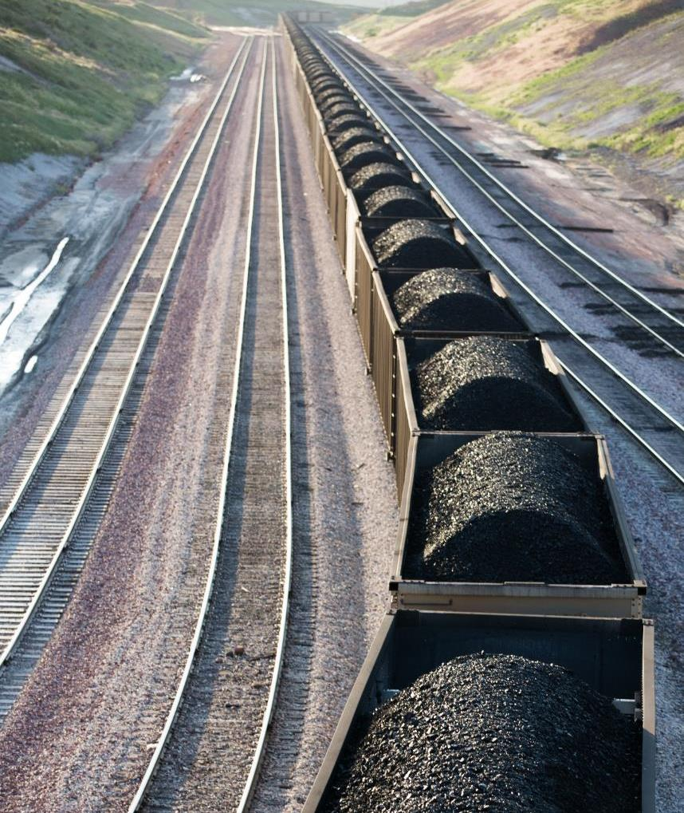
Wyoming is unique
because much of its energy comes from products within Wyoming. In fact, Wyoming not only helps power itself but the nation as well.
Photos courtesy of Cloud Peak Energy
and the Wyoming Mining Association
Notes:
Wyoming Natural Resources PowerPoint

Slide 14
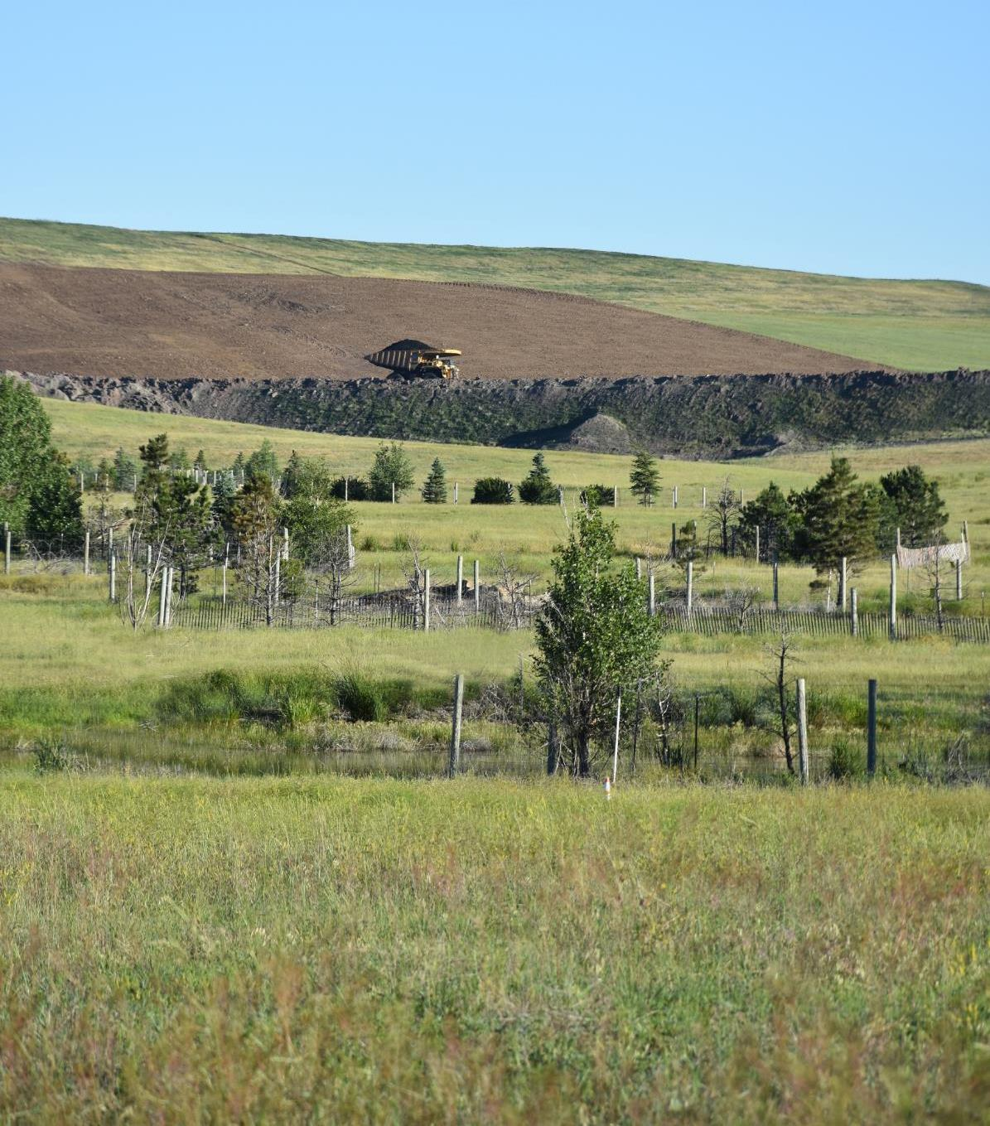
We can be stewards of Wyoming’s natural resources by working to conserve the energy we use, mining responsibly, not over mining, and using reclamation efforts to restore the land.
Photo courtesy of Cloud Peak Energy
Notes:
Wyoming Natural Resources PowerPoint

Slide 15
Let’s Discuss:
What uses oil? |  | What uses electricity? |  | What uses natural gas?
Notes:
Procedure #1: This table allows you to collect student responses. You can add more rows by clicking on the table, click “format”, and then click “add below”.

Slide 16
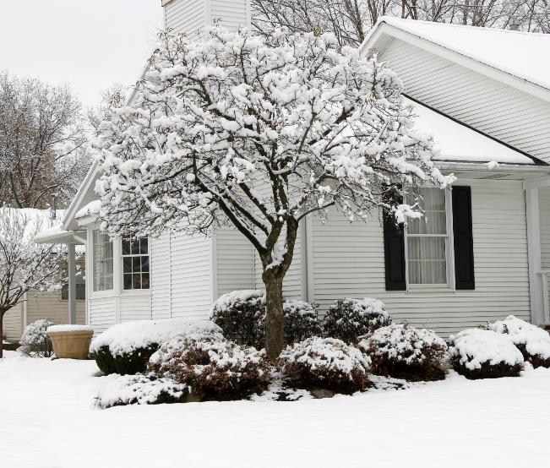
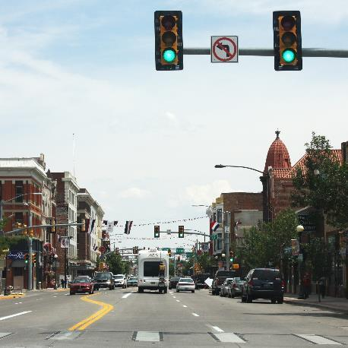
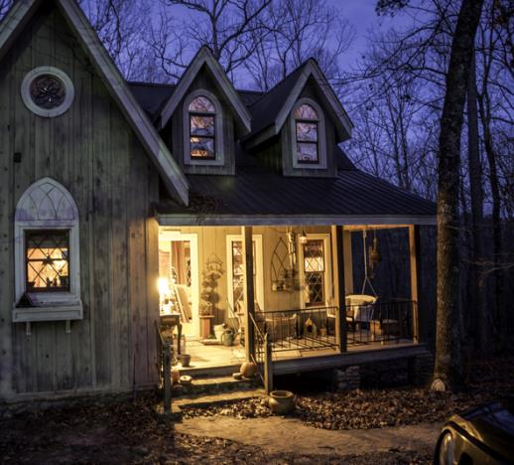
Thinking further:
Why do lights in our home or school come on?
What makes our car run?
How do we make our homes warm?
This Photo by Unknown Author is licensed under CC BY-SA
Notes:
Procedure #1

Slide 17
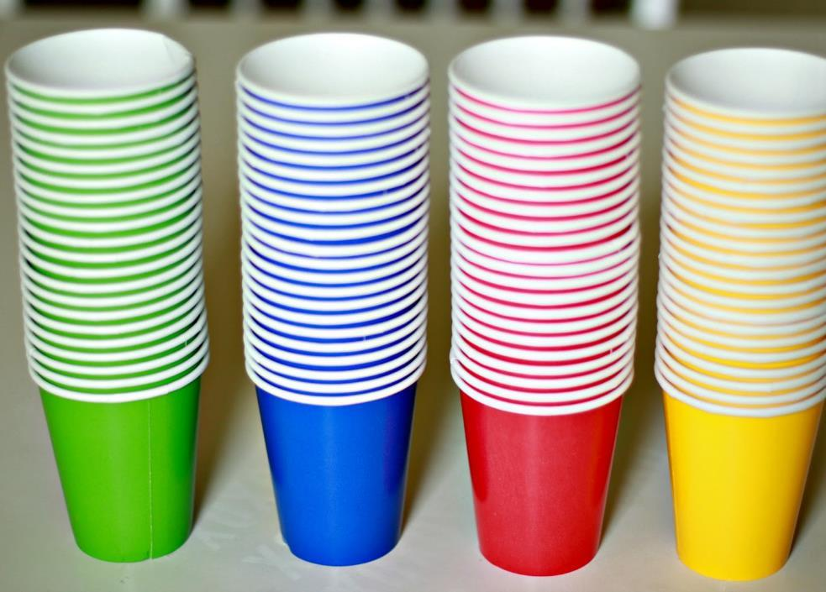
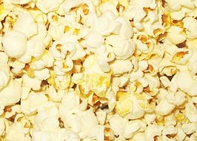
Use your cup.
You may take as much popcorn as you can in the time given.
Put your popcorn on your desk.
Don’t eat any popcorn.
You may take as many trips as you want.
This Photo by Unknown Author is licensed under CC BY-SA
This Photo by Unknown Author is licensed under CC BY
Notes:
Procedure #2 and #3: This is the set up for the popcorn activity.

Slide 18
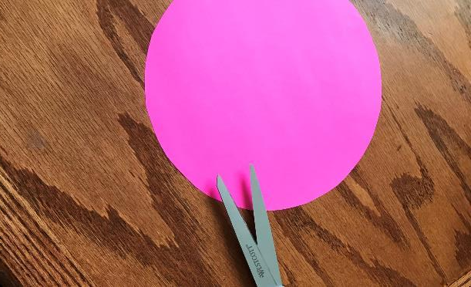
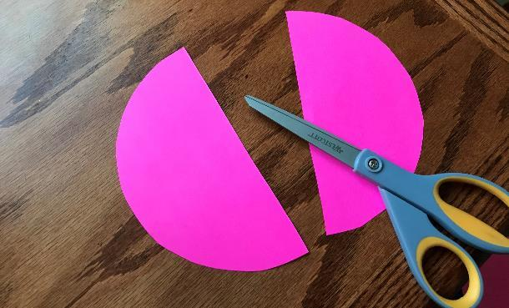
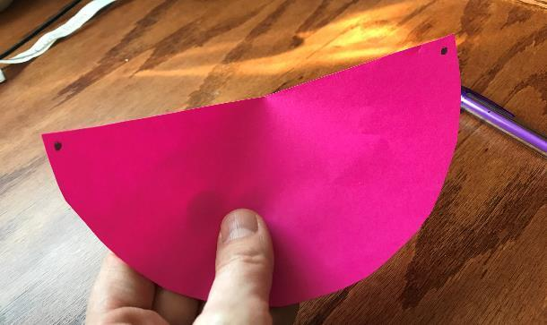
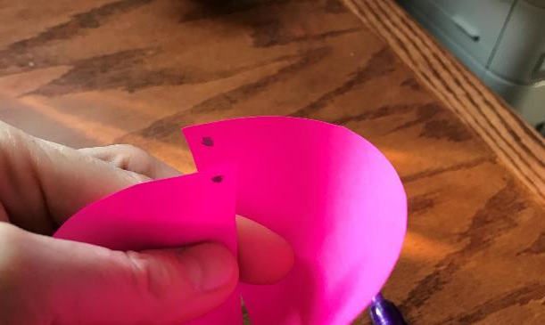
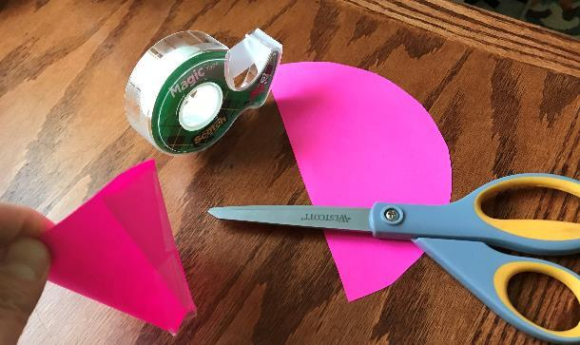
1
2
To make a cup:
Draw a circle.
Cut it out
Fold the circle in half and cut it in half along the fold line.
Put a dot on each corner of the half circle.
Bring the edges together so the circles meet – they will likely overlap to close up the cup.
Tape the cup closed. If you have a hole in the bottom, bend it up and tape it shut.
3
4
5
6
Notes:
If you don’t have cups handy, they can easily be made using construction paper, old folders, or copy paper. If you don’t have 4 colors, it doesn’t matter as long as the groups are separated. This slide is a simple step-by-step for making a little cup. It can be deleted if you don’t need it.

Slide 19
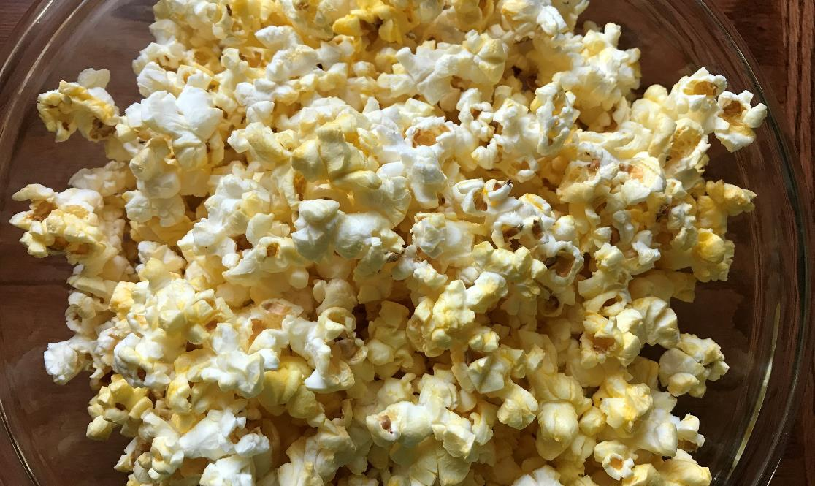
This Photo by Unknown Author is licensed under CC BY-NC-ND
You are Generation 1.
You have 20 seconds to take as much popcorn as you want.
Group 1
Notes:
Procedure #3: The popcorn icon is a timer. In presentation mode, click on the slide and the popcorn will slide off screen. When it is gone, 20 seconds is up.

Slide 20
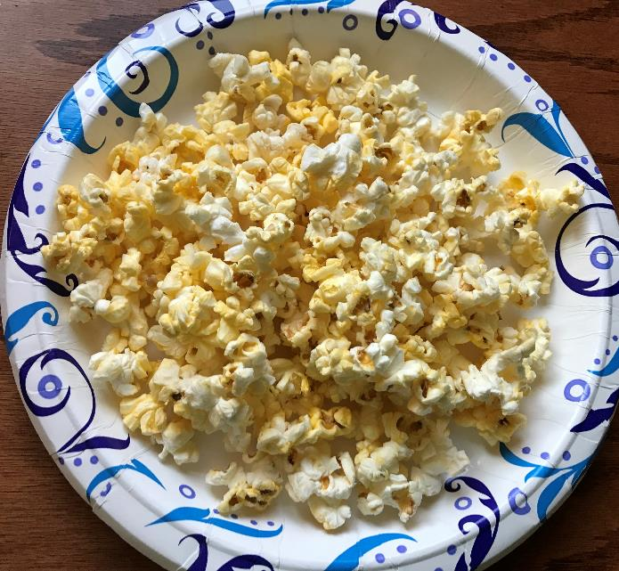
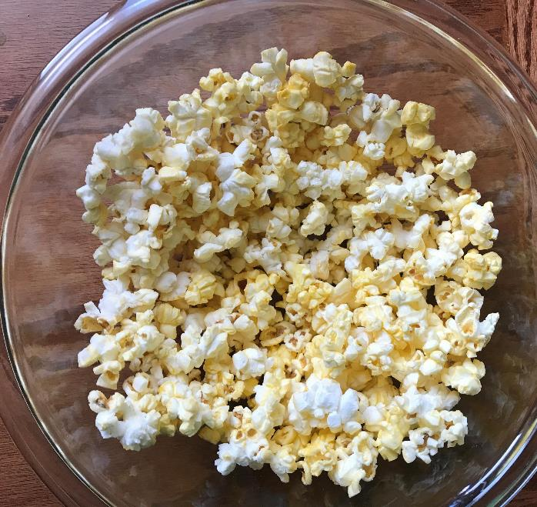
Making Observations:
I am adding 10 kernels of popcorn back in because nonrenewable resources can be made again, but they do not do it fast enough to replace what has being used.
What did you notice when Generation 1 was collecting popcorn?
How did it make you feel?
Notes:
Procedure #3: After Generation 1 takes their popcorn – if you feel you have a better representation of this, replace these pictures with your pictures. You may need to have a discussion about nonrenewable resources if this doesn’t make sense to your students.

Slide 21
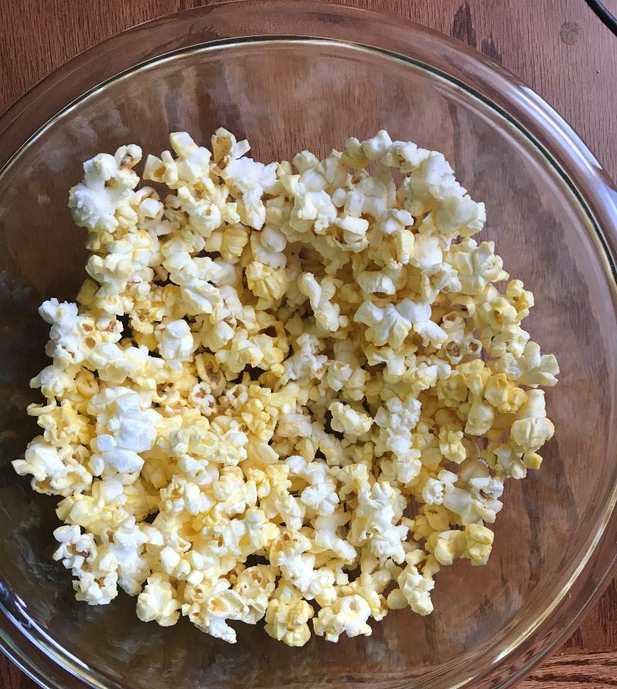
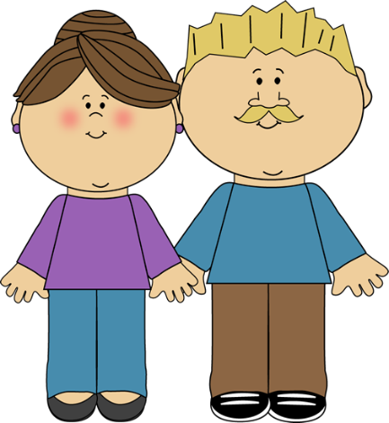
Group 2
You are Generation 2.
You have 15 seconds to take as much popcorn as you want.
This Photo by Unknown Author is licensed under CC BY-SA-NC
This Photo by Unknown Author is licensed under CC BY
Notes:
Procedure #3: The popcorn icon is a timer. In presentation mode, click on the slide and the popcorn will slide off screen. When it is gone, 15 seconds is up.

Slide 22
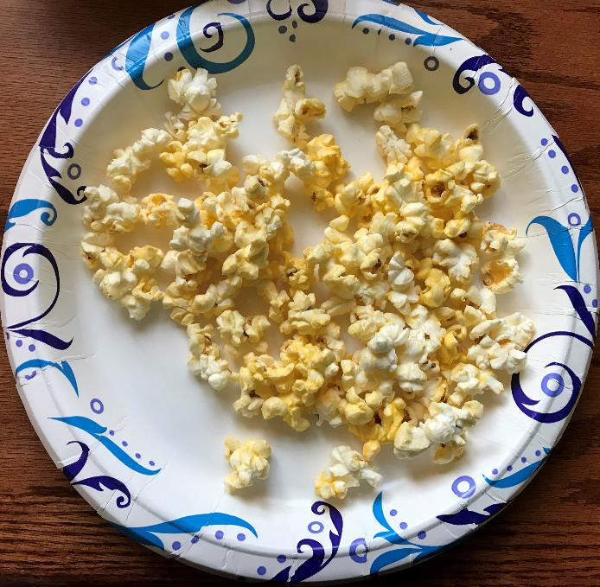
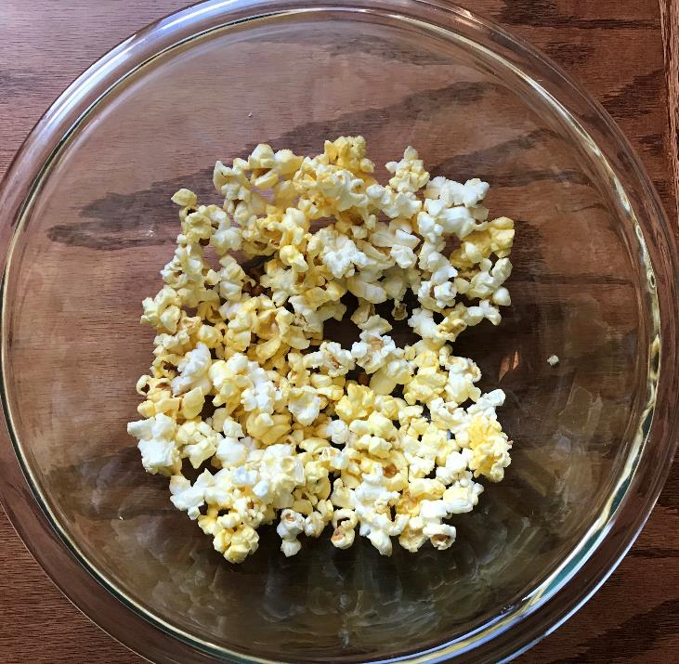
Making Observations:
I will add 7 kernels to our nonrenewable popcorn resource.
What did you notice when Generation 2 was collecting popcorn?
How did it make you feel?

Slide 23
You are Generation 3.
You have 10 seconds to take as much popcorn as you want.
Group 3

Slide 24
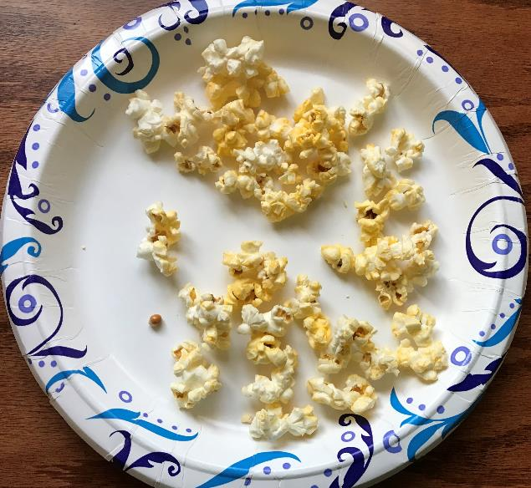
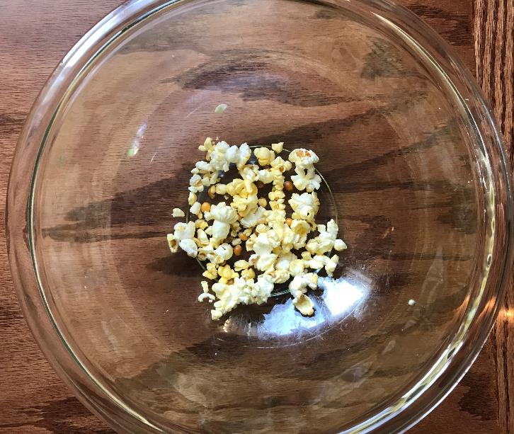
Making Observations:
I will add 5 kernels to our nonrenewable popcorn resource.
What did you notice when Generation 3 was collecting popcorn?
How did it make you feel?

Slide 25
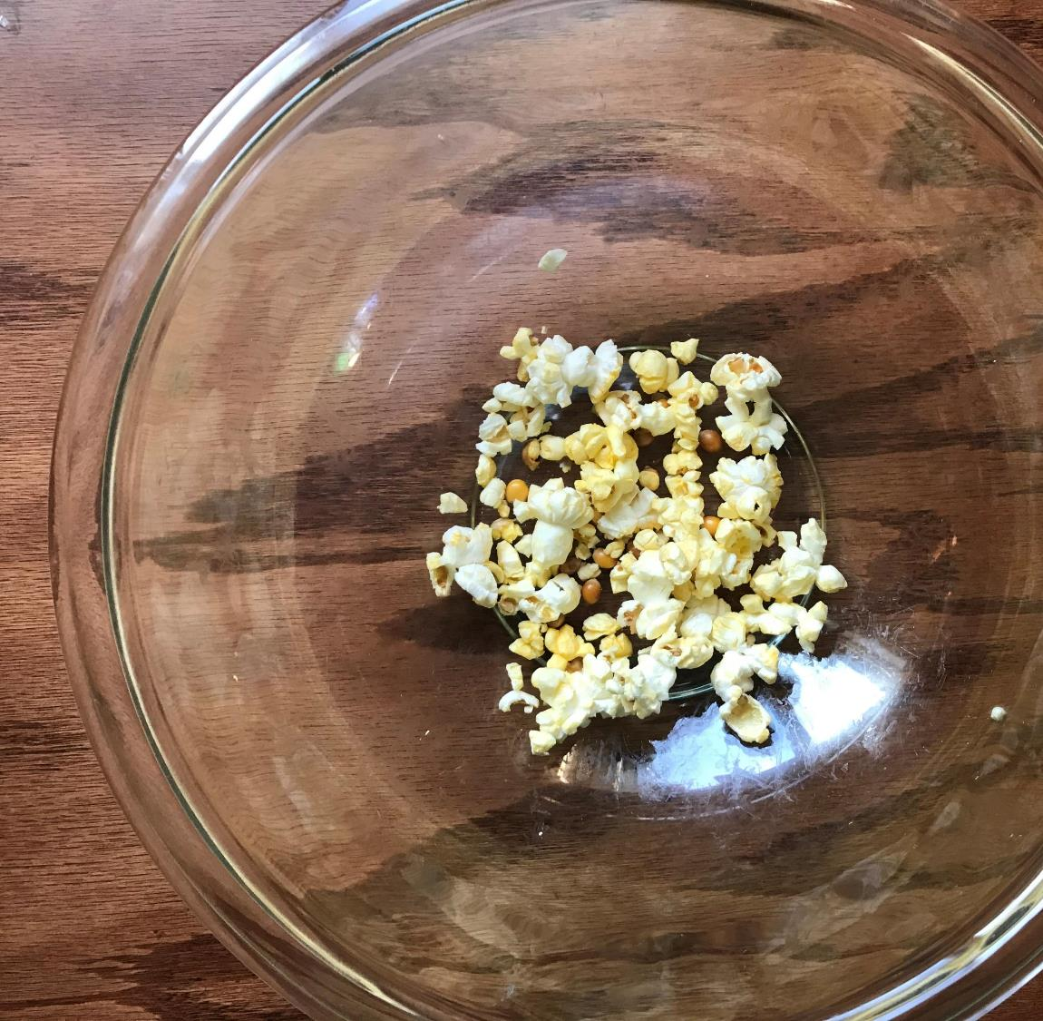
Group 4
You are Generation 4.
You have 5 seconds to take as much popcorn as you want.

Slide 26
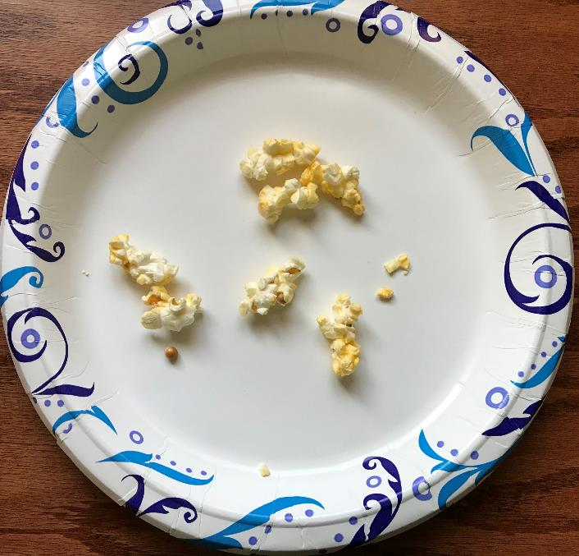
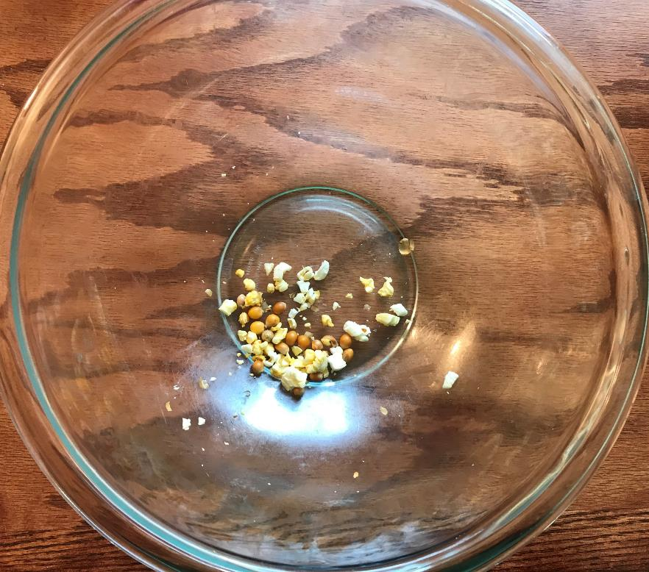
Making Observations:
What did you notice when Generation 4 was collecting popcorn?
How did it make you feel?

Slide 27
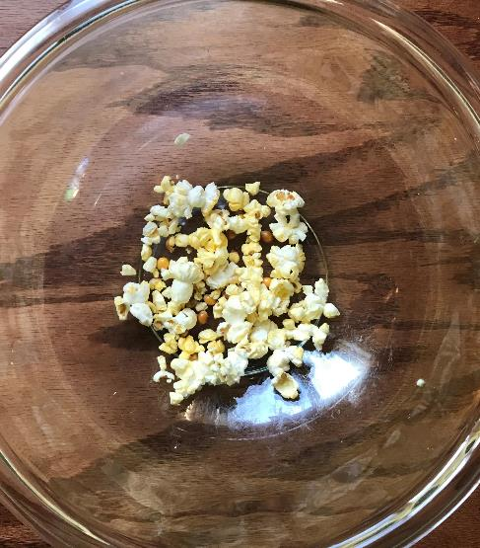
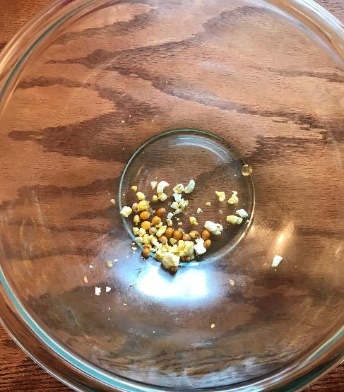
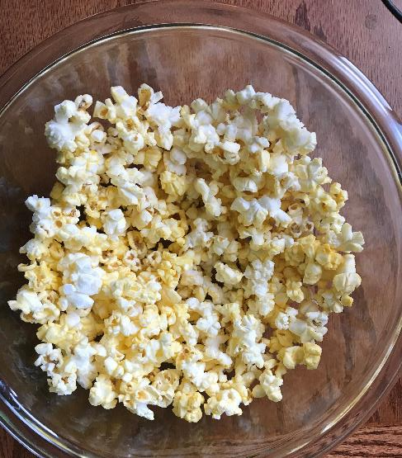
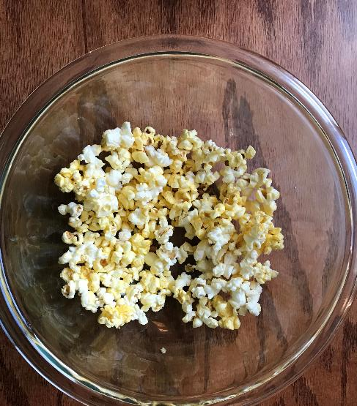
Sharing our thoughts:
What did you notice?
How did this activity make you feel?
Notes:
Procedure #4

Slide 28
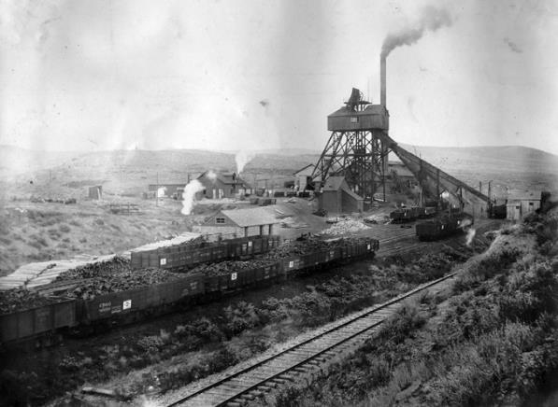
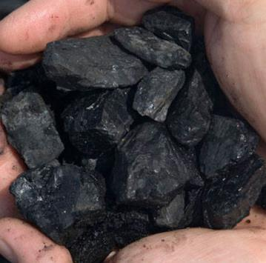
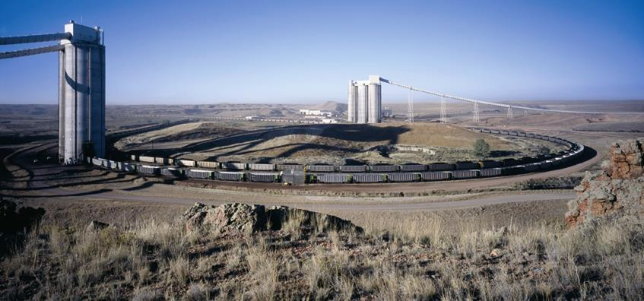
Nonrenewable natural resources exist in limited quantities.
Who felt like they got enough of the resource?
Who felt they did not get enough?
Was there a lot of popcorn remaining or only a little?
Was there any left by the time the fourth generation gained access to the nonrenewable resource?
Photo retrieved from
WyoHistory.org
Notes:
Procedure #5: You may have to have a deeper discussion about nonrenewable resources and the idea that they cannot be replaced. We have been mining them for many years in Wyoming, and even though we still have a large amount left, we must make sure we don’t run out if we want them to be used by future generations.

Slide 29
Stewards of Wyoming’s
Minerals and Energy Resources
Conservation: the careful utilization of a resource in order to prevent waste and leave some for future generations.
This means we should use what resources we have carefully so the next generations, your children and grandchildren, have some, too.
Notes:
Assessment: Vocabulary

Slide 30
Showing what we know…
Sentence Stem resource link
Think about what you learned during today’s activity.
Complete the sentence on your Sentence Stem sheet.
Notes:
Assessment

Slide 31
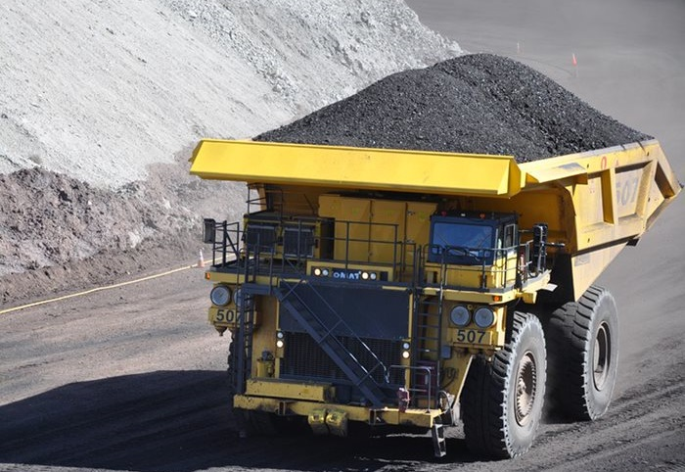
What did we learn from today’s challenge?
Notes:
Provide the students an opportunity to explain their learning.

