Slide 1
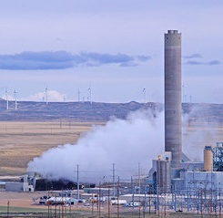

Minerals & Energy
2nd Grade
Lesson 4:
By-product Bonanza
Notes:
The name of the lesson is a link to the Wyoming Agriculture in the Classroom website where the lesson can be downloaded.

Slide 2
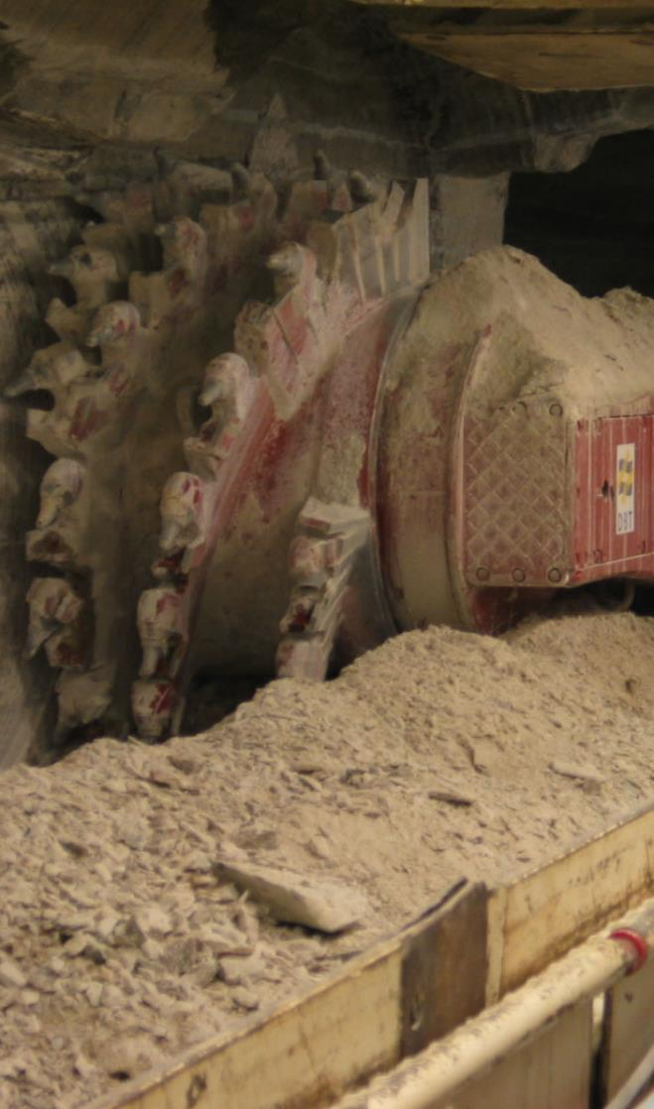
Today’s Challenge
Students learn that without Wyoming’s nonrenewable natural resources, we wouldn’t have many of the items we use every day.
Notes:
This is the focus of today’s lesson.

Slide 3
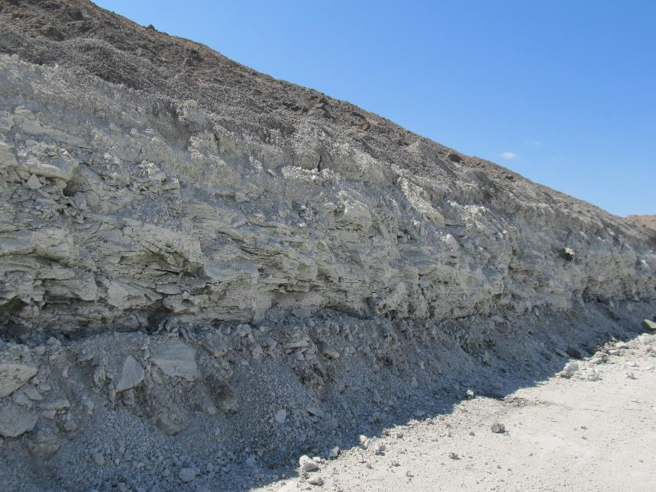
• Bentonite – a kind of absorbent clay formed by the breakdown of volcanic ash
Vocabulary
Notes:
These are the new vocabulary words for this lesson. You may need to adjust this list according to the needs of your students.

Slide 4
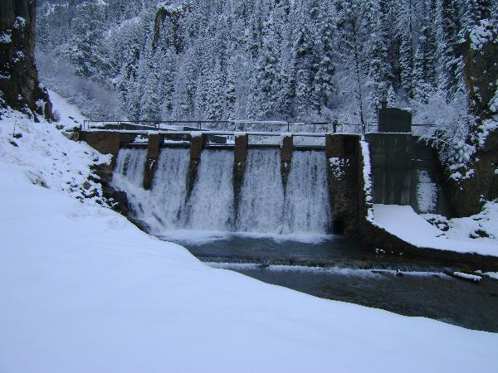
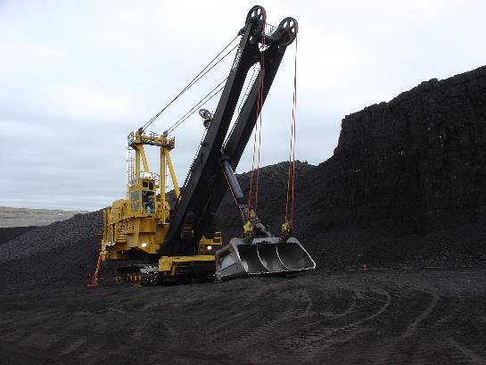
Highlights from our last lesson:
What did you learn from yesterday’s challenge?
Think back on:
  Renewable resources
  Nonrenewable resources
Notes:
Look back on the previous lesson and review the key ideas.

Slide 5

Nonrenewable Natural Resources:
Making many things we use daily possible.
What is nonrenewable natural resource?
What are some things you use in your life that are possible because of a Wyoming nonrenewable natural resource?
Notes:
Procedure #1: You can record student responses in the tables on this slide. A brainstorming tech tool would also work for collecting ideas for the things they use.

Slide 6




Mystery Bag
Did you know?
Our homes are full of objects and products that contain a Wyoming nonrenewable natural resource.
Let’s Explore
I have some examples of those objects:
What is the object?
What is the component it is made with?
Are you surprised our mystery item has that in it?
Why?
Oil
This Photo by Unknown Author is licensed under CC BY-NC-ND
Notes:
Procedure #2, #3, and #4: Click on the bag in presentation mode, and it will reveal the example (balloon from oil). This example is different than any of the other bags in this slide presentation so the students will have different mystery bags from the example.

Slide 7
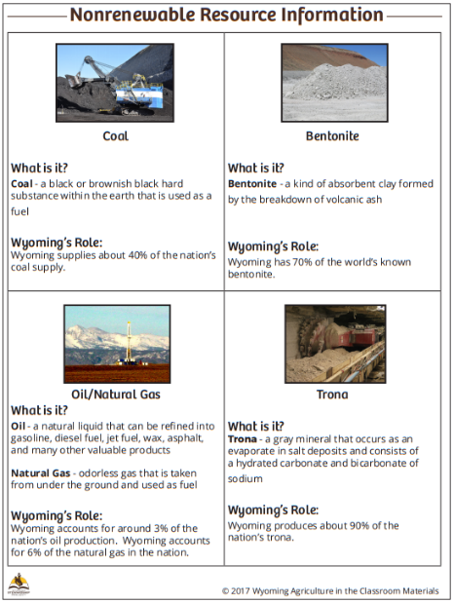

Wyoming’s Nonrenewable Resources:
They make us special!
Wyoming is unique in our nonrenewable resource production:
We have a large amount of them.
We provide many of these resources for the whole country.
Nonrenewable Resource Information link
Notes:
Procedure #5

Slide 8

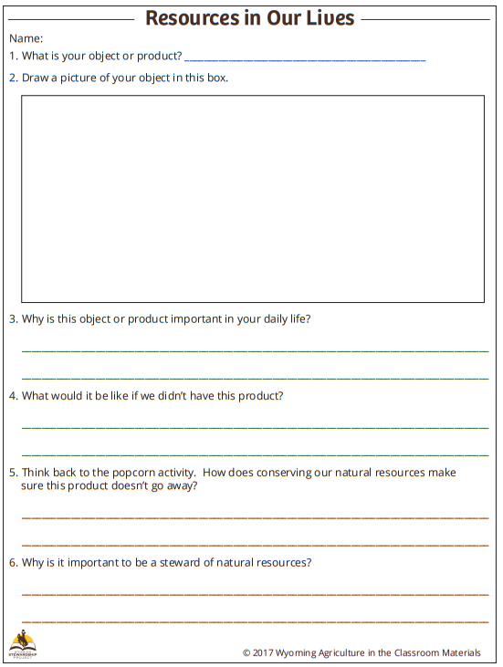
Let’s Practice
Oil
Resources in Our Lives link
This Photo by Unknown Author is licensed under CC BY-NC-ND
Notes:
Procedure #6: You can use your platform’s drawing tools to fill in the example worksheet with the class.

Slide 9


Vocabulary
Anchor Chart
Generation | Mineral
Natural resources | Natural gas
Stewardship | Oil
Conservation | Trona
Energy
Nonrenewable resources
Reclamation
Renewable resources
Coal
Energy
Gasoline
Hydropower
Notes:
This Vocabulary Anchor Chart can be completed as you do the lesson. The next lesson will have a pre-filled chart for you to continue using.

Slide 10

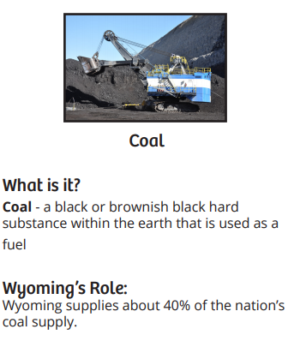
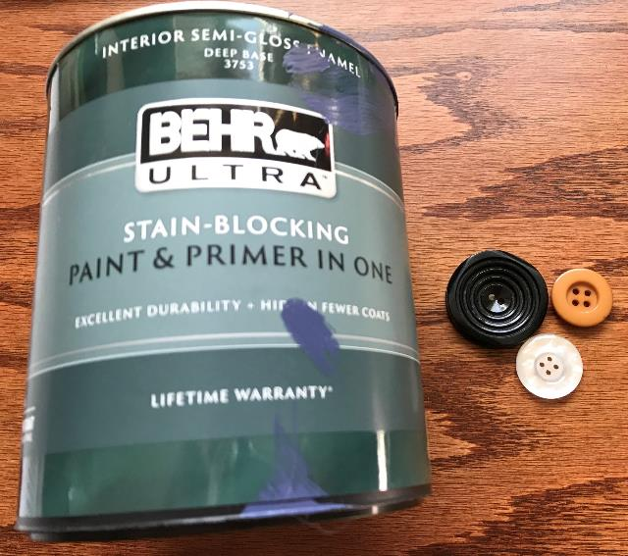
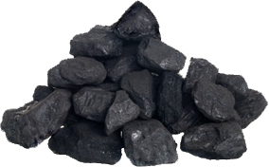
This Photo by Unknown Author is licensed under CC BY-NC
Notes:
Procedure #7: These are set up for you to use if you are unable to put together your own mystery bag or if you are virtual. The items are hidden under the bag, which will reveal the objects when you click on it in presentation mode. Each bag has 2 objects from the list so students can choose one. If you prefer to have only one object, just slide the bag over, crop out what you don’t want, and slide the bag back.

Slide 11
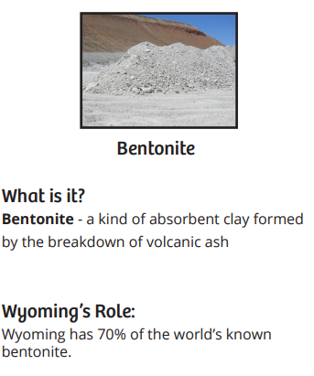
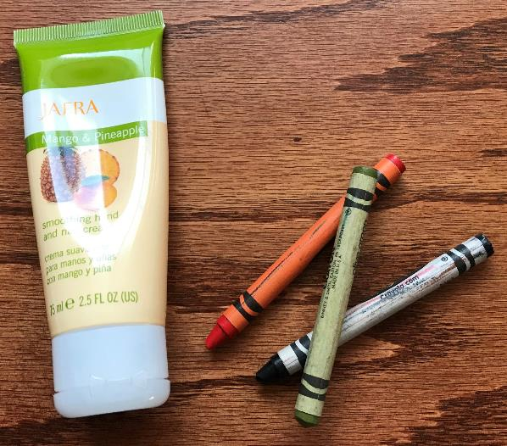
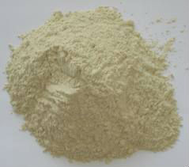
This Photo by Unknown Author is licensed under CC BY-SA-NC

Slide 12
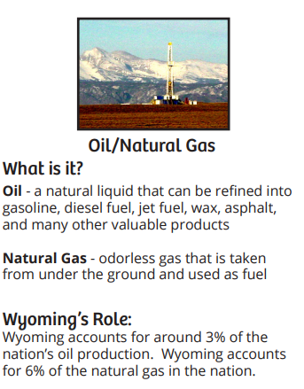
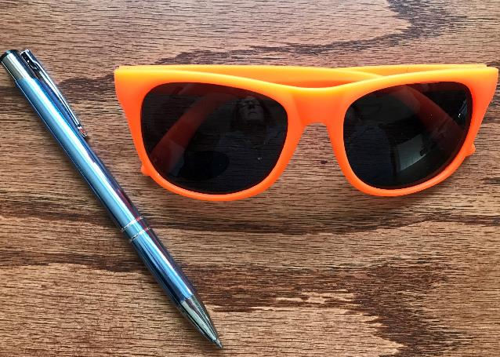
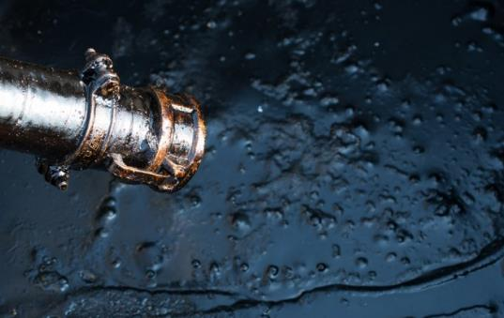
This Photo by Unknown Author is licensed under CC BY-SA-NC

Slide 13
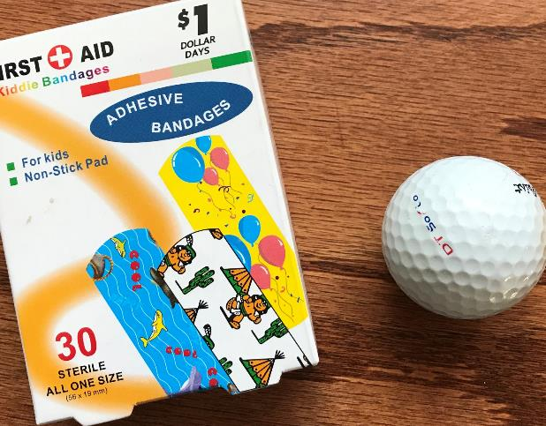
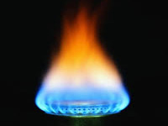
This Photo by Unknown Author is licensed under CC BY-SA

Slide 14
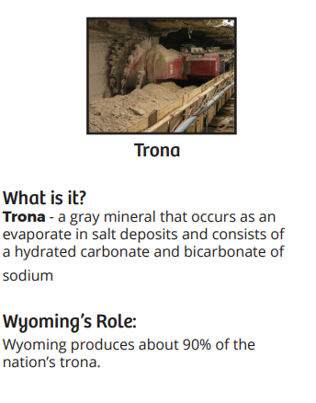
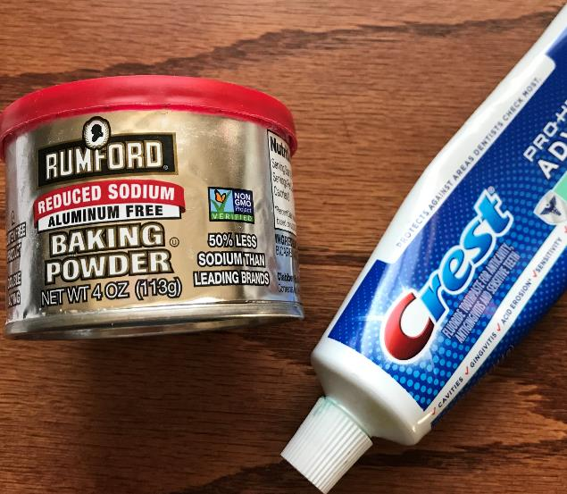
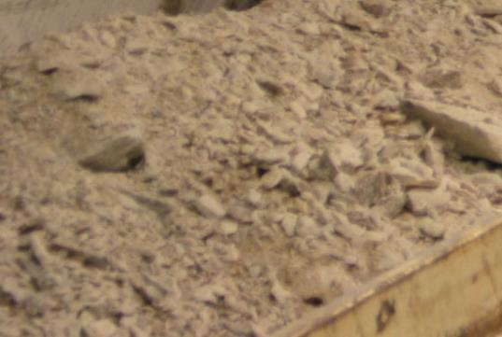

Slide 15

All About Our Mystery Item
Tell the class:
Are you surprised to learn that your object contains the resource it has?
What are your reasons?
What do you think?
Why is this object important in your life?
What would it be like if we did not have this product.
Notes:
Procedure #8, #9, and #10: Slide 8 has the sheet that students will use to do this activity.

Slide 16


Things to Ponder
What could cause these products or objects to not be available anymore?
How does conserving our natural resources help to ensure that our products don’t go away?
Notes:
Procedure #11

Slide 17

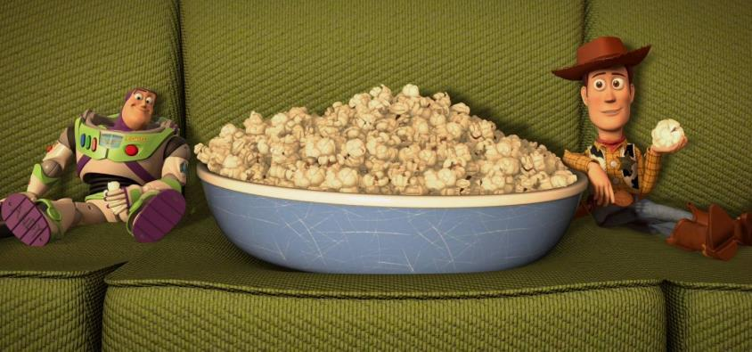
Stewardship
How can we be good stewards of Wyoming’s natural resources to make sure we have the for ourselves and others in the future?
This Photo by Unknown Author is licensed under CC BY-SA
Notes:
Procedure #12

Slide 18

Updating our charts to show how much we’ve learned.
What is nonrenewable natural resource?
What are some things you use in your life that are possible because of a Wyoming nonrenewable natural resource?
Notes:
Procedure #13: This is a copy of slide 5. You can either delete this slide and copy your slide with the student answers, or copy/paste the student responses into this one. You will be able to update the previous student either way.

Slide 19
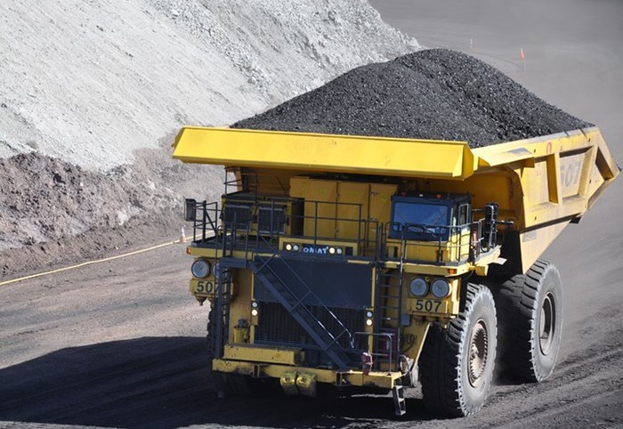
What did we learn from today’s challenge?
Notes:
Provide the students an opportunity to explain their learning.

