Slide 1
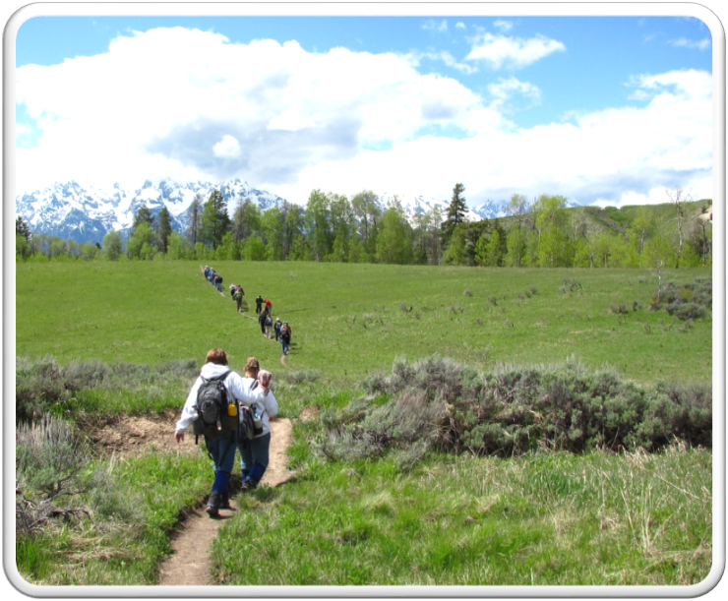
Outdoor Recreation & Tourism
2nd Grade
Lesson 4:
Mapping in 3-D
Notes:
The name of the lesson is a link to the Wyoming Agriculture in the Classroom website where the lesson can be downloaded.

Slide 2
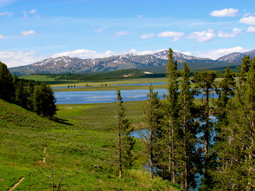
Today’s Challenge:
Students will:
Learn how models are used in science.
Create a model to represent different types of terrain.
This Photo by Unknown Author is licensed under CC BY-SA
Notes:
This is the focus of today’s lesson.

Slide 3
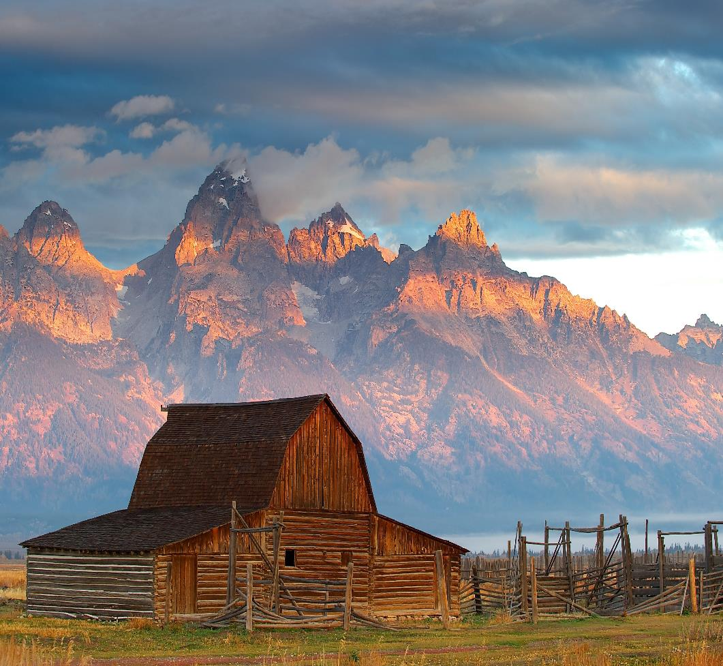
Vocabulary:
Forest – a large area of land covered with trees and underbrush
Grassland – an area of land on which most of the natural plant forms are grasses
Lake - a body of fresh or salt water of considerable size that surrounded by land
Mountain - a raised area of land higher and steeper than a hill
Recreation - an activity that is undertaken for pleasure or relaxation
Reservoir - a natural or artificial place where water is collected and stored for use
River - a large, flowing stream of water
Scenery - the view of natural features that are pleasing to look at
Terrain - the physical features of an area of land
This Photo by Unknown Author is licensed under CC BY-SA
Notes:
These are the new vocabulary words for this lesson. You may need to adjust this list according to the needs of your students.

Slide 4
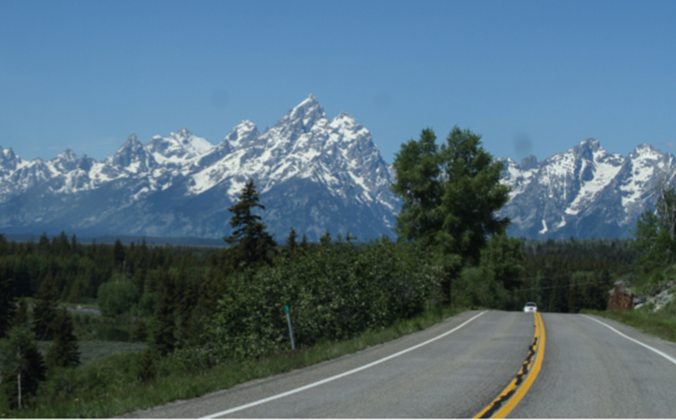
Highlights from our last lesson:
Think back on:
Terrains
Notes:
Look back on the previous lesson and review the key ideas.

Slide 5
Day One
Notes:
This is a two-day lesson

Slide 6
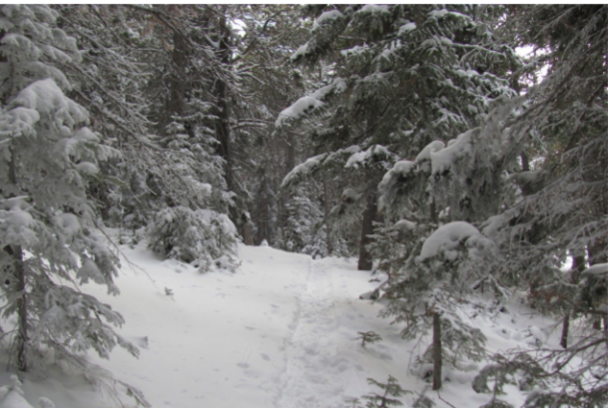
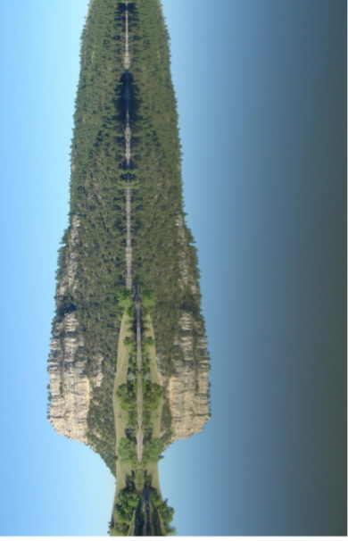
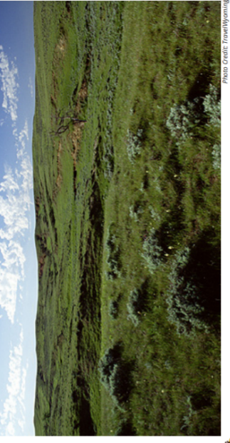
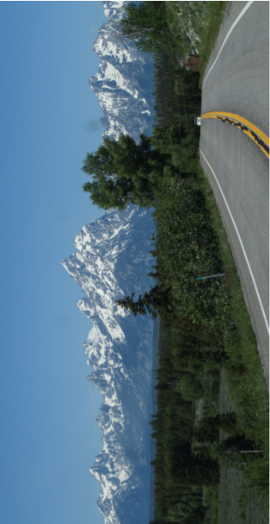
Terrain Photos
Forest
Water
Grassland
Mountains
What can you do on
this land?
Notes:
Procedure #1
You will remind the students of the previous lesson.

Slide 7
Terrain Photos
What terrain would
you enjoy?
Notes:
Procedure #2 & #3
Students will be in small groups and will discuss things that they could do on that land. Provide them an opportunity to create the terrain that they would most enjoy.

Slide 8
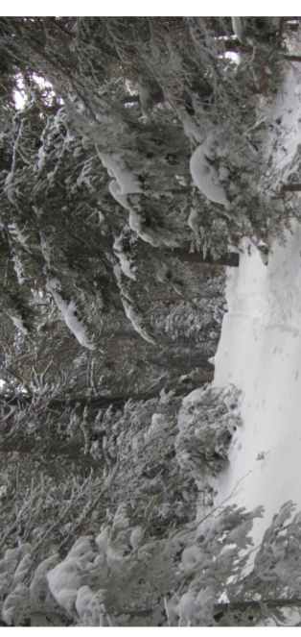
Forest
Characteristics:
Notes:
Procedure #2
Students will visit each different terrain photo to describe each terrain.

Slide 9
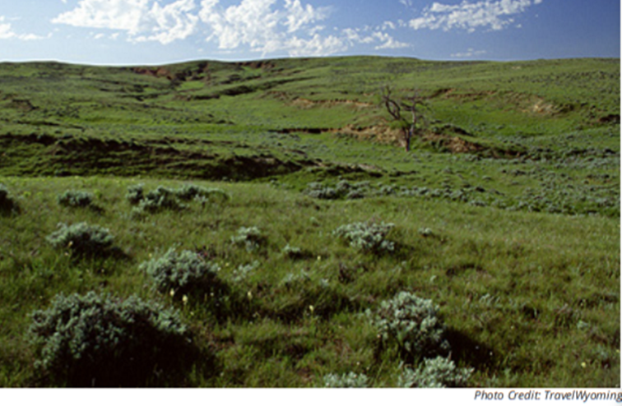
Grassland
Characteristics:
Notes:
Procedure #2
Students will visit each different terrain photo to describe each terrain.

Slide 10
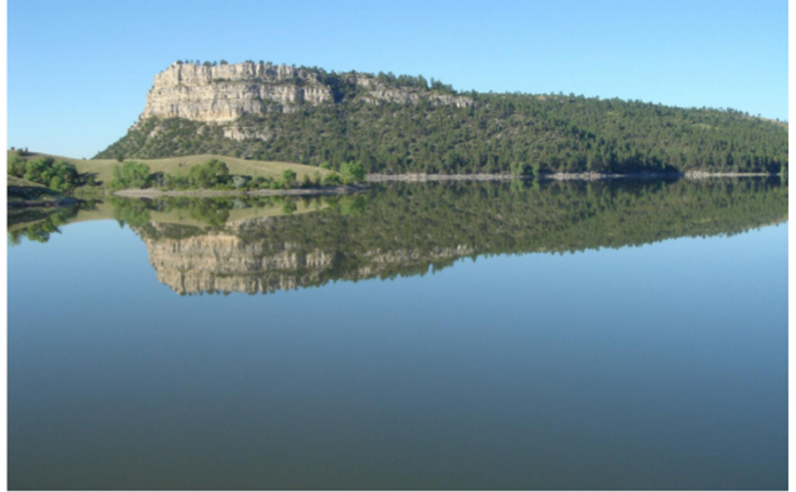
Water
Characteristics:
Notes:
Procedure #2
Students will visit each different terrain photo to describe each terrain.

Slide 11
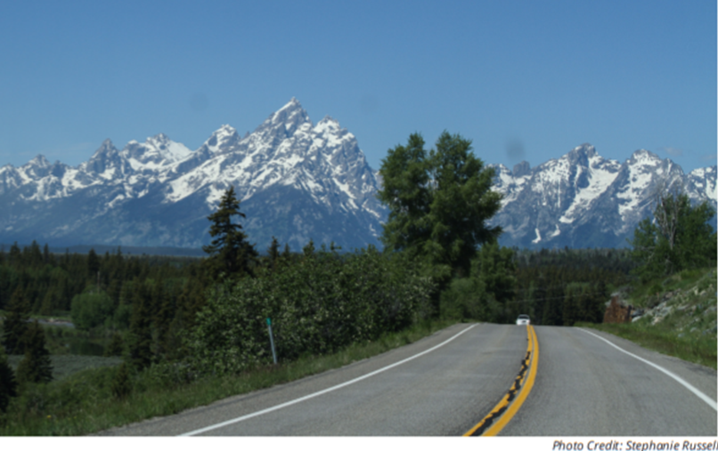
Mountains
Characteristics:
Notes:
Procedure #2
Students will visit each different terrain photo to describe each terrain.

Slide 12
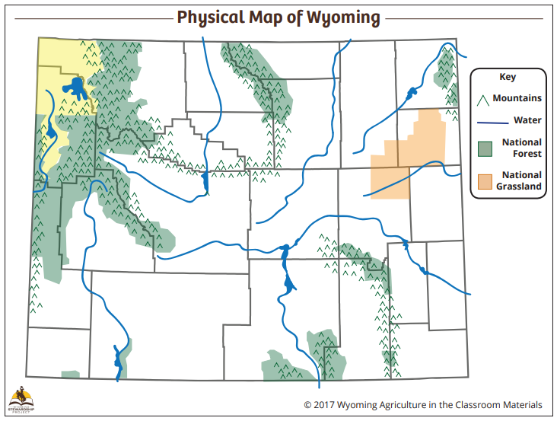
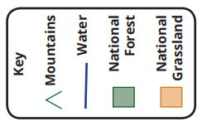
Physical Map
Notes:
Procedure #3
Students will be labeling their town and location on the map. You will also help the students read the map key. You can use the drawing tool to

Slide 13
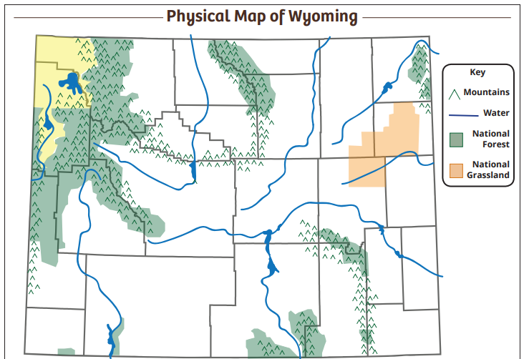
What symbols do you see in our area?
Notes:
Procedure #3
Students will be labeling their town and location on the map. You will also help the students read the map key. You can use the drawing tool to mark the features found in your area.

Slide 14
Day Two

Slide 15
What symbols do you see on the map?
What terrain do you notice on the map?
Notes:
Day #2 Procedure #1 & #2
Students will be answering the posed questions.

Slide 16
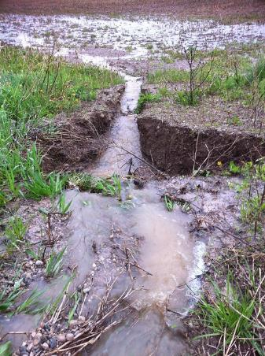
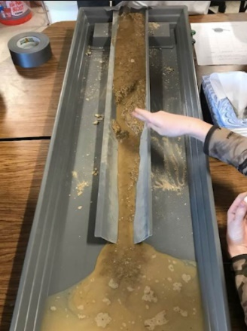
Using Models
Models represent things we can’t experience directly.
This Photo by Unknown Author is licensed under CC BY-SA-NC
Notes:
Day #2, Procedure #2:

Slide 17
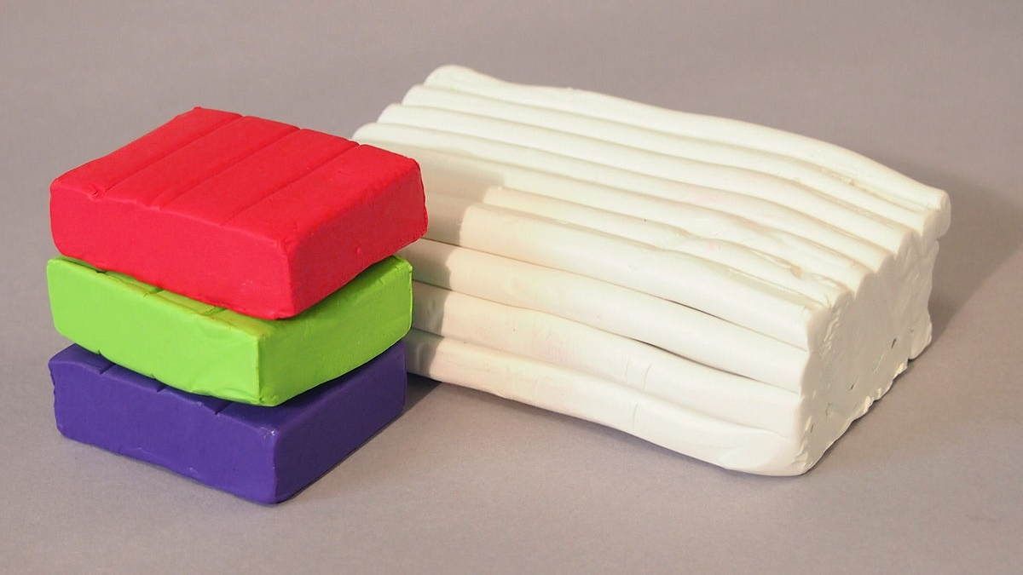
Let’s make models of our terrain!
This Photo by Unknown Author is licensed under CC BY-SA
Notes:
Day #2 procedure #2
Students will be creating models of the different terrains.

Slide 18
Examining our work:
How are our models similar?
How are they different?
In what way do they look like a real mountain?
Why are they tall instead of flat?
Let’s make models of the other kinds of terrain.
Notes:
Day #2 Procedure #2: Begin the modeling process by asking students to create a model of a mountain. After discussing the models, repeat the process with three other terrain types: body of water, forest, and grassland. Make sure to emphasize that students are modeling different features of the terrain.

Slide 19
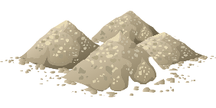
Representing Wyoming’s Terrain
Use your clay to create Wyoming’s terrain on your laminated map.
Physical Map
Notes:
Assessment: Procedure #4

Slide 20
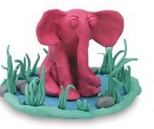
Why are models useful?
How are our 3D models like the actual terrain we are learning about?
This Photo by Unknown Author is licensed under CC BY-SA-NC
Notes:
Day #2 Procedure #3
Explain the difference between the 2-D and 3-D process.

Slide 21
Let’s Discuss:
What do you notice about our terrain?
What kinds of terrain do you see?
What would happen if we did not have mountains? Bodies of water? Forests? Grasslands?
Who would be affected?
What will happen to future generations if we did not take care of our terrain?
Would others want to come visit our state without our unique terrain?
Notes:
Day #2 Procedure # 5 & #6
Assessment and discussion questions for whole group

Slide 22
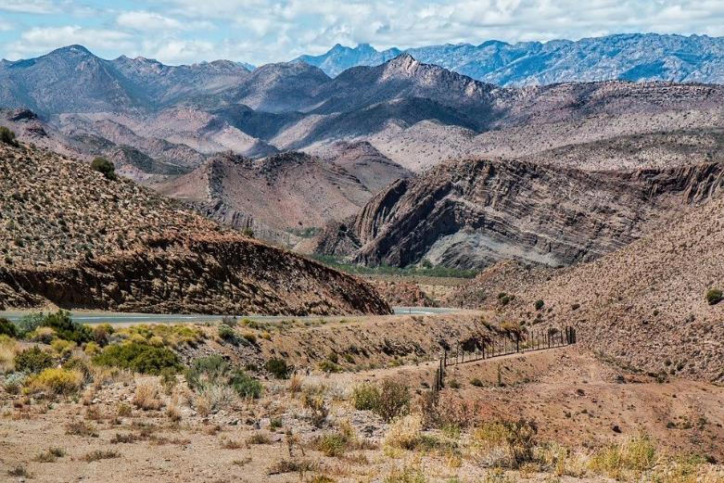
What did we learn from today’s challenge?
ThisPhoto by Unknown Author is licensed under CC BY-SA
Notes:
Procedure #6: Provide the students an opportunity to explain their learning.

