Slide 1
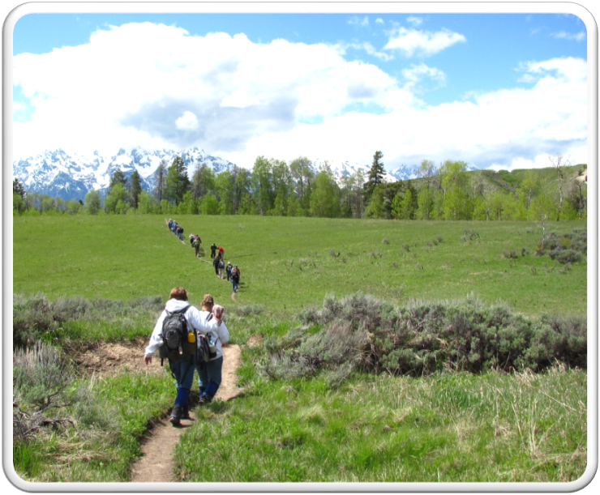
Outdoor Recreation & Tourism
2nd Grade
Lesson 5:
Wyoming’s Unique Terrain
Notes:
The name of the lesson is a link to the Wyoming Agriculture in the Classroom website where the lesson can be downloaded.

Slide 2
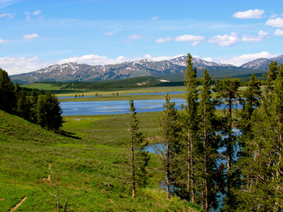
Today’s Challenge:
Students will:
Identify and describe the different types of Wyoming terrain.
Explain how to be stewards of each type of Wyoming terrain.
This Photo by Unknown Author is licensed under CC BY-SA
Notes:
This is the focus of today’s lesson.

Slide 3
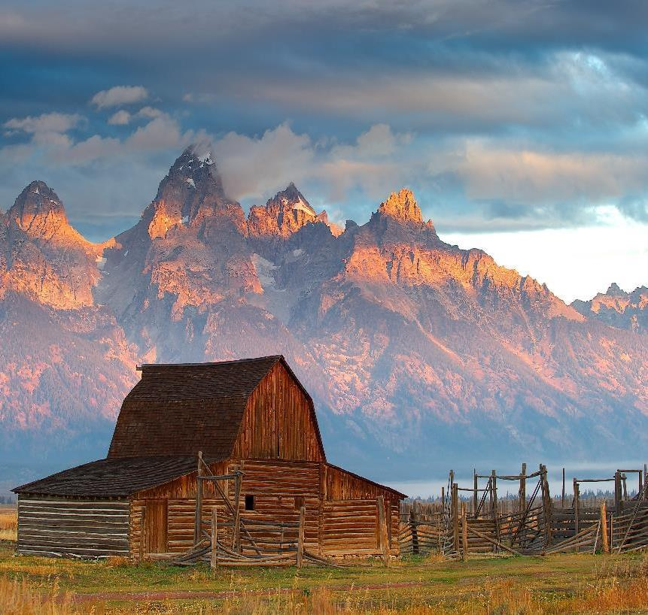
Vocabulary:
Geothermal - relating to or produced by the internal heat of the earth
Forest – a large area of land covered with trees and underbrush
Grassland – an area of land on which most of the natural plant forms are grasses
Lake - a body of fresh or salt water of considerable size that surrounded by land
Mountain - a raised area of land higher and steeper than a hill
Reservoir - a natural or artificial place where water is collected and stored for use
River - a large, flowing stream of water
Scenery - the view of natural features that are pleasing to look at
Terrain - the physical features of an area of land
This Photo by Unknown Author is licensed under CC BY-SA
Notes:
These are the new vocabulary words for this lesson. You may need to adjust this list according to the needs of your students.

Slide 4
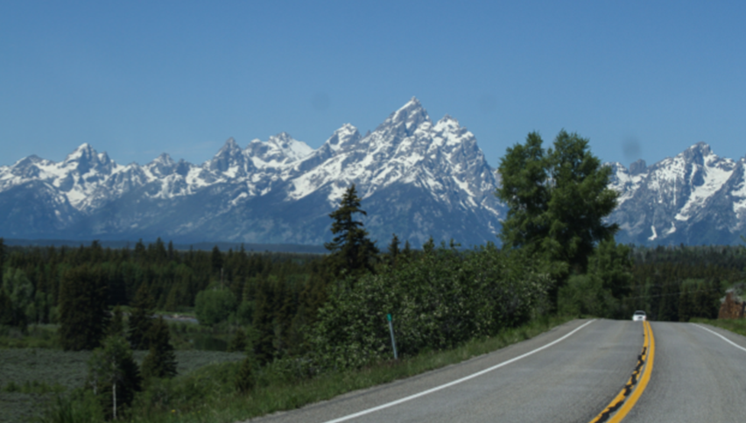
Highlights from our last lesson:
Think back on:
Modeling terrains
Types of terrains
Notes:
Look back on the previous lesson and review the key ideas.

Slide 5
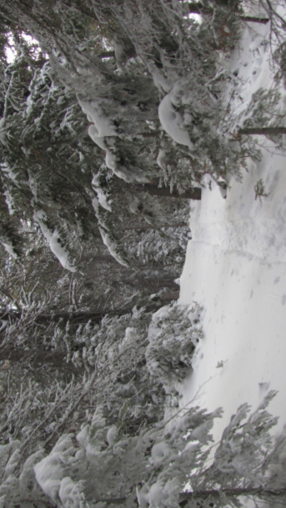
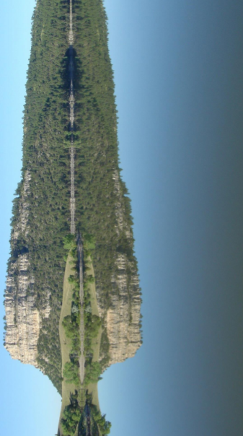
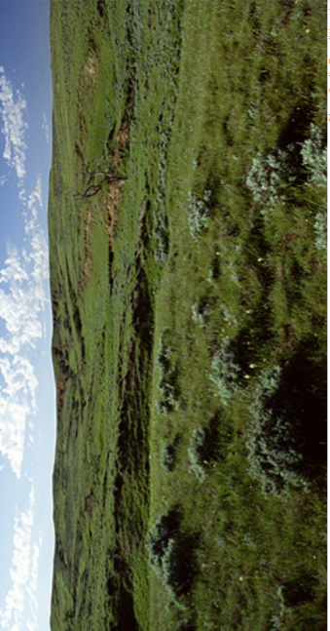
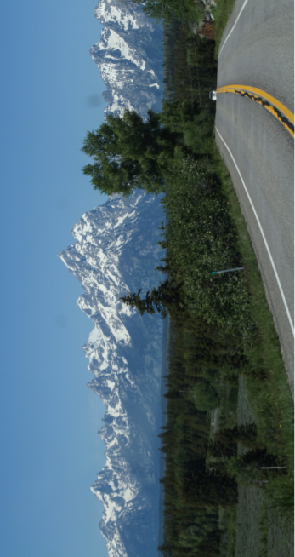
Terrain Photos
TERRAIN TYPES
Forest
Water
Grassland
Mountains
Notes:
Procedure #1
You will remind the students of the previous lesson, and explain to them they will be identifying which terrain a given scenario takes place in.

Slide 6
Terrain Type stories
Notes:
Procedure #1
Students will decide which terrain this story took place in.

Slide 7
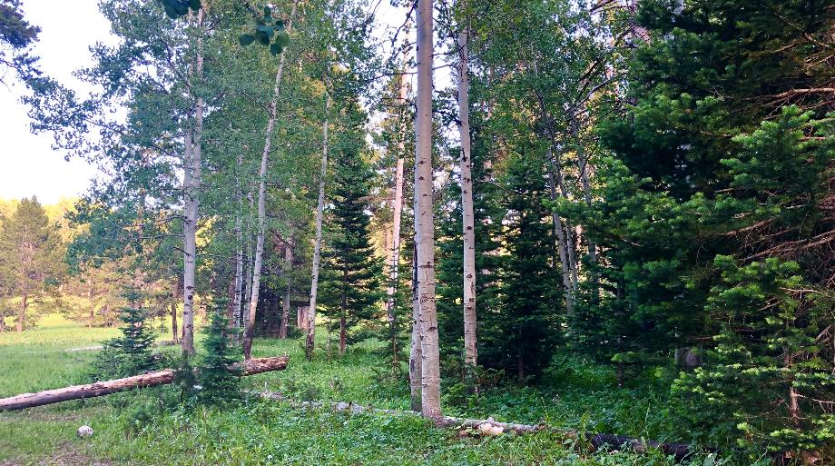
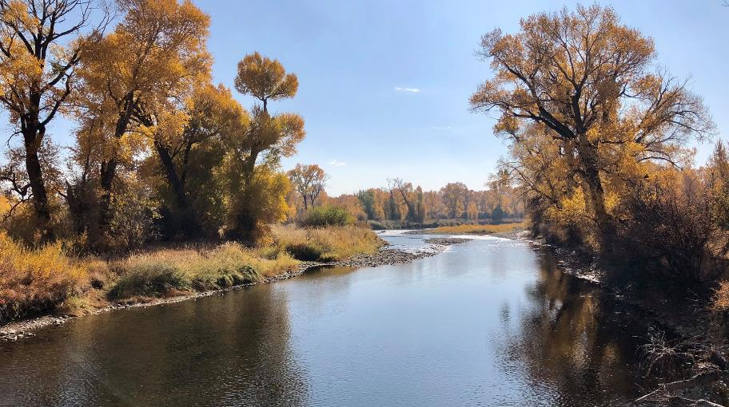
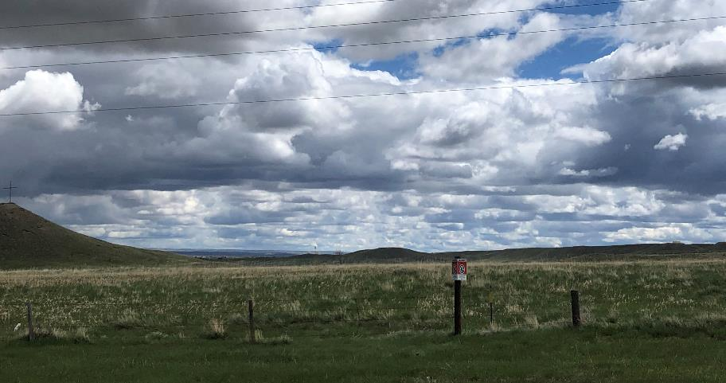
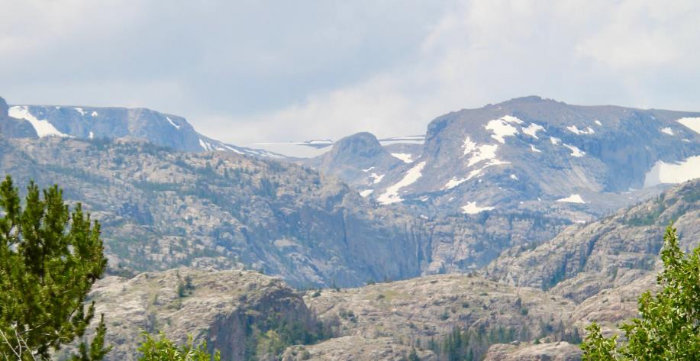
Which Terrain Type was in the story?
Forest
Water
Grassland
Mountains
Photos courtesy of C. Jacobs
Notes:
Procedure #1
You will remind the students of the previous lesson, and explain to them they will be identifying which terrain a given scenario takes place in.

Slide 8
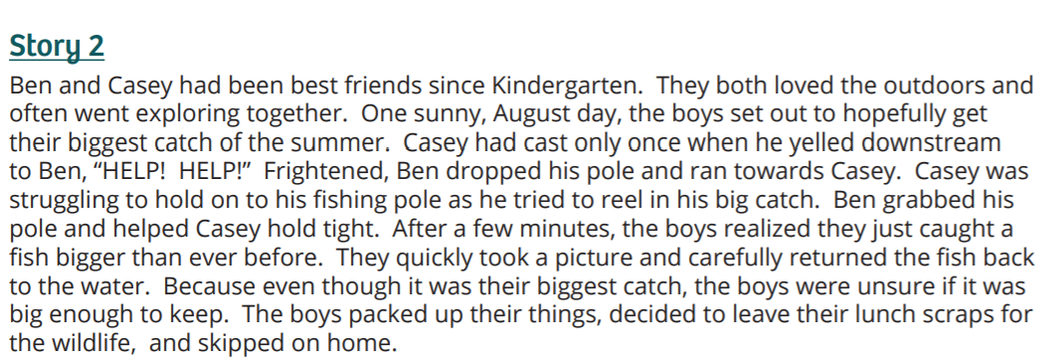
Terrain Type stories
Notes:
Procedure #1
Students will decide which terrain this story took place in.

Slide 9
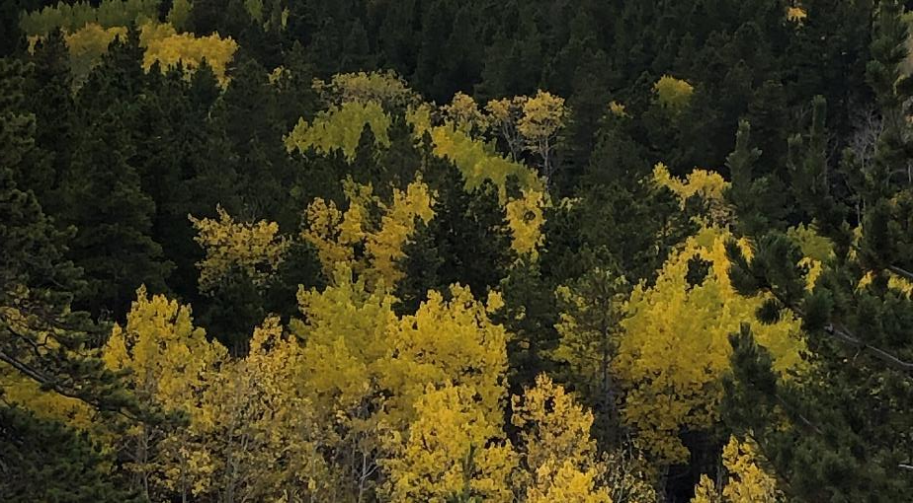
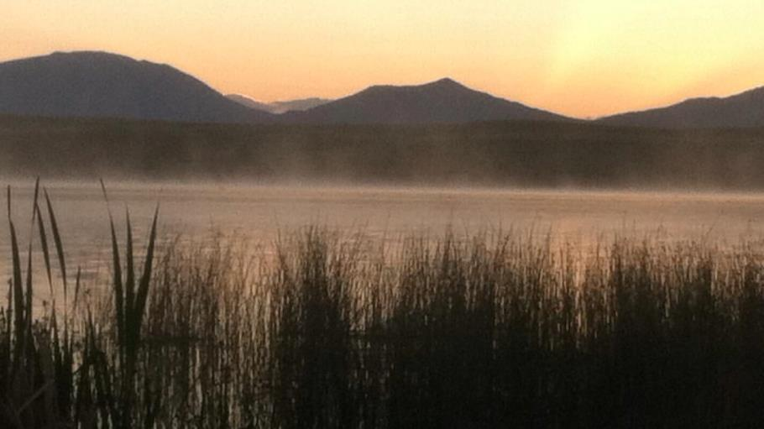
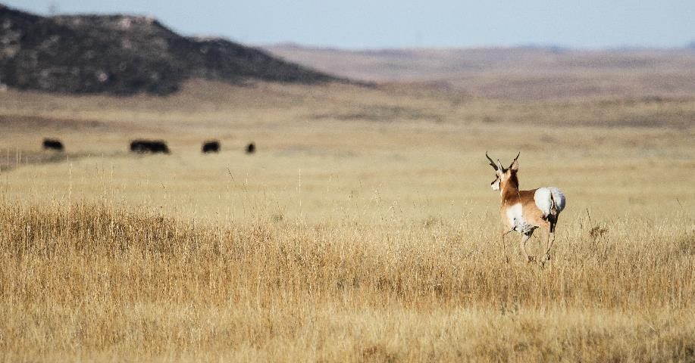
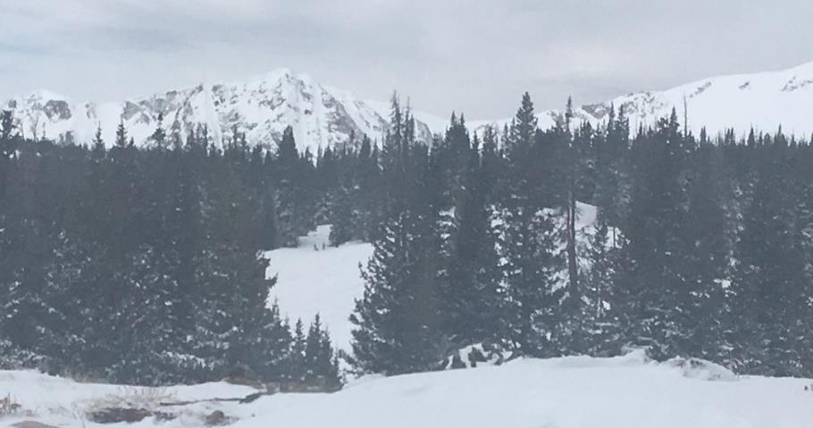
Which Terrain Type was in the story?
Forest
Water
Grassland
Mountains
Courtesy of Wyoming Game & Fish
Photos courtesy of C. Jacobs & K. Jacobs
Notes:
Procedure #1
You will remind the students of the previous lesson, and explain to them they will be identifying which terrain a given scenario takes place in.

Slide 10
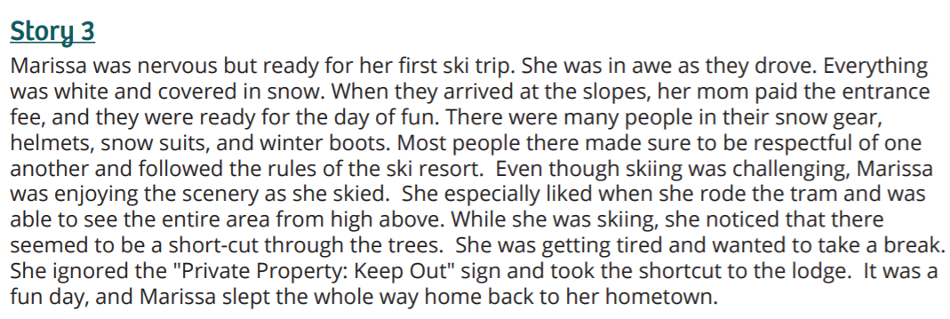
Terrain Type stories
Notes:
Procedure #1
Students will decide which terrain this story took place in.

Slide 11
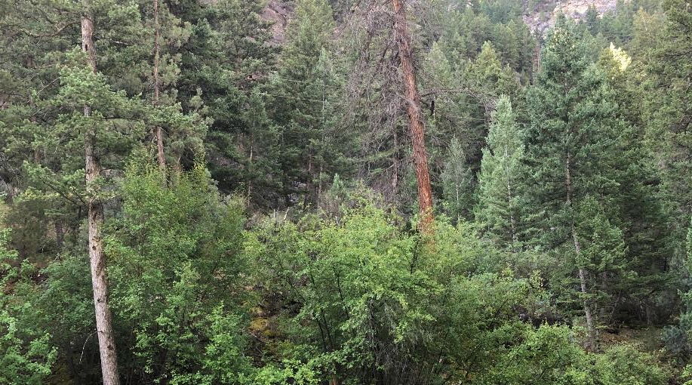
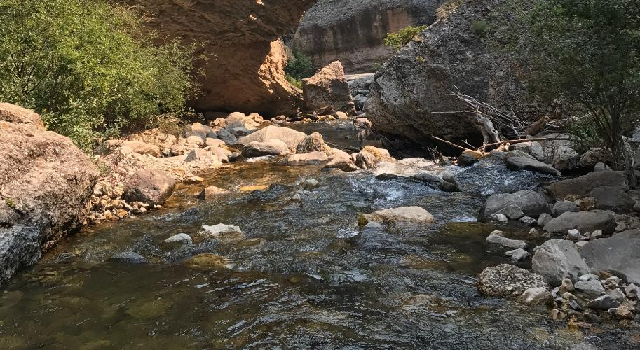
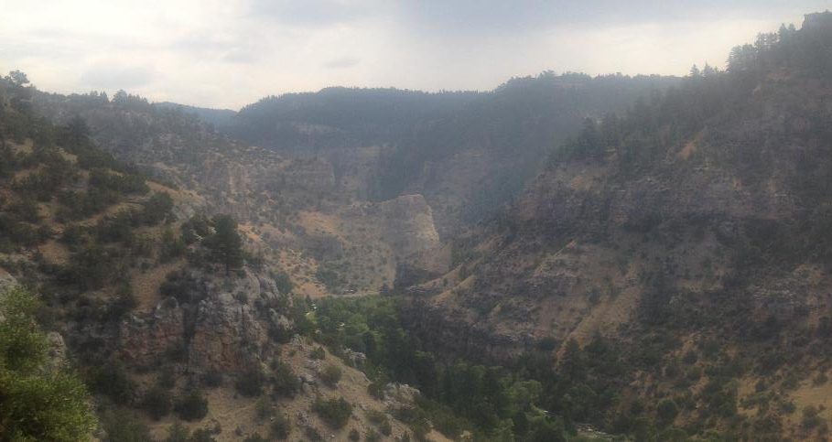
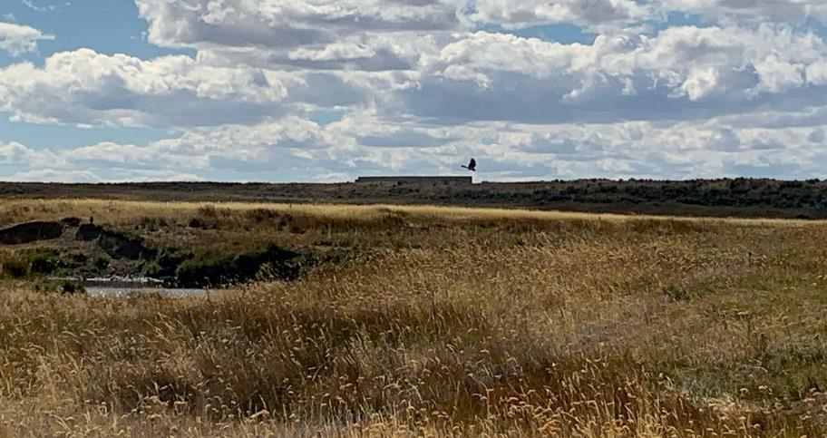
Which Terrain Type was in the story?
Forest
Water
Grassland
Mountains
Photos courtesy of C. Jacobs & K. Jacobs
Notes:
Procedure #1
You will remind the students of the previous lesson, and explain to them they will be identifying which terrain a given scenario takes place in.

Slide 12
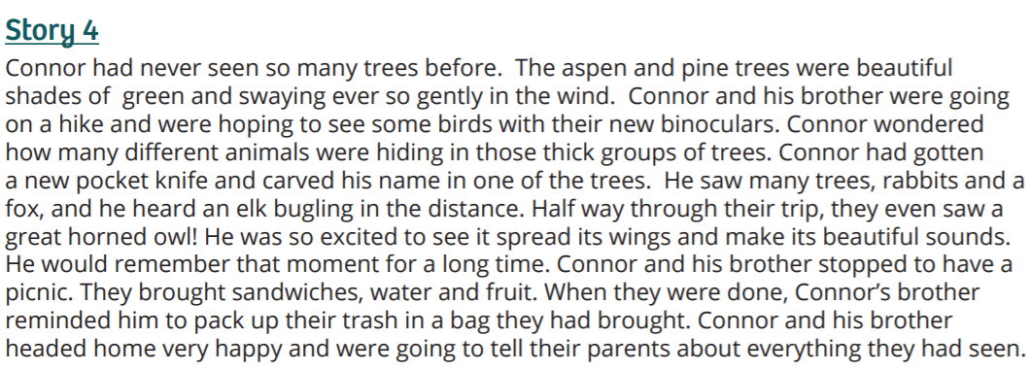
Terrain Type stories
Notes:
Procedure #1
Students will decide which terrain this story took place in.

Slide 13
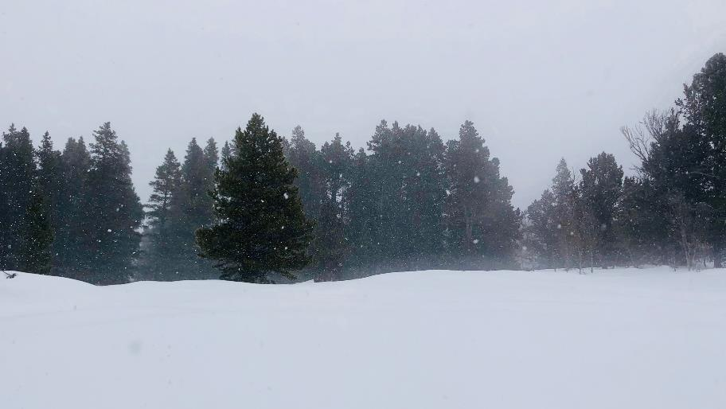
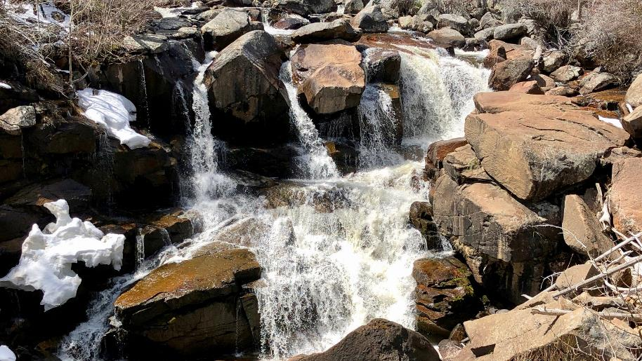
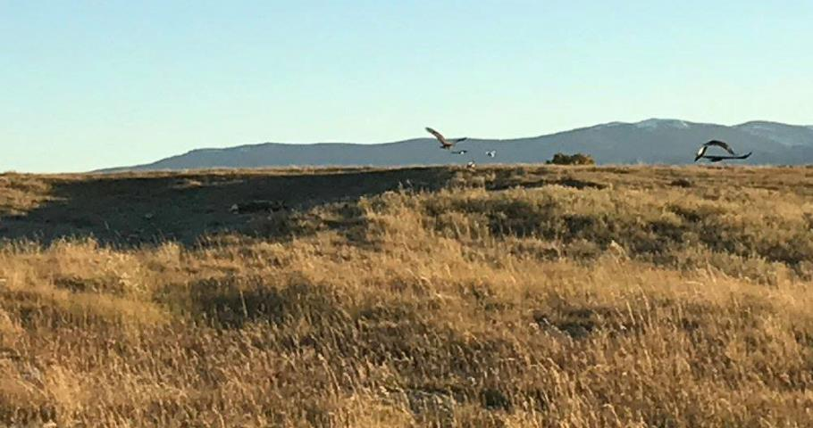
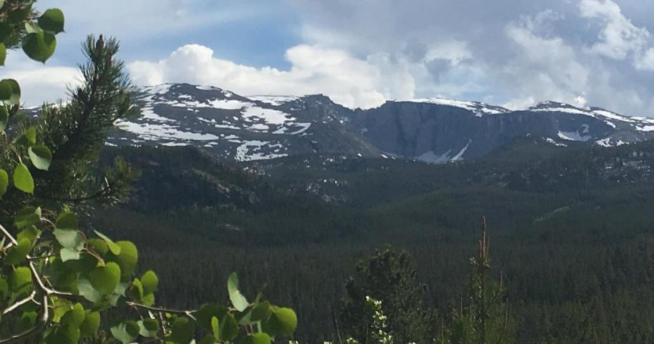
Which Terrain Type was in the story?
Forest
Water
Grassland
Mountains
Photos courtesy of C. Jacobs & K. Jacobs
Notes:
Procedure #1
You will remind the students of the previous lesson, and explain to them they will be identifying which terrain a given scenario takes place in.

Slide 14
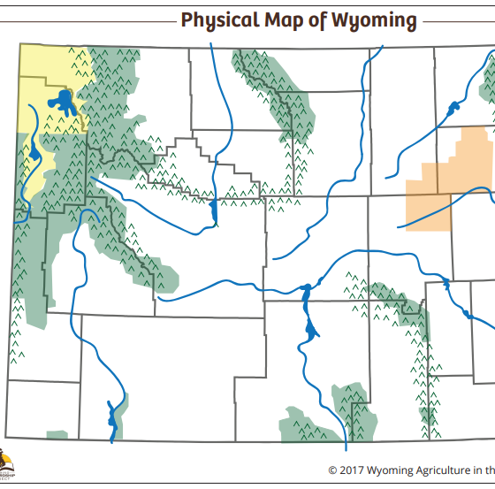
Yellowstone National
Park
Notes:
Procedure #2
Stop and have students notice what is different about the terrain in different areas. (Geyser parts, bison areas, and waterfalls) The link to the video is “Yellowstone National Park” found in the black circle.

Slide 15
Discussion
Do we have any similar types of land/terrain around our town?
Why do you think Yellowstone was make a national park?
What things do people need to do to keep Yellowstone a special place to visit?
What would happen if people didn’t take
care of places like Yellowstone?
What would happen if people didn't
practice stewardship?
Notes:
Procedure #3
Students will explain their understanding through the discussion questions.

Slide 16
My favorite way to use public lands is…
On what type of terrain would you do your activity?
Try to think of an activity not shown in the pictures!
Notes:
Procedure #4

Slide 17
Share your ideas about activities you like to do. Share what type of terrain where you would do that activity. Fill in the blanks in the sentence stem: When I (favorite activity)________________ on/in a (type of terrain)_______________________, I need to be sure I ______________________________ to be a steward of that land.
Notes:
Procedure 4
Students will complete the sentence stem on a piece of paper or in their journals. You may want to provide examples for the students before they complete their own stem.

Slide 18
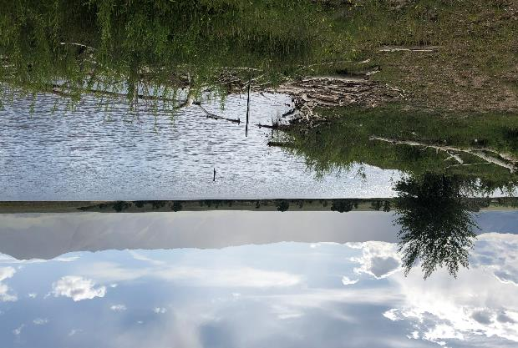
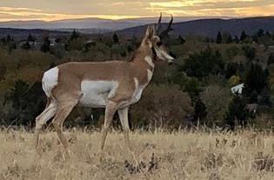
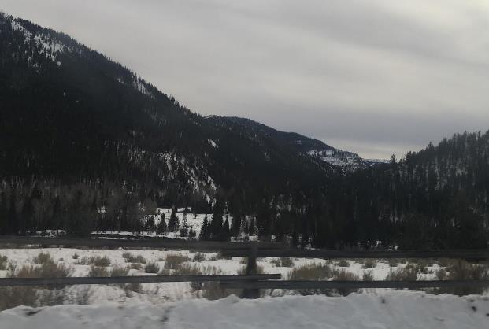
4 Corners
Fishing
Snowboarding
Hiking
Camping
Snowshoeing
Animal watching
Swimming
Hunting
Skiing
Photos courtesy of C. Jacobs & K. Jacobs
Notes:
Assessment: Each item is text box that can be moved into the correct picture.

Slide 19
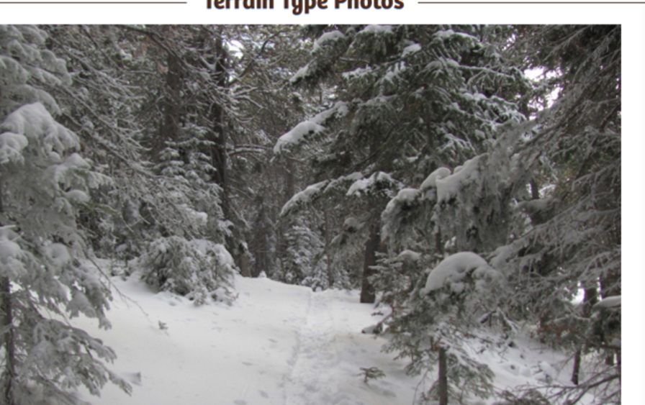
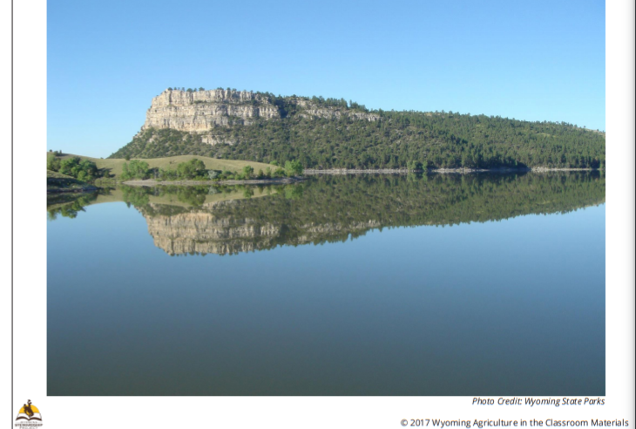
Fill in the blanks in the sentence stem.
My favorite type of terrain is______________________.
One way I can be a steward of that terrain is______________
________________________.
Notes:
Assessment

Slide 20
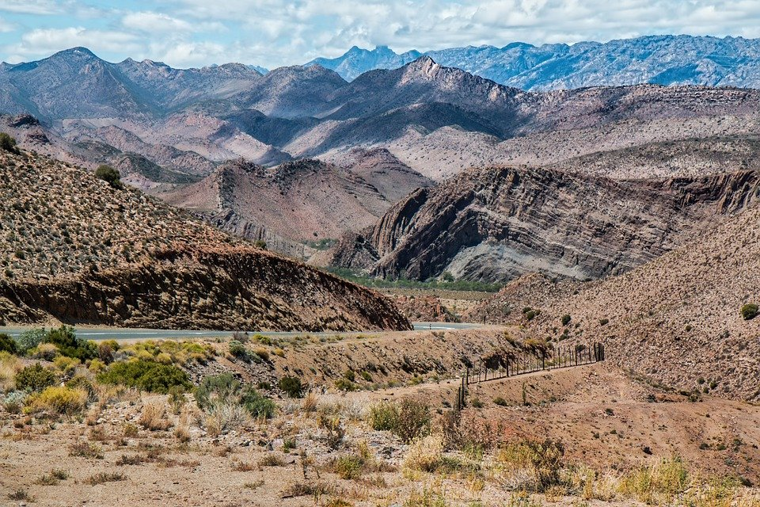
What did we learn from today’s challenge?
This Photo by Unknown Author is licensed under CC BY-SA
Notes:
Procedure #6: Provide the students an opportunity to explain their learning.

