Slide 1
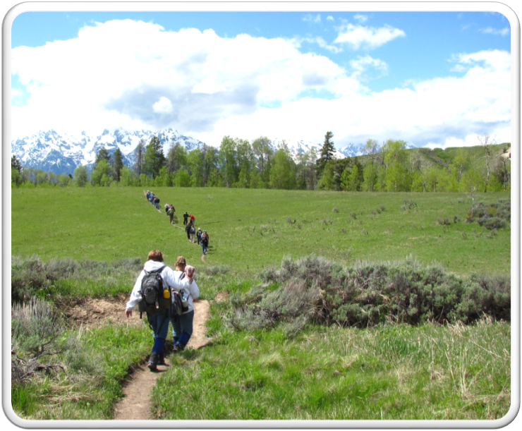
Outdoor Recreation & Tourism
2nd Grade
Lesson 6, Day 1 and 2:
How to be a Steward?
Notes:
The name of the lesson is a link to the Wyoming Agriculture in the Classroom website where the lesson can be downloaded.

Slide 2
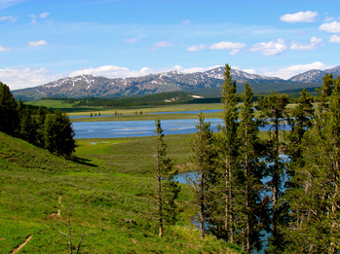
Today’s Challenge:
Students will:
Identify what it takes to be a steward of Wyoming’s private and public lands.
Learn about professional jobs caring for Wyoming’s lands.
This Photo by Unknown Author is licensed under CC BY-SA
Notes:
This is the focus of today’s lesson.

Slide 3
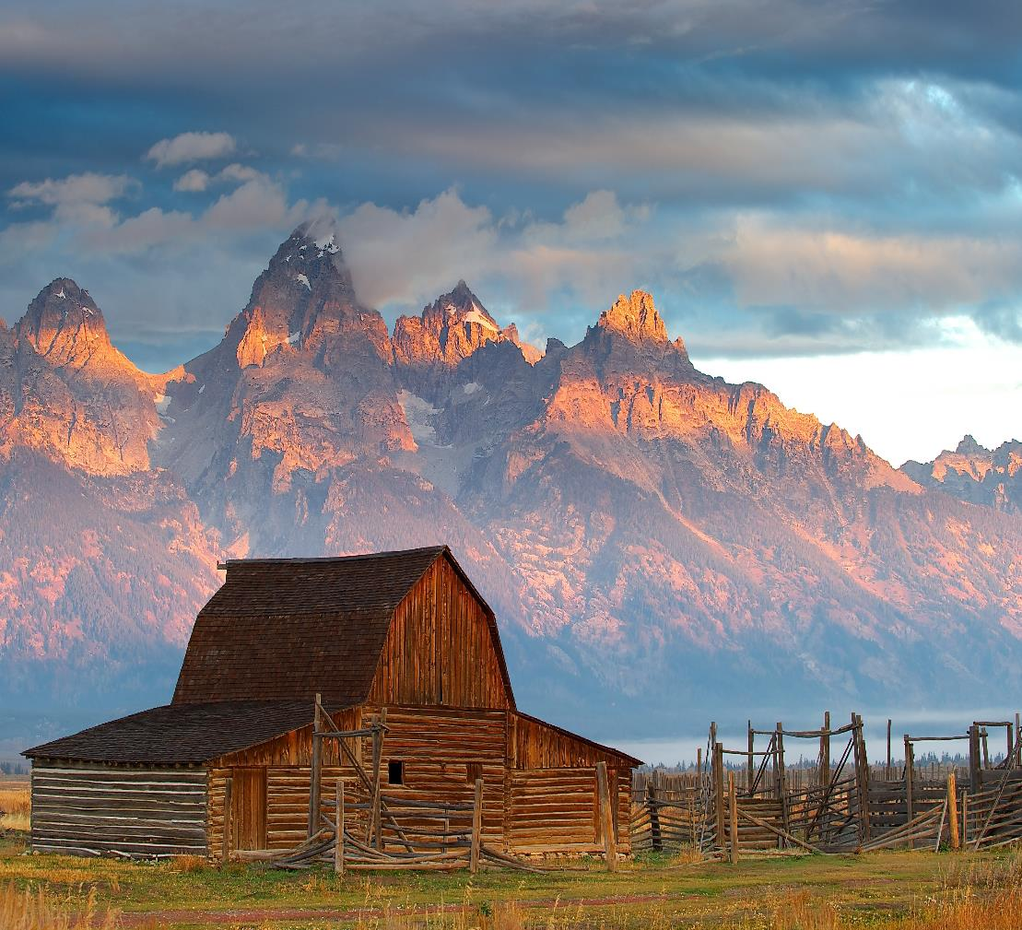
Vocabulary:
Stewardship - As Wyoming citizens, we are stewards entrusted with the responsible development, care, and use of our resources to benefit current and future generations.
This Photo by Unknown Author is licensed under CC BY-SA
Notes:
These are the new vocabulary words for this lesson. You may need to adjust this list according to the needs of your students.

Slide 4
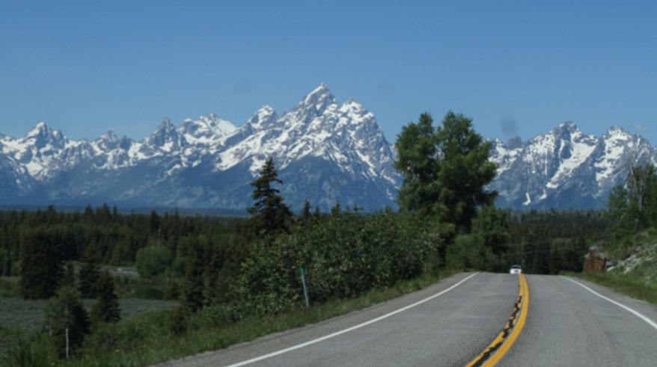
Highlights from our last lesson:
Think back on:
Yellowstone National Park
Types of terrains
Notes:
Look back on the previous lesson and review the key ideas.

Slide 5
Day 1
Photo courtesy of C. Jacobs

Slide 6
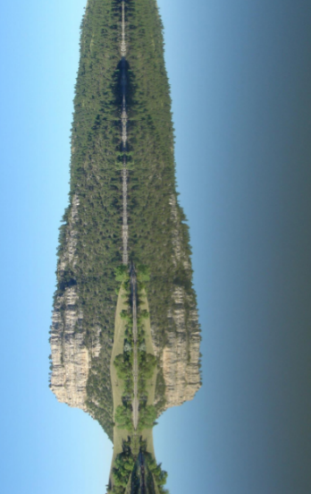
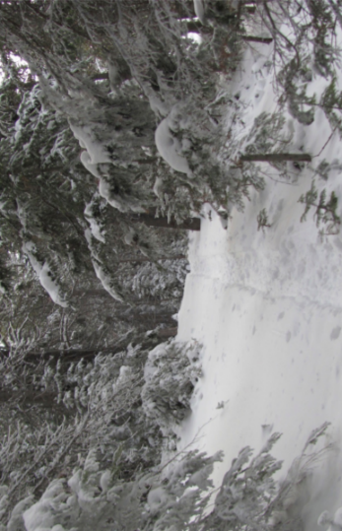
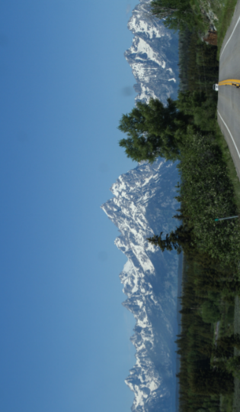
Terrain Photos
What are the rules and laws for using Wyoming lands?
Notes:
Day 1/Procedure #1

Slide 7
Park Signs Slideshow
These signs show the rules and laws that must be followed on public or private lands.
Why do you think these signs were posted?
Why are rules important?
Notes:
Day 1/Procedure #2
Slides 8-14 are from the PowerPoint. Use the lesson prompts to discuss each slide.

Slide 8
Park Signs
Notes:
Park Signs PowerPoint

Slide 9
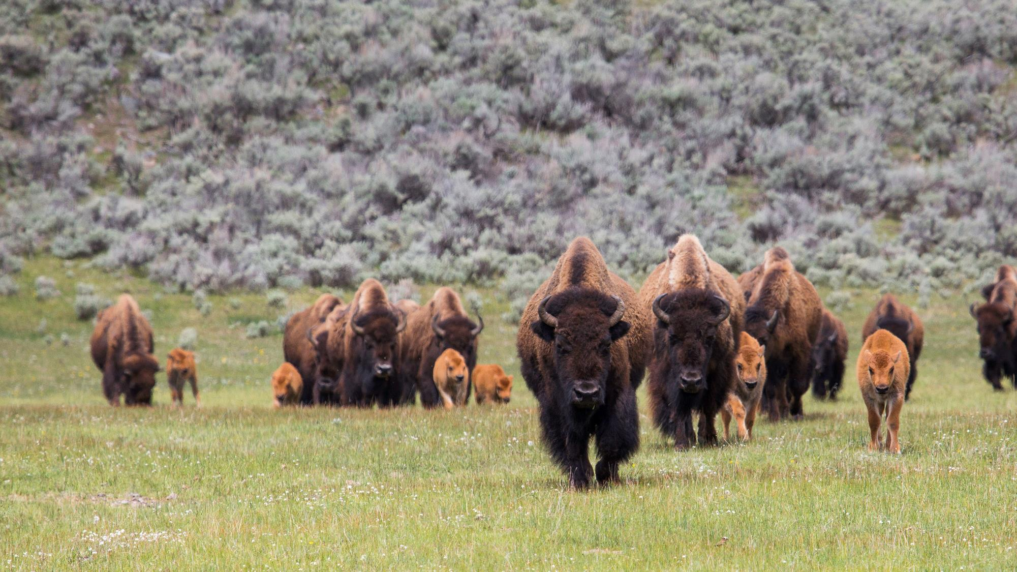
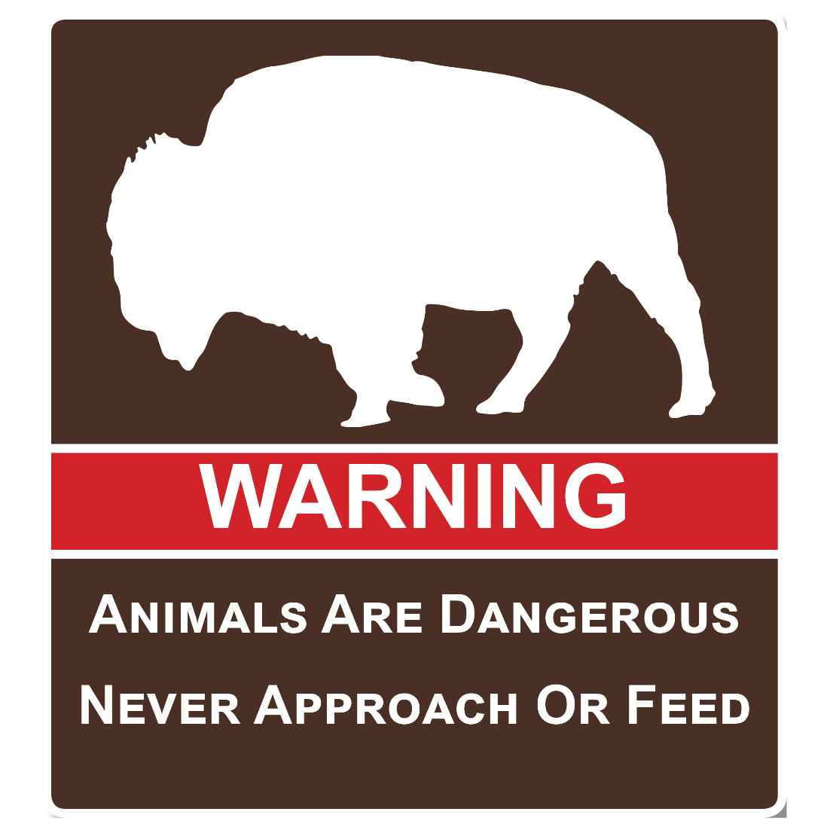

Slide 10
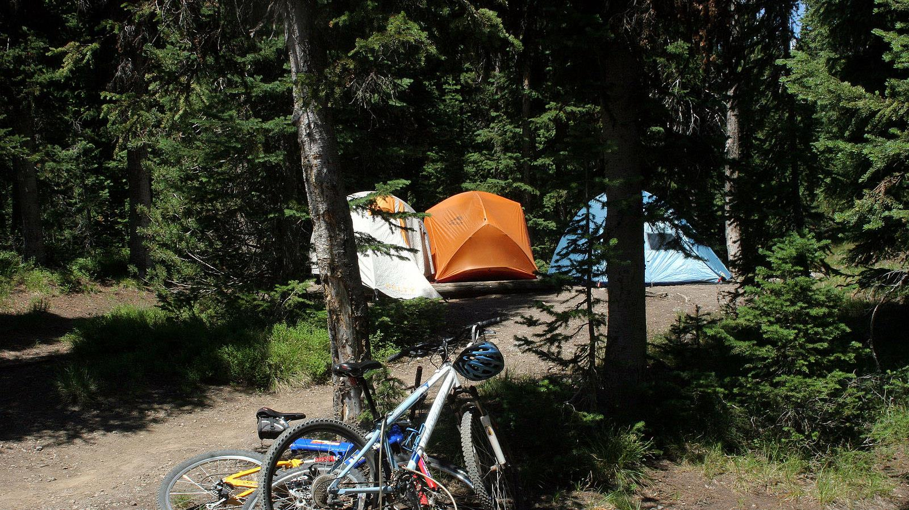
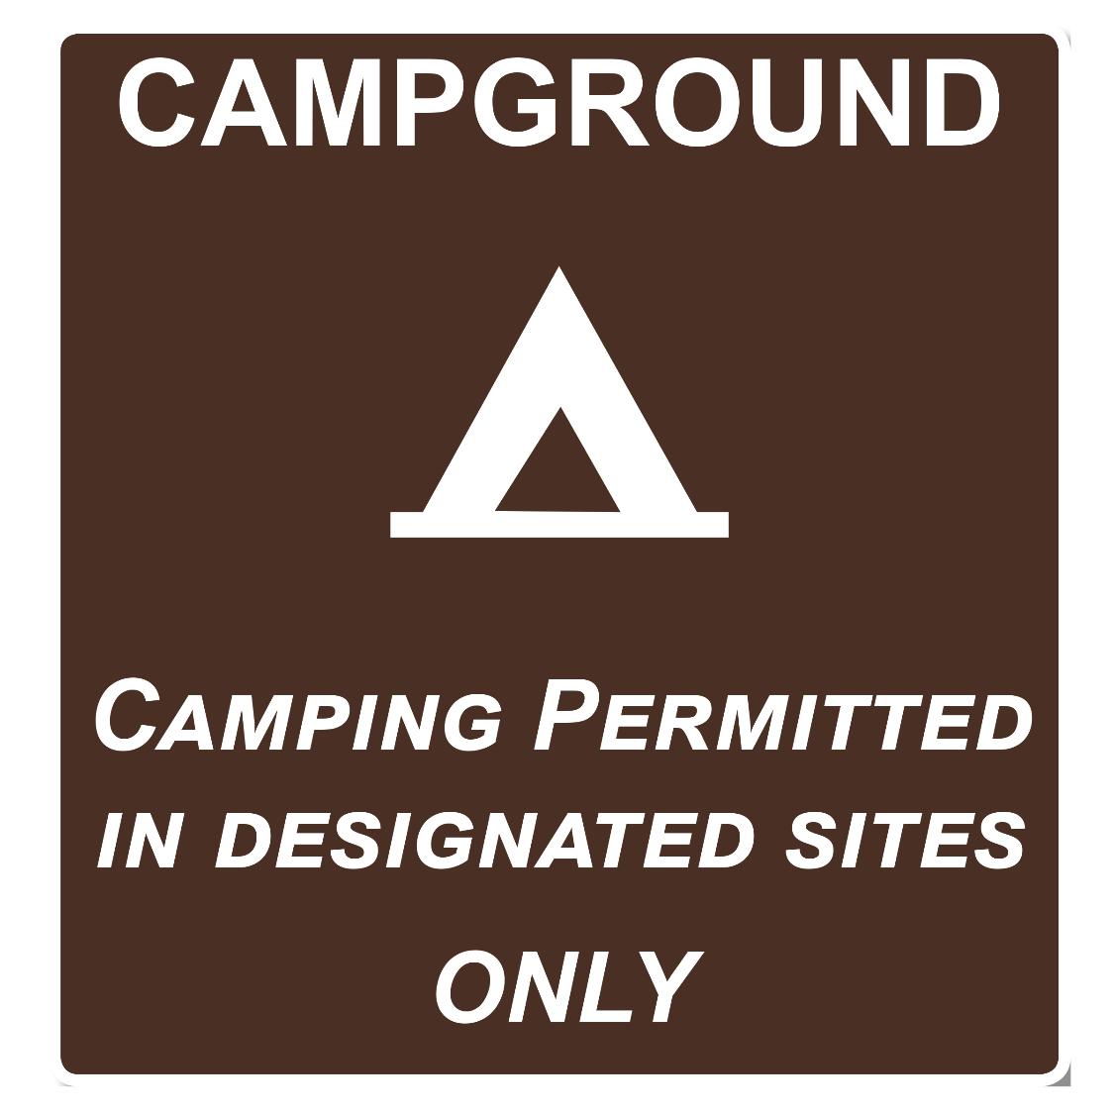

Slide 11
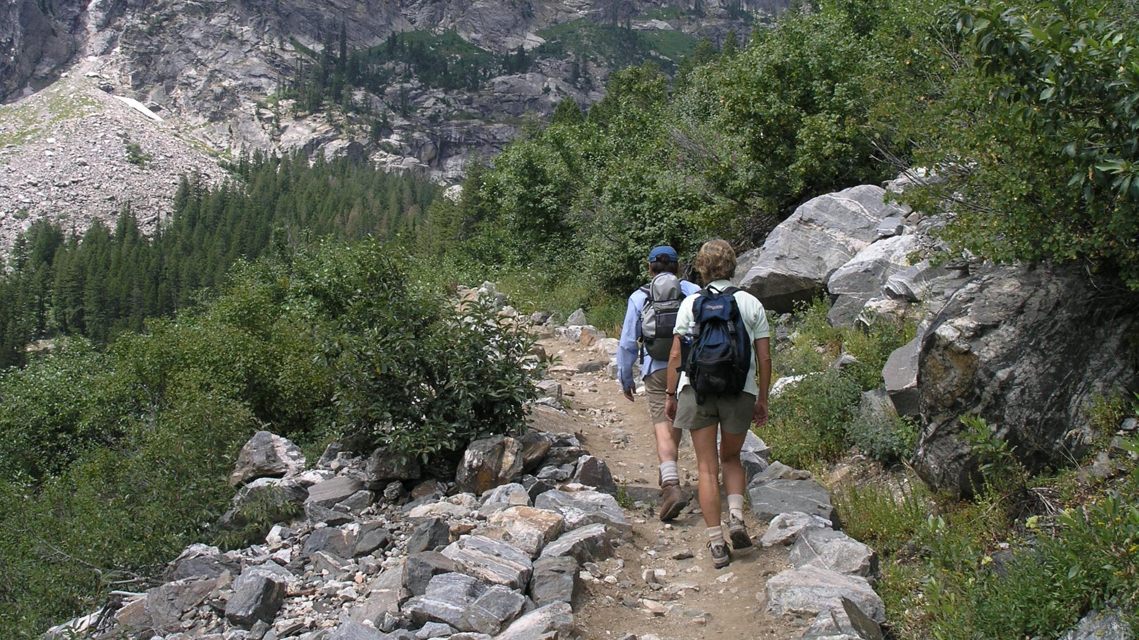

Slide 12
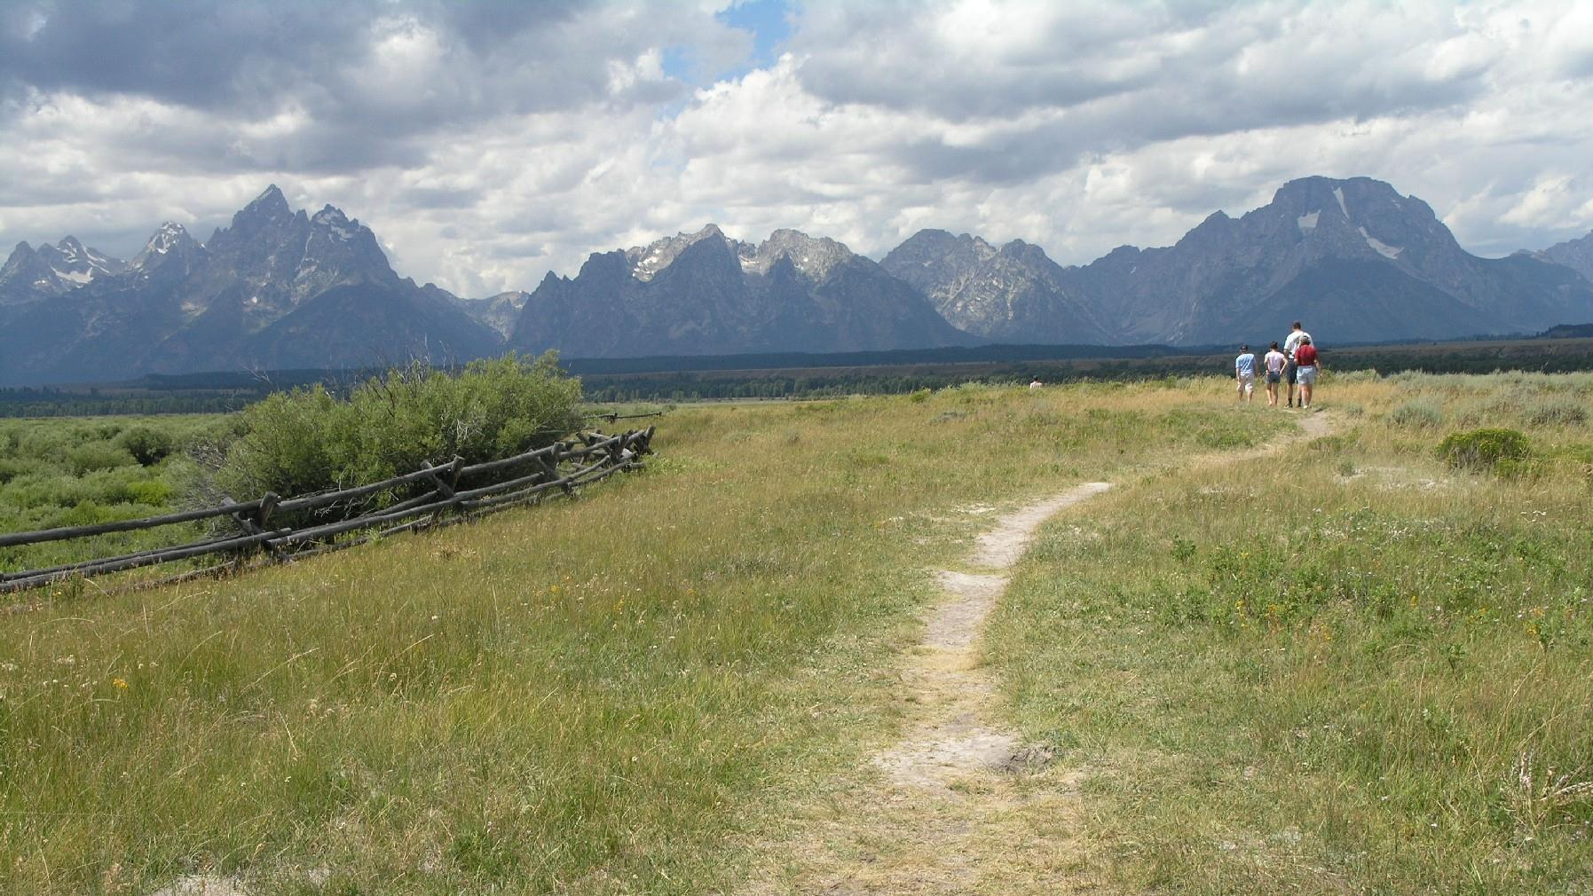

Slide 13
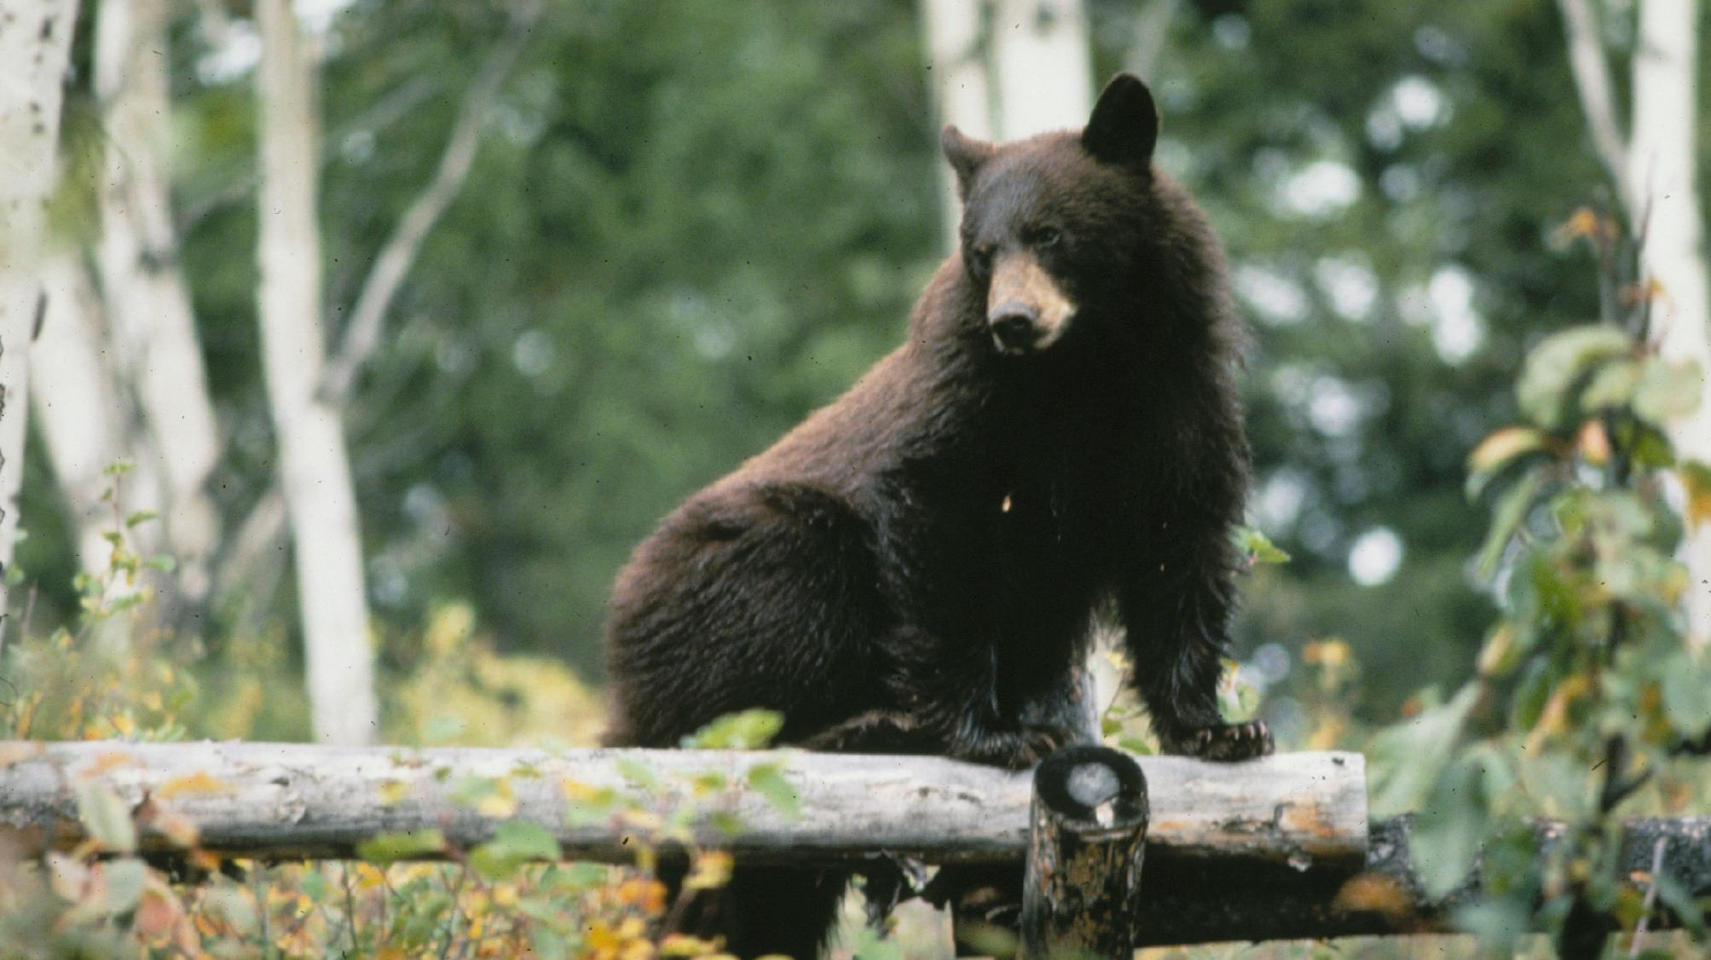

Slide 14
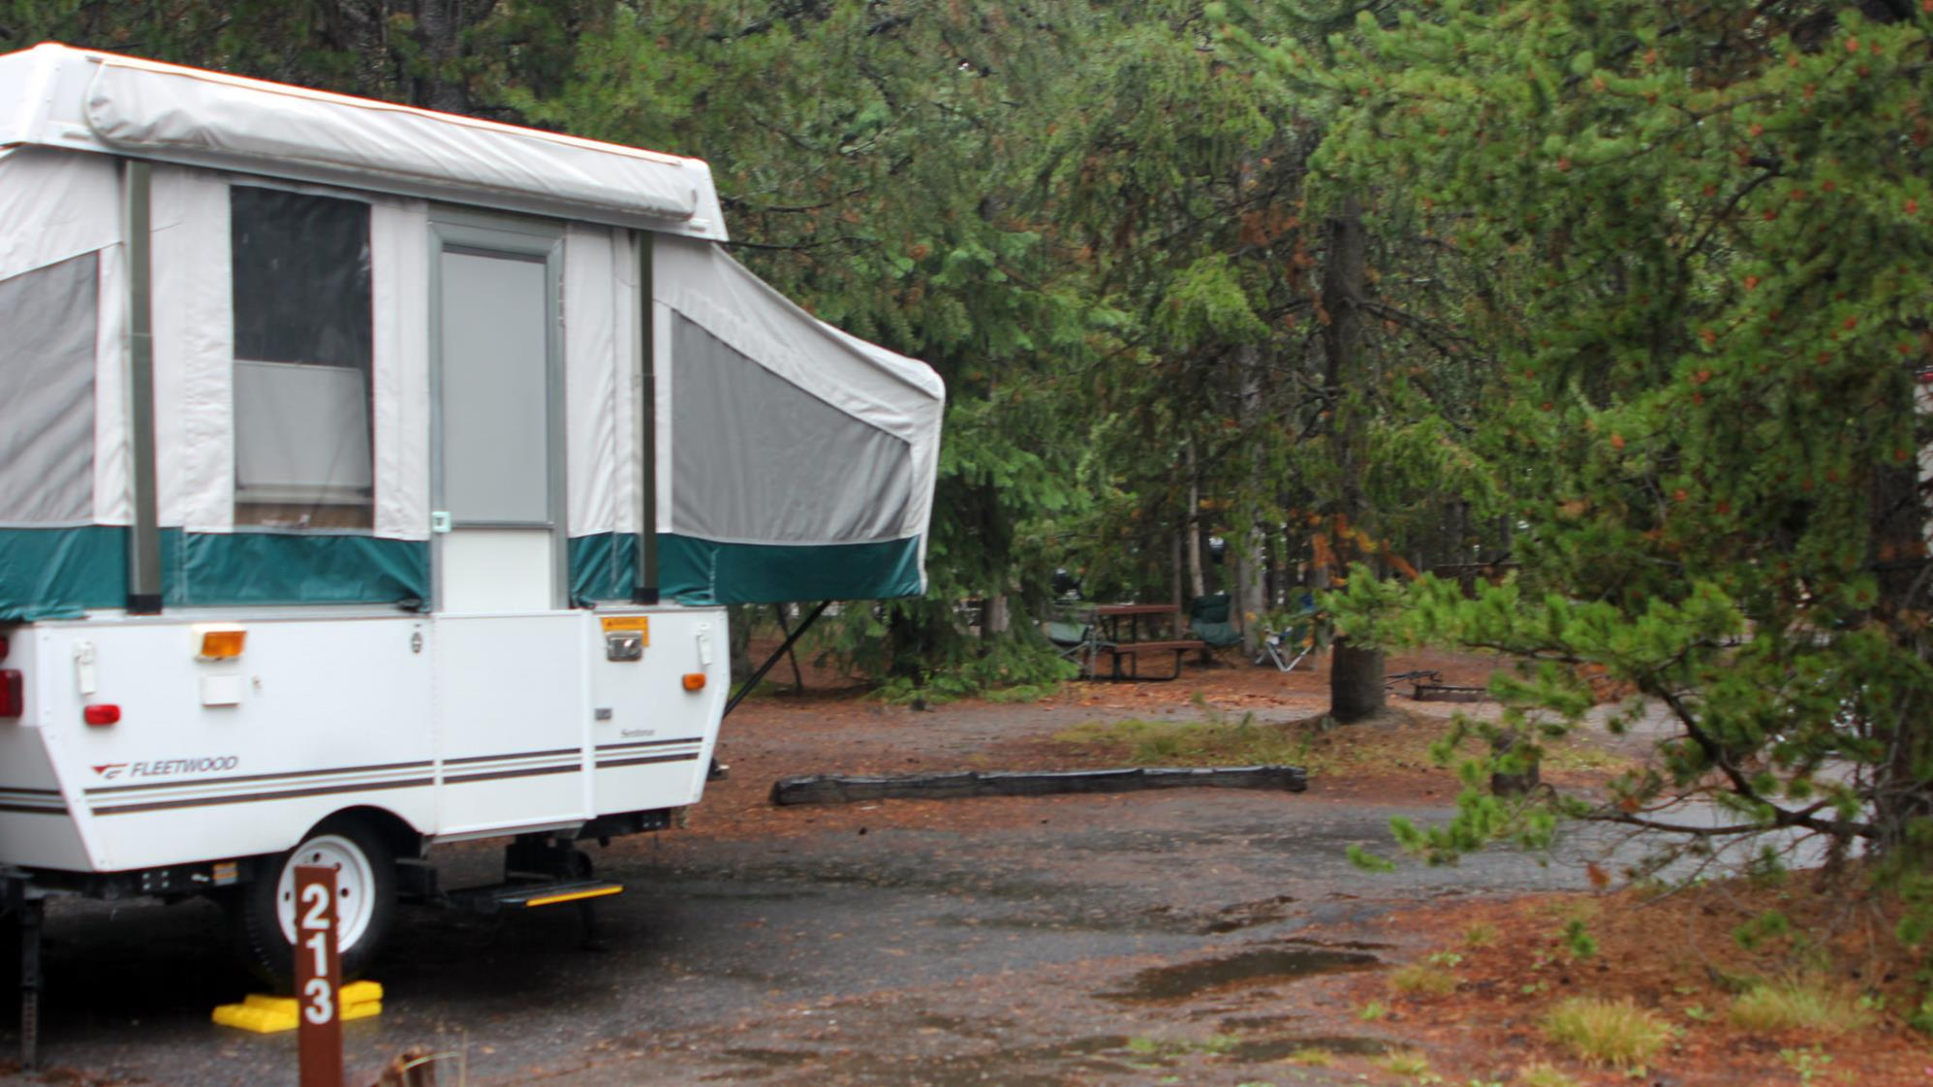

Slide 15
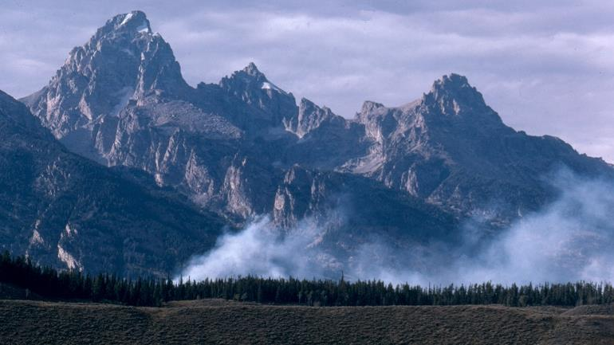

Slide 16
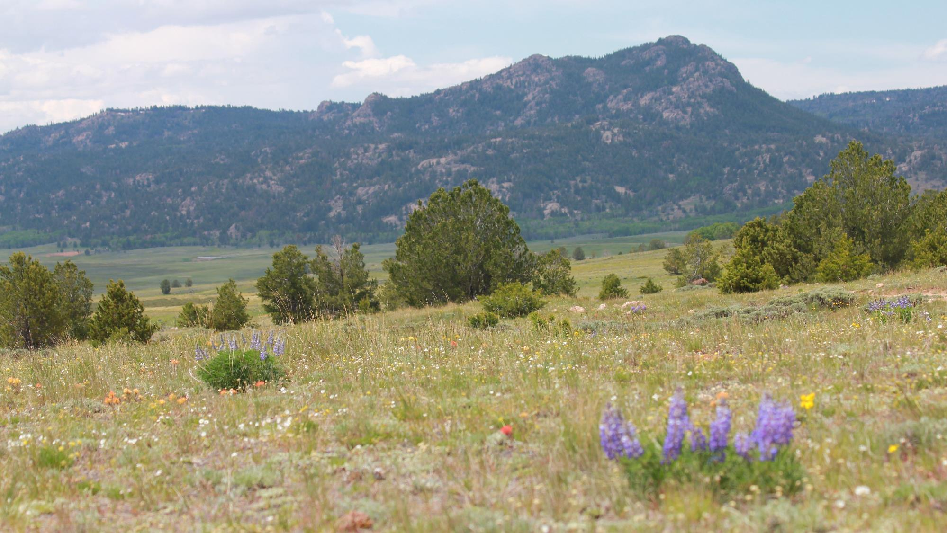
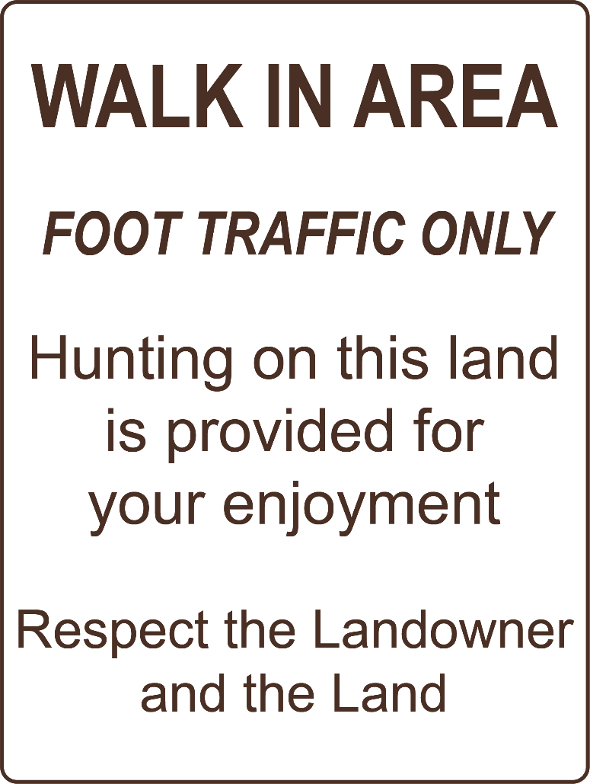

Slide 17
Why are rules important?
Notes:
Day 1/Procedure #2

Slide 18
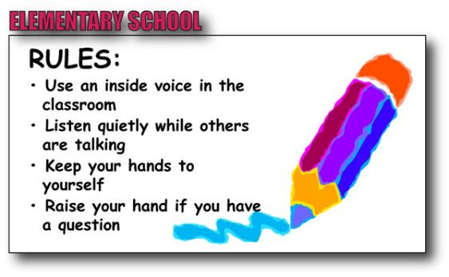
Design a Sign
This Photo by Unknown Author is licensed under CC BY-NC-ND
Notes:
Assessment Day #1
Students will create a sign that represents the rules and laws that need to be followed in their school community.

Slide 19
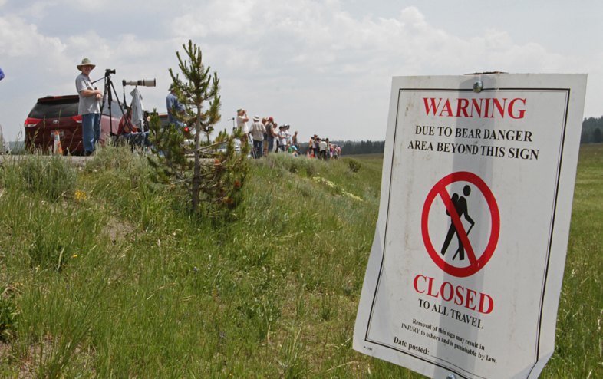
What did we learn from the today’s challenge?
Notes:
Provide the students an opportunity to explain their learning.

Slide 20
Day 2
Photo courtesy of C. Jacobs

Slide 21
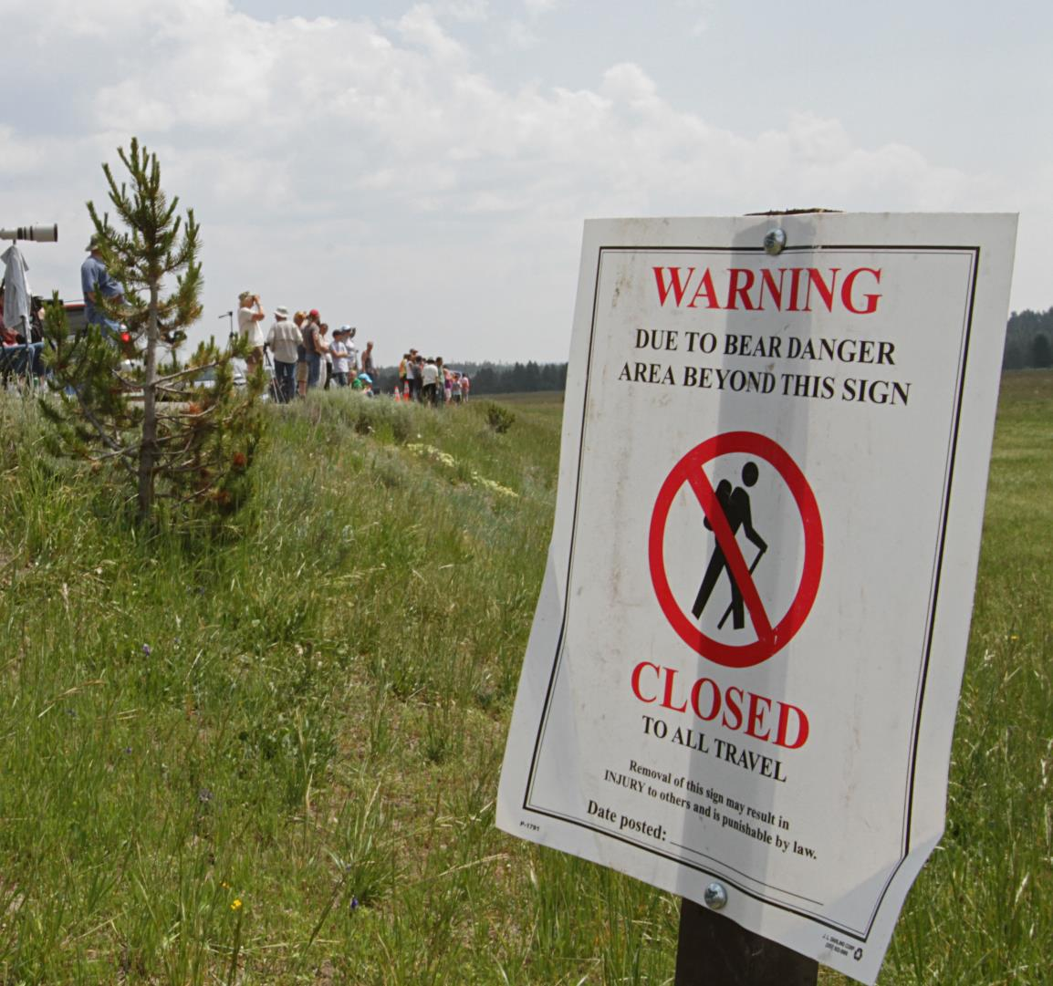
Highlights from our last lesson:
Think back on:
Signs
Why rules are important
Notes:
Day 2/Procedure #3: Look back on the previous lesson and review the key ideas.

Slide 22
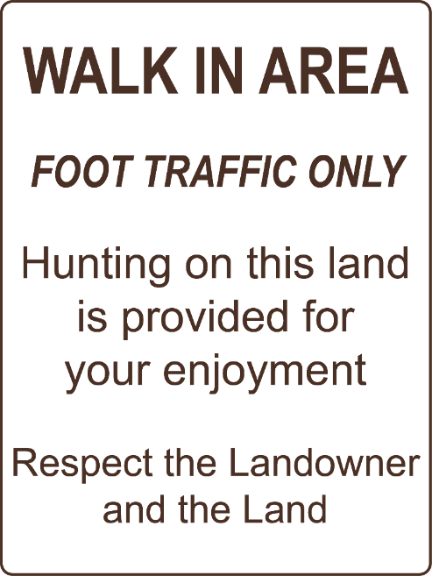
Rules help us be good stewards.
Notes:
Day 2/Procedure 3
Introduction to scenarios

Slide 23
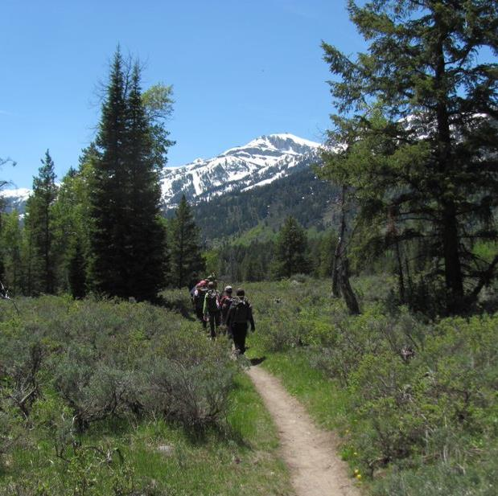
Stewardship Scenarios
Our space will be called our “public land.”
You will be in Group A or Group B.
You will play a role depending on your group.
Each scenario will be done twice.
We will compare the differences between how the scenarios turn out.
Notes:
Day 2/Procedure #3

Slide 24
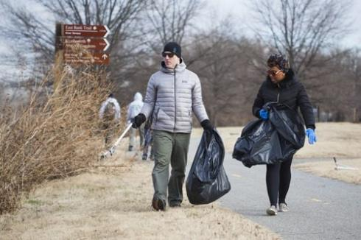
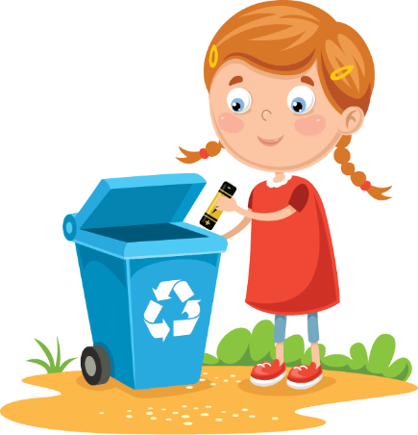
Scenario 1 – Don’t Litter
Group A: One student cleans the “public land” by picking up all the paper. Group B: All students drop their paper while walking around the “public land.”
How effective was the Group A student?
What challenge did the one student have?
What impact does this have on our public land?
Who was being the steward?
Who was not being a steward?
Notes:
Day 2/Procedure #3

Slide 25
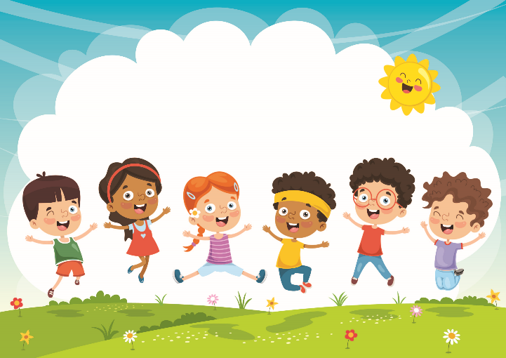
Scenario – Don’t Litter
Group A: Many students clean the “public land” by picking up the paper. Group B: 3 or 4 students drop their paper while walking around the “public land.”
How was the scenario different from when we did it the first time?
Who was being the steward?
What does this show you about being a steward?
It takes many people being stewards to keep our land clean.
Notes:
Day 2/Procedure #3

Slide 26
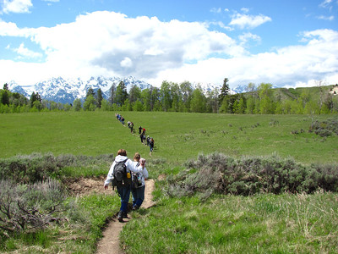
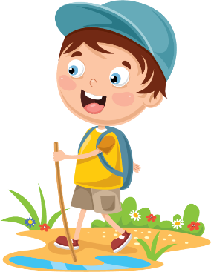
Scenario 2 – Use Trails
Group A: One student is in charge of keeping everyone on the path by tapping them on the shoulder. Group B: Everyone wanders off the path until they are tapped on the shoulder then they return to and stay on the path.
How effective was the Group A student?
What challenges did the one student have?
What impact does this have on our public lands?
Who was being the steward? Who was not being a steward?
Notes:
Day #2 Procedure #3
Students will complete the scenario several times, and then answer the discussion questions.

Slide 27
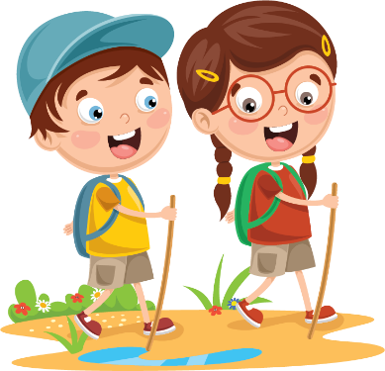
Scenario 2 – Use Trails
Group A: The group is in charge of keeping everyone on the path by tapping them on the shoulder. Group B: 3 or 4 students wander off the path until they are tapped on the shoulder then they return to and stay on the path.
How was the scenario different from when we did it the first time?
Who was being the steward?
What does this show you about being a steward?
It takes many people being stewards to limit the number of roads and trails across our public lands.
Notes:
Day #2 Procedure #3
Students will complete the scenario several times, and then answer the discussion questions.

Slide 28
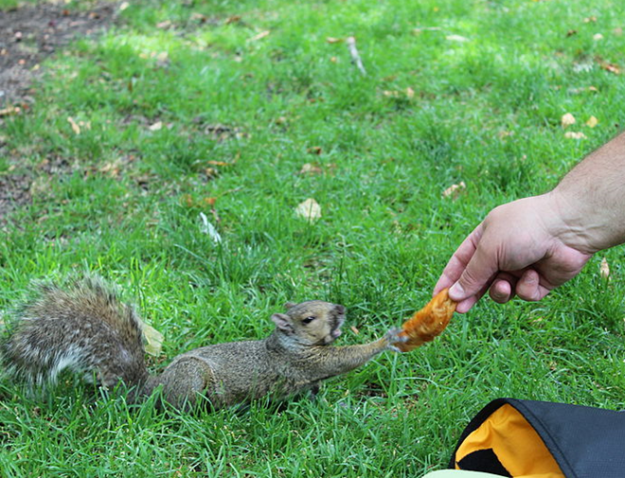
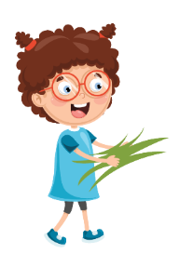
Scenario 3 – Don’t Feed the Animals
Group A: One student removes the “food” from in front of the animal and puts it into the “trash.” Group B: Everyone places “food” in front of different animals. If an animal has 3 food cards, it is “sick.”
This Photo by Unknown Author is licensed under CC BY-SA
How effective was the group A student?
What challenges did the one student have?
What impact does this have on our public lands?
Who was being the steward? Who was not being a steward?
Notes:
Day 2/Procedure #3: The cards for this scenario are in slides 30 and 31.

Slide 29
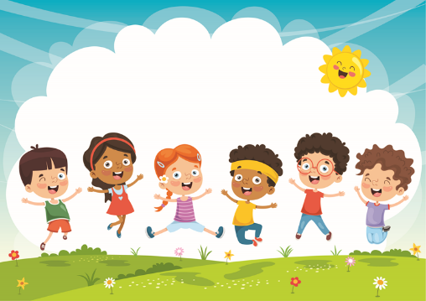
Scenario 3 – Don’t Feed the Animals
Group A: The group removes the “food” from in front of the animal and puts it into the “trash.” Group B: 3 or 4 students place “food” in front of different animals. If an animal has 3 food cards, it is “sick.”
How was the scenario different from when we did it the first time?
Who was being the steward?
What does this show you about being a steward?
Stewards do not feed wild animals because the animals will learn to rely on
human food instead of what they’re supposed to eat.
Notes:
Day 2/Procedure #3

Slide 30
What did we learn from the today’s challenge?
Notes:
Provide the students an opportunity to explain their learning.

