Slide 1
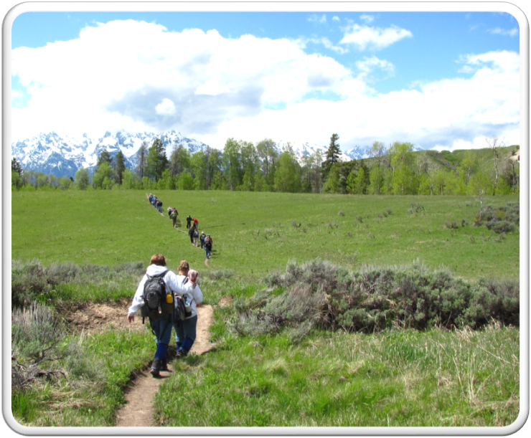
Outdoor Recreation & Tourism
2nd Grade
Lesson 6:
How to be a Steward?
Notes:
The name of the lesson is a link to the Wyoming Agriculture in the Classroom website where the lesson can be downloaded.

Slide 2
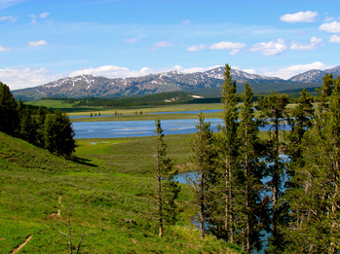
Challenge:
Day 3 and 4
Students will:
Identify what it takes to be a steward of Wyoming’s private and public lands.
Learn about professional jobs caring for Wyoming’s lands.
This Photo by Unknown Author is licensed under CC BY-SA
Notes:
This is the focus of today’s lesson.

Slide 3
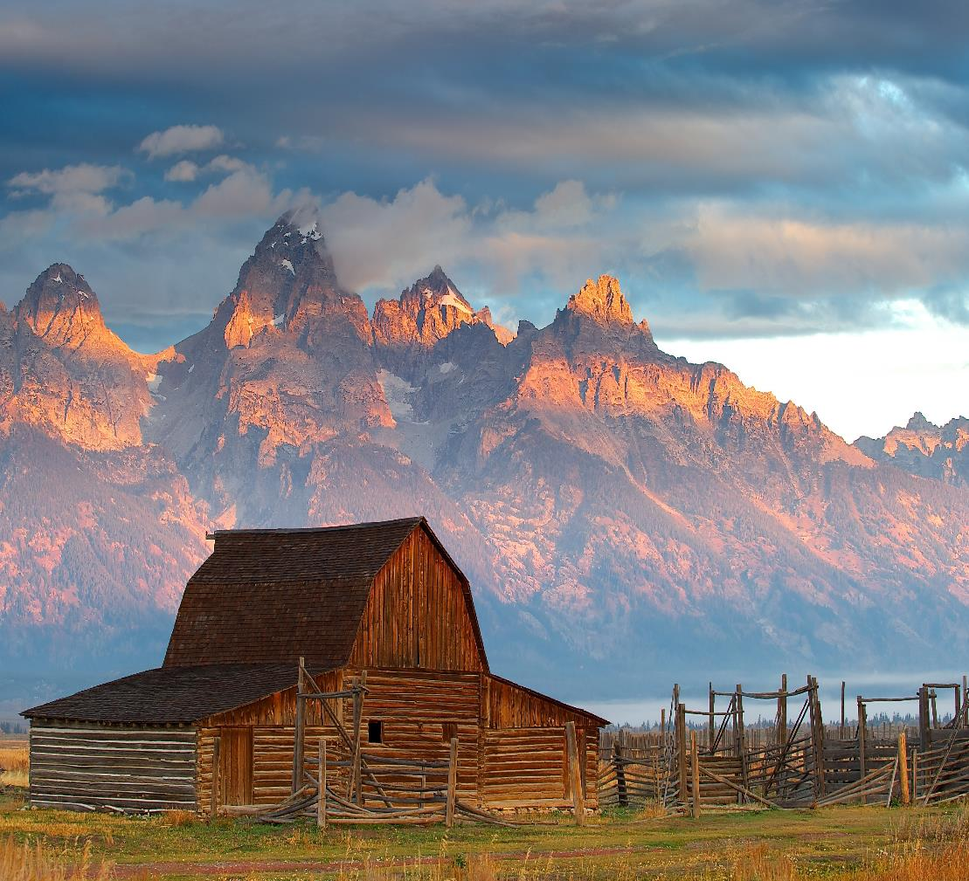
Vocabulary:
Stewardship - As Wyoming citizens, we are stewards entrusted with the responsible development, care, and use of our resources to benefit current and future generations.
This Photo by Unknown Author is licensed under CC BY-SA
Notes:
These are the new vocabulary words for this lesson. You may need to adjust this list according to the needs of your students.

Slide 4
Day 3
Photo courtesy of C. Jacobs

Slide 5
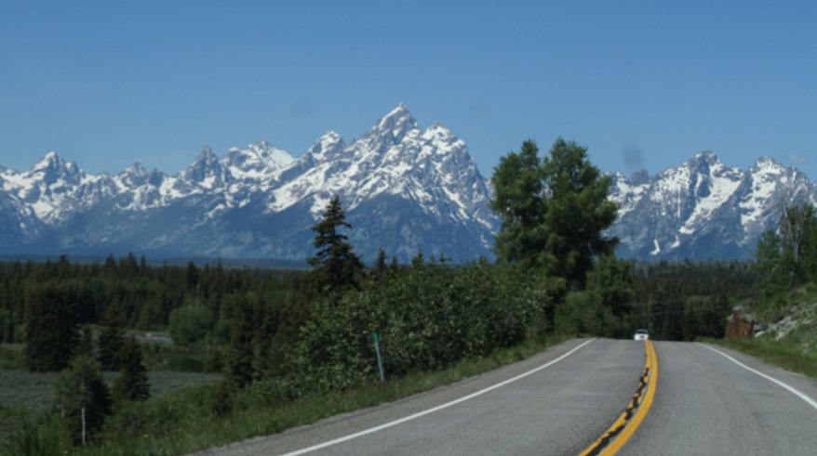
Highlights from our last lesson:
Think back on:
Stewards of our public lands
Notes:
Look back on the previous lesson and review the key ideas.

Slide 6
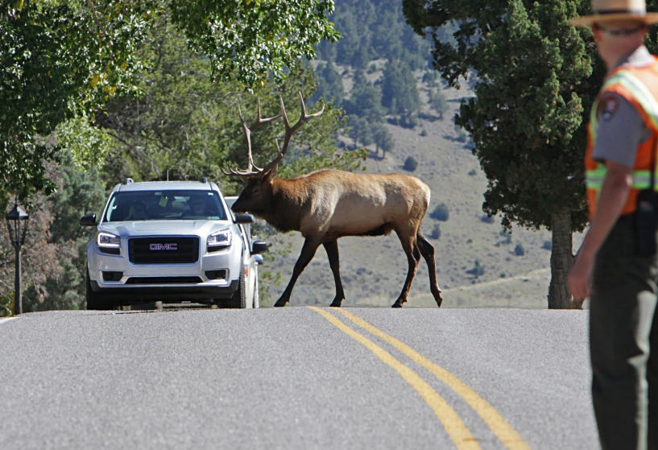
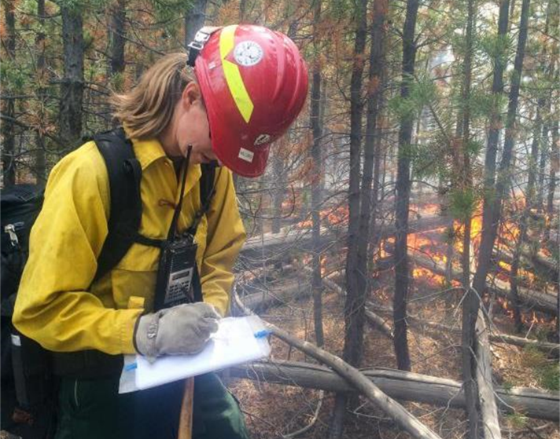
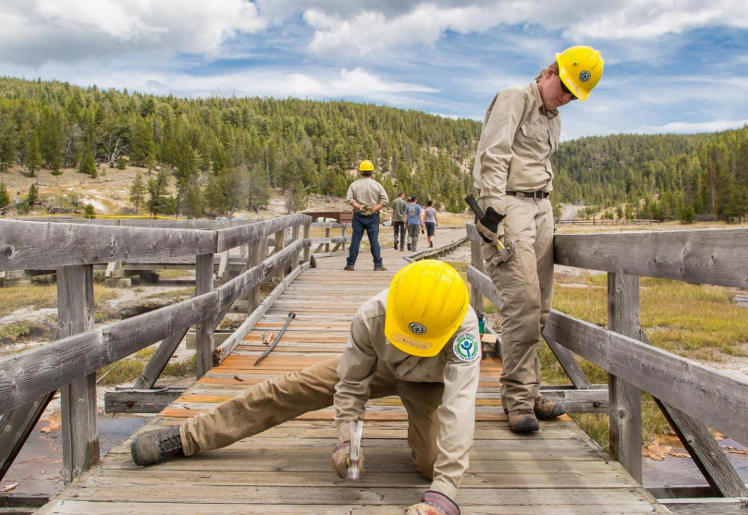
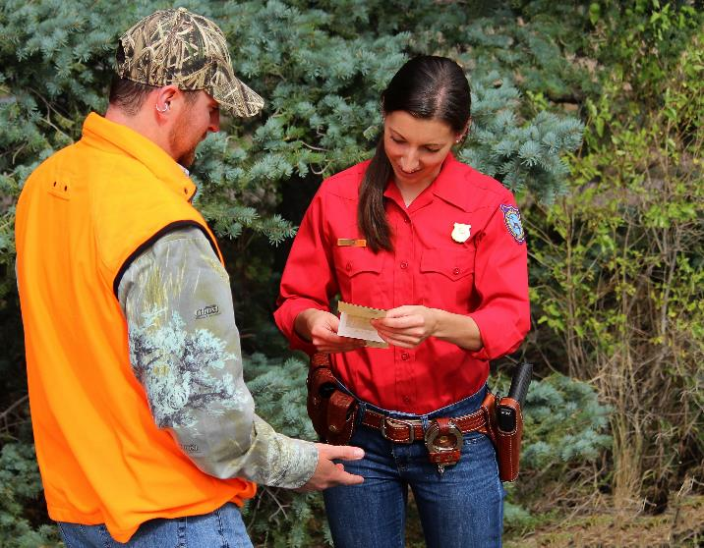
Examples of stewardship through professional jobs.
Notes:
Day #3/Procedure #4
Students will watch the Power Point while being provided the information about this professional’s job duties. These are included in this slideshow. The link will take you to the lesson page, where you can also download an original copy of the PowerPoint.

Slide 7
Careers on Public Lands

Slide 8
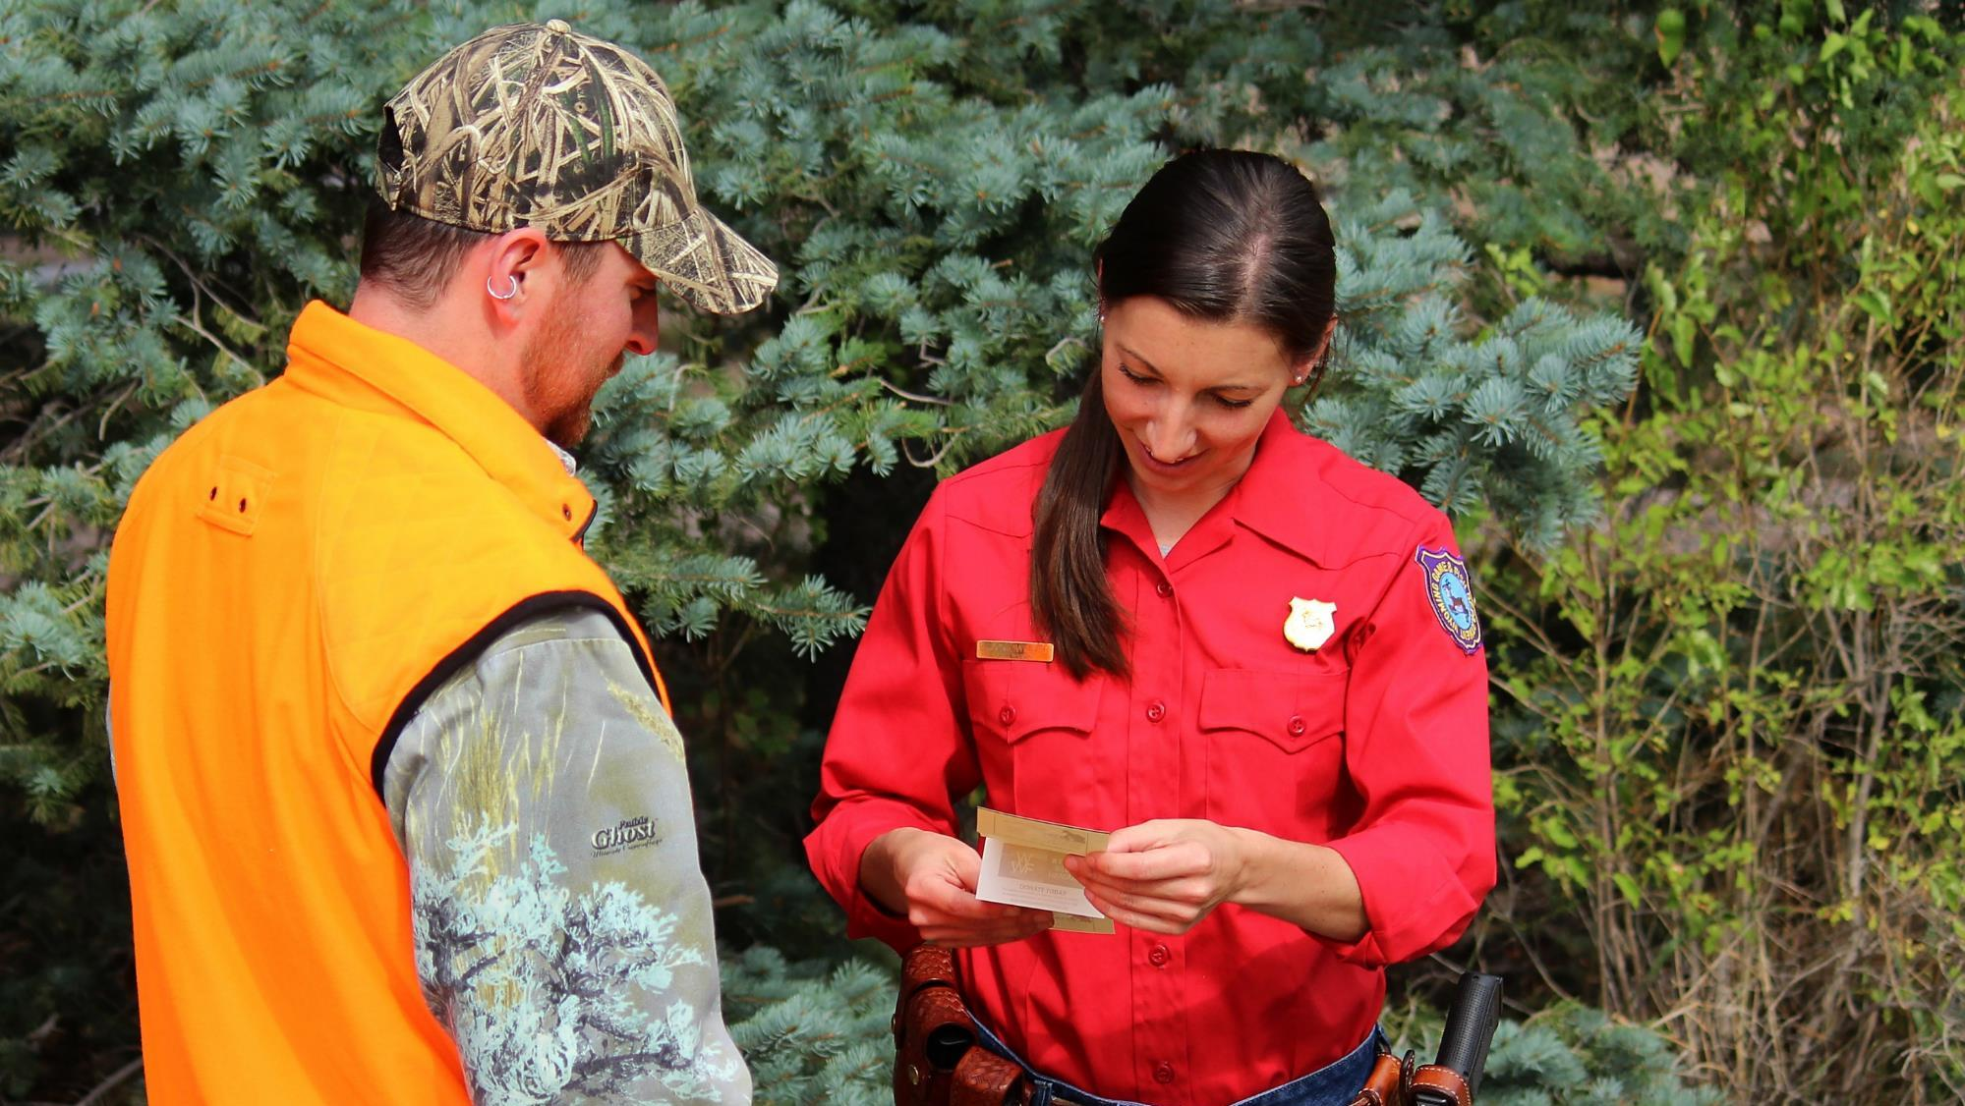
Game Warden
Photo courtesy of Wyoming Game and Fish

Slide 9
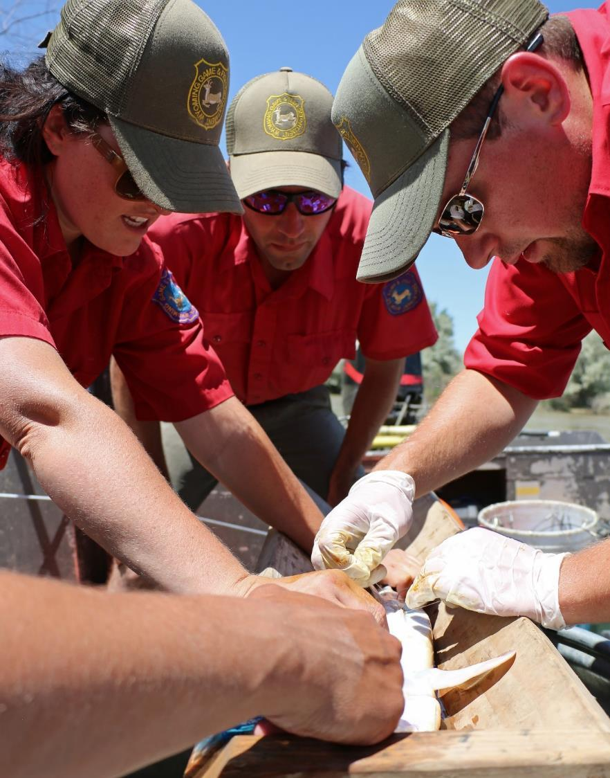
Wildlife/Aquatic Biologist
Photo courtesy of Wyoming Game and Fish

Slide 10
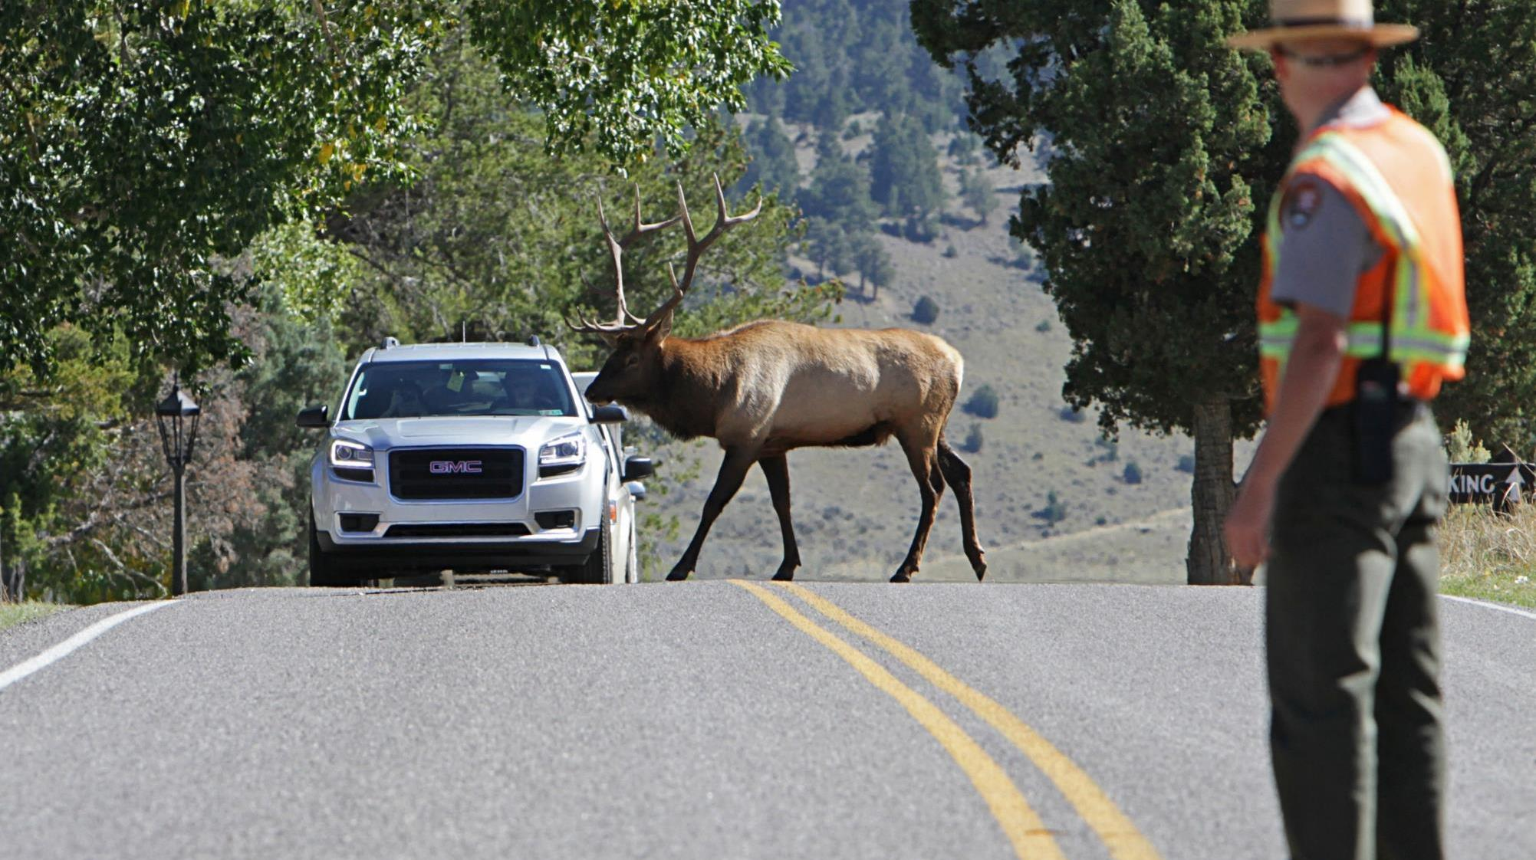
Park Ranger
Photo courtesy of National Park Service

Slide 11
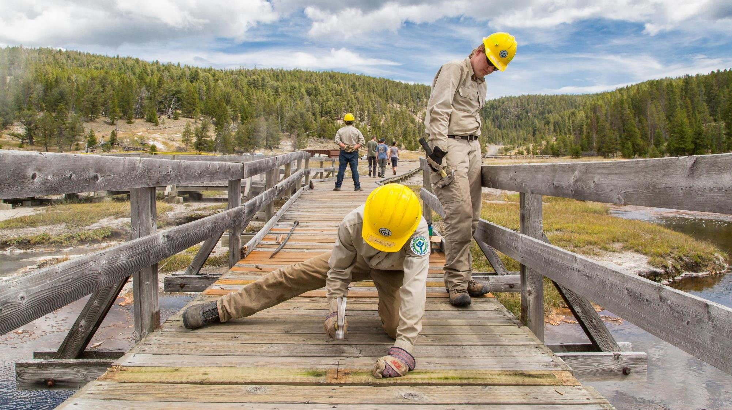
Maintenance Worker
Photo courtesy of National Park Service

Slide 12
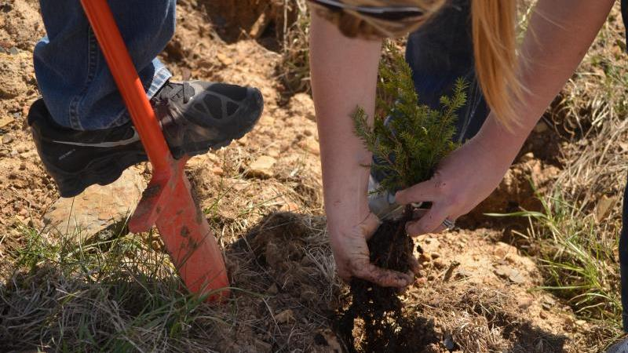
Forester
Photo courtesy of National Park Service

Slide 13
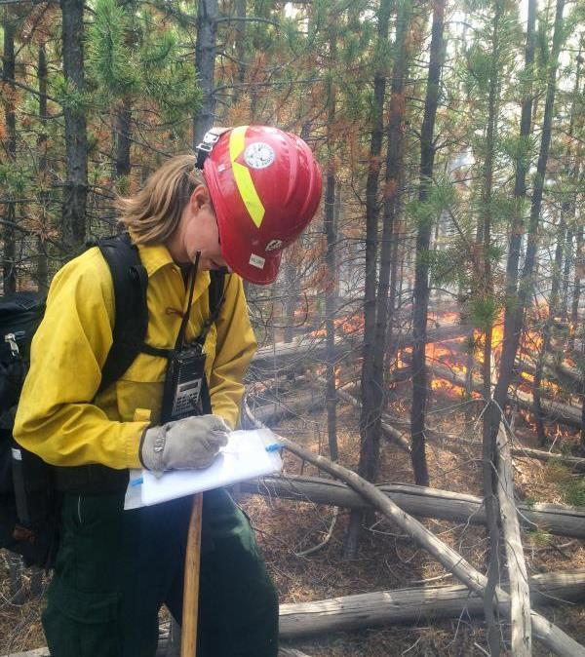
Wildland Firefighter

Slide 14
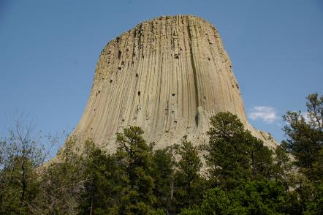
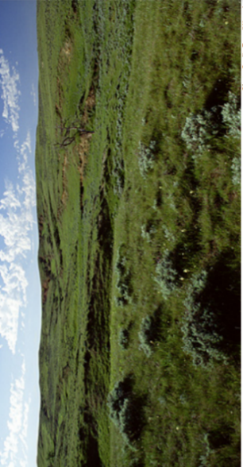
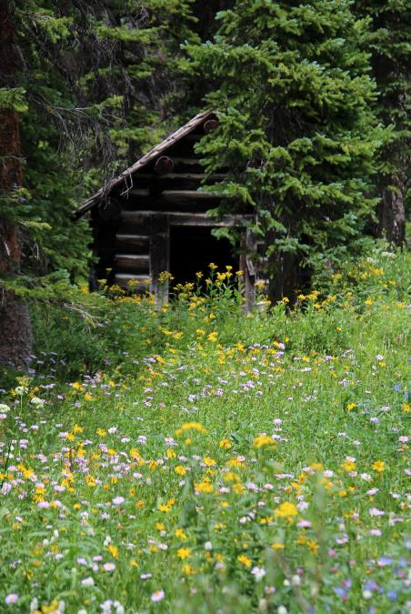
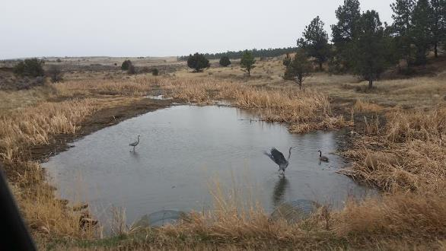
Where do these people work?
Wyoming has:
12 State Parks
2 National Parks
5 National Forests
1 National Grassland
Wyoming State Parks website
Notes:
Day 3/Procedure #5

Slide 15
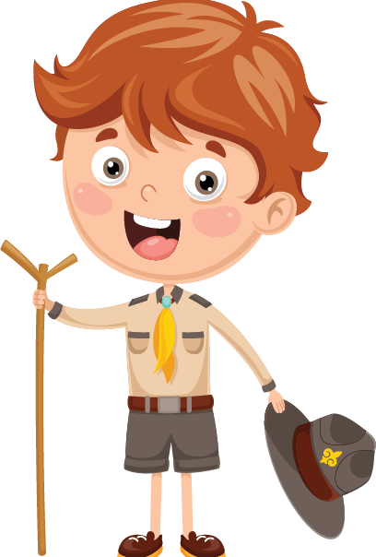
Discussion Questions
How is the land in the park being used?
Do you see signs of stewardship?
Who is responsible for the stewardship?
What could happen if we don’t take care of this land?
Notes:
Day #3/Procedure #5
Students will provide answers to the posted questions to explain their thinking.

Slide 16
What did we learn from today’s challenge?
Notes:
Provide the students an opportunity to explain their learning.

Slide 17
Day 4
Photo courtesy of C. Jacobs

Slide 18
Highlights from our last lesson:
Think back on:
Jobs and stewardship
Notes:
Look back on the previous lesson and review the key ideas.

Slide 19
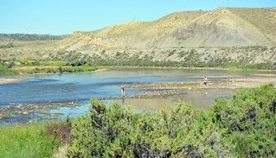
Illustrate a picture or write a scenario of an
individual not being a good steward on public land.
This Photo by Unknown Author is licensed under CC BY
Notes:
Day #4 procedure #6 & #7

Slide 20
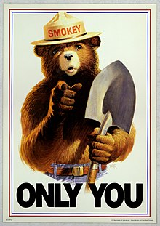
How can we teach and remind users of public and private lands to be stewards?
Smokey Bear
Play Clean Go
Tread Lightly
Fishing and Boating
This Photo by Unknown Author is licensed under CC BY-SA
Notes:
Day 4/Procedure #7:
Optional activity

Slide 21
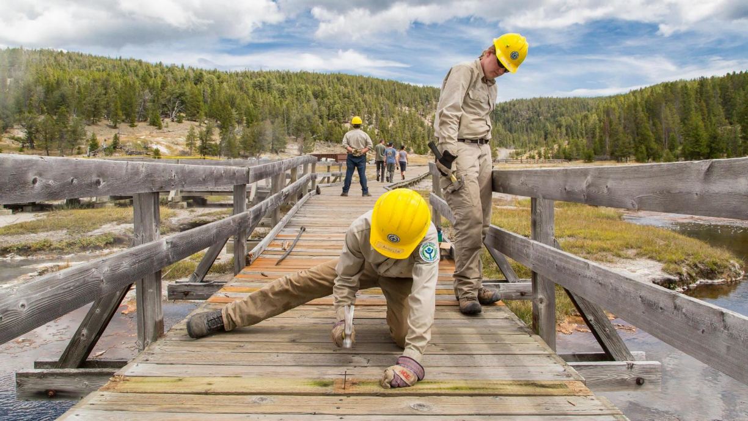
What did we learn from today’s challenge?
Notes:
Provide the students an opportunity to explain their learning.

