Slide 1
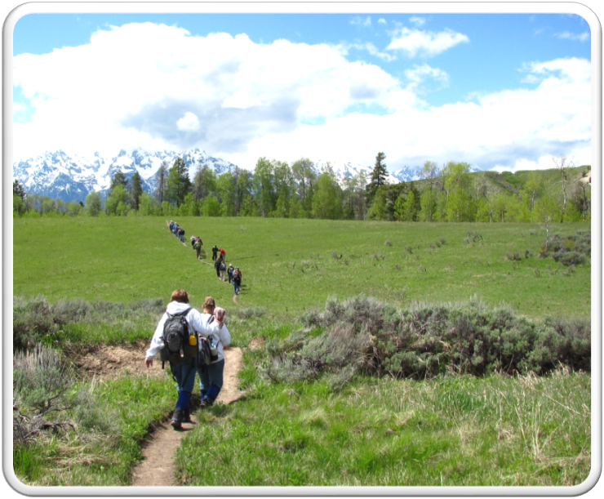
Outdoor Recreation & Tourism
2nd Grade
Lesson 8:
Discovering Wyoming’s State Parks
Notes:
The name of the lesson is a link to the Wyoming Agriculture in the Classroom website where the lesson can be downloaded.

Slide 2
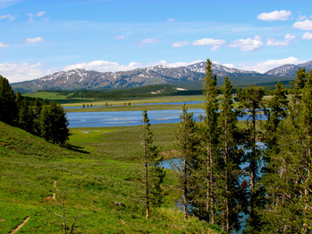
Today’s Challenge:
Students will:
Demonstrate how well they can identify Wyoming’s unique terrain, its multiple uses, the importance of caring for it, and how to be a steward of it.
This Photo by Unknown Author is licensed under CC BY-SA
Notes:
This is the focus of today’s lesson.

Slide 3
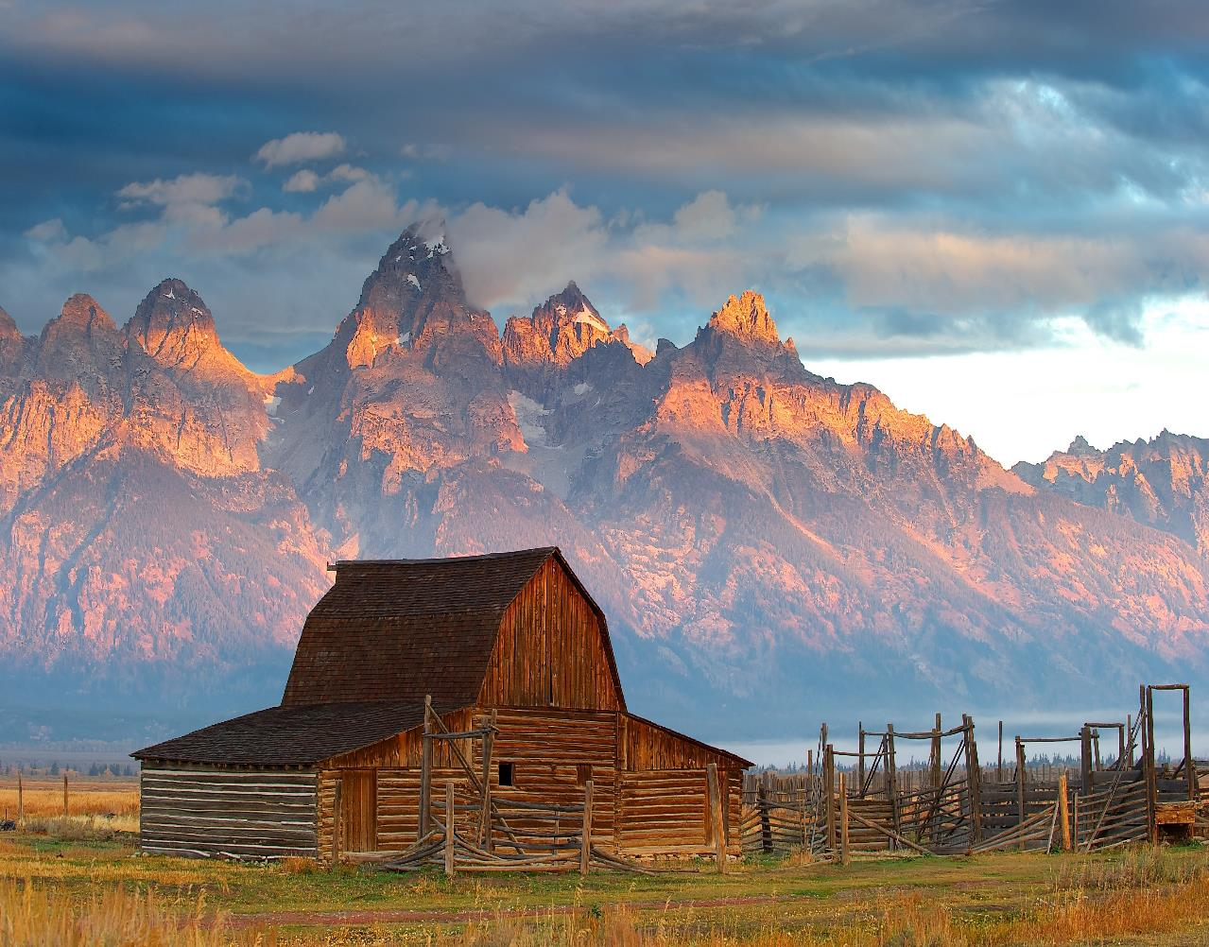
Vocabulary:
Stewardship - As Wyoming citizens, we are stewards entrusted with the responsible development, care, and use of our resources to benefit current and future generations.
This Photo by Unknown Author is licensed under CC BY-SA
Notes:
These are the new vocabulary words for this lesson. You may need to adjust this list according to the needs of your students.

Slide 4
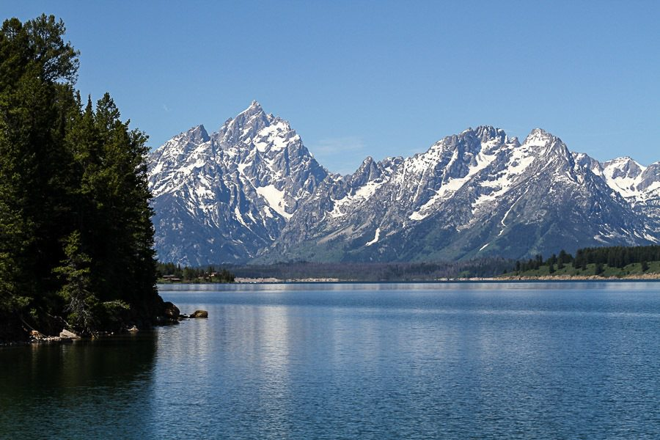
Highlights from our last lesson:
Think back on:
The way individuals use the land
Tourism in Wyoming
Notes:
Look back on the previous lesson and review the key ideas.

Slide 5
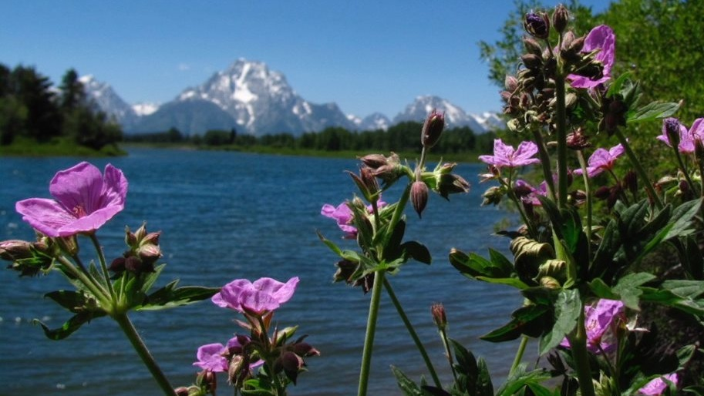
Day One
Notes:
Day #1 Procedure #1
This will be a two-step day taking approximately 30 minutes.

Slide 6
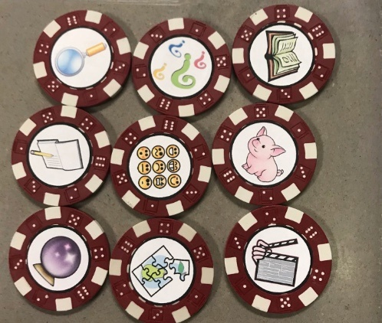
Talking Chips Game
This Photo by Unknown Author is licensed under CC BY-NC
Notes:
Day #1 Procedure #1

Slide 7
Talking Chip Game Rules:
Each person gets 3 chips to start.
There will be 5 rounds.
You can only answer if you have a chip to put in the pile.
By the end of the rounds, all your chips must be used.
If you run out of chips, you cannot answer so that everyone can have a chance.
If everyone runs out of chips, you can take your chips back and keep going if needed.

Slide 8
Discussion Questions
Round 1: What are some different types of terrain found in Wyoming?
Round 2: What are some activities or uses for lands in Wyoming?
Round 3: What are some rules or ways to care for our lands in Wyoming?
Round 4: How can we be stewards of Wyoming’s lands by following established rules and laws in those areas?
Round 5: What is a job you might like to have that would help people who visit Wyoming?
Notes:
Day #1 Procedure #1

Slide 9
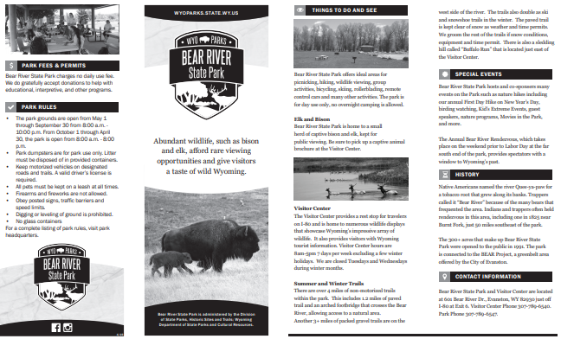
Wyoming State Park
Choose a State Park from the list.
What is the terrain of this park?
What activities are available at this park?
How do we know how to care for this park?
Why is this brochure important for visitors of the park?
Credit to: https://wyoparks.wyo.gov/
Notes:
Day #1 Procedure #2: To view the brochure on the website you will have to choose a park, then you will find the green box with the brochure (to be downloaded) in the green box. It is not on the main page of the website.

Slide 10
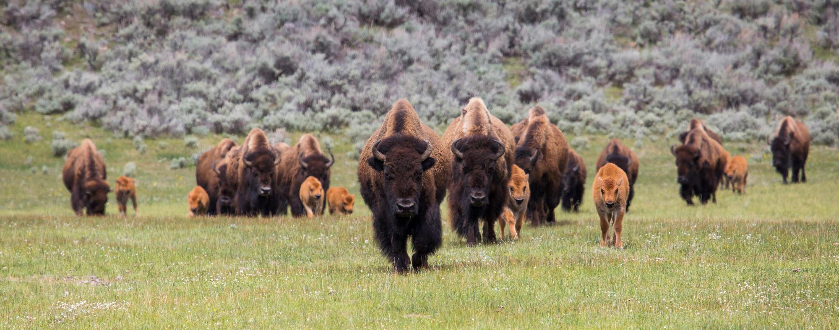
Day Two

Slide 11
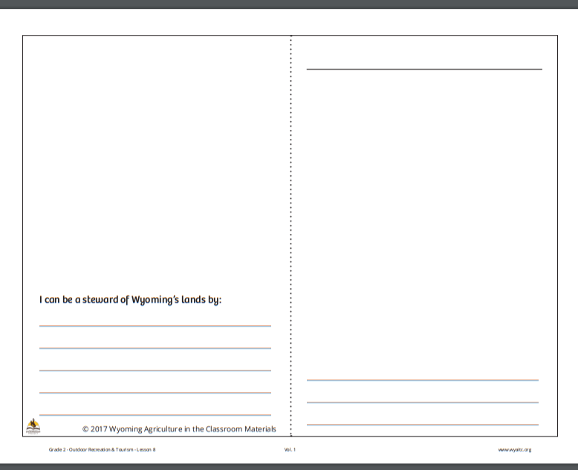
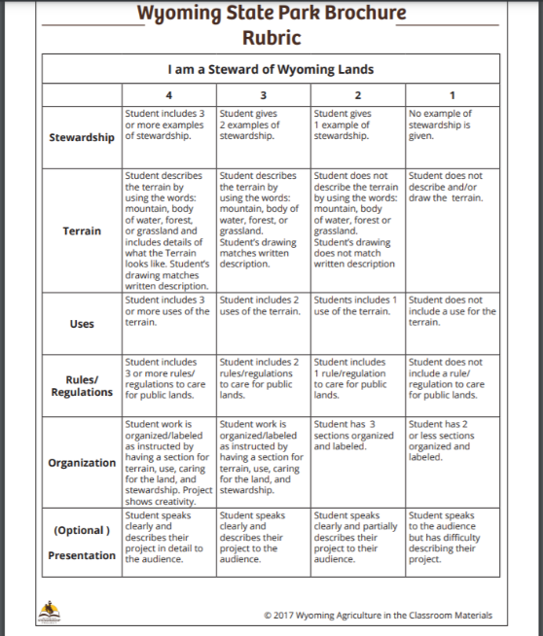
Brochure
Creating Our Stewardship Brochure
Notes:
Day #2 Procedure #3
Provide students with instructions on the expectations for the park brochure. What are the items that they should include in their brochure?

Slide 12
Our Word Bank
Notes:
Day 2/Procedure #3: This table allows you to create a word bank for the students to use.

Slide 13
Our Stewardship Brochure It must:
Include at least two examples of stewardship.
Name the terrain (mountain, water, forest, grassland).
Describe what the terrain looks like.
Include a drawing of the area.
Include at least two uses of the terrain.
Include at least two rules/regulations describing how to care for public lands.
Have all sections labeled and organized.

Slide 14
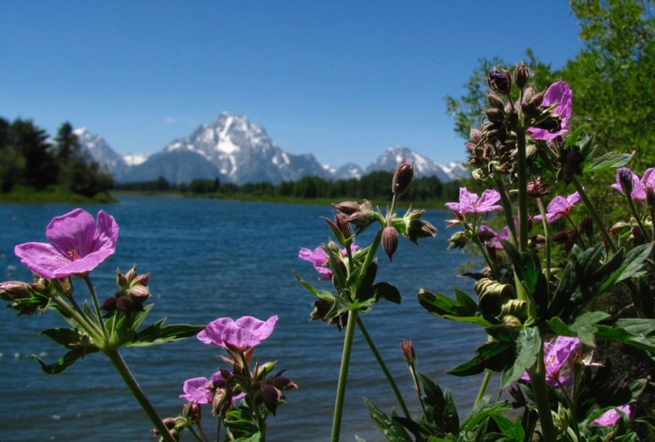
Day Three and Day Four

Slide 15
Completing Research and Brochure
This Photo by Unknown Author is licensed under CC BY-SA
Notes:
Day #3 Procedure #4
Students will complete research and design a brochure.

Slide 16
Final Product
Notes:
Day #3 & #4/Procedure #4
Students will be researching over several days and creating a final product to present to the class.

Slide 17
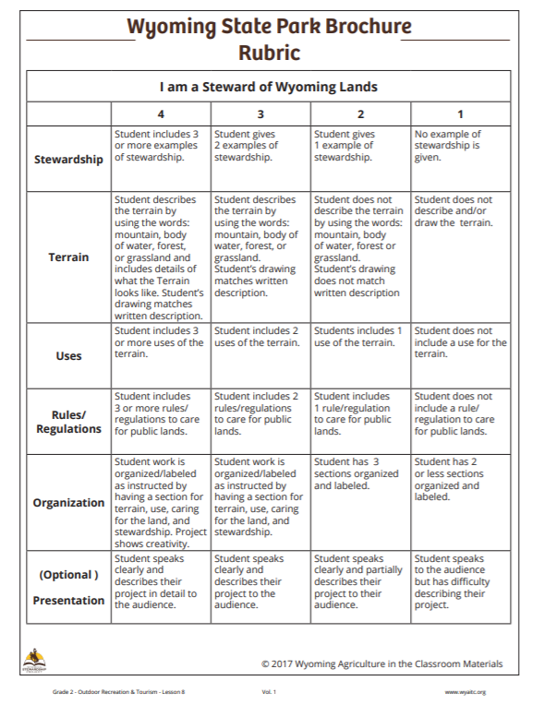
Notes:
Assessment
Students will be scored on the rubric

Slide 18
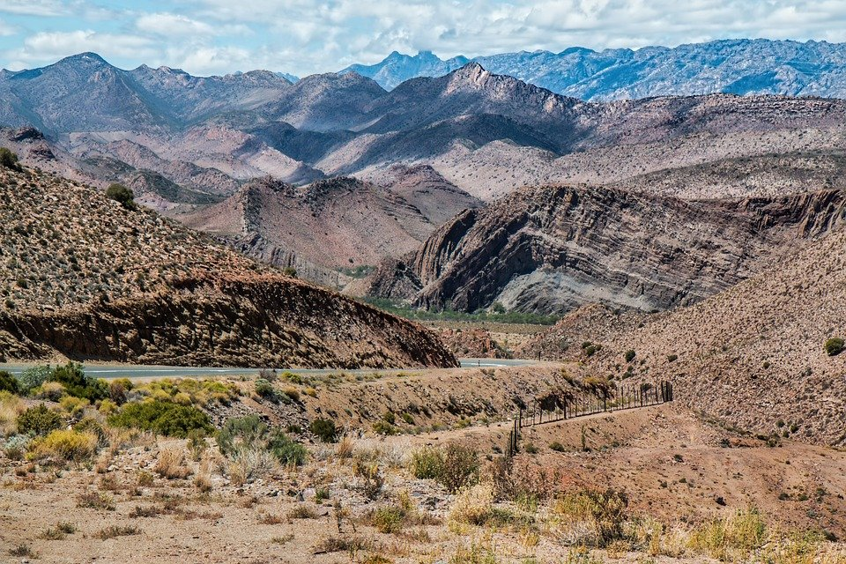
What did we learn from today’s challenge?
This Photo by Unknown Author is licensed under CC BY-SA
Notes:
Procedure #6: Provide the students an opportunity to explain their learning.

Slide 19
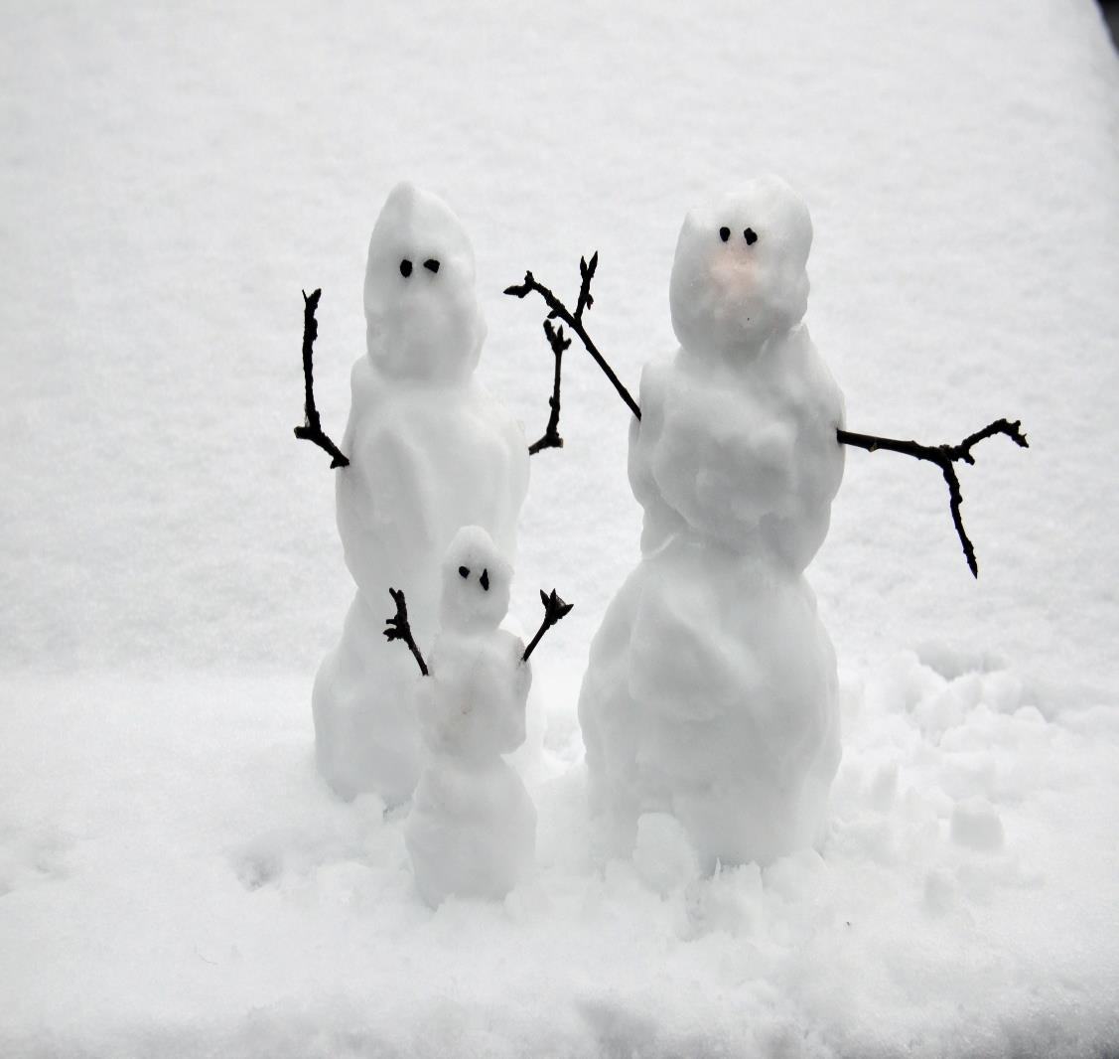
Essential Question:
How can we be stewards of Wyoming’s public and private lands to benefit current and future generations?
Notes:
This is a chance to review the Essential Question for this unit.

Slide 20
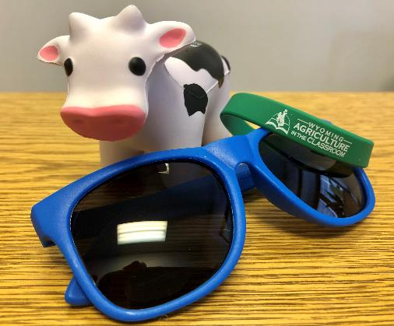
We need your help!
Wyoming Ag in the Classroom is a non-profit organization. Through the generosity of donors and grant providers, we can provide our programs free of charge. For us to continue, we need data from you that we can share with our donors and grant providers.
How you can help:
After completing a unit, please complete our questionnaire:
Feedback Questionnaire
Our way to say thanks:
Once you and your students complete the questionnaire, you will be sent a package with a fun reward for your class.
You will also be entered in a drawing for a Samsung Galaxy Tab A!

