Slide 1
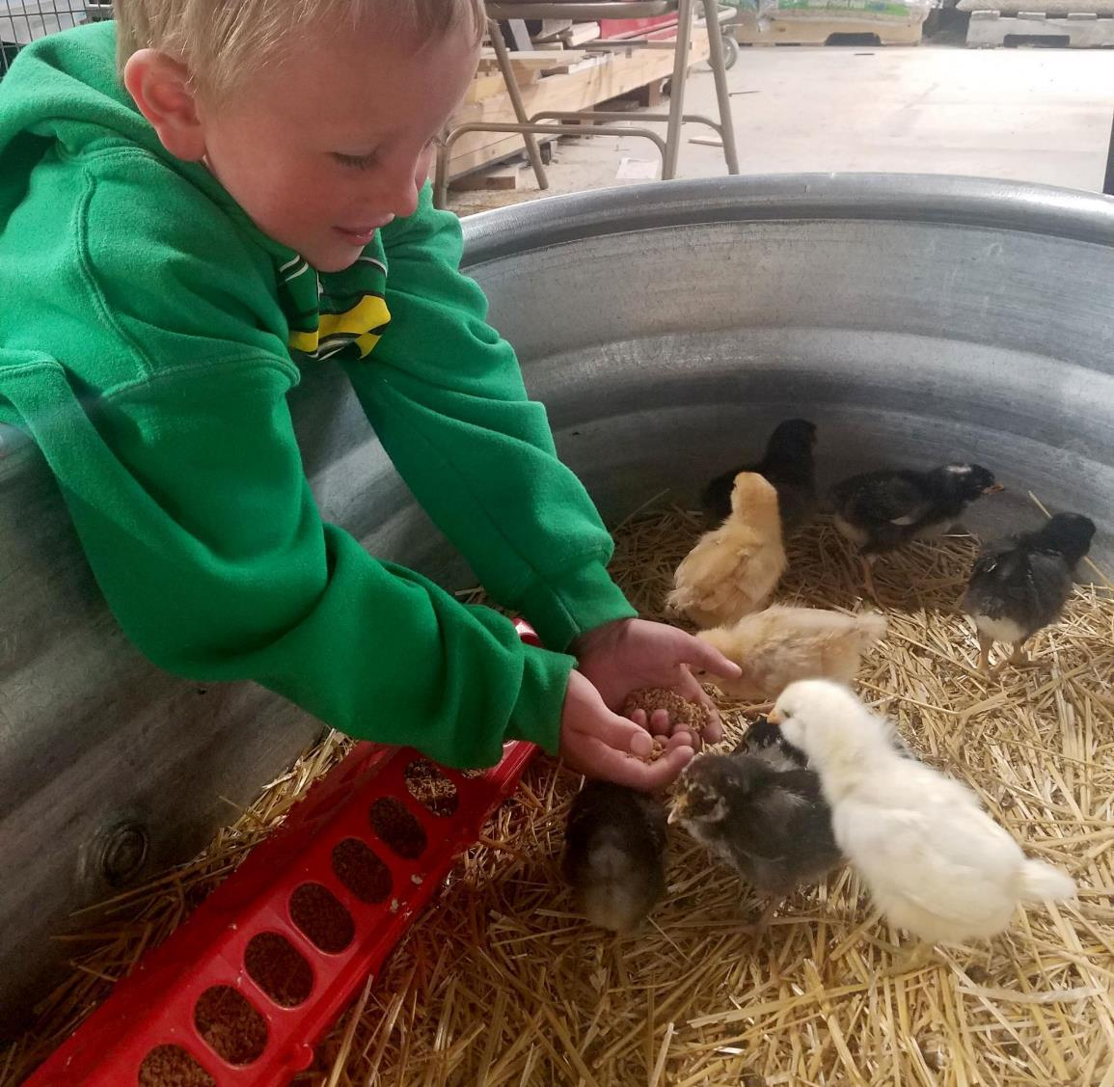
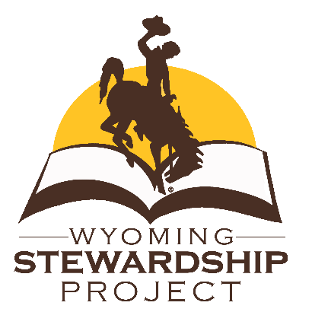
Agriculture
3rd grade
Lesson 3:
Hooves on the Ground
Notes:
Name of the lesson will be a link to the website where the lesson can be viewed or downloaded.

Slide 2
Today’s Challenge
Students will:
Understand that Wyoming is unique because of the amount of space available for our livestock.
Notes:
This is the focus of today’s lesson.

Slide 3
Graze – eat grass or forage in a pasture
Grazed – pasture grass that has been partially eaten by livestock
Larkspur – native plant with blue flowers that is poisonous when eaten by livestock.
Livestock – animals kept for use and profit
Pasture – fenced-in area of grazing land
Rotational grazing – the practice of moving grazing livestock between pastures as needed or on a regular schedule
Vocabulary
Notes:
These are the new vocabulary words for this lesson. You may need to adjust this list according to the needs of your students.

Slide 4
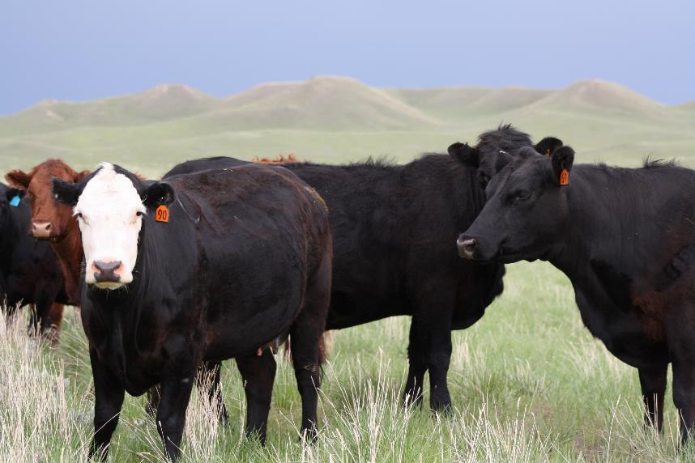
Think back on:
What is livestock and what is a crop
Different types of livestock found in Wyoming
Highlights from our last lesson
What did you learn from yesterday’s challenge?
Notes:
Look back on the previous lesson and review the key ideas.

Slide 5
LAND FOR OUR LIVESTOCK
Notes:
Procedure #1: This is the beginning of the Land for our Livestock PowerPoint. The title is a link to the original PPT.

Slide 6
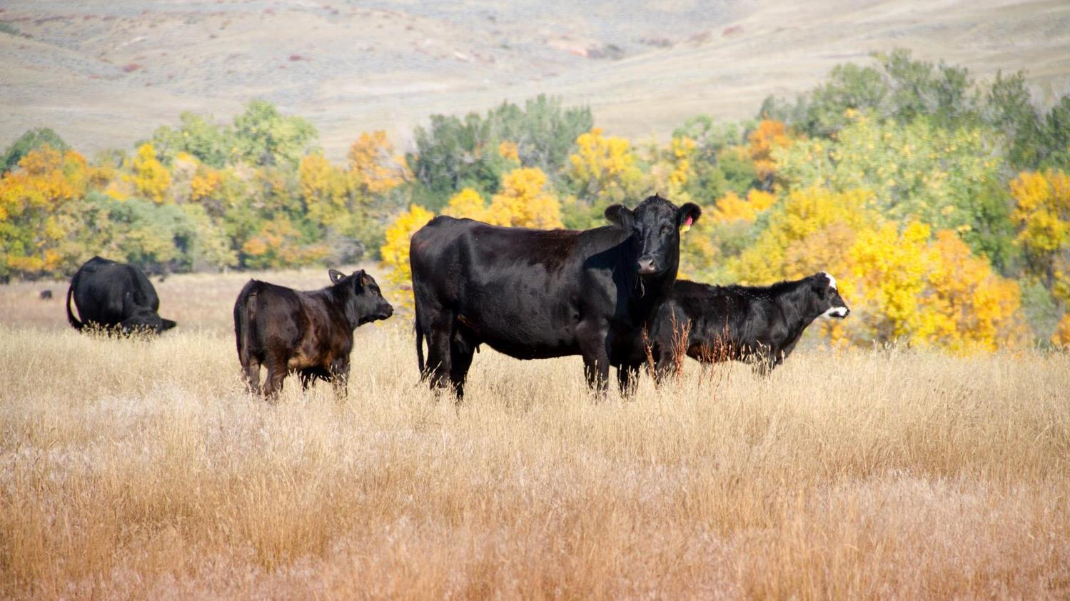
The top two types of livestock in our state are cattle and sheep.
Cattle is the third largest money-maker in Wyoming. 75% of our cattle are sold for beef. The rest will be raised to produce more cattle.
Photo by Wayne Fahsholtz, courtesy of the Wyoming Beef Council
Notes:
Procedure #1, Slide 3

Slide 7
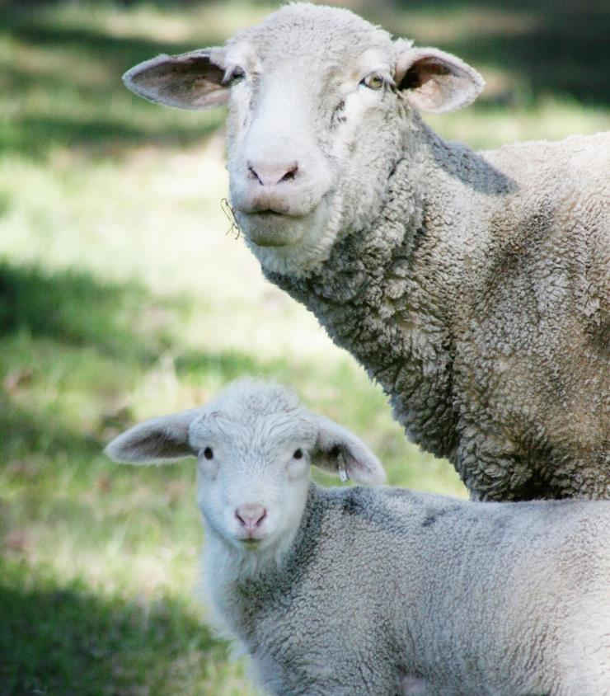
We also learned Wyoming is unique because we are the fourth largest producer of sheep in the United States.
Notes:
Procedure #1, Slide 4

Slide 8
Here are some other ways that Wyoming is unique.
Notes:
Procedure #1, Slide 5

Slide 9
Wyoming is the ninth largest state in the United States!
Notes:
Procedure #1, Slide 6

Slide 10
Wyoming
population:
587,910 (2016)
Colorado population: 5,557,000 (2016)
Source: United states census bureau
Wyoming is the least populated state in the United States. That means there are fewer people in our state than any other. Just look at the difference between Wyoming and our neighboring state, Colorado. They have almost five million more people than we do!
Notes:
Procedure #1, Slide 7

Slide 11
Since we have so much space and so few people, what do you think we use all this land for?
Turn and talk with your neighbor about your thoughts.
Notes:
Procedure #1, Slide 8

Slide 12
This is a map of Wyoming that shows private and public land.
Notes:
Procedure #1, Slide 9

Slide 13
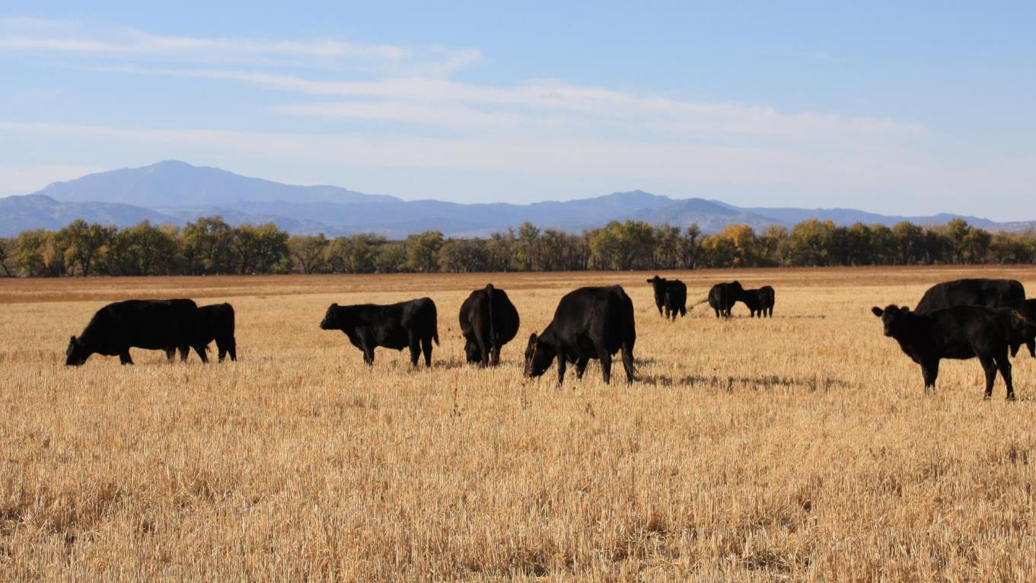
We have the biggest ranches in the United States here in Wyoming. We may not have a lot of people in our big open space, but our space serves a really important purpose. We have over one million head of cattle in our state. That means we have more cows than people!
Photo by Liz Lauck
Notes:
Procedure #1, Slide 3

Slide 14
The cattle that live in Wyoming have needs just like us. We need food and water to survive, and so do they. Our land helps supply the cattle and sheep with those basic needs.
Now, we are going to play a game to show how ranchers use our great Wyoming land to feed their livestock.
Notes:
Procedure #1, Slide 11

Slide 15
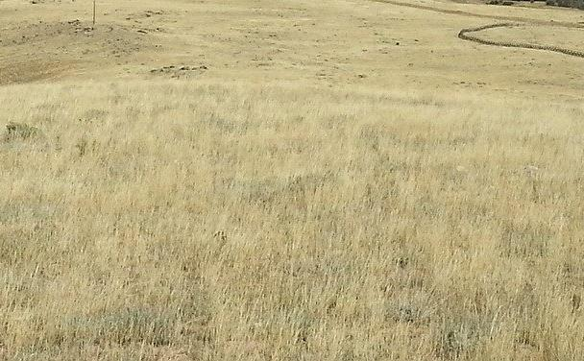
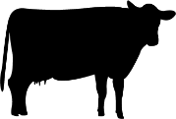
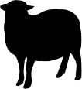
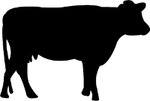
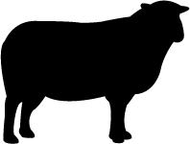
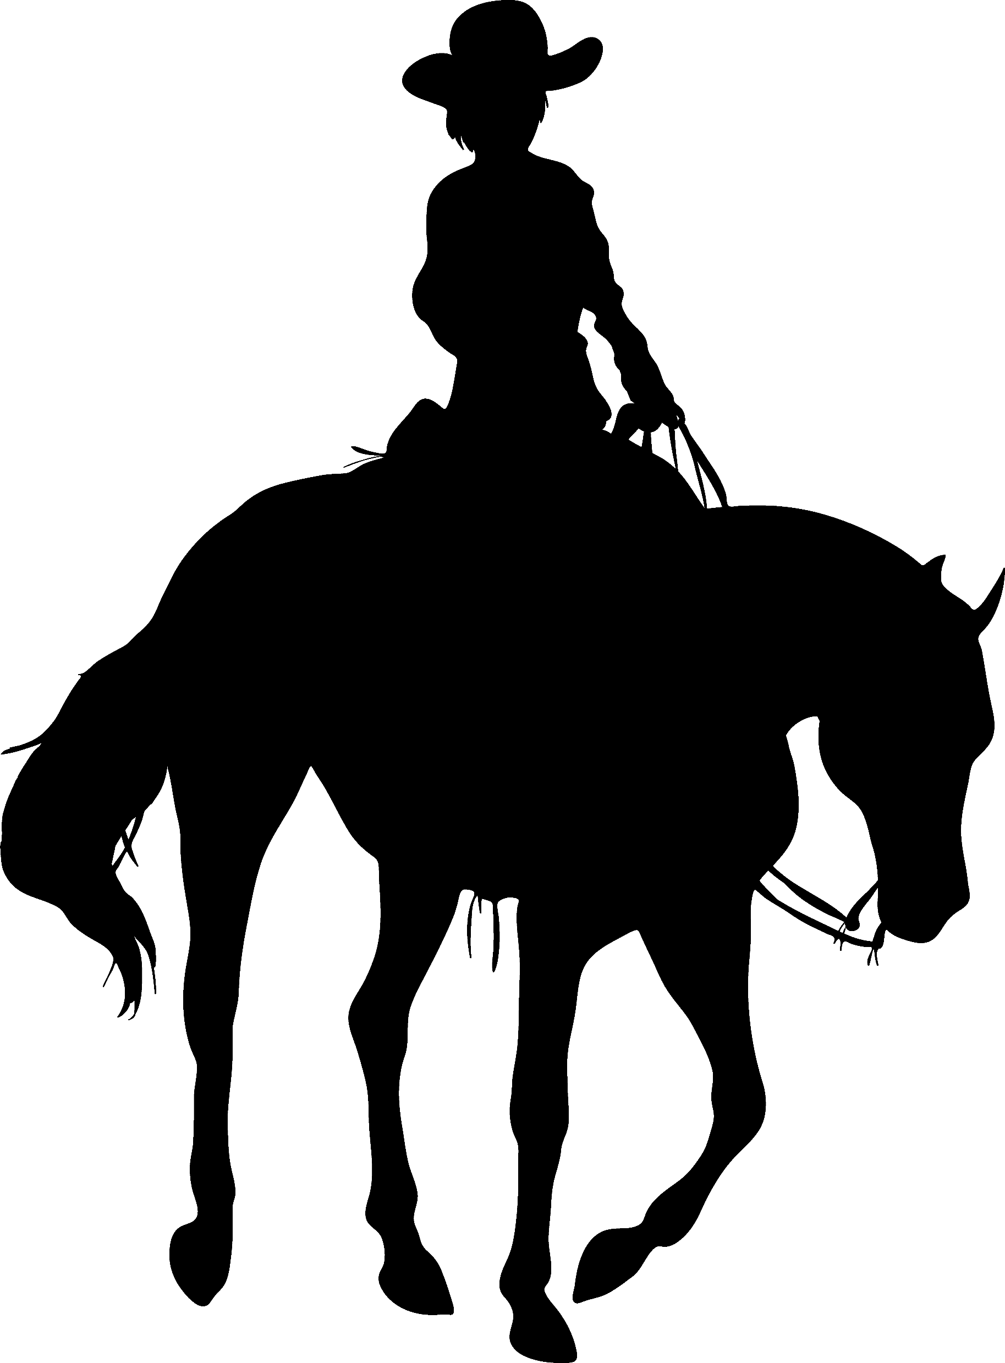
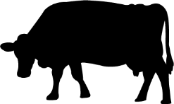
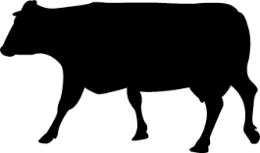
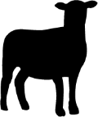
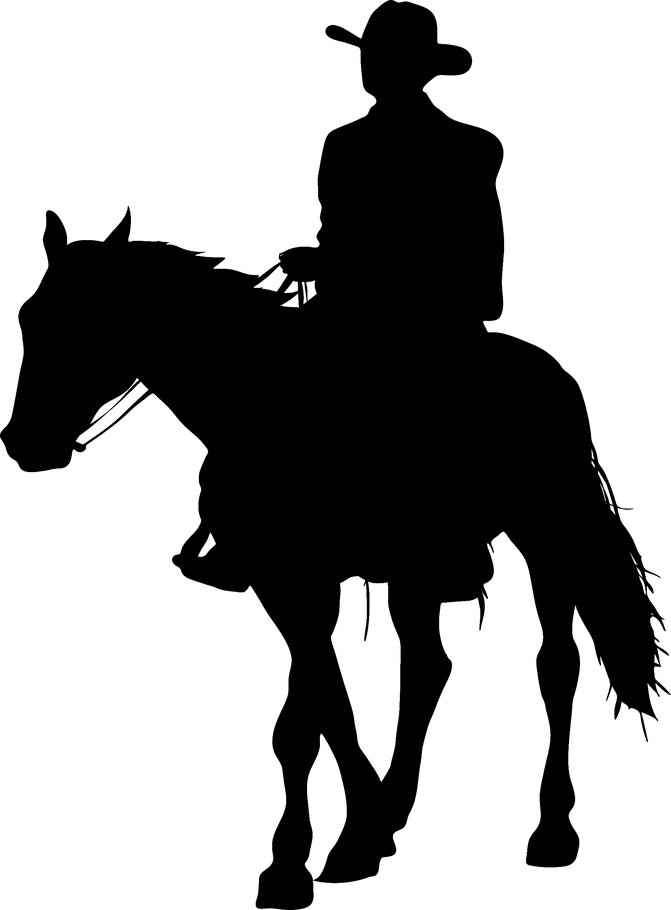
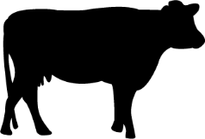
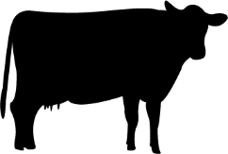
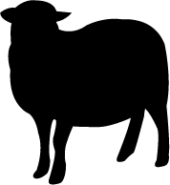
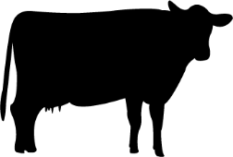
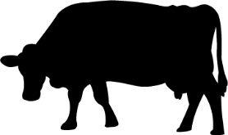
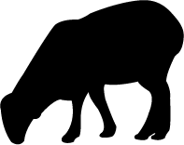
Get your task card to play the Livestock Simulation Game
Sheep
Rancher
Cattle
Rancher
Notes:
Procedure #2: Remember to have more cattle than sheep. The name of the game is a link to the resources.

Slide 16
Welcome to the __________ Ranch
Sheep
Rancher
Cattle
Rancher
Notes:
Procedure #3, 2nd paragraph of 1st bullet:

Slide 17
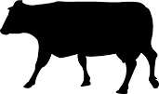
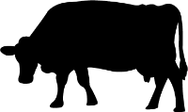
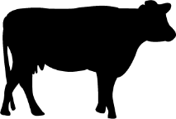
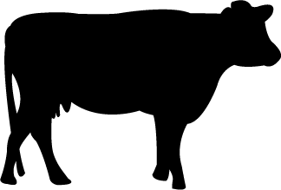
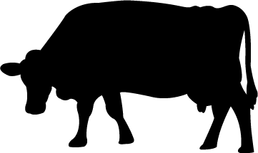
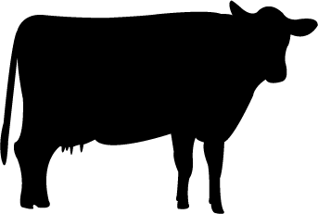
Cattle
Rancher
Notes:
Procedure #3, 2nd paragraph of 1st bullet:

Slide 18
The cattle ate all the grass!
We need to take care of the cattle and the land they use. How can we do that?
Should we:
Let the grass continue to grow?
Feed the cattle?
Keep them together so we are being good stewards of both?
This Photo by Unknown Author is licensed under CC BY-NC-ND
Notes:
Procedure #3, 2nd Bullet:

Slide 19
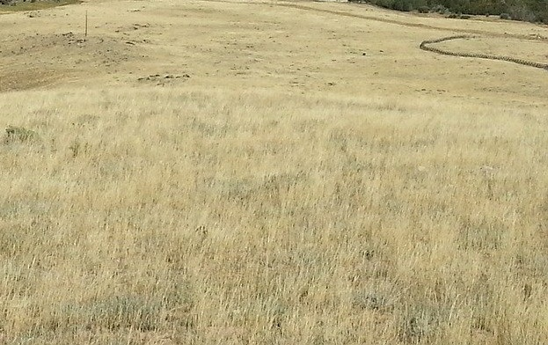
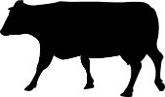
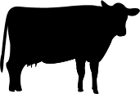
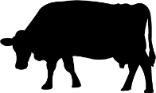
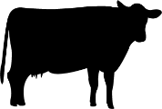
1
2
Cattle
Rancher
4
3
Notes:
Procedure #3, 3rd – 6th Bullets: The dotted lines represent the fence. This is a good activity to support area (where the animals graze) and perimeter (the fence) instruction.

Slide 20
1
2
Cattle
Rancher
4
3
Notes:
Procedure #3, 7th and 8th Bullets: To have the herd move, click on the image of the cowboy and “herd” the cattle into the next pasture.

Slide 21
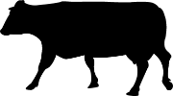
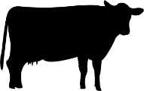
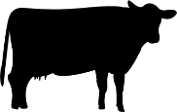
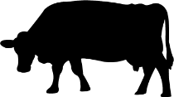
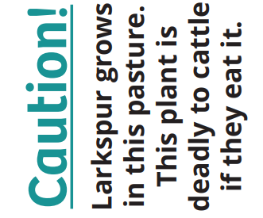
1
2
Cattle
Rancher
4
3
Notes:
Procedure #3, 8th – 10th Bullets

Slide 22
Finding a Solution
Sheep
Rancher
Cattle
Rancher
Notes:
Procedure #3, 10th Bullet :

Slide 23
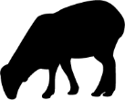
1
2
Cattle
Rancher
4
3
Sheep
Rancher
Notes:
Procedure #3, 10th and 11th Bullets

Slide 24
1
2
Cattle
Rancher
4
3
Sheep
Rancher
Notes:
Procedure #3, 12th and 13th Bullets. Click on the sheep and move the herd to the next pasture (bottom left), then move the herd of cows to the now larkspur-free pasture.

Slide 25
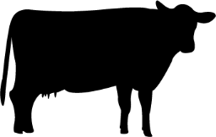
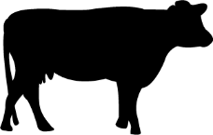
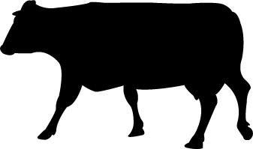
1
2
We had enough rain for our grass to grow back.
We have enough grass for our cattle and sheep.
The cattle and sheep are eating well.
Rotational Grazing – It Works!
4
3
Sheep
Rancher
Cattle
Rancher
Notes:
Procedure #3,14th Bullet

Slide 26
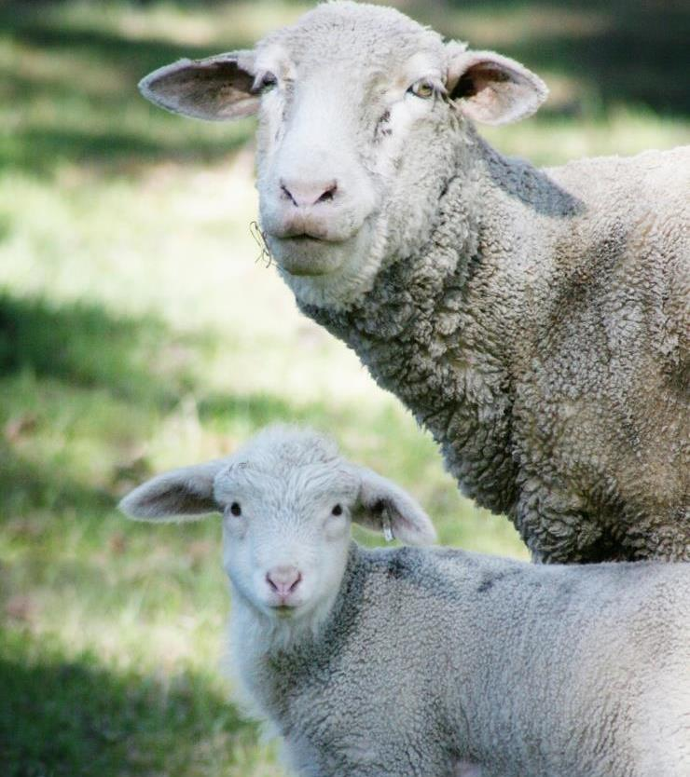
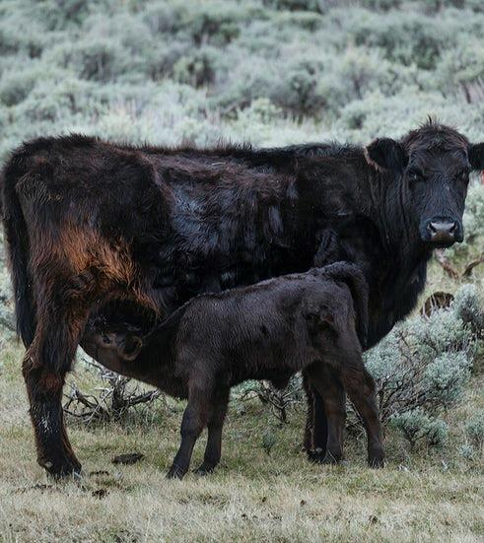
Things to remember and think about:
Notes:
Procedure #3: Reshowing the slides 6, 7, and 10 – the next 3 slides.

Slide 27
Wyoming is the ninth largest state in the United States!
Notes:
Final 2 paragraphs of Procedure #3: This is slide 6

Slide 28
Wyoming
population:
587,910 (2016)
Colorado population: 5,557,000 (2016)
Source: United states census bureau
Wyoming is the least populated state in the United States. That means there are fewer people in our state than any other. Just look at the difference between Wyoming and our neighboring state, Colorado. They have almost five million more people than we do!
Notes:
Final 2 paragraphs of Procedure #3: This is slide 7

Slide 29
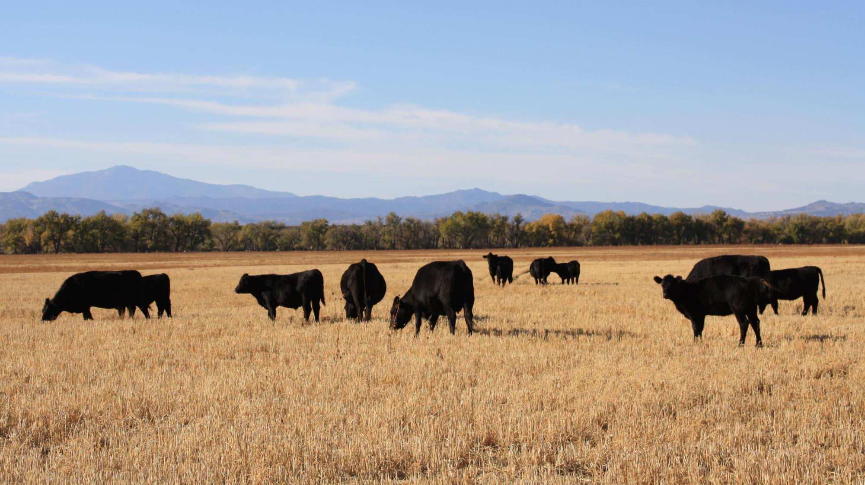
We have the biggest ranches in the United States here in Wyoming. We may not have a lot of people in our big open space, but our space serves a really important purpose.
We have over one million head of cattle in our state. That means we have more cows than people!
Photo by Liz Lauck
Notes:
Final 2 paragraphs of Procedure #3: This is slide 10

Slide 30
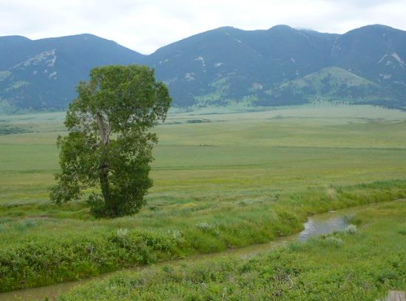
Let’s discuss:
How does our state’s size and our small population help ranchers graze their livestock?
If our population grew as big as Colorado, how would that affect our ranch sizes?
This Photo by Unknown Author is licensed under CC BY-SA
Notes:
Final 2 paragraphs of Procedure #3:

Slide 31
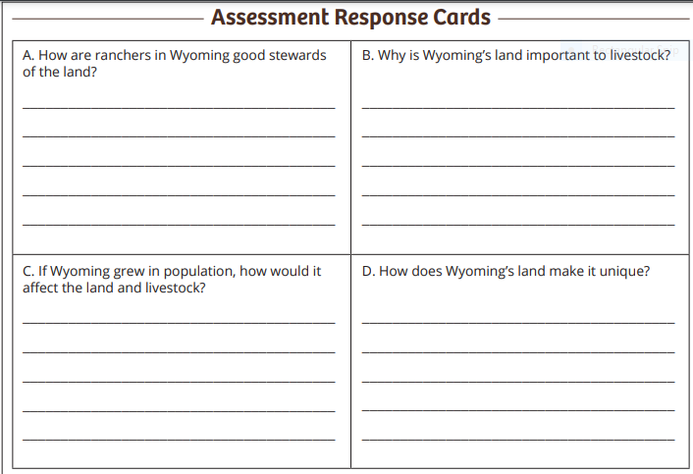
Choose one of these questions to answer on your Response Card:
How are ranchers in Wyoming good stewards of the land?
Why is Wyoming’s land important to livestock?
If Wyoming grew in population, how would it affect the land and livestock?
How is Wyoming agriculture unique?
Defend your answer by giving evidence from our activity.
This Photo by Unknown Author is licensed under CC BY-SA
Notes:
Assessment: If virtual, students can write their answers on a device or on a bulletin board tool such as Padlet or CardSmith. This activity can be done in breakout rooms for the partner discussion.

Slide 32
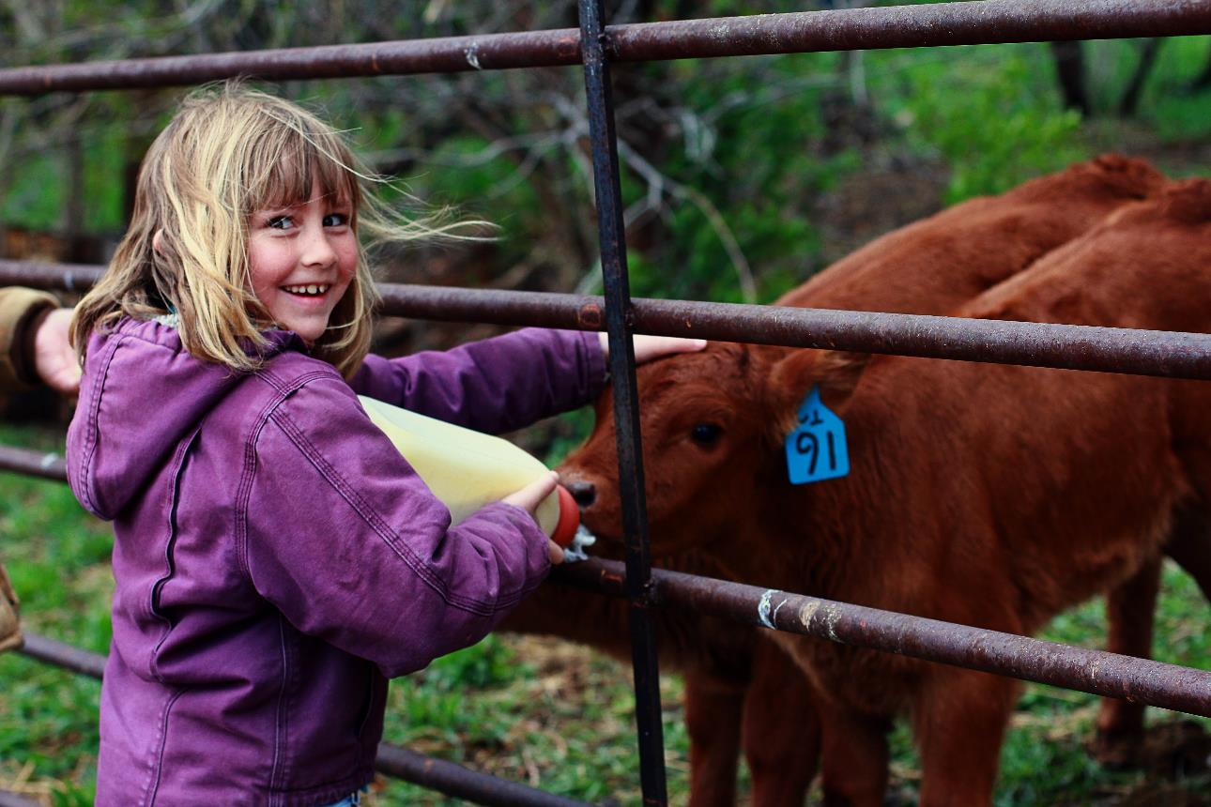
What did we learn from today’s challenge?
Notes:
Provide the students an opportunity to explain their learning.

