Slide 1
Minerals & Energy 3rd Grade Lesson 8: You-The Missing Piece for Wyoming’s Future
Notes:
The name of the lesson is a link to the Wyoming Agriculture in the Classroom website where the lesson can be downloaded.

Slide 2
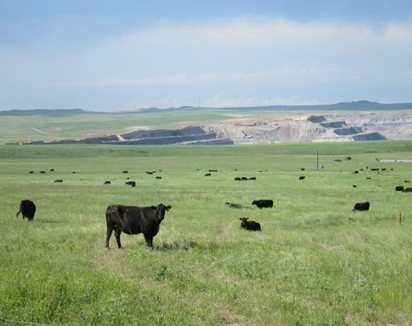
Essential Question:
How can we be stewards of Wyoming’s mineral and energy resources to benefit current and future generations?
Notes:
This is a chance to share the Essential Question for this unit.

Slide 3
Today’s Challenge
Students will create an acrostic poem using one of the vocabulary words from the unit.
Notes:
This is the focus of today’s lesson.

Slide 4
Vocabulary
Efficiency- not wasting materials or time
Stewardship- As Wyoming citizens, we are stewards entrusted with the responsible development, care, and use of our resources to benefit current and future generations.
Notes:
These are the new vocabulary words for this lesson. You may need to adjust this list according to the needs of your students.

Slide 5
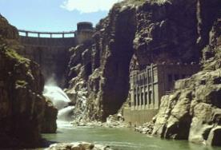
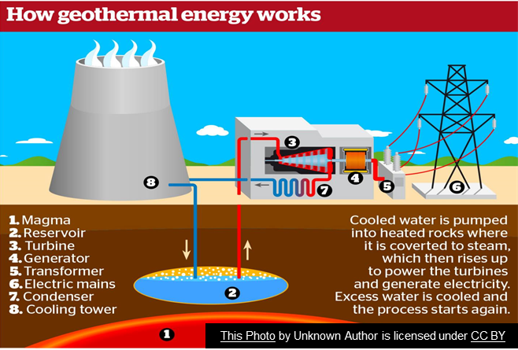
Highlights from our last lesson:
What did you learn from yesterday’s challenge?
This Photo by Unknown Author is licensed under CC BY-SA
Hydro | Solar | Geothermal
Notes:
Look back on the previous lesson and review the key ideas.

Slide 6
Let’s Review
What is Stewardship?
What are the nonrenewable and renewable energy resources found in Wyoming?
How can you be a good steward of these nonrenewable and renewable resources?
Notes:
Procedure #1
Spend time reviewing the concepts and ideas of the last 7 lessons.

Slide 7
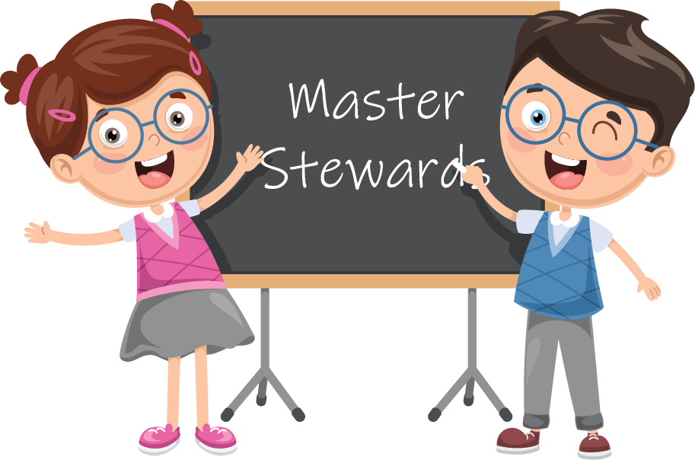
Stewards of Wyoming’s Energy
S
Students can be stewards
T
Trusted
E
Efficient
W
Wyoming
A
Aware
R
Responsible
D
Direction
Notes:
Procedure #2
Discuss with students how they can be stewards of Wyoming’s energy. You will be modeling what an acrostic poem is. The poem will be the evidence of your learning for the unit.

Slide 8
Creating your Poems
Variable
Coal
Nonrenewable Resources
Stewardship
Motion
Energy
Electrical Energy
Geothermal Energy
Constraint
Renewable Resources
Natural Resource
Oil
Turbine
Force
Hydropower
Notes:
Procedure #3
Give the students 10-20 minutes to create their poem. You may have students work with partners or independently.

Slide 9
Time to Share
Notes:
Procedure #4
You will provide the students that are comfortable sharing their poems the opportunity to share their poems. Collect the poems for assessing or for display.

Slide 10
Congratulations on the growing and learning that you have done!

Slide 11
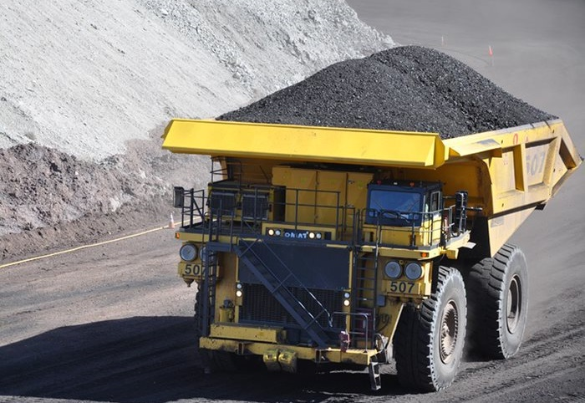
What did we learn from today’s challenge?
Notes:
Provide the students an opportunity to explain their learning.

Slide 12
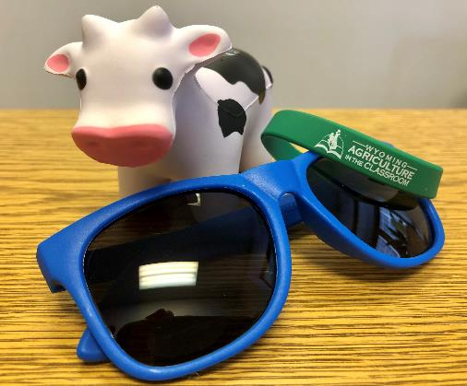
We need your help!
Wyoming Ag in the Classroom is a non-profit organization. Through the generosity of donors and grant providers, we can provide our programs free of charge. For us to continue, we need data from you that we can share with our donors and grant providers.
How you can help:
After completing a unit, please complete our questionnaire:
Feedback Questionnaire
Our way to say thanks:
Once you and your students complete the questionnaire, you will be sent a package with a fun reward for your class.

