Slide 1
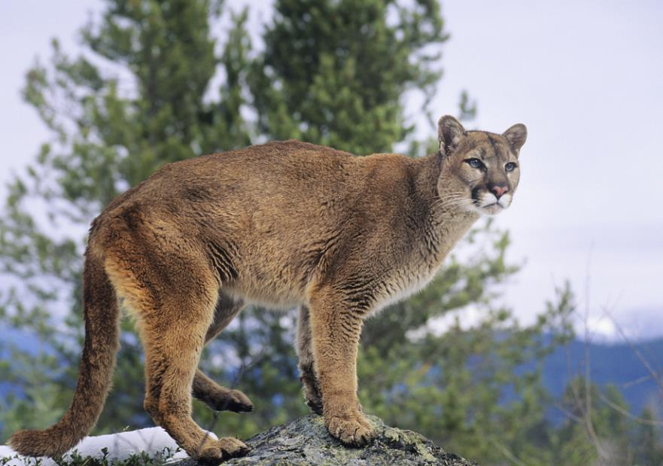
Outdoor Recreation & Tourism
3rd Grade
Lesson 1:
Plants, Wildlife, Recreation, Oh My!
Notes:
The name of the lesson is a link to the Wyoming Agriculture in the Classroom website where the lesson can be downloaded.

Slide 2
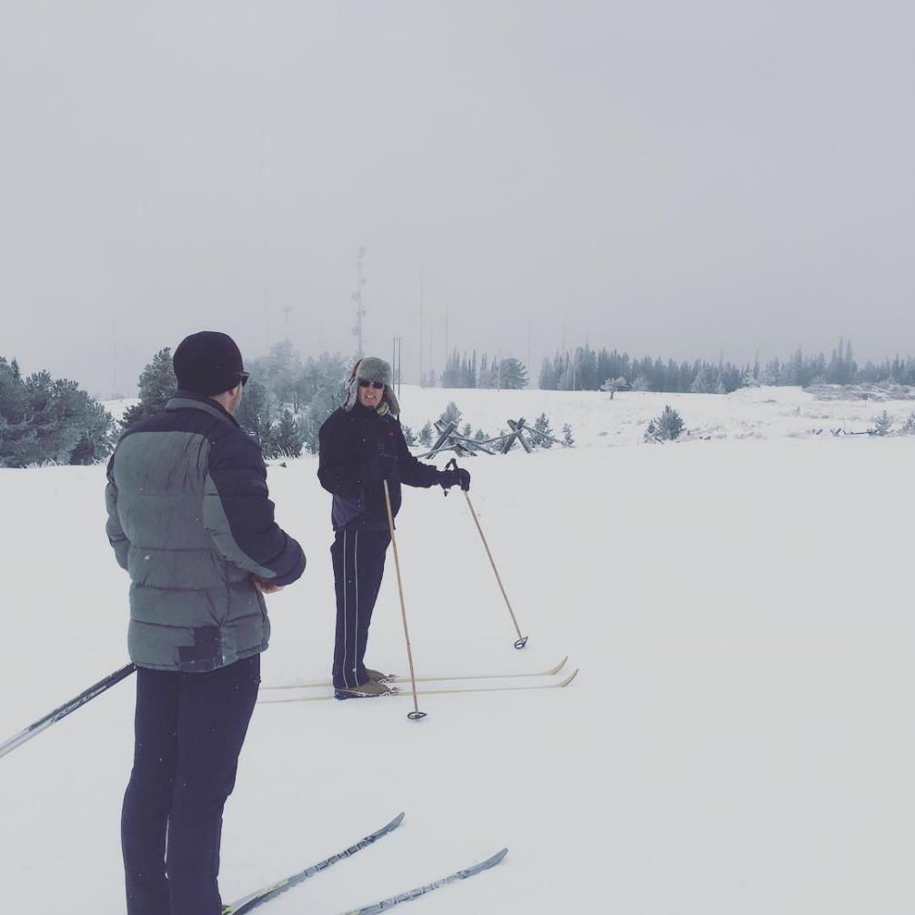
Essential Question:
How can we be stewards of Wyoming’s public and private lands to benefit current and future generations?
Photo courtesy of C. Jacobs
Notes:
This is a chance to share the Essential Question for this unit.

Slide 3
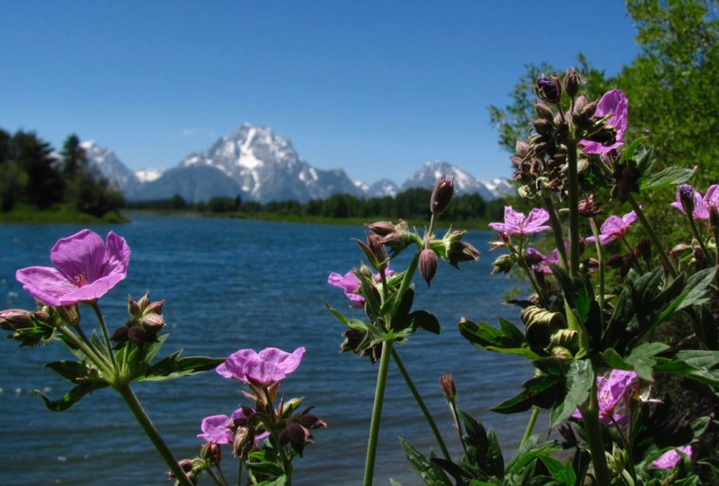
Today’s Challenge:
Students Will:
Identify plants, wildlife, and recreation in Wyoming.
Notes:
This is the focus of today’s lesson.

Slide 4
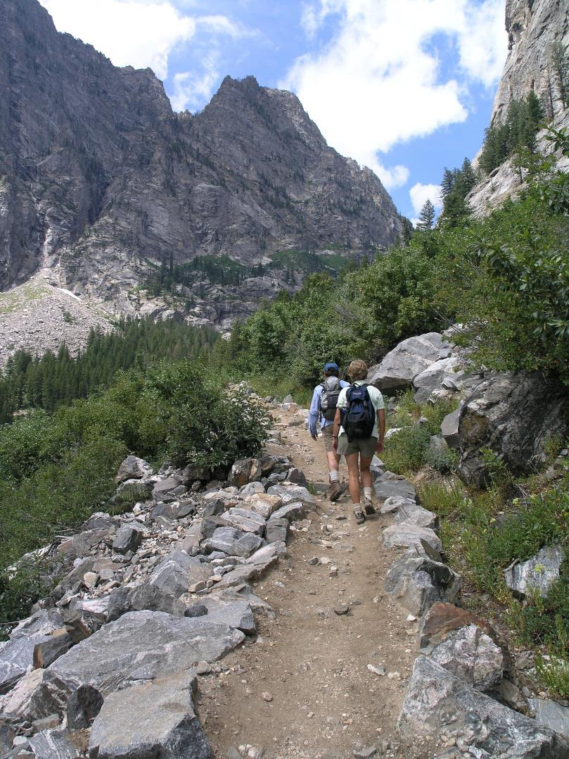
Attributes – a quality or feature of someone or something
Characteristic – a feature or quality belonging typically to a person, place, or thing and serving to identify it
Plant – a living thing that relies on photosynthesis (the process in which it makes its own food)
Public land – land owned by a government; may or may not be accessible to the public
Private land – land owned by a person or group and kept for their exclusive use; permission and access for any purpose must be granted by the owner
Recreation – an activity that is undertaken for pleasure or relaxation
Unique – being the only one of its kind; unlike anything else
Wildlife – living things, especially mammals, birds, and fish that are neither human nor domesticated
Vocabulary
Notes:
These are the new vocabulary words for this lesson. You may need to adjust this list according to the needs of your students.

Slide 5
Public land – land owned by a government; may or may not be accessible to the public
Link to Maps
Notes:
Procedure #1
Guide students understanding by posing the questions in procedure one of the lesson. These questions are in the slides that follow.

Slide 6
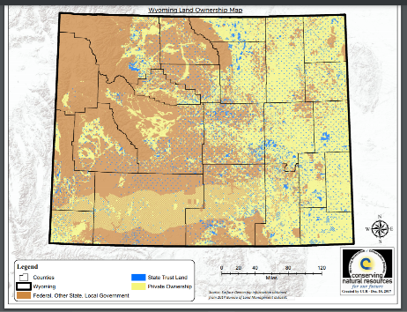
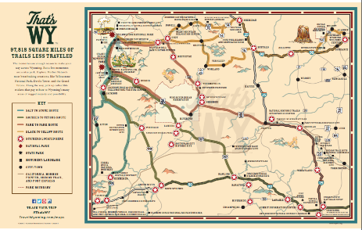
How are they similar?
Student responses:
Notes:
Procedure #1
Students will explain the similarities of the maps.

Slide 7
How are they different?
Student responses:
Notes:
Procedure #1
Students will identify the differences that they notice.

Slide 8
Why might certain areas be public land?
Student responses:
Notes:
Procedure #1
Students will use what they have notice to determine why areas on the map might be public land.

Slide 9
What does the yellow on the map indicate?
Student responses:
Notes:
Procedure #1
Students will use what they have learned and noticed to make predictions about the map.

Slide 10
What does it mean that the land is privately owned?
Student responses:
Notes:
Procedure #1
Students will use their background knowledge to continue to make predictions.

Slide 11
Highlight important facts and information
Link to Text
This Photo by Unknown Author is licensed under CC BY-SA
Notes:
Procedure #1
Students will practice listening comprehension as the teacher reads the article aloud. Students will highlight important facts and information. You might complete the highlighting as individuals or whole group.

Slide 12
Share your highlighted facts with the group.
Notes:
Procedure #2
Students will share the facts that were highlighted and provide evidence of why they are important to their group.

Slide 13
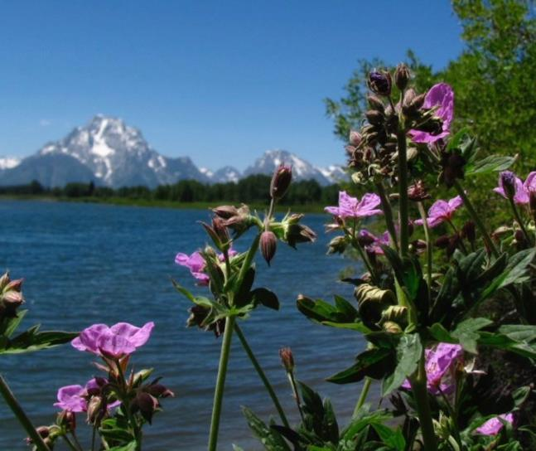
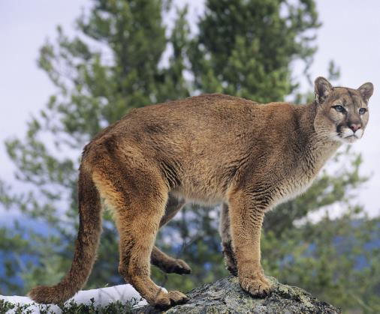
Unique: Being the only one of its kind; unlike anything else
Why is Wyoming unique?
Notes:
Procedure #4
You will be identifying and discussing how and why Wyoming lands are unique.

Slide 14
Wyoming Lands
Link to Title Cards and Pictures
Notes:
Procedure #4: If you are unable to do this activity in your classroom, use the next three slides for students to identify the category in which the picture belongs.

Slide 15
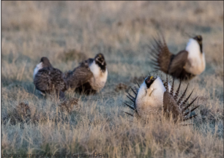
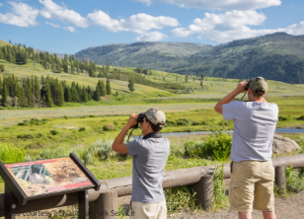
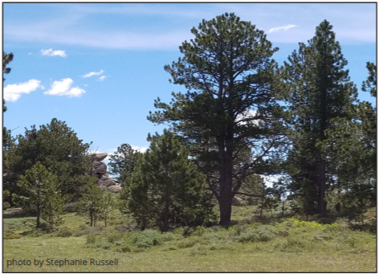
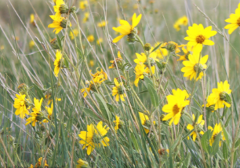
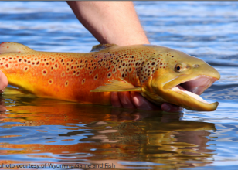
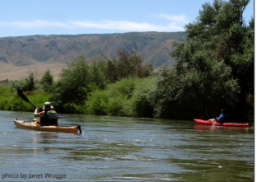
Which category is this picture?
Wildlife
Plants
Recreation
Notes:
Procedure #4 & #5
Students will be discussing their thought process of why they categorized their cards in the way the have chosen.

Slide 16
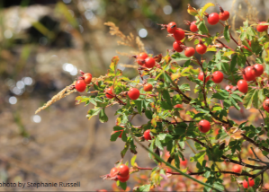
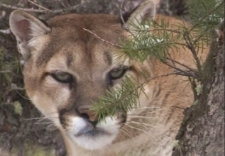
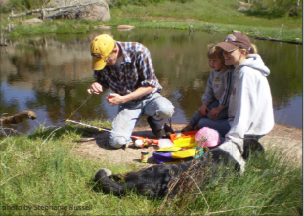
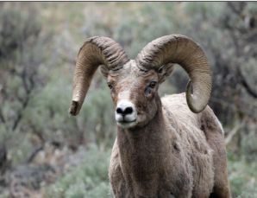
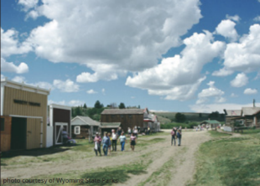
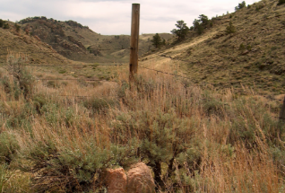
Which category is this picture?
Wildlife
Plants
Recreation
Notes:
Procedure #4 & #5

Slide 17
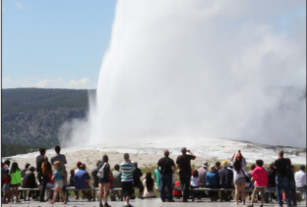
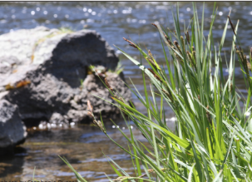
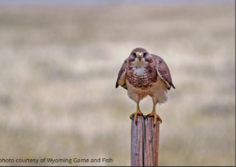
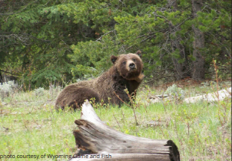
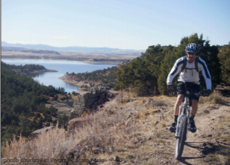
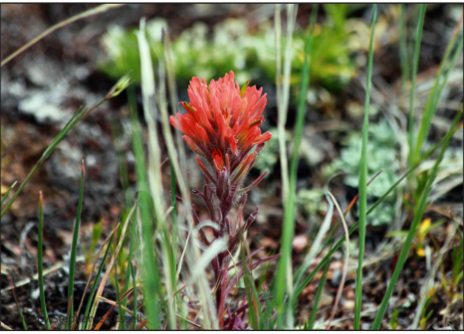
Which category is this picture?
Wildlife
Plants
Recreation
Notes:
Procedure #4 & #5

Slide 18
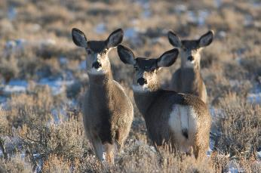
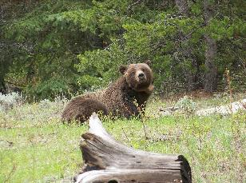
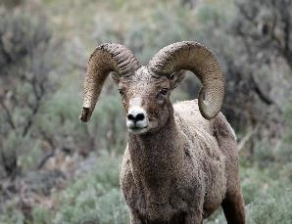
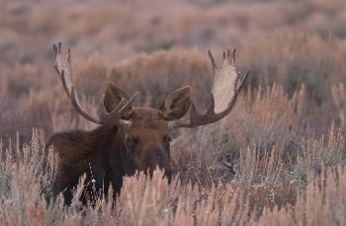
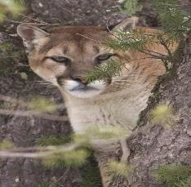
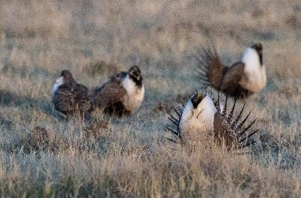
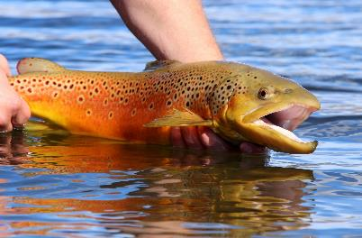
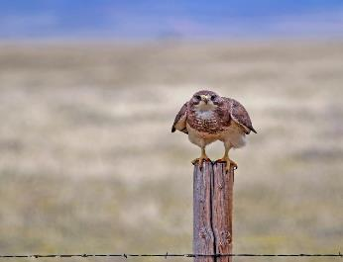
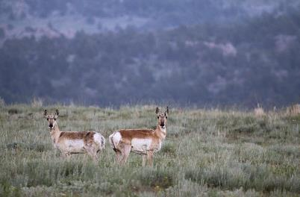
Characteristics of Animals
Notes:
Procedure #5: Use this slide to discuss the characteristics of animals (questions on the back of the cards).

Slide 19
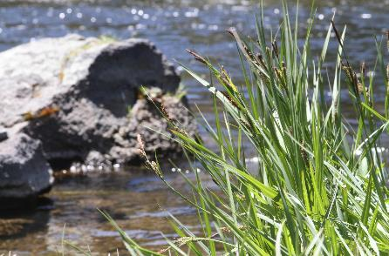
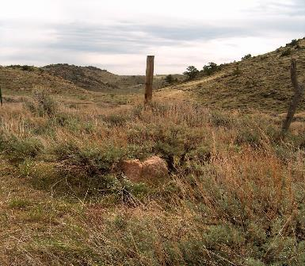
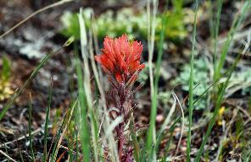
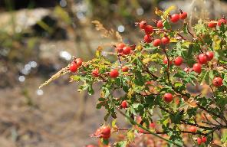
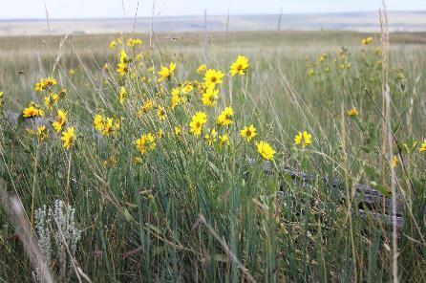
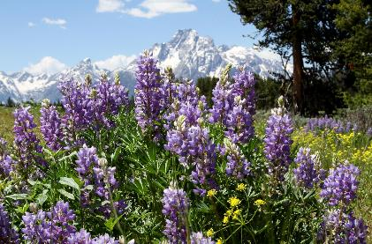
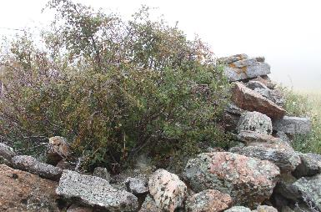
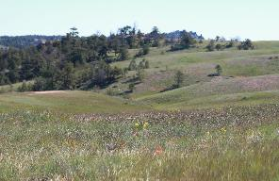
Characteristics of Plants
Notes:
Procedure #5: Use this slide to discuss the characteristics of plants (questions on the back of the cards).

Slide 20
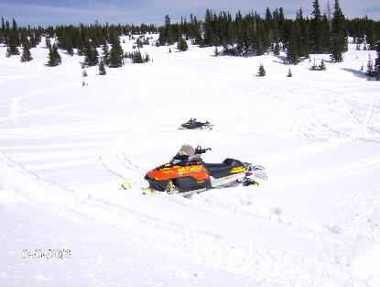
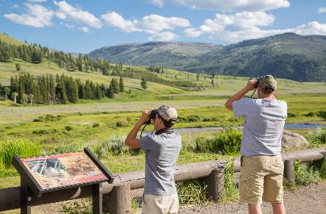
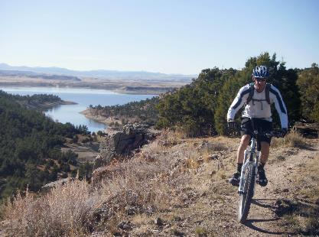
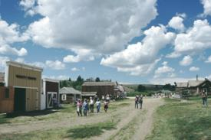
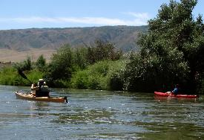
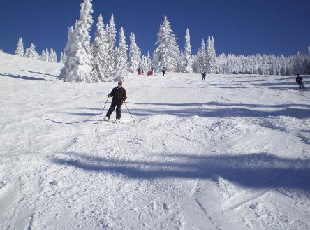
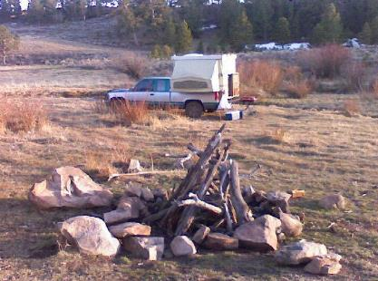
Characteristics of Recreation
Notes:
Procedure #5: Use this slide to discuss the characteristics of recreational activities (questions on the back of the cards).

Slide 21
What did you notice about wildlife, plants, and recreational activities?
What other examples of wildlife, plants, and recreational activities do you know?
What makes Wyoming unique?
Notes:
Procedure #6
Students will use the posed questions to come to the understanding of why and what makes Wyoming unique. Students should come to the understanding that Wyoming’s diverse environment makes it unique for plants, animals, and humans.

Slide 22
Unique: Being the only one of its kind; unlike anything else
Wyoming’s land is unique because__________.
Another reason the land in Wyoming is unique is___________.
Since these attributes make Wyoming unique, what do you think might happen if the opportunity to enjoy them went away?
Notes:
Assessment
Students will complete the sentence stems to provide evidence of their understanding.

Slide 23
What did we learn from today’s challenge?
Notes:
Provide the students an opportunity to explain their learning.

