Slide 1
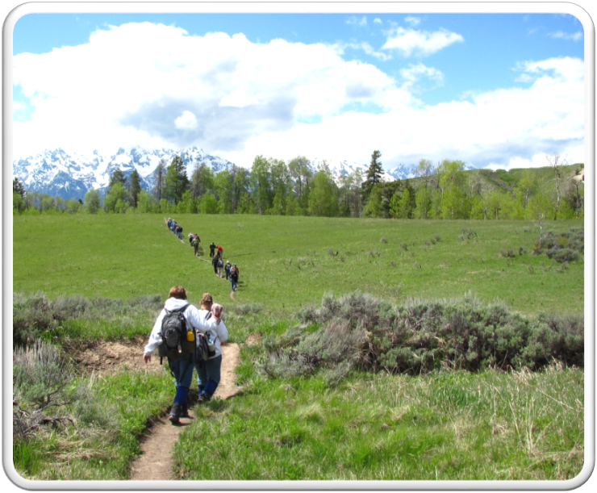
Outdoor Recreation & Tourism
3rd Grade
Lesson 2: Digging Deeper
Notes:
The name of the lesson is a link to the Wyoming Agriculture in the Classroom website where the lesson can be downloaded.

Slide 2
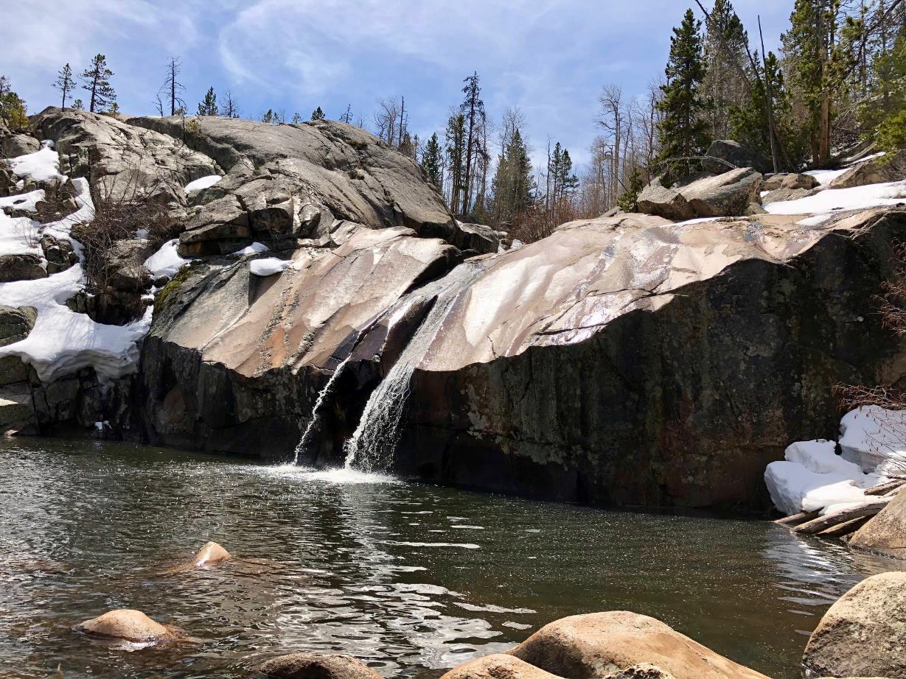
Today’s Challenge:
Students will:
Be able to show how lands are used for wildlife and recreation in Wyoming.
Learn how lands are developed, cared for, and used.
Photo courtesy of C. Jacobs
Notes:
This is the focus of today’s lesson.

Slide 3
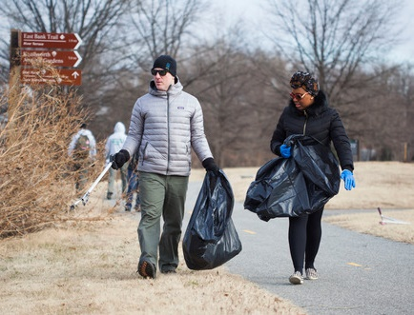
Entrust – to give somebody the responsibility of doing something or of caring for someone or something
Generation – a group of individuals, most of whom are the same approximate age
Public land – land owned by a government; may or may not be accessible to the public
Private land – land owned by a person or group and kept for their exclusive use; permission and access for any purpose must be granted by the owner.
State Trust Lands – lands that were granted to Wyoming and designated to generate revenue for public schools and other state institutions
Stewardship – As Wyoming citizens, we are stewards entrusted with the responsible development, care, and use of our resources to benefit current and future generations.
Vocabulary
Notes:
These are the new vocabulary words for this lesson. You may need to adjust this list according to the needs of your students.

Slide 4
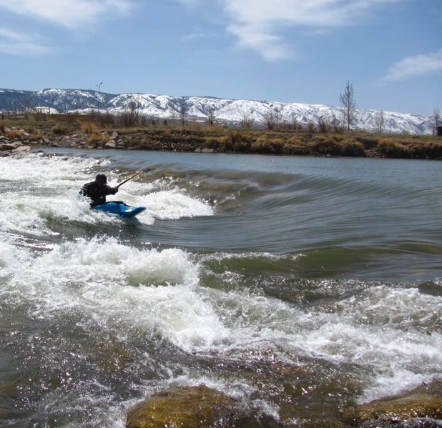
Highlights from our last lesson:
Think back on:
Wildlife
Plants
Recreation
Notes:
Procedure #1: Look back on the previous lesson and review the key ideas.

Slide 5
Notes:
Procedure #1/Version A: Version A was used for this presentation; however, Version B can be used. The numbering of the two versions is different (by one).
Students will be identifying words that they may not understand. Ask them what entrusted means to ensure their understanding of the definition.

Slide 6
Using and Caring for Wyoming Land
Read
Read the text
Complete
Complete the graphic organizer
Show
Show what you learned
Link to Graphic Organizer
Notes:
Procedure #2 & #3/Version A – Each student will read one text and fill out the graphic organizer. We suggest modeling the procedure using “The Bitterroot Ranch” text.
Students will use background knowledge from the previous lesson and evidence from the text to complete the graphic organizer.

Slide 7
Wildlife
What was the title of your article?
What wildlife did you read about?
What was something unique about this animal?
Why is Wyoming land important for this animal?
How can you as a steward use and care for Wyoming’s land for wildlife?
Recreation
What was the title of your article?
What wildlife did you read about?
What was something unique about this animal?
Why is Wyoming land important for this animal?
How can you as a steward use and care for Wyoming’s land for wildlife?
Text Link
Notes:
Procedure #3/Version A
You or the students may read the text, but you will be completing the graphic organizer whole group in order to model the process.

Slide 8
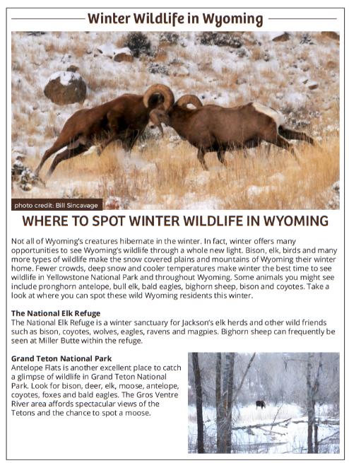
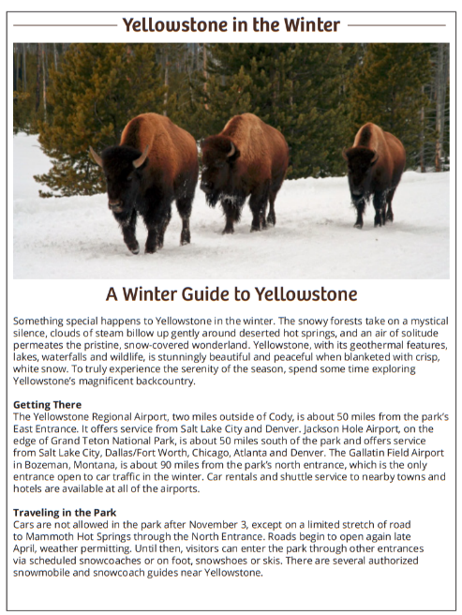
Become the Expert
Text Link
Notes:
Procedure #4/Version A
Students will become experts by choosing an article to read and completing the graphic organizer for the text they have chosen.

Slide 9
Give one, Get one
Student #1
Student #2
Notes:
Procedure #5/Version A: Students can be divided out into breakout sessions to complete this activity. (This slide can be duplicated for each pair.) If you prefer a class discussion about the articles, use the next 3 slides.

Slide 10
Take notes about important facts and details as you read the text.
Notes:
Procedure #5/Version A: If you prefer a class discussion about the articles, use the next 3 slides.

Slide 11
Winter Wildlife in Wyoming
Student responses
Notes:
Procedure #5/Version A: Students may take notes or share the important facts that they learned while working with a partner.

Slide 12
Outdoor Adventure Haven
Student responses
Notes:
Procedure #5/Version A
Students may take notes or share the important facts that they learned while working with a partner.

Slide 13
Yellowstone in the Winter
Student responses
Notes:
Procedure #5/Version A
Students may take notes or share the important facts that they learned while working with a partner.

Slide 14
Wildlife and Recreation in Wyoming
Wildlife list:
Recreation list:
Notes:
Procedure #6/Version A
The class will create an anchor chart by using the information they have learned through the activity. You may use the discussion content as your assessment.

Slide 15
What did we learn from today’s challenge?
Notes:
Provide the students an opportunity to explain their learning.

