Slide 1
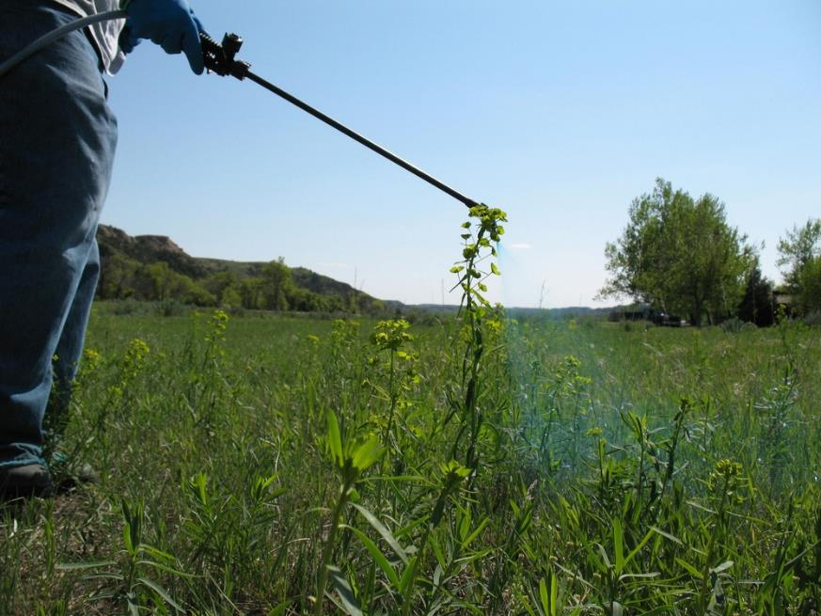
Outdoor Recreation & Tourism
3rd Grade
Lesson: Weeds Invade!
Notes:
The name of the lesson is a link to the Wyoming Agriculture in the Classroom website where the lesson can be downloaded.

Slide 2
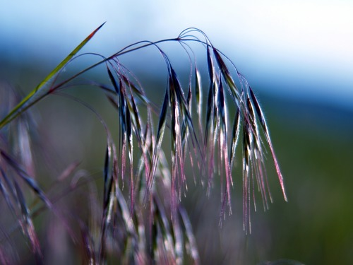
Today’s Challenge:
Students will:
Discuss the relationships of humans, plants, and animals in Wyoming.
Notes:
This is the focus of today’s lesson.

Slide 3
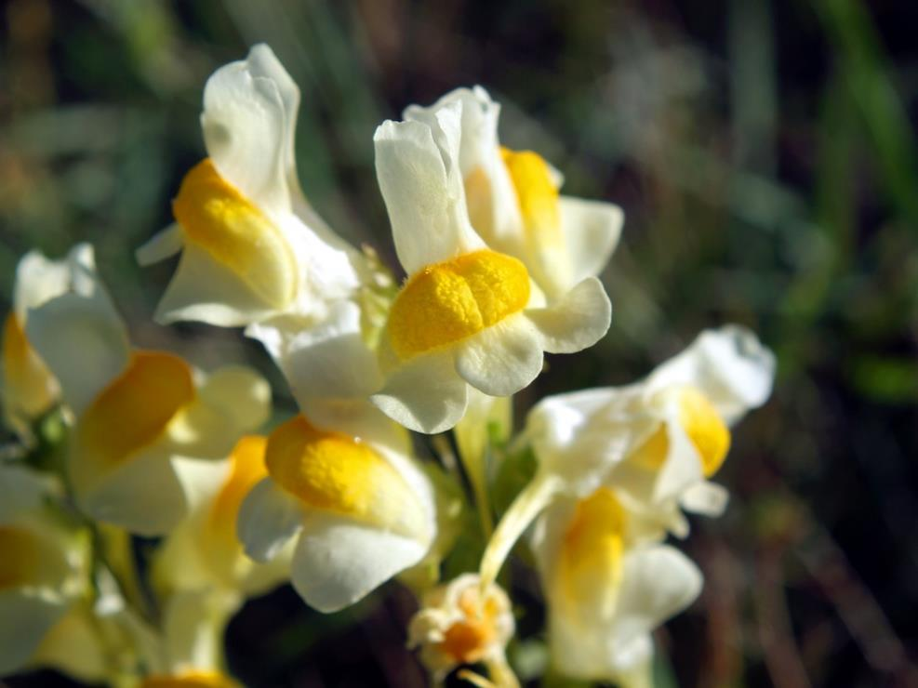
Vocabulary:
Invasive – growing and dispersing easily, usually to the detriment of native species and ecosystems
Native – found originally in a place, not introduced from another place
Noxious weed – plant that has been introduced, accidentally or intentionally, into an environment and causes or is likely to cause environmental or economic harm.
Notes:
These are the new vocabulary words for this lesson. You may need to adjust this list according to the needs of your students.

Slide 4
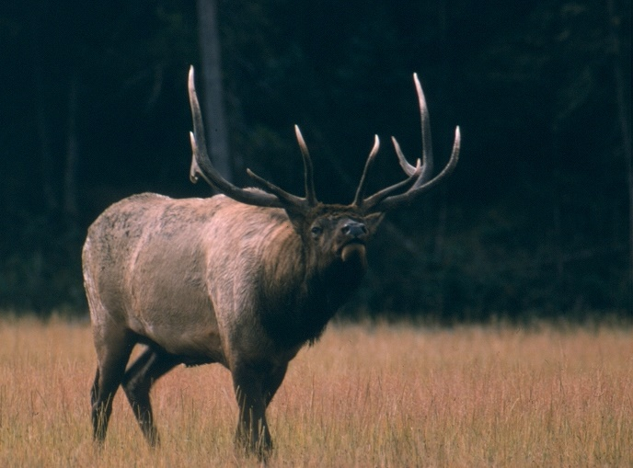
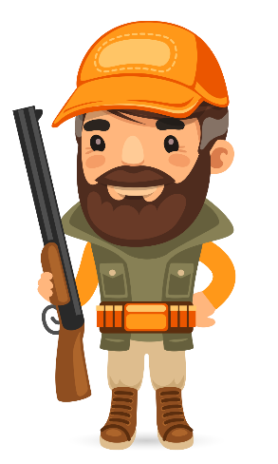
Highlights from our last lesson:
Think Back On:
Wildlife Populations
Human Impact
Notes:
Look back on the previous lesson and review the key ideas.

Slide 5
The Relationship Between Humans, Wildlife, & PLANTS
This Photo by Unknown Author is licensed under CC BY-NC-ND
Notes:
Procedure #1
Students will be looking at the relationships between plants, animals, and humans.

Slide 6
You are wildlife grazing on plants.
Notes:
Procedure #2: If you are unable to do this in person, the following slides will show a representation of the activity.

Slide 7
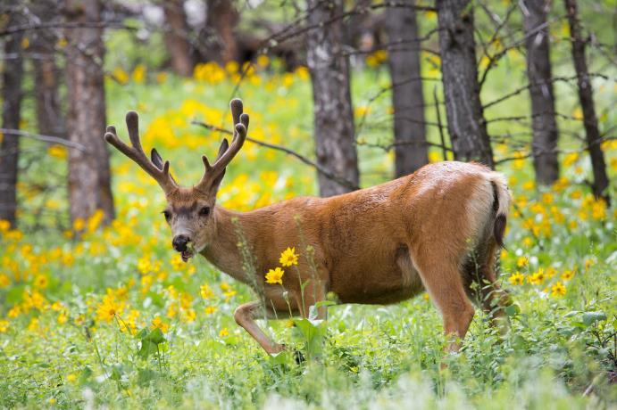
Collect your food!
Notes:
Procedure #2:
Students will be determining the importance of plants/ food through an activity.

Slide 8
Notes:
Procedure #2:
What can be determined from the activity?

Slide 9
Green flowers represent native plants.
Yellow flowers represent noxious weeds.
Notes:
Procedure #3:
Through a class discussion, students will be introduced to the impact of noxious weeds.

Slide 10
What do you notice about the noxious weeds and the native plants?
Notes:
Procedure #3: The darker yellow flowers represent the yellow papers torn in half.

Slide 11
Let’s do it again!
Notes:
Procedure #4:
Students will complete the activity again not eating the noxious weeds to determine a new outcome.

Slide 12
Green,
YUM!
Yellow,
YUCK!
Notes:
Procedure #4:

Slide 13
Now what will the wildlife eat?
Notes:
Procedure #5:
Students will be introduced to the challenges when noxious weeds are left as a food source.

Slide 14
How can we be good stewards of Wyoming plants and wildlife?
Weed and Pest spraying weeds
Squirrel eating pinecones
Notes:
Procedure #6
Students will determine ideas of how to solve the problem of noxious weeds through the lens of good stewardship.

Slide 15
Wyoming Stewards
Why should we care about noxious weeds (invasive species)?
Why is it important to solve this problem?
Link to Weed & Pest Overview
Notes:
Procedure #6
The article will be read aloud to students and they should be able to explain why it is important to solve the problem.

Slide 16
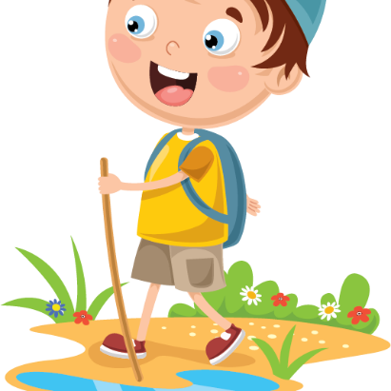
Human, Wildlife & Plants
What are other plant and human relationships or challenges that you are aware of?
How might the challenges you mentioned be solved?
Notes:
Procedure #7
Students will answer the posed questions.

Slide 17
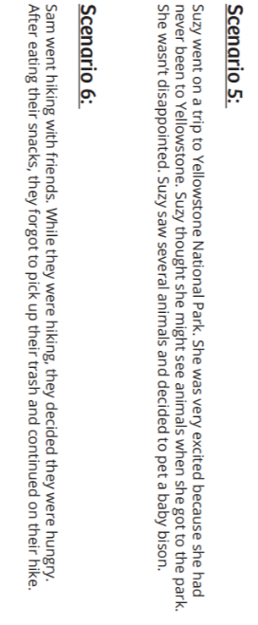
Group Work
Link to Scenarios
Notes:
Procedure # 8: The individual scenarios are provided on the following slides.

Slide 18
Scenario #1
Park Ranger Steve notices that some hikers have strayed from the trail. He finds the hikers and explains to them that when they are not on the trail, they could be harming native plants or disturbing the homes of wildlife. The ranger explains that trails are marked so that the plants and wildlife’s homes can stay safe. The hikers apologize and make sure to stick to the trails for the remainder of their hike.
Notes:
Procedure #8
Students will individually determine if their scenario is helpful or not.

Slide 19
Scenario #2
Abby is camping in the mountains of Wyoming. She loves to look at the variety of plants that she finds. Abby stumbles upon a plant that she has never seen before. It looks like a beautiful flower. The plant looks so interesting; Abby wants to pick the plant and take it home with her. Abby then remembers that sometimes noxious weeds can look like flowers. She knows how invasive and harmful noxious weeds can be. Abby doesn’t not know if this plant is a flower or a weed. She decides that she will leave the plant where it is, but she will take a picture so that she can remember what it looks like. She does not want to risk spreading a noxious weed.
Notes:
Procedure #8
Students will individually determine if their scenario is helpful or not.

Slide 20
Scenario #3
Bob overhears two people talking about how they want to hunt a moose this year. Bob knows that the hunting season is over for the year. Bob decides to call the game warden to warn that people may be hunting moose without permission.
Notes:
Procedure #8
Students will individually determine if their scenario is helpful or not.

Slide 21
Scenario #4
Joe was hiking in the forest. He decided that he really liked a flower growing near one of the trees he walked by. He decided to pick the flower and take it back to his campsite. When he got back to his campsite, his wife asked him to go pick more flowers because she really liked the flowers, too.
Notes:
Procedure #8
Students will individually determine if their scenario is helpful or not.

Slide 22
Scenario #5
Suzy went on a trip to Yellowstone National Park. She was very excited because she had never been to Yellowstone. Suzy thought she might see animals when she got to the park. She wasn’t disappointed. Suzy saw several animals and decided to pet a baby bison.
This Photo by Unknown Author is licensed under CC BY-SA-NC
Notes:
Procedure #8
Students will individually determine if their scenario is helpful or not.

Slide 23
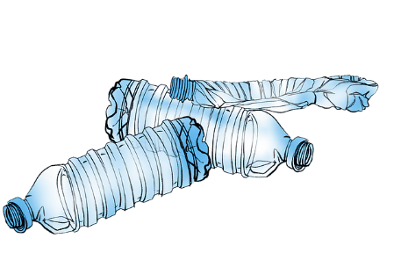
Scenario #6
Sam went hiking with friends. While they were hiking, they decided they were hungry. After eating their snacks, they forgot to pick up their trash and continued on their hike.
Notes:
Procedure #8
Students will individually determine if their scenario is helpful or not.

Slide 24
Scenario Chart
As your classmate shares a scenario, answer the following questions, and write your answer on the Scenario Chart.
Was this person helping or harming the land?
How do you know the person was helpful or harmful?
Link to Weeds Invade!
Notes:
Procedure #8
Each small group will collaborate to complete the chart about their scenario.

Slide 25
Were they good stewards?
Link to Scenarios
Notes:
Procedure # 9:
As a whole group, you will determine the correct answer for each scenario. Students will interact by providing a thumbs up or down response.

Slide 26
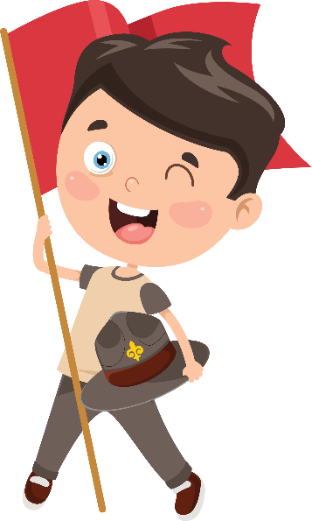
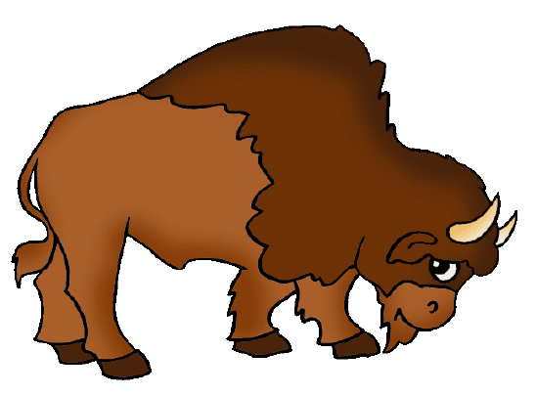
How can we fix the problem?
This Photo by Unknown Author is licensed under CC BY-SA-NC
Notes:
Assessment
Students will provide a solution to each scenario to determine if they are able to correctly address the problem.

Slide 27
What did we learn from today’s challenge?
Notes:
Provide the students an opportunity to explain their learning.

