Slide 1
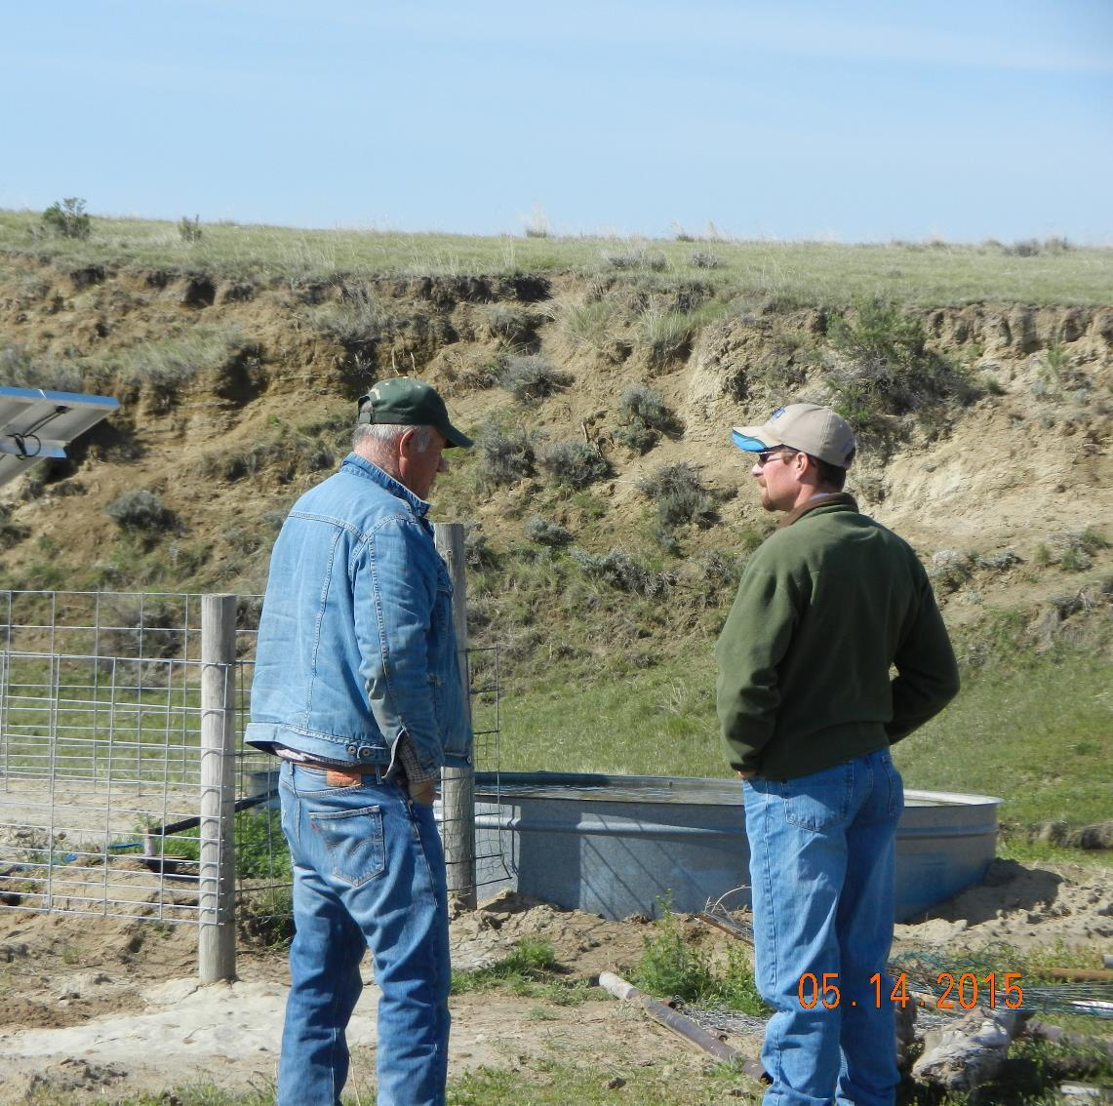
Outdoor Recreation & Tourism
3rd Grade
Lesson 5: Careers in Stewardship
Notes:
The name of the lesson is a link to the Wyoming Agriculture in the Classroom website where the lesson can be downloaded.

Slide 2
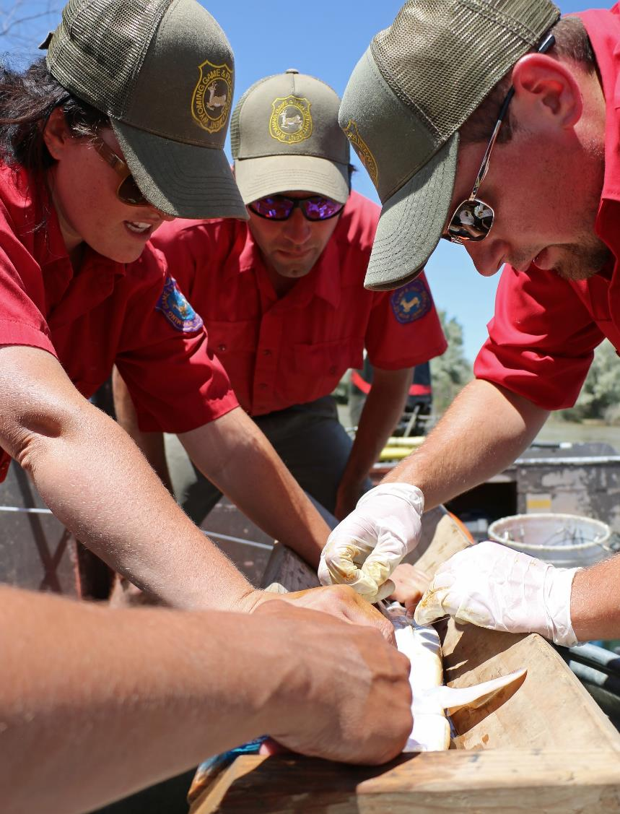
Today’s Challenge:
Students will:
Describe one of three occupations: Weed & Pest (Ecologist), Game & Fish (Game Warden), and Parks & Recreation (Park Ranger) involved in land use and maintenance.
Explain how being a good steward impacts the culture of Wyoming.
Notes:
This is the focus of today’s lesson.

Slide 3
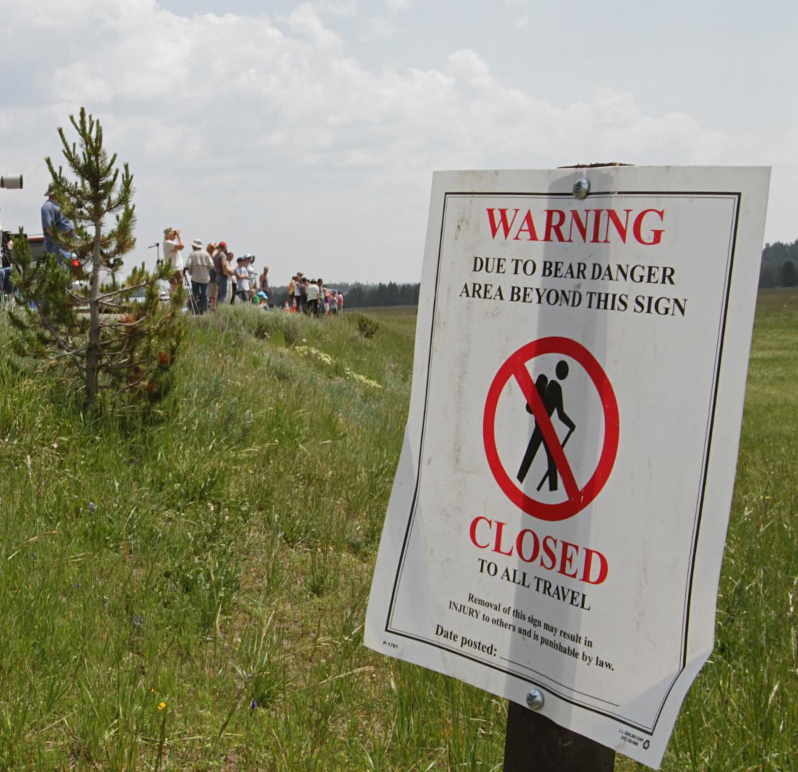
Vocabulary:
Ecologist – a person who studies how animals and plants interact in an environment
Game Warden – a person who cares for wildlife and makes sure that hunting and fishing laws are obeyed
Park Ranger – a person in charge of managing/caring for a park
Notes:
These are the new vocabulary words for this lesson. You may need to adjust this list according to the needs of your students.

Slide 4
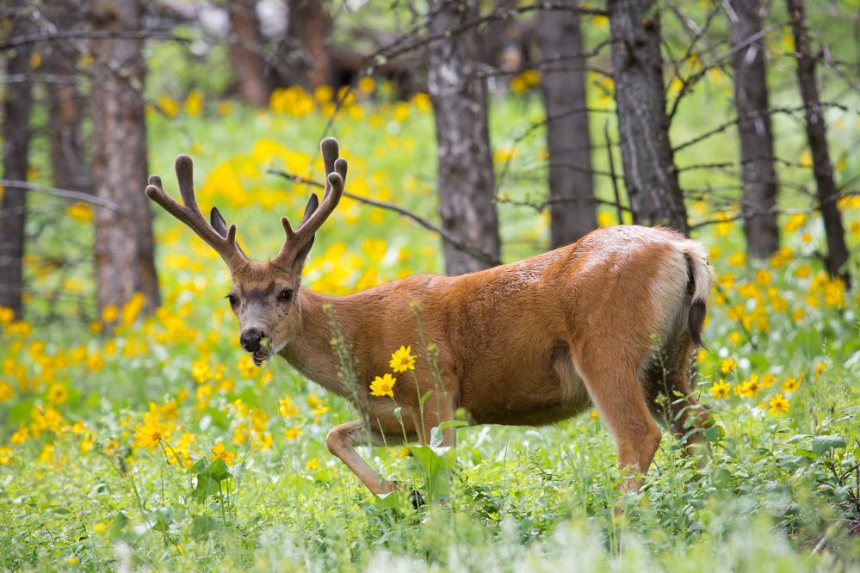
Highlights from our last lesson:
Think Back On:
The relationship between humans, plants, and animals
Invasive species (noxious weeds)
How to be a good steward of plants and wildlife
Notes:
Look back on the previous lesson and review the key ideas.

Slide 5
Day 1

Slide 6
Stewardship Jobs in Wyoming
Ecologist Game Warden Park Ranger
Notes:
Day 1/Procedure #1 & #2: Please see ‘Teacher Note’ in the lesson for additional information.

Slide 7
With your partner: Read the assigned text. Answer the questions on the graphic organizer.
Link to Graphic Organizer
Notes:
Day 1/Procedure #3
Students will read assigned text and complete the organizer.

Slide 8
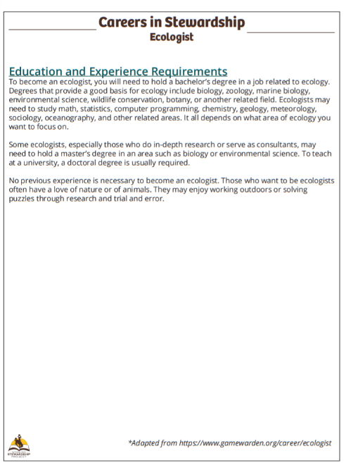
Ecologist
Link to Text
Notes:
Day 1/Procedure #3
Students will be assigned their text for reading. You may need to adjust the reading to meet the needs of your students, such as with a partner or small group.

Slide 9
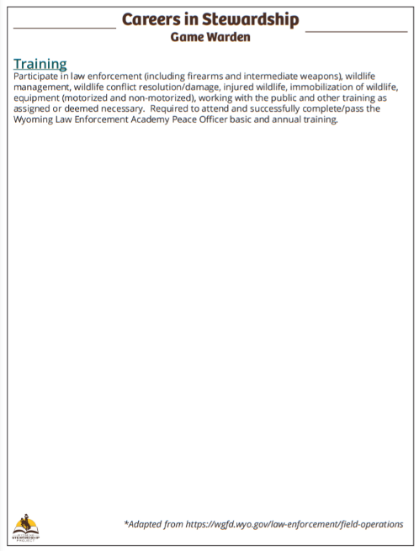
Game Warden
Link to Text
Notes:
Day 1/Procedure #3
Students will be assigned their text for reading.

Slide 10
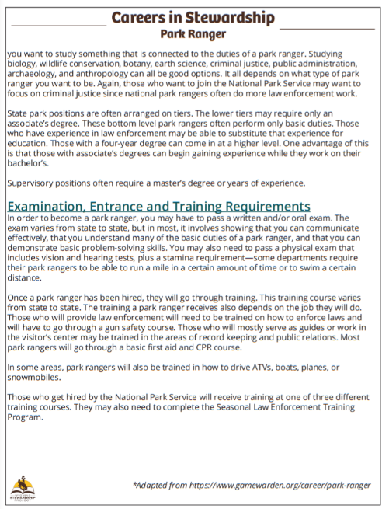
Park Ranger
Link to Text
Notes:
Day 1/Procedure #3
Students will be assigned their text for reading.

Slide 11
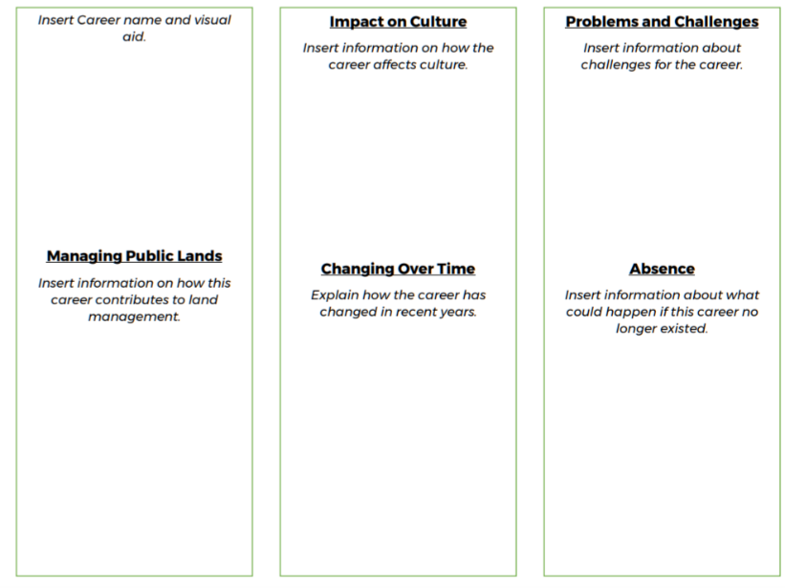
Create a brochure about a career!
Explain why the career is important.
Use the information from your Graphic Organizer.
Fill in the Brochure Template.
Decorate your Brochure!
Link to Template
Notes:
Day 1/Procedure #4
Students will create brochures after the complete the previous steps.

Slide 12
Day 2

Slide 13
Share your Brochure!
Present To Your Group
Your Group Presents to the Class
Notes:
Day 2/Procedure #1 & #2
Students will be sharing their brochures with the class.

Slide 14
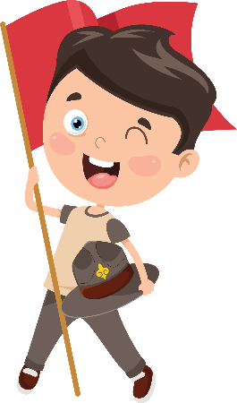
It Takes Everyone!
Notes:
Day 2/Procedure #2
What is our role in the stewardship?

Slide 15
What Did We Learn?
Write a summary of what you learned about each career.
Write 2 sentences for each career.
Include the name of the occupation.
Why is this job important to Wyoming?
How are people in this career good stewards?
Notes:
Assessment
Students will be demonstrating their understanding of the content and lesson through a summary sentence.

Slide 16
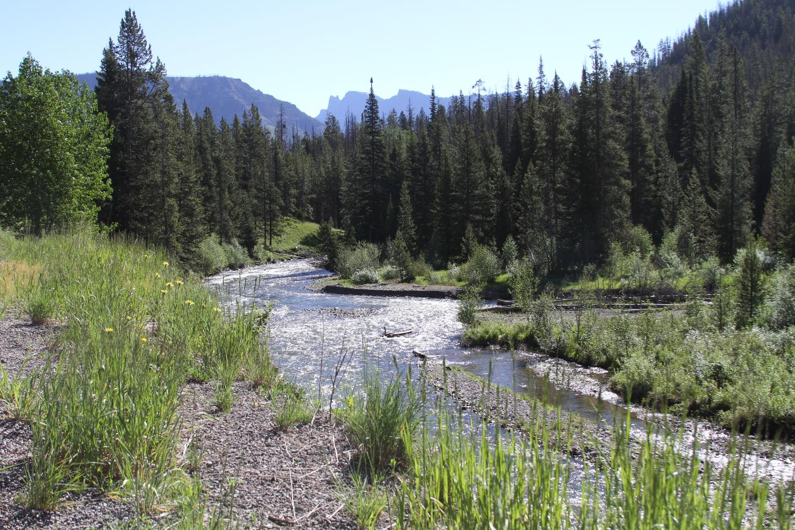
What did we learn from today’s challenge?
Notes:
Provide the students an opportunity to explain their learning.

