Slide 1
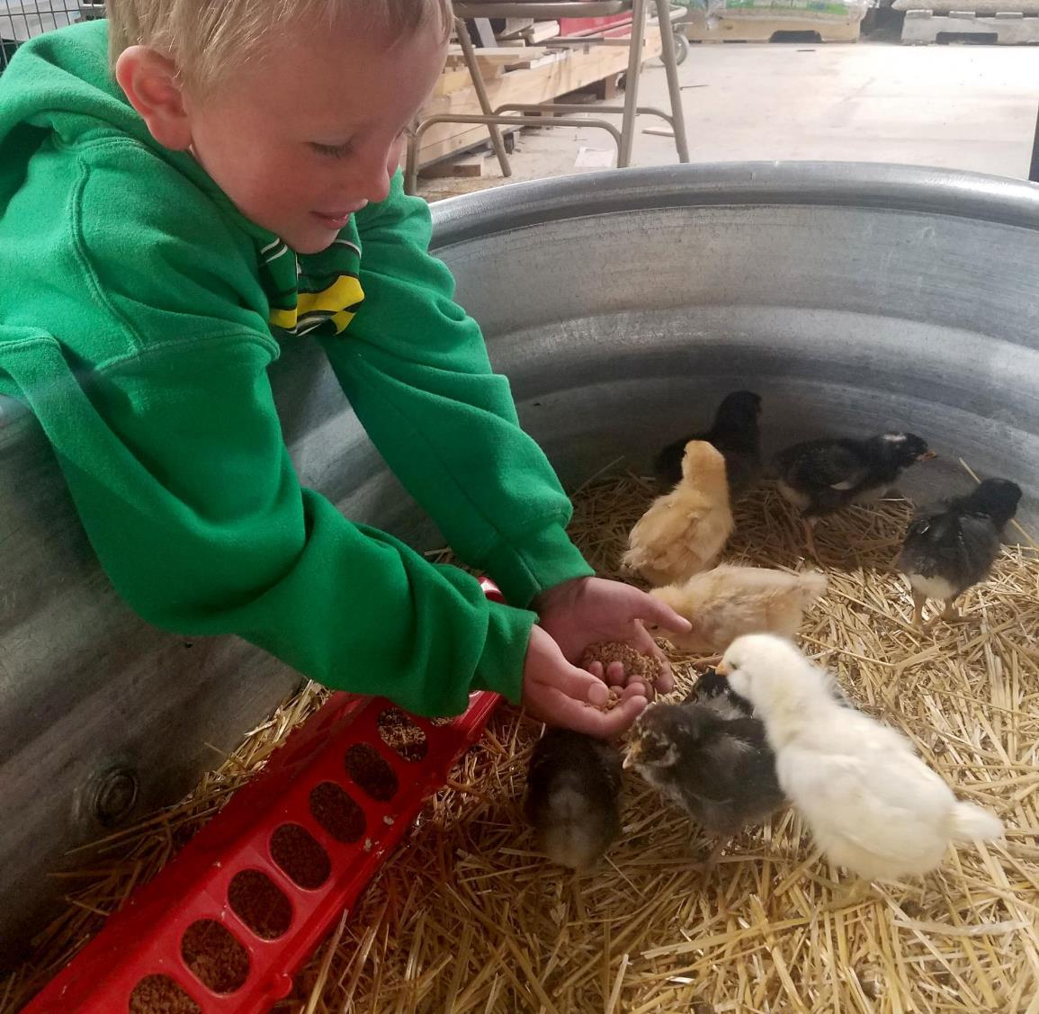
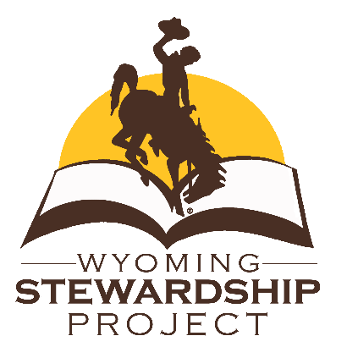
Agriculture
4th grade
Lesson 2:
Hills and Valleys
Notes:
Name of the lesson will be a link to the lesson can be viewed or downloaded.

Slide 2
Today’s Challenge
Students will
Understand which crops and livestock are produced in our state.
Apply information of topography, irrigation, and precipitation to draw conclusions about crops or livestock.
Notes:
This is the focus of today’s lesson.

Slide 3
Crop - a cultivated plant that is grown for food, fiber, or livestock feed
Irrigation - the process of delivering water to crops
Livestock- animals kept for use and profit
Precipitation - the amount of water an area receives through weather, example: rain and snow
Topography - the features such as mountains and rivers in an area of land
Vocabulary
Notes:
Look back on the previous lesson and review the key ideas.

Slide 4
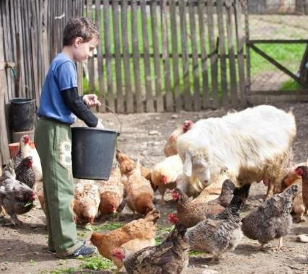
Think back on:
Stewardship
Positive and negative facts in the article “The Roots of Agriculture”
Highlights from our last lesson
What did you learn from yesterday’s challenge?
This Photo by Unknown Author is licensed under CC BY
Notes:
Look back on the previous lesson and review the key ideas.

Slide 5
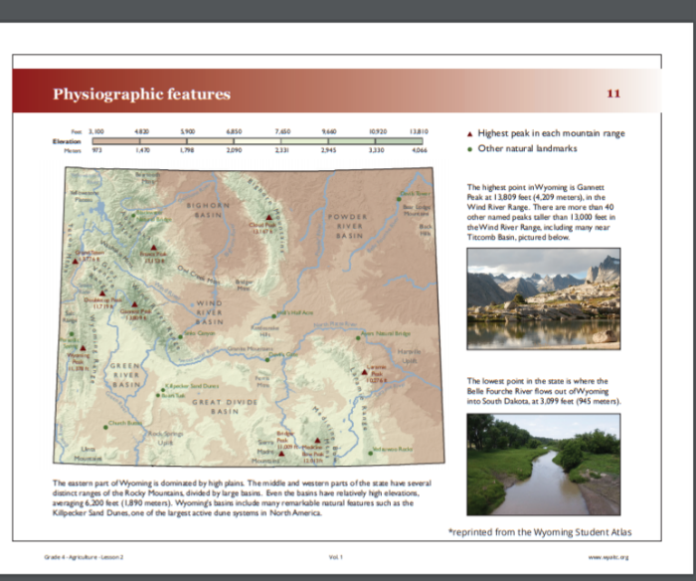
What do you think Topography is?
Notes:
Procedure #1 & #2

Slide 6
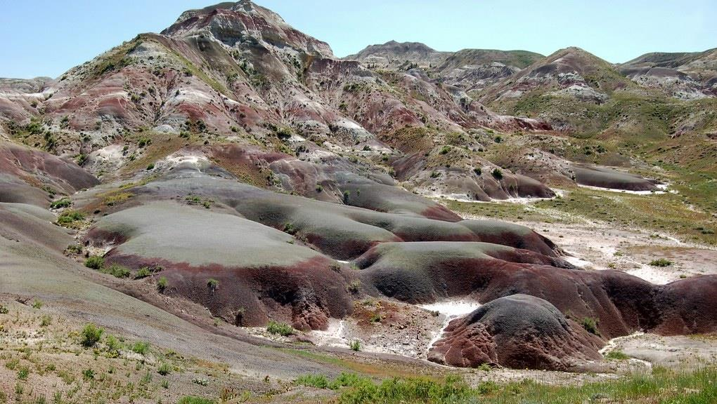
“What is Topography” Video
What is topography?
Did your definition or idea of topography change after watching the video?
This Photo by Unknown Author is licensed under CC BY-SA-NC
Notes:
Procedure #2 & #3
Discuss with the students that topography is the features such as mountains and rivers in an area of land. Use the map to help students build an understanding of the information about Wyoming’s topography.

Slide 7
How could topography potentially affect what
crops/livestock are produced in Wyoming?
Notes:
Procedure #4
Provide the students with the definition of crops before discussing the posted question. More questions are included in the lesson.

Slide 8
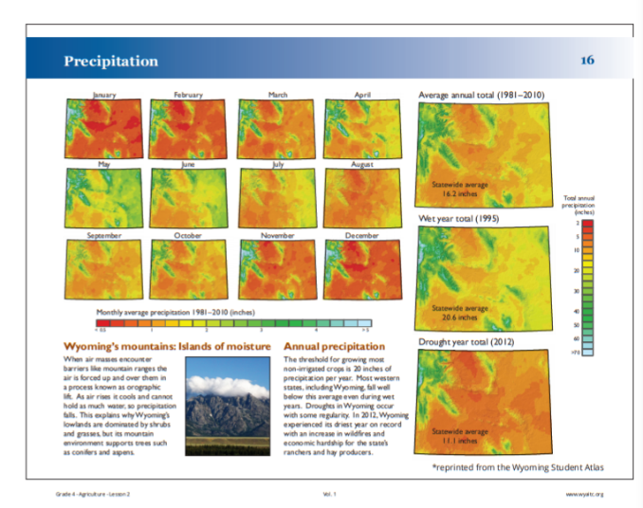
What is the definition of precipitation?
Notes:
Procedure #6
Help the students build an understanding of the information about Wyoming’s precipitation.

Slide 9
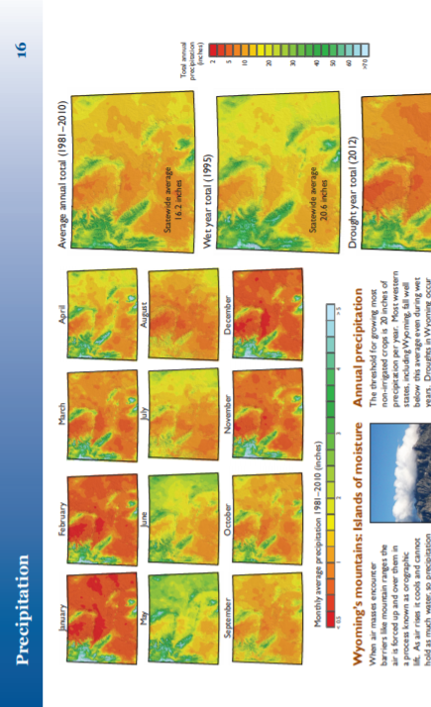
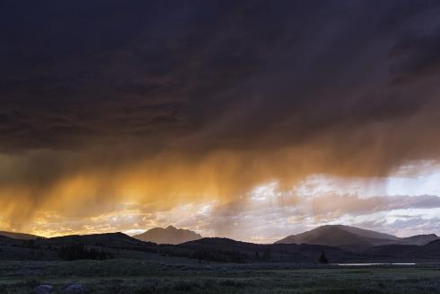
How could precipitation potentially affect what crops and livestock are produced in Wyoming?
Notes:
Procedure #7
Some more questions for the students to think about are included in the lesson.

Slide 10
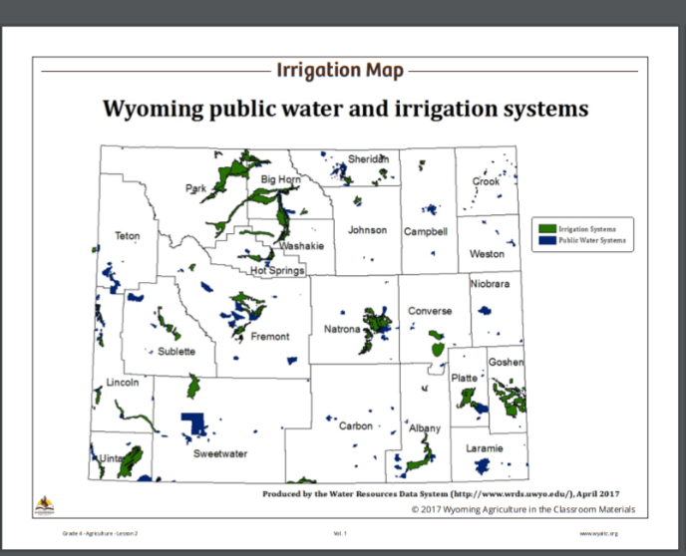
What is the definition of irrigation?
Notes:
Procedure #8 & #9
Help students gather information about Wyoming’s irrigation.

Slide 11
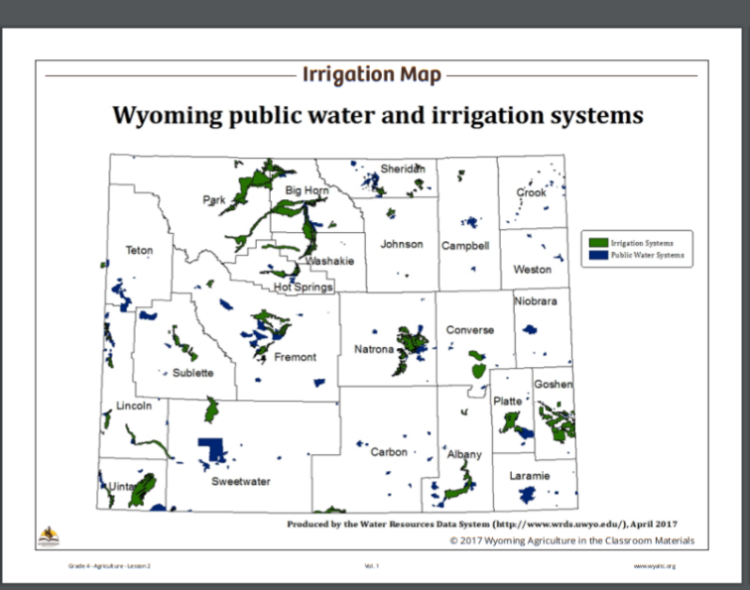
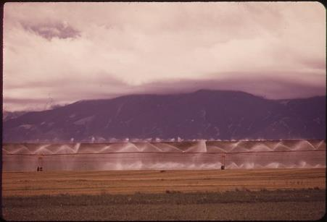
How could irrigation
potentially affect
what crops and
livestock are
produced in
Wyoming?
This Photo by Unknown Author is licensed under CC BY-SA
Notes:
Procedure #10
Some more questions for the students to discuss are found in the lesson.

Slide 12
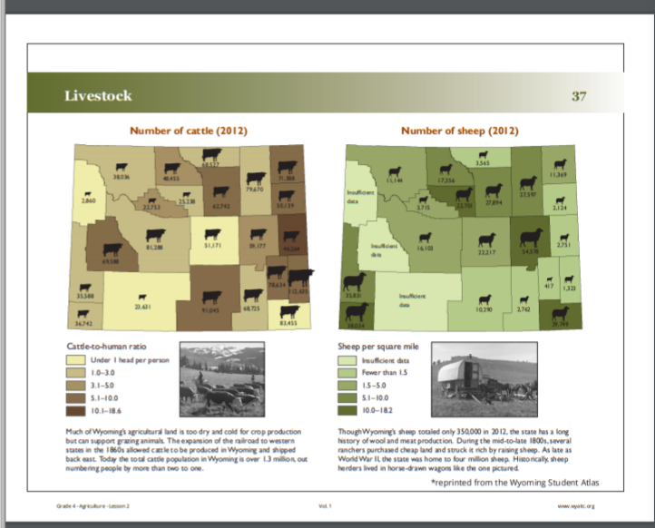
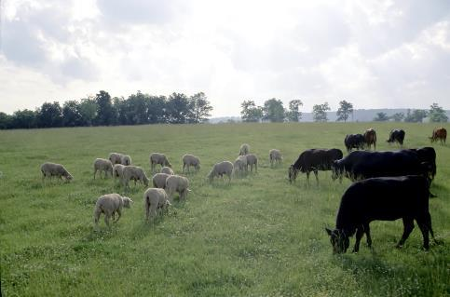
What do you
notice when you compare the
maps of Carbon
County and
Park County livestock?
This Photo by Unknown Author is licensed under CC BY-SA
Notes:
Procedure #11

Slide 13
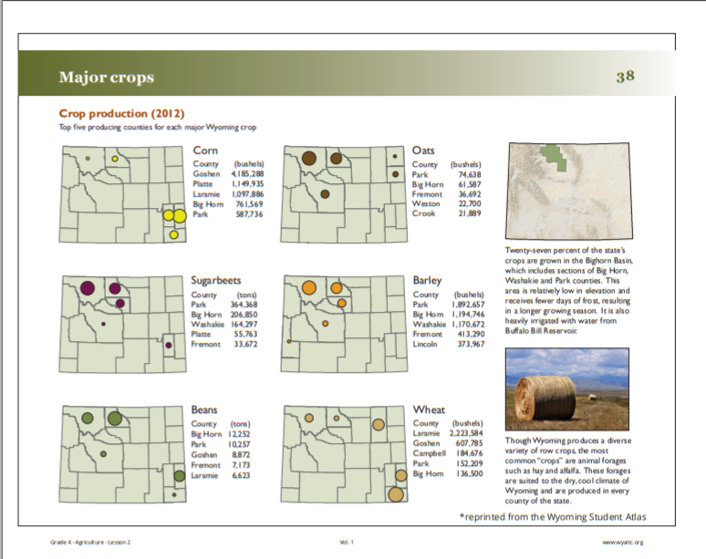
What do you notice when you
compare Carbon County and Park
County’s amount of crops?
Notes:
Procedure #12
More discussion questions in the lessons

Slide 14
What have you learned today that helps you understand the effects topography, precipitation, and irrigation have on our state’s livestock and crop production?
Notes:
Procedure #14 #15
Have students use the inside outside circle activity to discuss the posted question. The directions to the inside/outside circle are in the teacher’s notes.

Slide 15
3-2-1Exit Ticket link
Notes:
Procedure #15 and Assessment
The maps will be used again in lesson 6. You may want to collect the maps if you passed them out.

Slide 16
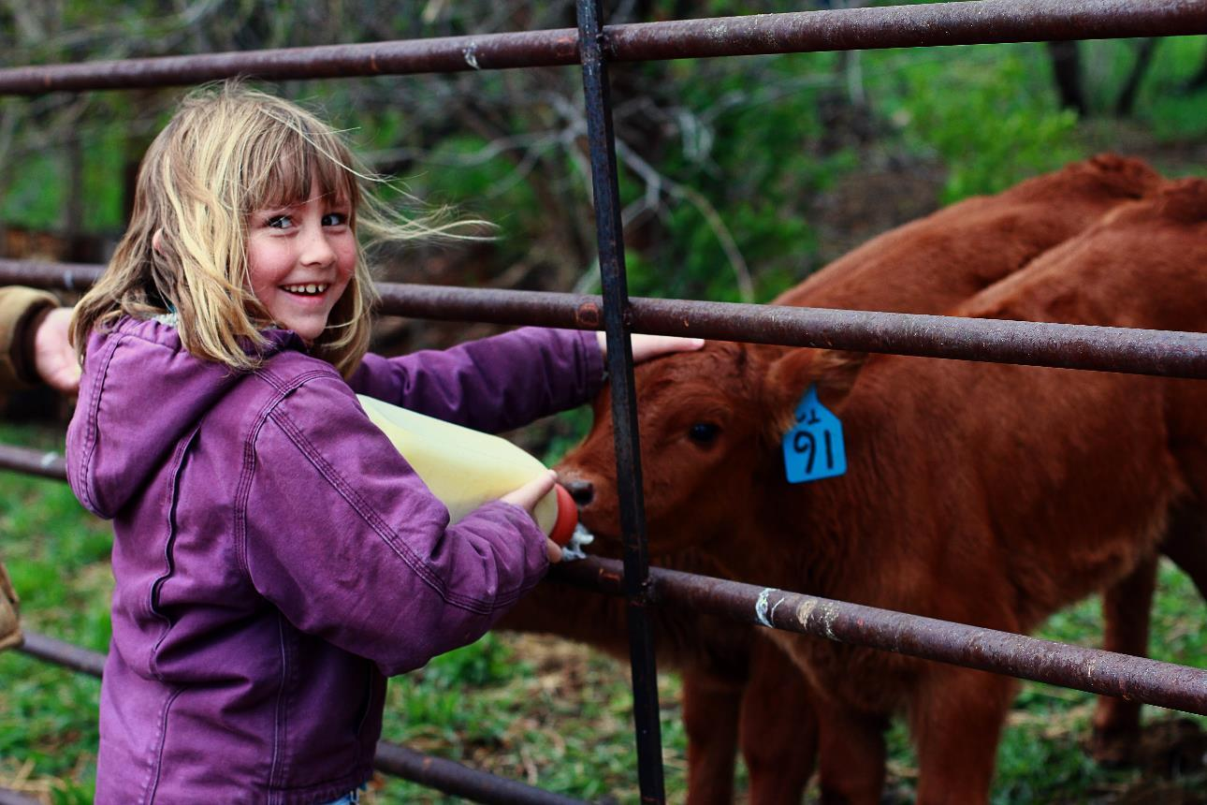
What did we learn from today’s challenge?
Notes:
Provide the students an opportunity to explain their learning.

