Slide 1
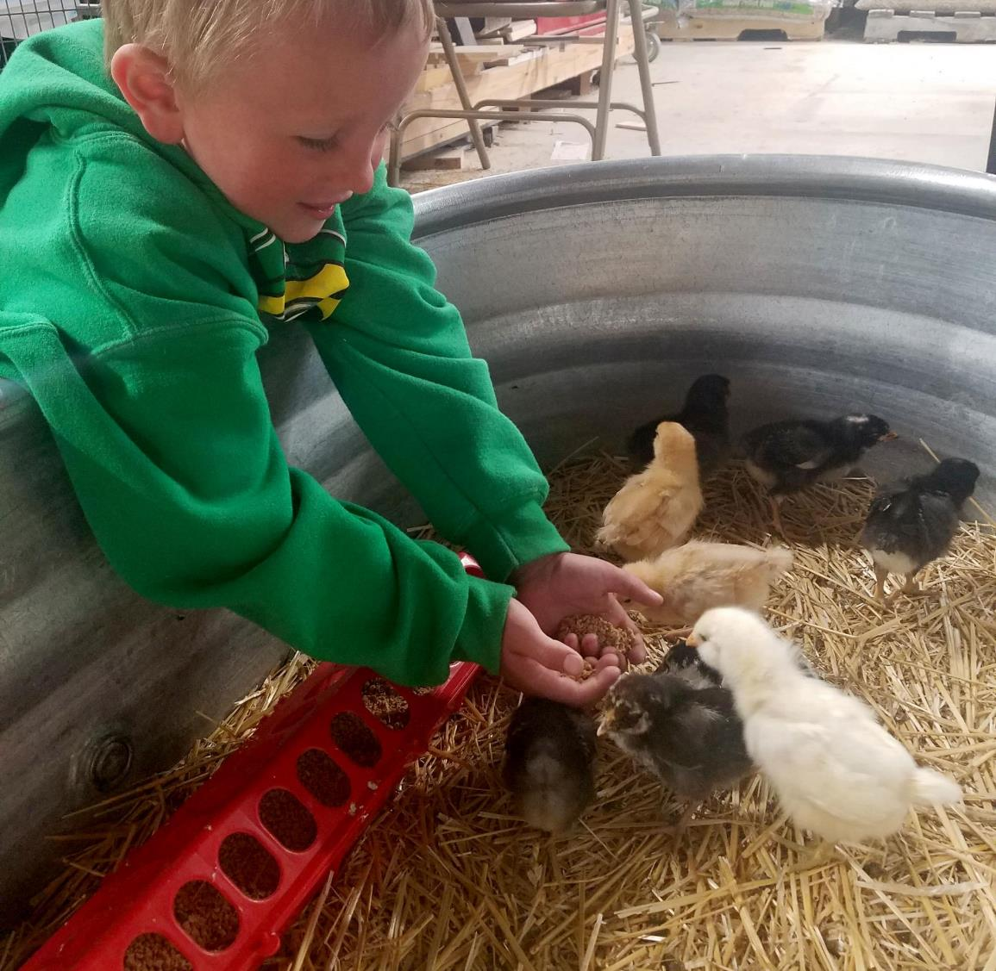
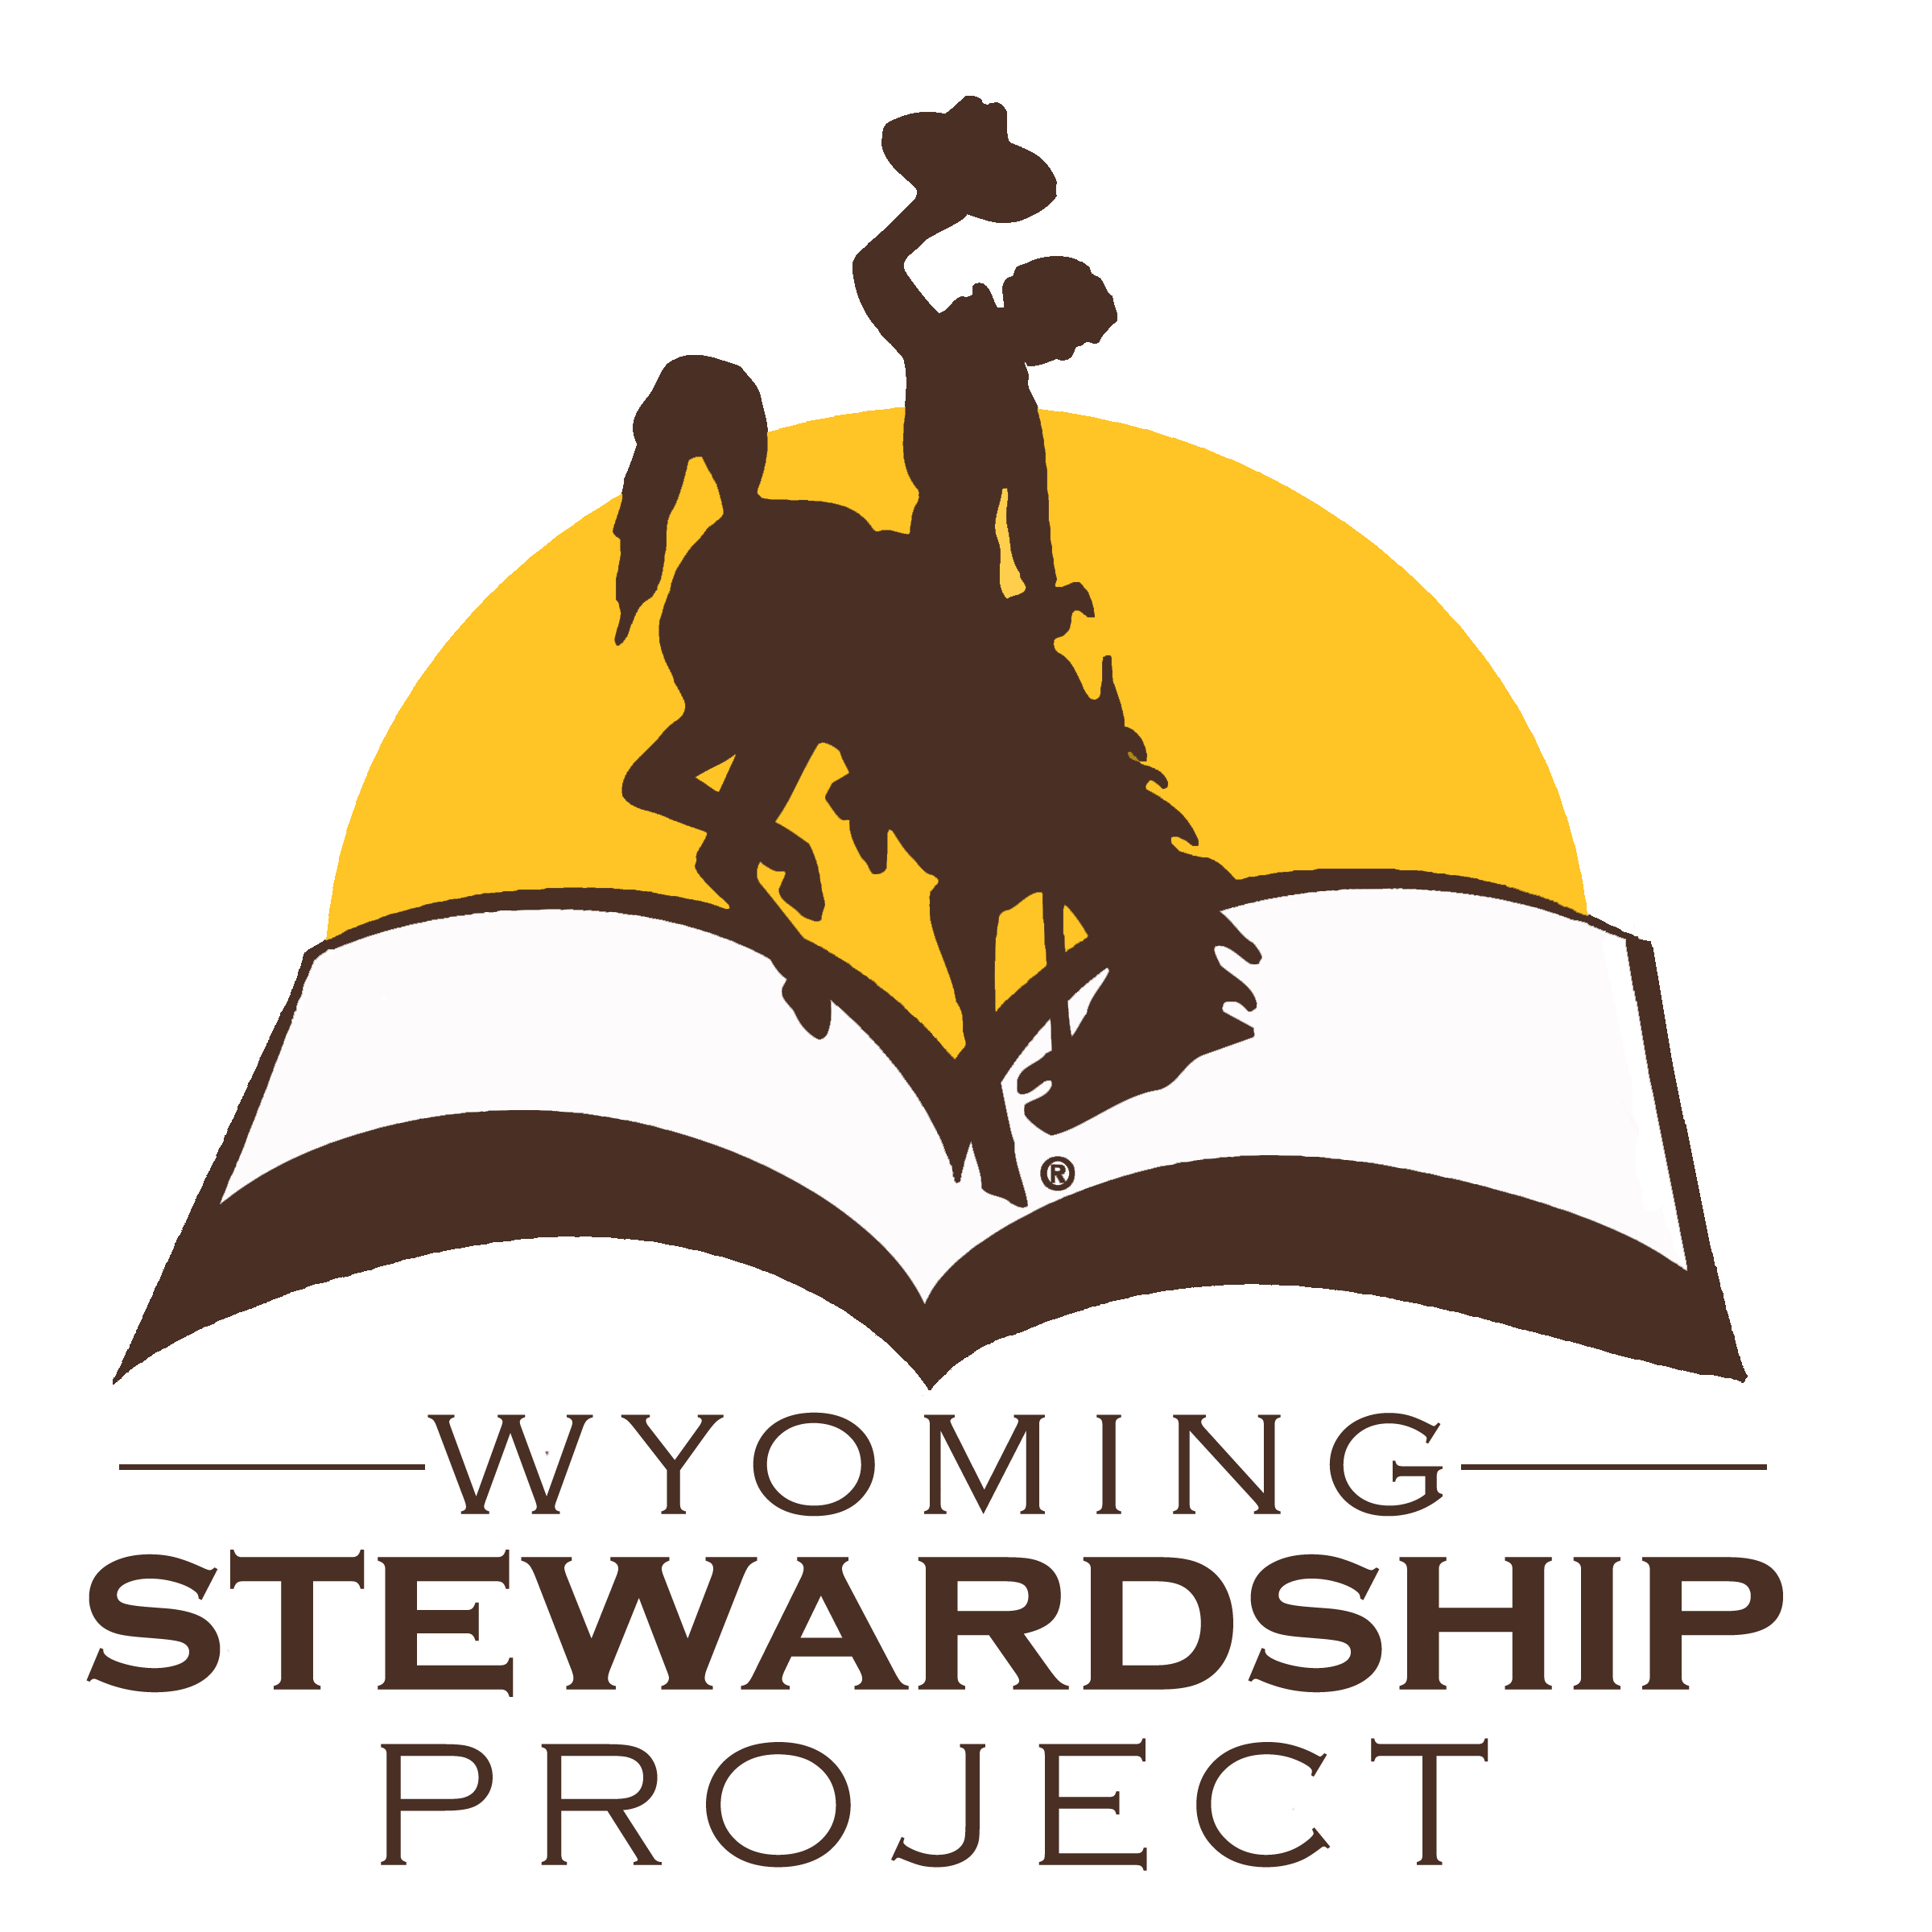
Agriculture
4th grade
Lesson 3:
Made for Success
Notes:
Name of the lesson will be a link to the lesson can be viewed or downloaded.

Slide 2
Today’s Challenge
Student’s will
Read and discuss how ranchers can be good stewards.
Create a graphic of various Wyoming animals and their structures and make a claim as to why the animals are suited to Wyoming.
Notes:
This is the focus of today’s lesson.

Slide 3
Aerate - process of introducing air into the soil to improve plant growth
Economy - financial system of interaction and exchange
Livestock - animals kept for use and profit
Oversight - the action of overseeing or supervising something
Rancher - a person who raises livestock and may also cultivate the land or crops
Ruminant - animal’s stomach with four components or chambers enabling it to digest plant materials
Sustainable - able to be maintained, able to last or continue for a long time
Ungulate - hoofed mammal
Vocabulary
Notes:
These are the new vocabulary words for this lesson. You may need to adjust this list according to the needs of your students.

Slide 4
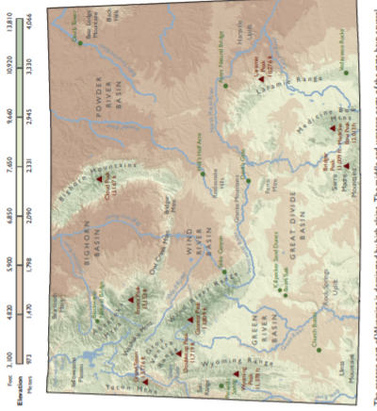
Think back on:
Livestock and crops
Highlights from our last lesson
What did you learn from yesterday’s challenge?
Notes:
Look back on the previous lesson and review the key ideas.

Slide 5
What would be considered
part of the structure of a house?
Notes:
Procedure #1

Slide 6
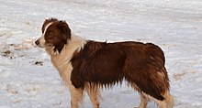
Do animals have structure?
This Photo by Unknown Author is licensed under CC BY-SA
What would be considered
part of the structure of a dog?
Notes:
Procedure #1

Slide 7
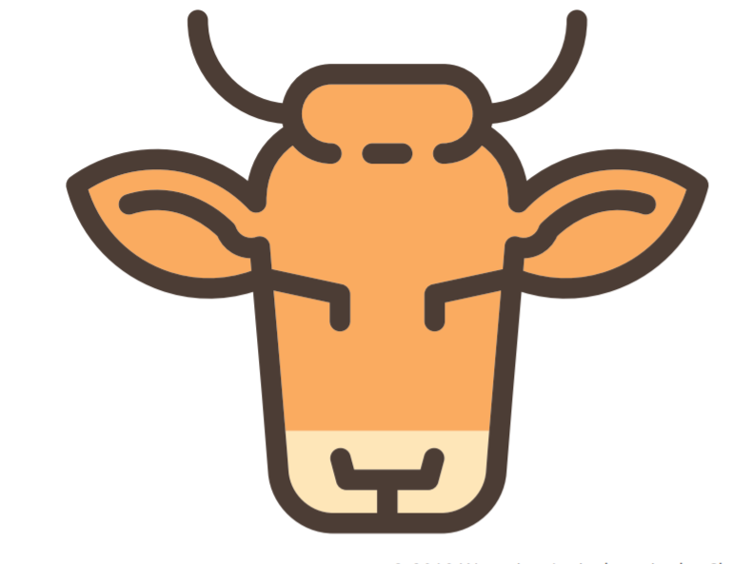
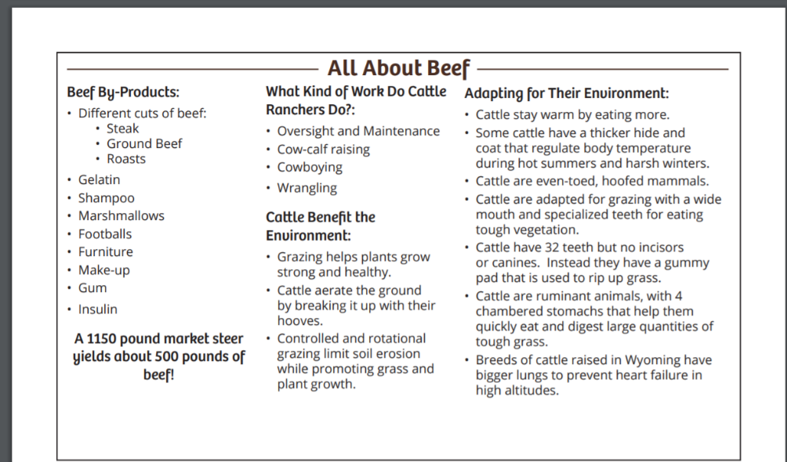
Learn about Beef Cattle
All About Beef link
Notes:
Procedure #2
Groups of 4-5 students or in breakout rooms
Each group of students will be provided the reading material to become experts on their assigned animal.

Slide 8
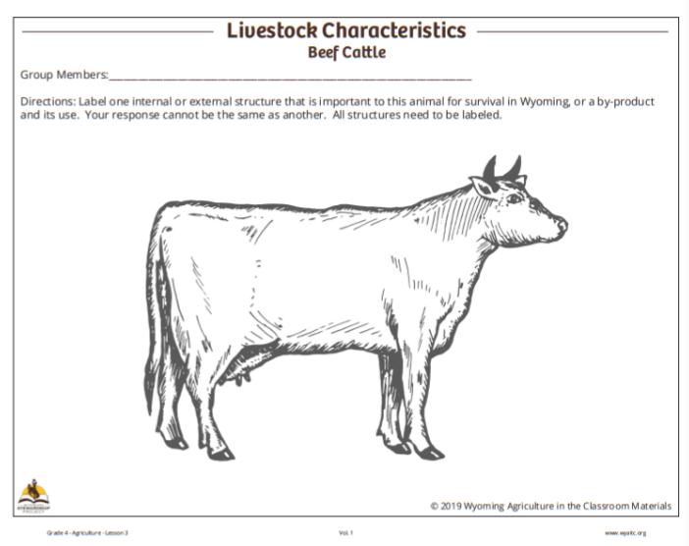
Label the animal’s structure
Notes:
Procedure #2
Groups of 4-5 students or in breakout rooms
Each group of students will be provided the material to label the structure of their assigned animal. The correct labeling of each structure is in the resources on the website.

Slide 9
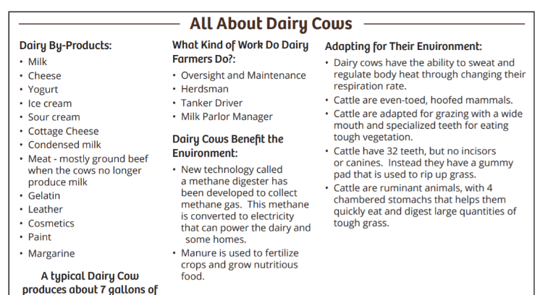
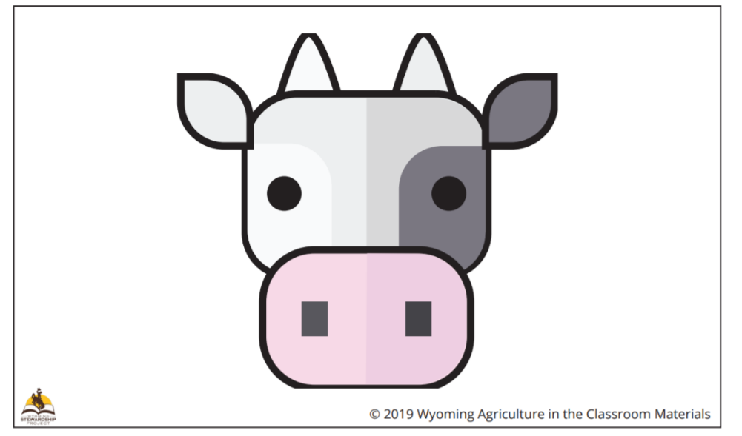
Learn About Dairy Cattle
All About Dairy Cows link
Notes:
Procedure #2
Groups of 4-5 students or in breakout rooms
Each group of students will be provided the reading material to become experts on their assigned animal.

Slide 10
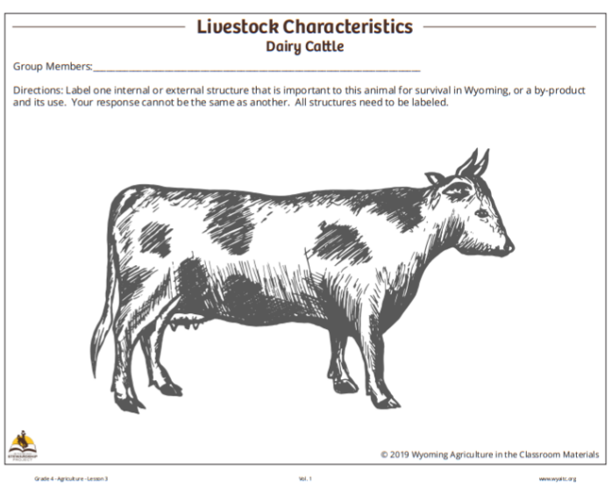
Label the animal’s structure
Notes:
Procedure #2
Groups of 4-5 students or in breakout rooms
Each group of students will be provided the material to label the structure of their assigned animal.

Slide 11
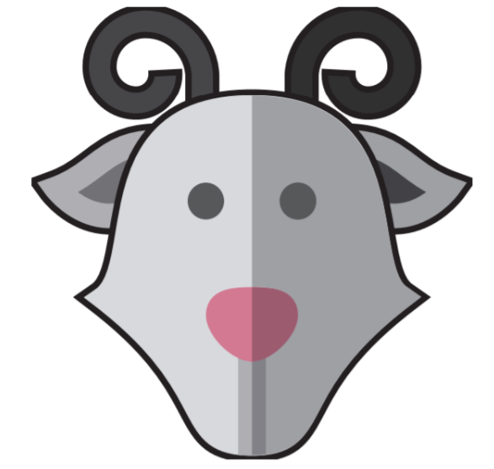
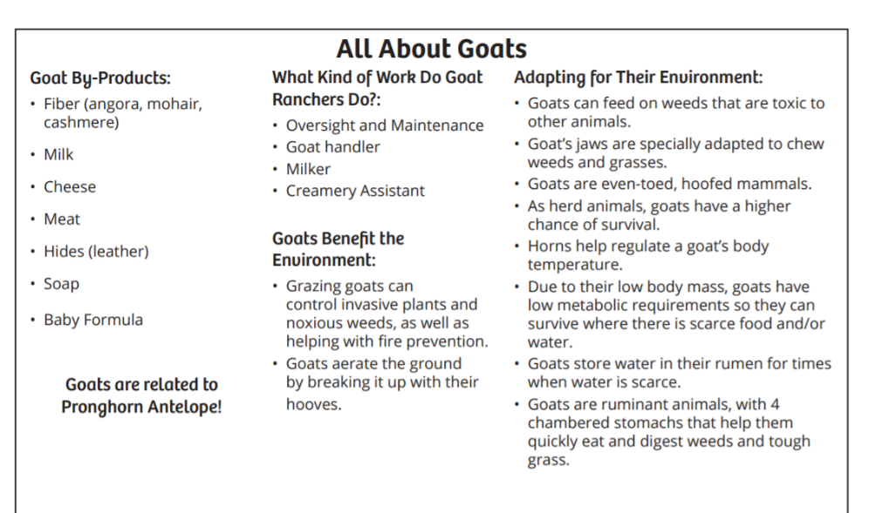
Learn about Goats
All About Goats link
Notes:
Procedure #2
Groups of 4-5 students or in breakout rooms
Each group of students will be provided the reading material to become experts on their assigned animal.

Slide 12
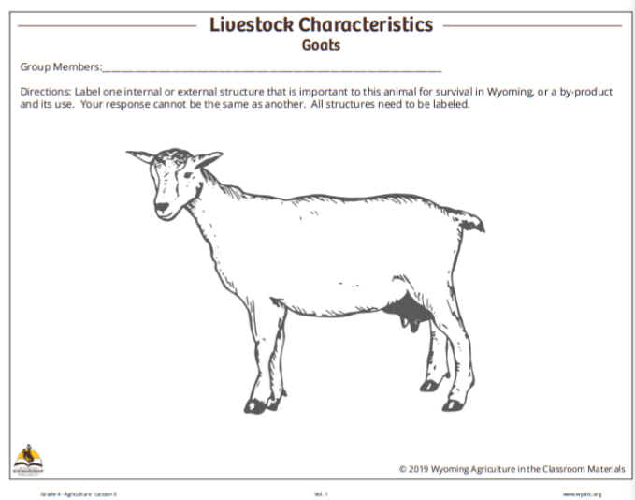
Label the animal’s structure
Notes:
Procedure #2
Groups of 4-5 students or in breakout rooms
Each group of students will be provided the material to label the structure of their assigned animal.

Slide 13
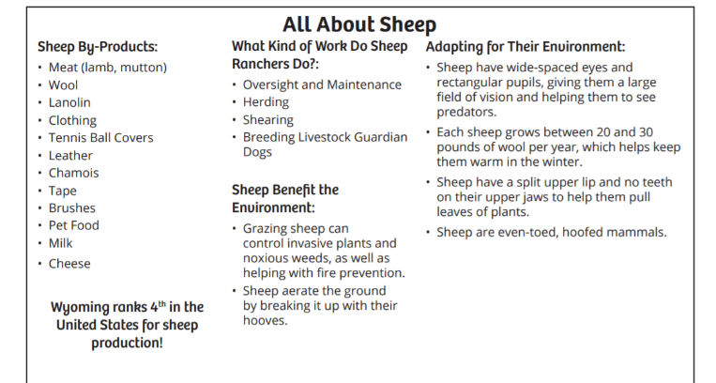
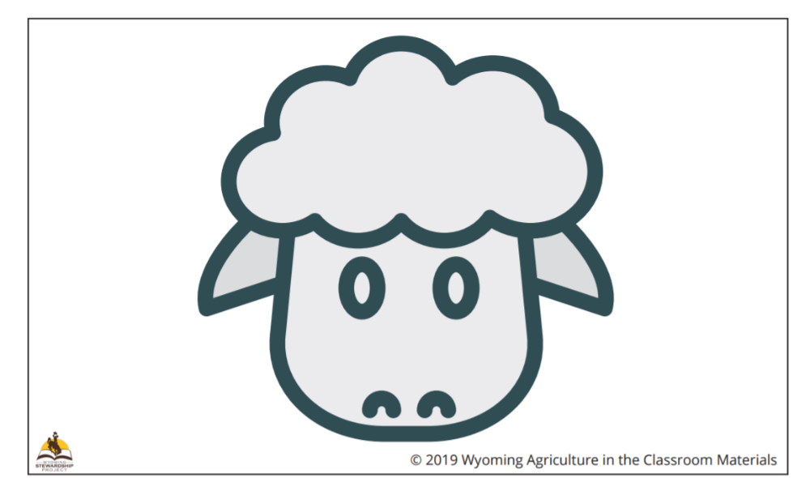
Learn about Sheep
All About Sheep link
Notes:
Procedure #2
Groups of 4-5 students or in breakout rooms
Each group of students will be provided the reading material to become experts on their assigned animal.

Slide 14
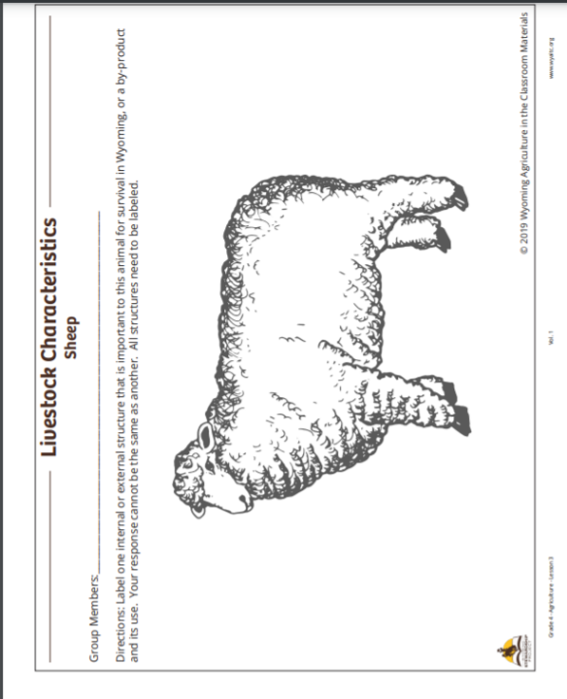
Label the animal’s structure
Notes:
Procedure #2
Groups of 4-5 students or in breakout rooms
Each group of students will be provided the material to label the structure of their assigned animal.

Slide 15
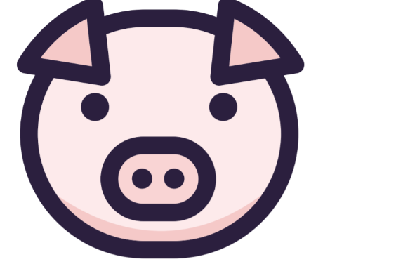
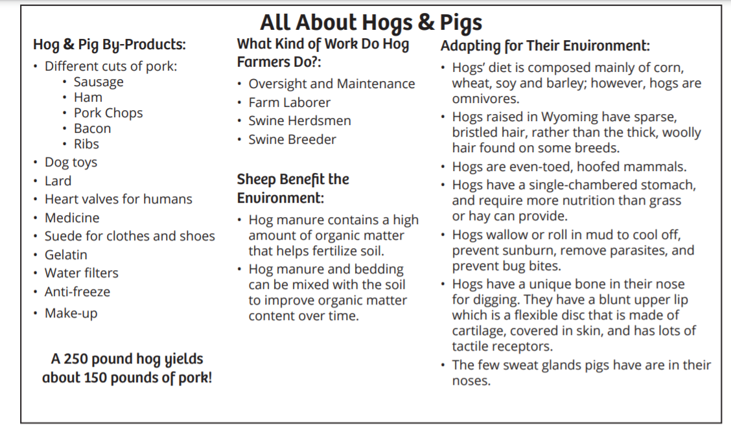
Learn about Hogs & Pigs
All About Hogs & Pigs link
Notes:
Procedure #2
Groups of 4-5 students or in breakout rooms
Each group of students will be provided the reading material to become experts on their assigned animal.

Slide 16
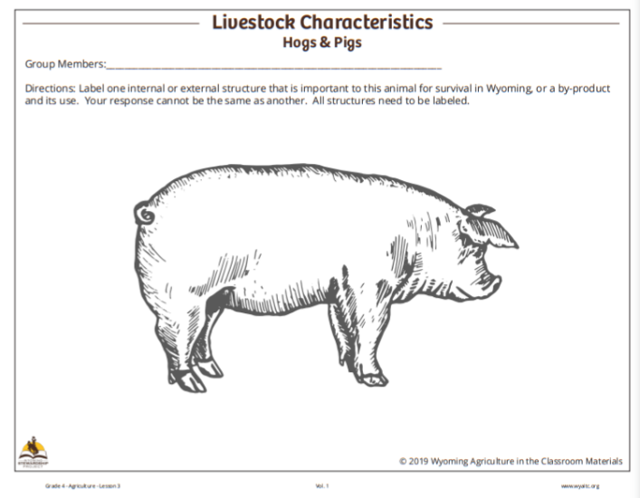
Label the animal’s structure
Notes:
Procedure #2
Groups of 4-5 students or in breakout rooms
Each group of students will be provided the material to label the structure of their assigned animal.

Slide 17
What important structures were labeled for each animal’s survival in Wyoming?
Notes:
Procedure #4
Monitor group discussions to identify any missing structures or misconceptions.

Slide 18
Are any of these structures more
important than the others?
Why or Why not?
If any of the structures of these animals were missing, would the animal survive in Wyoming?
How does animal structure impact stewardship decisions?
Notes:
Procedure #5 & #6
Multiple questions will be discussed. The whip Around strategy is used in this procedure.

Slide 19
Make a Claim link
Notes:
Assessment or check in of the content. A technology tool or app of another kind may work here as well. A list of suggested technology tools is available on the teaching resources page for the 4th Grade Agriculture unit.

Slide 20
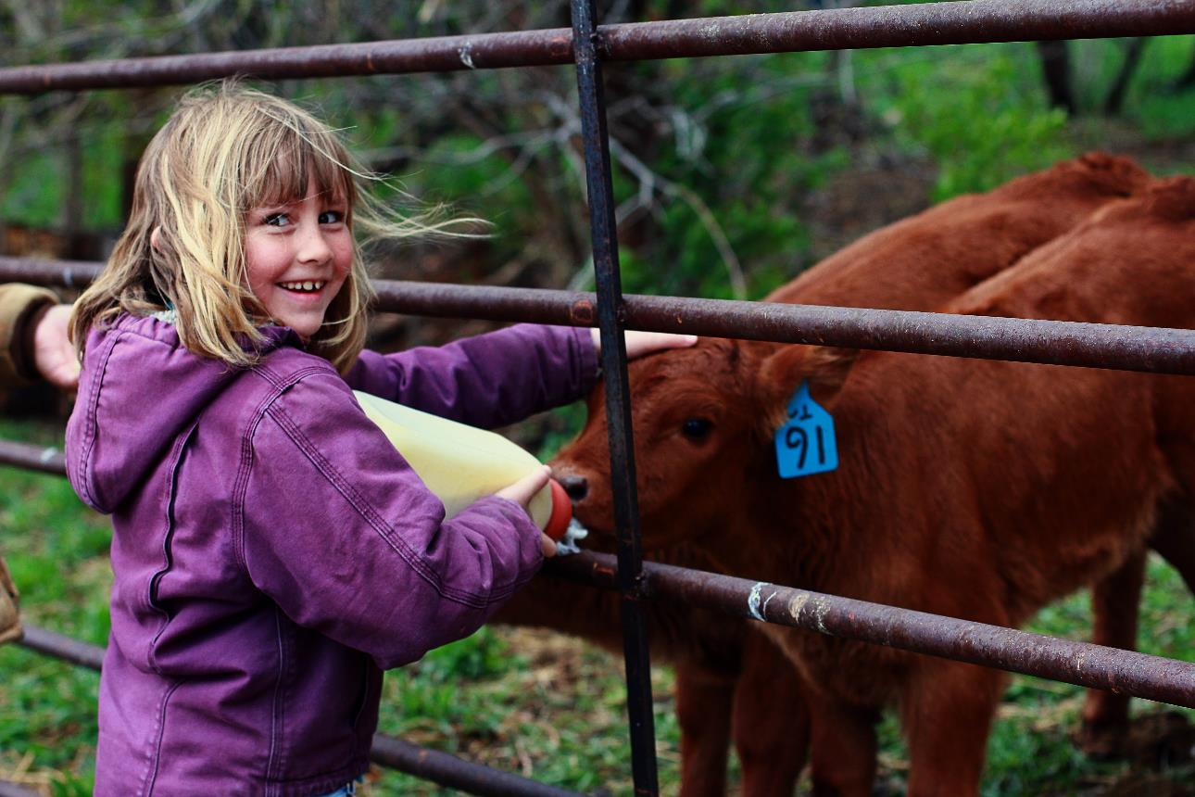
What did we learn from today’s challenge?
Notes:
Provide the students an opportunity to explain their learning.

