Slide 1
Minerals & Energy 4th Grade Lesson 1: What Does Stewardship Mean to You?
Notes:
The name of the lesson is a link to the Wyoming Agriculture in the Classroom website where the lesson can be downloaded.

Slide 2
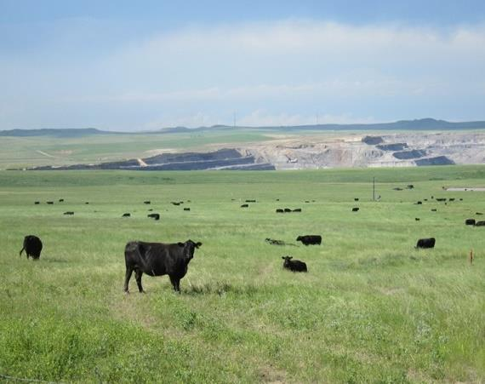
Essential Question:
How can we be stewards of Wyoming’s mineral and energy resources to benefit current and future generations?
Notes:
This is a chance to share the Essential Question for this unit.

Slide 3
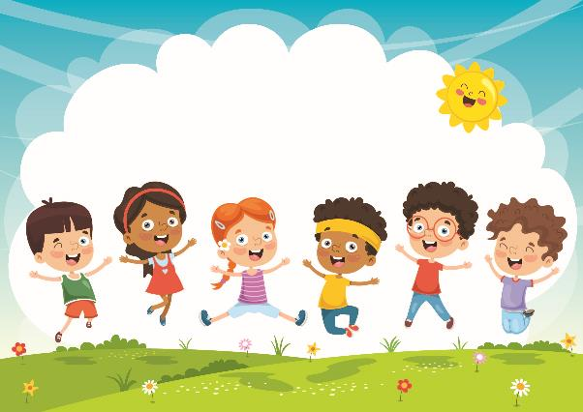
Today’s Challenge: Students will gain an understanding of the term stewardship and of their role in being stewards.
Notes:
This is the focus of today’s lesson.

Slide 4
Vocabulary
Benefit- an advantage or profit gained for something
Conservation- the careful utilization of a resource in order to prevent waste and leave some for future generations
Entrust- to give somebody the responsibility of doing something or of caring for someone or something
Generation- a group of individuals, most of whom are the same approximate age
Resource- a place or thing that provides something useful
Steward- an individual who manages areas or resources
Stewardship- As Wyoming citizens, we are stewards entrust with the responsible development, care, and use of our resources to benefit current and future generations.
Notes:
These are the new vocabulary words for this lesson. You may need to adjust this list according to the needs of your students.

Slide 5
Notes:
Procedure #1
You will discuss the definition of Stewardship.

Slide 6
Images of Stewardship
Notes:
Procedure #2
The slides that follow are the Power Point. Slide #19 provides talking points for each slide.

Slide 7
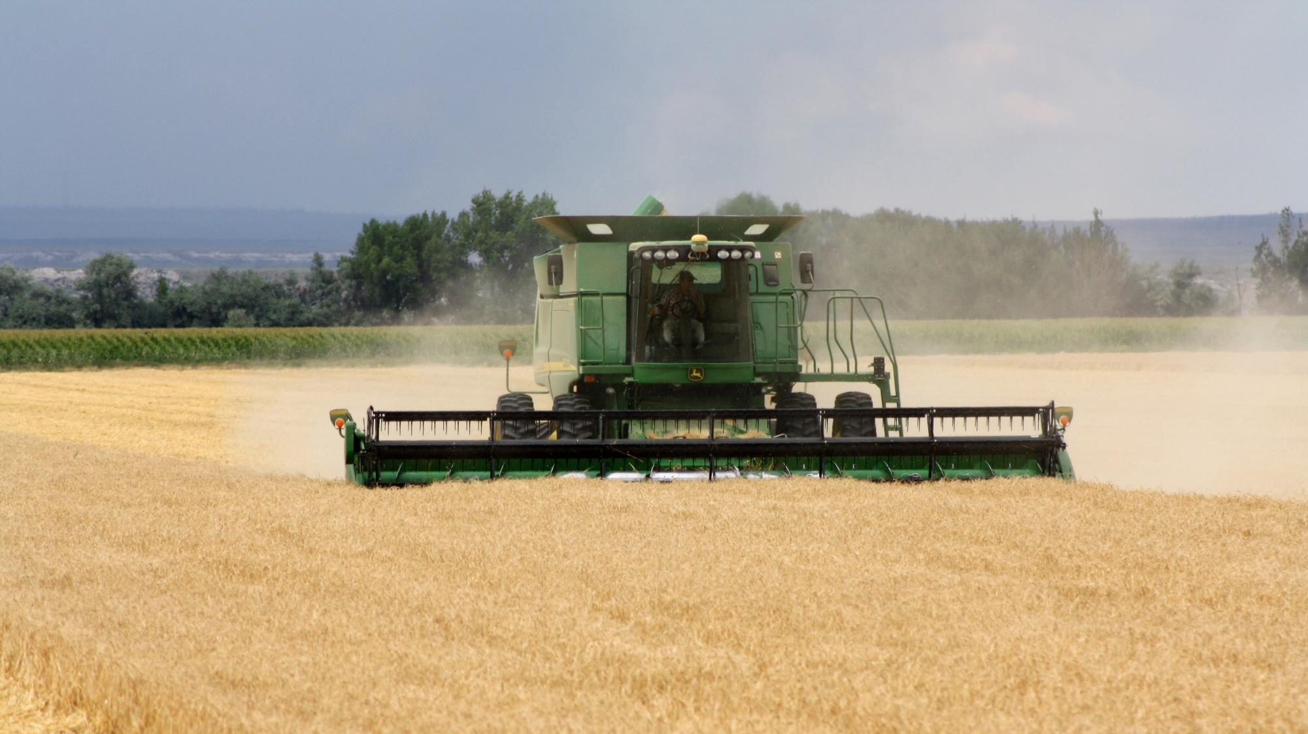
Harvesting grain
Notes:
Slide 1 – Harvesting grain

Slide 8
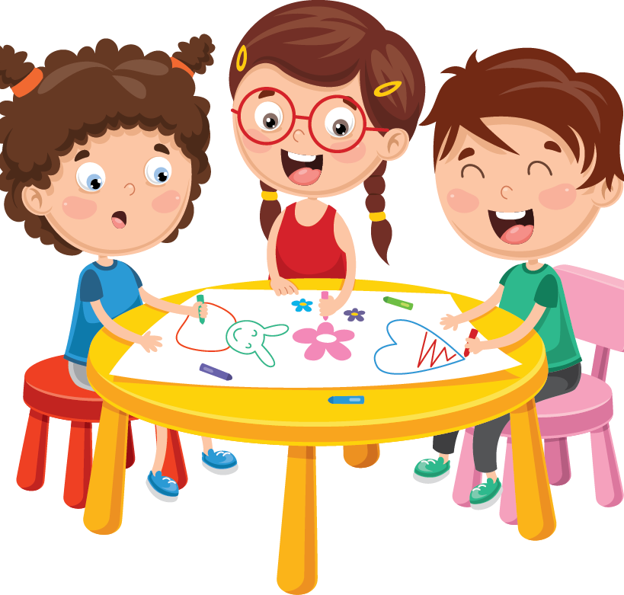
Discussion How does this show Stewardship?
Notes:
Talking point - New technology in tractors and harvesting equipment help farmers grow more food and feed more people with less land.

Slide 9
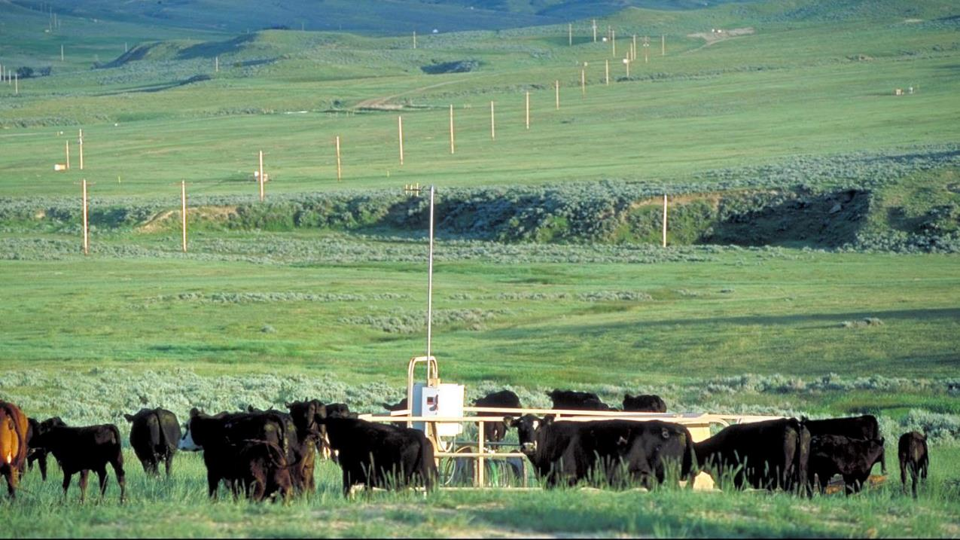
Cattle grazing the land where natural gas is produced
Notes:
Slide 2 – Cattle grazing the land where natural gas is produced

Slide 10
Discussion How does this show Stewardship?
Notes:
Talking point - Multiple land use, grazing and resource extraction can use the same land.

Slide 11
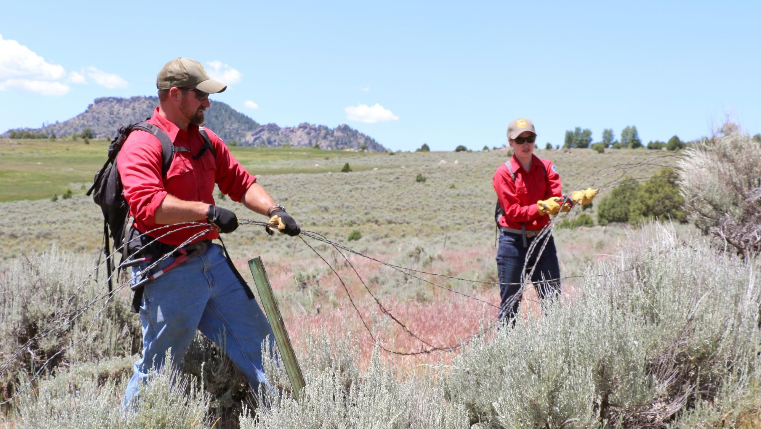
Fence Maintenance
Notes:
Slide 3 – Fence maintenance

Slide 12
Discussion How does this show Stewardship?
Notes:
Talking Point: Good fencing helps manage grazing of rangeland. Fixing the fence can help keep animals from getting tangled in down wires.

Slide 13
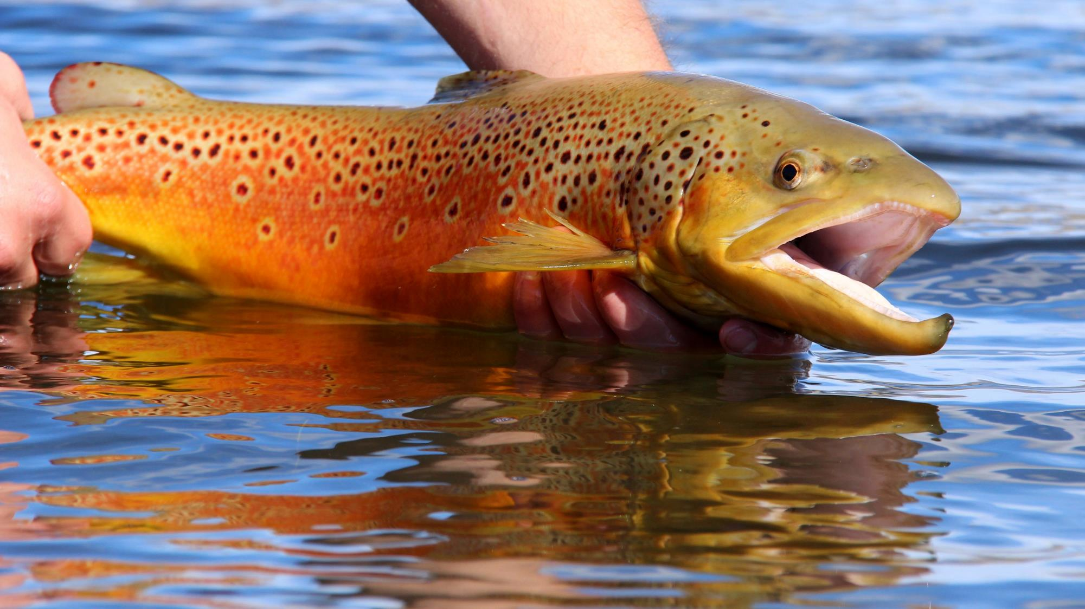
Fishing
Notes:
Slide 4 – Fishing

Slide 14
Discussion How does this show Stewardship?
Notes:
Talking Point: Catch and release fishing allows sportsmen to enjoy fishing, while still maintaining the fish population.

Slide 15
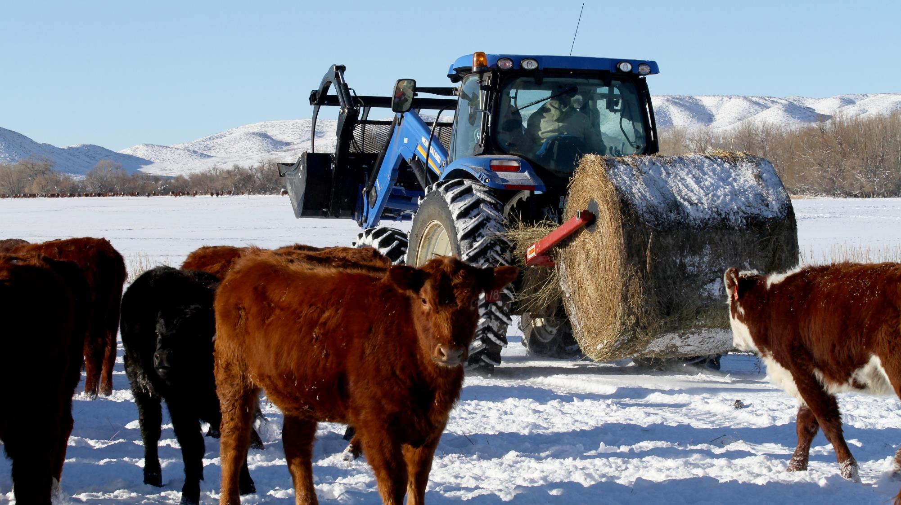
Feeding cattle in the winter.
Notes:
Slide 5 – Feeding cattle during the winter

Slide 16
Discussion How does this show Stewardship?
Notes:
Talking Point: Feeding hay and grain during the winter helps cattle get enough to eat and keeps them healthy when grazing is more difficult.

Slide 17
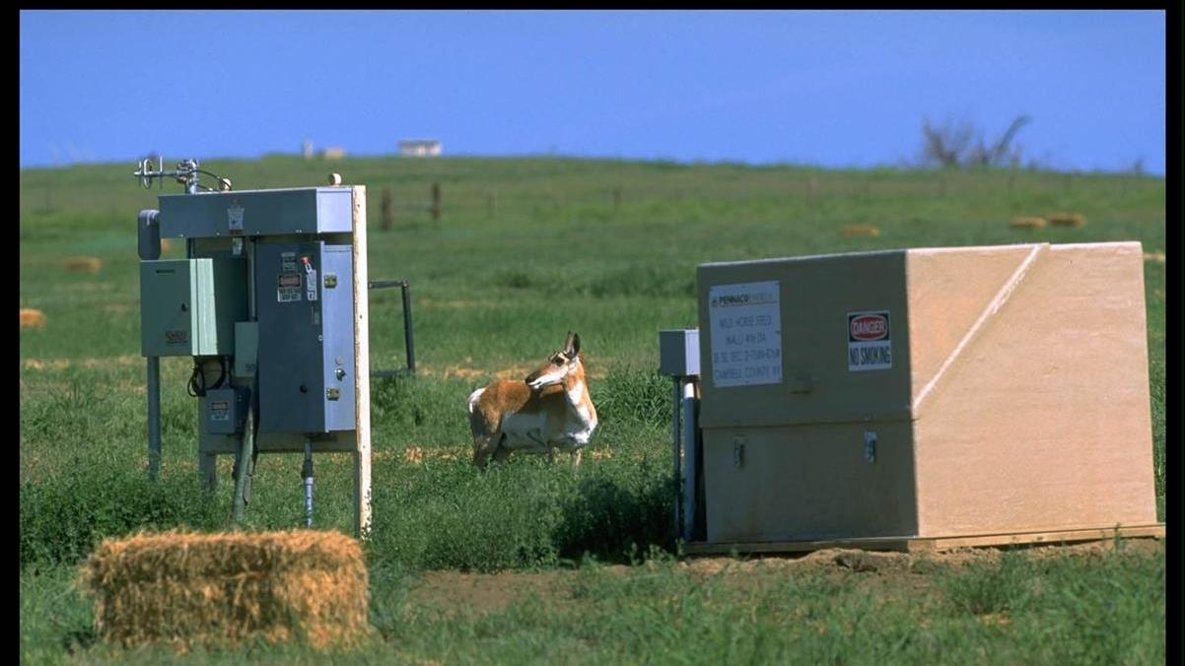
Wildlife grazing near natural gas production equipment
Notes:
Slide 6 – Wildlife grazing near natural gas production equipment

Slide 18
Discussion How does this show Stewardship?
Notes:
Talking Point: Multiple land use – wildlife can live where resources are being extracted.

Slide 19
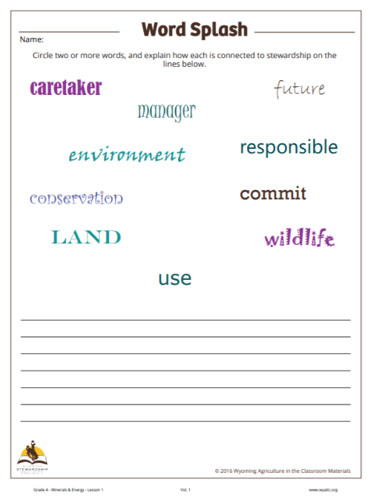
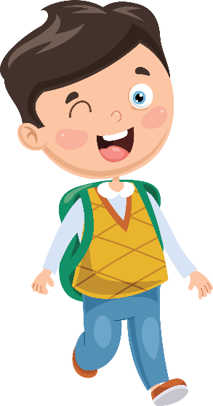
How do these words relate to Stewardship?
Link to Word Splash
Notes:
Procedure #3
Have students choose two or more of the words that connect with stewardship.

Slide 20
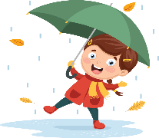
Key Terms
Benefit | Conservation
Entrusted | Generation
Resources | Stewards
Notes:
Procedure #4
Students will create synonyms for the key terms. Students will share out so that you can determine their understanding.

Slide 21
How can you be a steward in your everyday life?
Notes:
Procedure #6

Slide 22
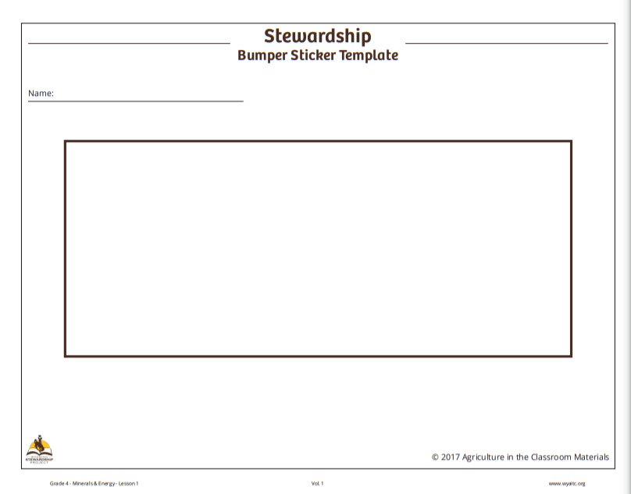
Create your
Stewardship
Bumper sticker.
Link to Template
Notes:
Procedure #5/Assessment
Students create a bumper sticker using words and images from the lesson.

Slide 23
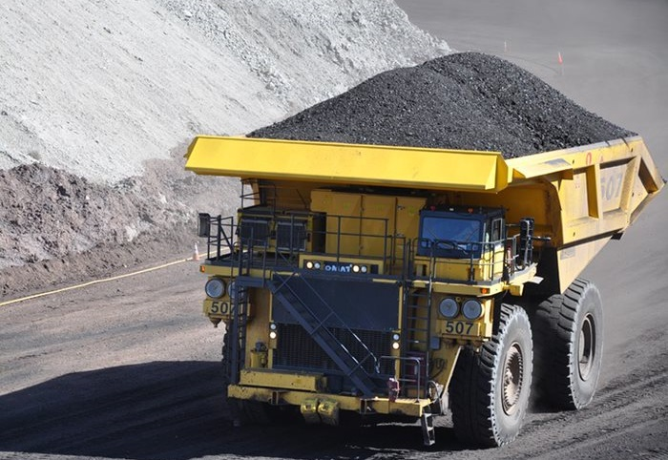
What did we learn from today’s challenge?
Notes:
Provide the students an opportunity to explain their learning.

