Slide 1
Minerals & Energy 4th Grade Lesson 6: Powering Up Wyoming’s Economy
Notes:
The name of the lesson is a link to the Wyoming Agriculture in the Classroom website where the lesson can be downloaded.

Slide 2
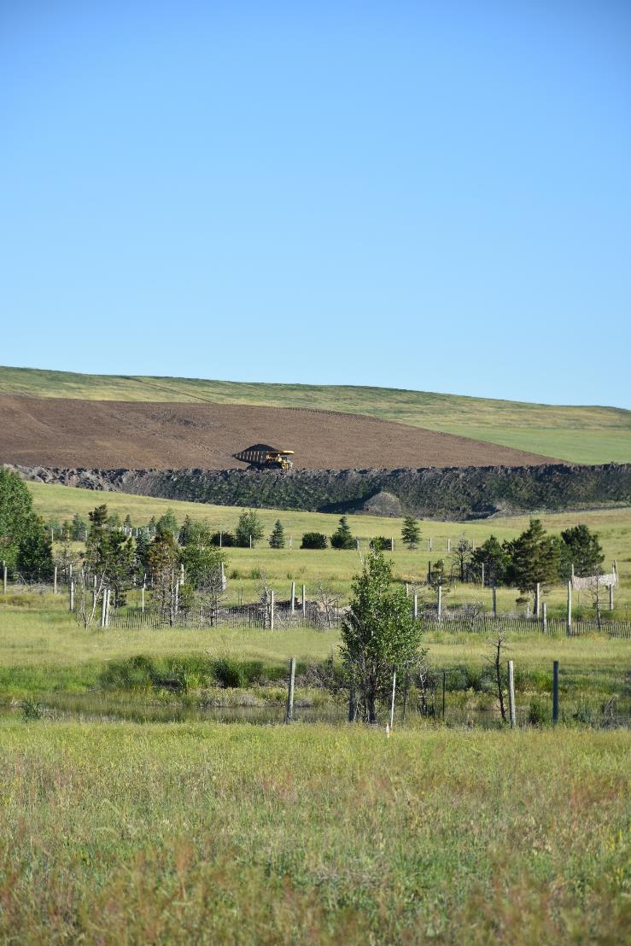
Today’s Challenge
Students learn how important mineral and energy resources are to Wyoming’s culture and economy.
Notes:
This is the focus of today’s lesson.

Slide 3
Culture – a way of thinking, behaving, or working that exists in a place or organization
Economy – financial system of interaction and exchange
Impact – have a strong effect on someone or something
Vocabulary
Notes:
These are the new vocabulary words for this lesson. You may need to adjust this list according to the needs of your students.

Slide 4
Highlights from our last lesson:
What did you learn from yesterday’s challenge?
Think back on:
Renewable resources
Nonrenewable resources
Stewardship of those resources
Notes:
Look back on the previous lesson and review the key ideas.

Slide 5
Thinking About
How Energy Impacts Us
Our Thoughts
Notes:
Procedure #1: This table allows you to collect student’s ideas. A brainstorming tech tool or a bulletin board tool is another way to collect student thinking.

Slide 6
Questions to Ponder:
Who pays for schools and government buildings to be built?
Who pays for teachers’, firefighters’, and police officers’ salaries?
How does the state of Wyoming receive money?
If the state was not able to make money off our resources, what would happen? For example, what would be the impact to our schools, our libraries, etc.? What jobs would be impacted?
Notes:
Procedure #2: See TEACHER NOTE

Slide 7
Let’s Play Kahoot!
Get your device and Cloze Activity sheet ready.
Go to Kahoot.it
Type in this code: - - - - - -
Type in your name
Kahoot Game link
Notes:
Procedure #3 and #4: Add the 6-digit code to the slide.

Slide 8
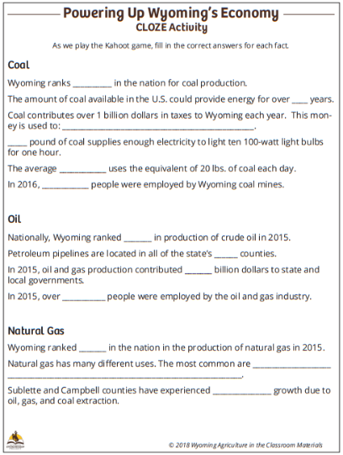
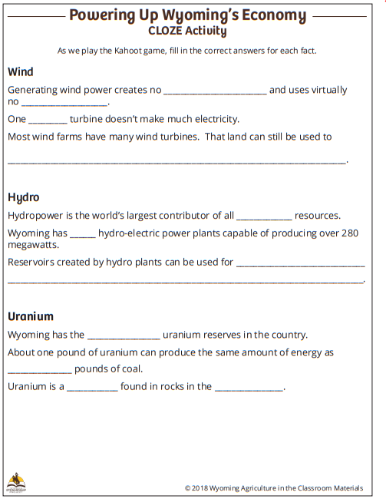
Fill in the blanks of your CLOZE Activity Sheet as we play the game.
Cloze Activity Resource link
Notes:
Procedure #3, #4, and #5: If you are unable to connect with the game, you can have students use a large font on the word processing program on their devices instead of a whiteboard to show their answers.

Slide 9
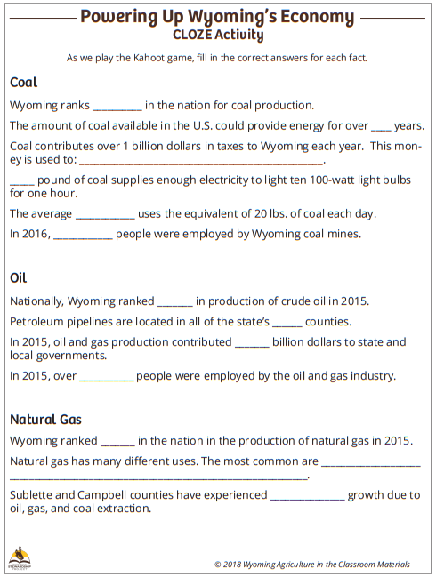
Notes:
Procedure #5: If you want to fill in the answer on this slide, either use the writing tool for your platform, or insert a text box in the space provided.

Slide 10
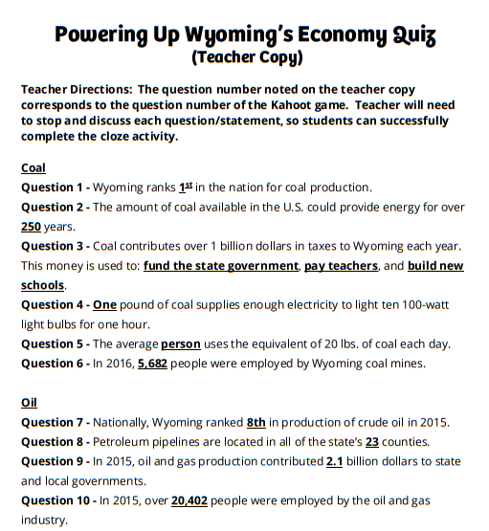
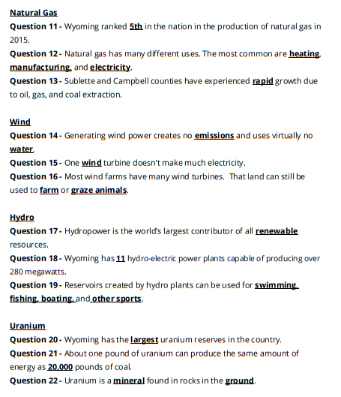
Cloze Activity Teacher Copy resource link
Notes:
Procedure #5: Teacher Slide – The Answer Key is here for your convenience.
Procedure #6: Stop here if you want to complete the lesson in two parts.

Slide 11
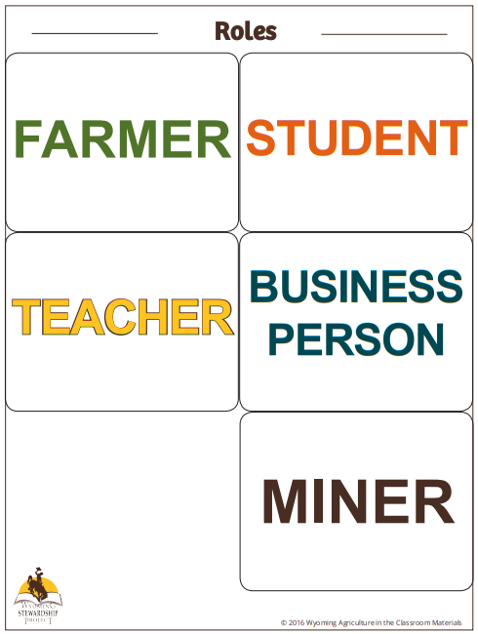
Taking on a New Role
Your group will think like the person you were assigned.
Review your Powering Up Wyoming’s Economy CLOZE Sheet.
Select 5 – 7 facts from your sheet that you feel:
Has the most impact on your assigned person.
Is most relevant to your assigned person.
Role Card Resource link
Notes:
Procedure # 7

Slide 12
FARMER
 | Fact 1: | Fact 2: | Fact 3:
Fact 4: | Fact 5: | Fact 6: | Fact 7:
Notes:
Procedure #7: These slides are for collecting student learning – they could be printed and given to each group, or given to them in an electronic format to fill in.

Slide 13
STUDENT
 | Fact 1: | Fact 2: | Fact 3:
Fact 4: | Fact 5: | Fact 6: | Fact 7:
Notes:
Procedure #7: These slides are for collecting student learning – they could be printed and given to each group, or given to them in an electronic format to fill in.

Slide 14
TEACHER
 | Fact 1: | Fact 2: | Fact 3:
Fact 4 | Fact 5: | Fact 6: | Fact 7:
Notes:
Procedure #7: These slides are for collecting student learning – they could be printed and given to each group, or given to them in an electronic format to fill in.

Slide 15
BUSINESS-PERSON
 | Fact 1: | Fact 2: | Fact 3:
Fact 4: | Fact 5: | Fact 6: | Fact 7:
Notes:
Procedure #7: These slides are for collecting student learning – they could be printed and given to each group, or given to them in an electronic format to fill in.

Slide 16
MINER
 | Fact 1: | Fact 2: | Fact 3:
Fact 4: | Fact 5: | Fact 6: | Fact 7:
Notes:
Procedure #7: These slides are for collecting student learning – they could be printed and given to each group, or given to them in an electronic format to fill in.

Slide 17
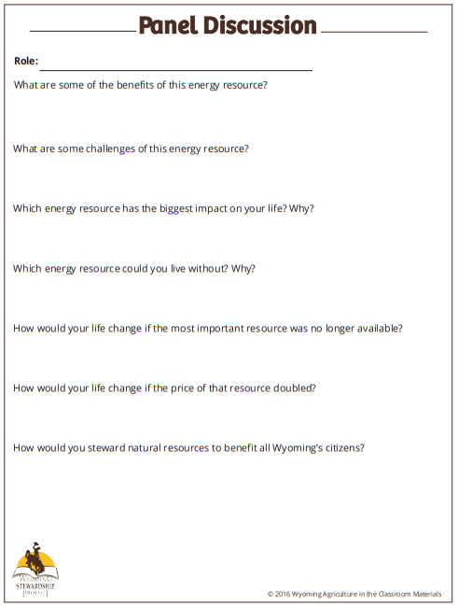
Preparing for the Panel Discussion:
Use your knowledge from the previous lessons.
Use the facts chosen by the group.
Answer the questions on the Panel Discussion question sheet.
Panel Discussion Resource link
Notes:
Procedure #8

Slide 18
Display your role card.
Use your discussion sheet if you need it.
Answer your question like an expert.
Pass your role card to the next person in your group.
Discussion Panel
You are the Experts!
This Photo by Unknown Author is licensed under CC BY-SA
Notes:
Procedure #9

Slide 19
Thinking About
How Energy Impacts Us
Our Thoughts
Notes:
Procedure #10: You can either copy and paste the table from slide #5 and add to it or copy the entire slide and delete this one.

Slide 20
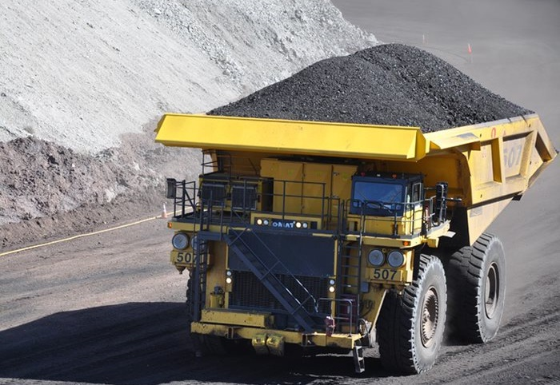
What did we learn from today’s challenge?
Notes:
Provide the students an opportunity to explain their learning.

