Slide 1
Minerals & Energy 2nd Grade Lesson 8: Chain Reactions
Notes:
The name of the lesson is a link to the Wyoming Agriculture in the Classroom website where the lesson can be downloaded.

Slide 2
Today’s Challenge
Students will:
Examine cause and effect relationships related to each type of energy resource.
Notes:
This is the focus of today’s lesson. See TEACHER NOTE on the introductory page of the lesson for additional information.

Slide 3
Vocabulary
Con – the unfavorable factors or reasons; disadvantages
Pro – the favorable factors or reasons; advantages
Notes:
These are the new vocabulary words for this lesson. You may need to adjust this list according to the needs of your students.

Slide 4
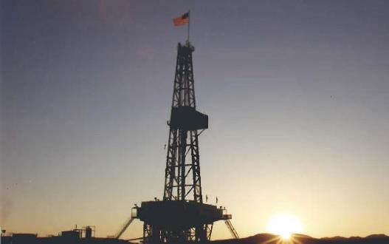
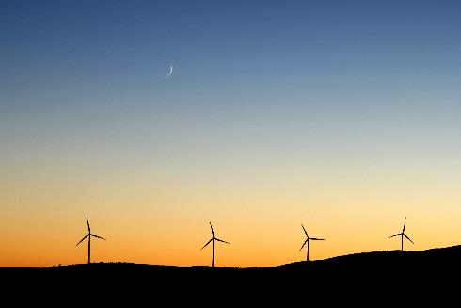
The pros and cons of renewable energy resources
The pros and cons of nonrenewable energy resources
Using resources wisely
Highlights from our last lesson:
What did you learn from yesterday’s challenge?
Notes:
Look back on the previous lesson and review the key ideas.

Slide 5
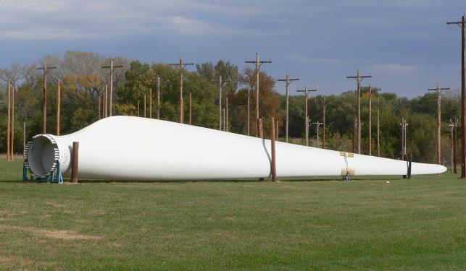
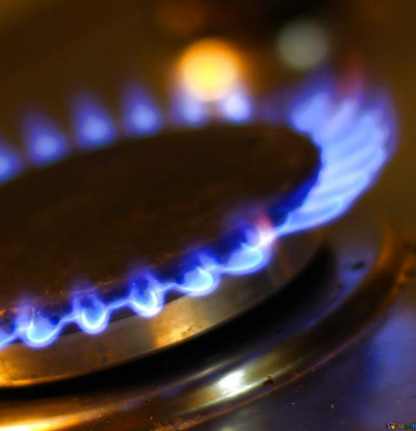
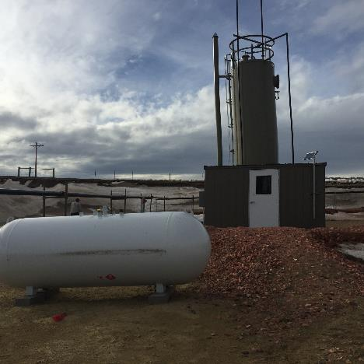
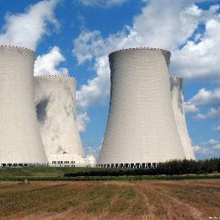
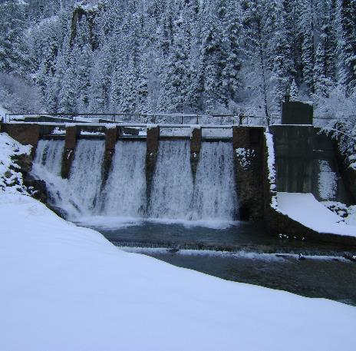
What are the six energy resources?
This Photo by Unknown Author is licensed under CC BY
This Photo by Unknown Author is licensed under CC BY-SA
This Photo by Unknown Author is licensed under CC BY-SA-NC
Notes:
Procedure #1

Slide 6
Cause and Effect
What is CAUSE?
What is EFFECT?
Student responses:
Student responses:
Notes:
Procedure #2

Slide 7
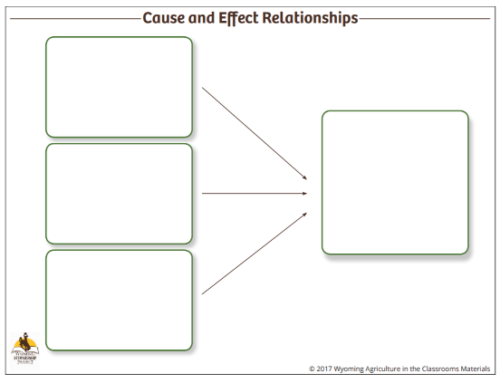
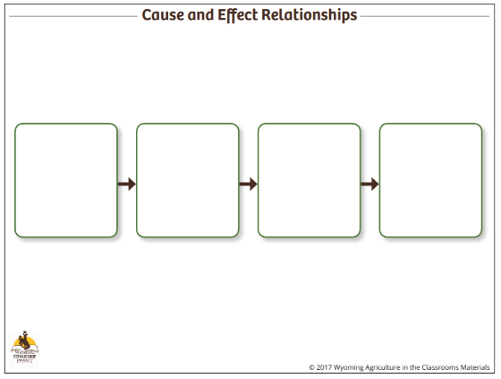
Cause and Effect
Link to Cause & Effect worksheets
Notes:
Procedure #3: Use this slide to explain how the cause and effect graphic organizers are used. The next three slides provide opportunities to model completing the graphic organizers.

Slide 8
EFFECT
CAUSE
In 2017, Wyoming remains the nation’s largest producer of coal.
Notes:
Procedure #3

Slide 9
EFFECT
Coal mining provides jobs.
CAUSE
In 2017, Wyoming remains the nation’s largest producer of coal.
Coal provides income for the state.
We are using up a nonrenewable resource.
Notes:
Procedure #3

Slide 10
New cause…
If Wyoming was no longer the leading coal producer, what new effects might that have?
Student responses:
Notes:
Procedure #4

Slide 11
CAUSE
EFFECT
Wyoming remains one of the leading coal producers in the country.
Notes:
Procedure #5

Slide 12
CAUSE
Wyoming has large coal reserves.
EFFECT
People want Wyoming coal because it has low amounts of sulfur, so it is more environmentally friendly.
Wyoming remains one of the leading coal producers in the country.
Wyoming coal is surface mined so it’s easier to access.
Notes:
Procedure #5

Slide 13
CAUSE
EFFECT
Wyoming remains one of the leading coal producers in the country.
Notes:
Procedure #5

Slide 14
CAUSE
EFFECT
Wyoming remains one of the leading coal producers in the country.
Coal provides income for the state.
Every Wyoming county has benefited from industry funds.
Highways, community colleges, and public schools have been improved because of the funds.
Notes:
Procedure #5

Slide 15
New Cause and Effect Scenarios
Coal contributes 69% of CO2, more than any other source.
After coal is mined, they put back the dirt and rocks and plant trees and grass. This is called reclamation.
Coal can be accessed through underground mining or surface mining.
Wyoming coal is low-sulfur.
Notes:
Procedure #6: Refer to TEACHER NOTES for additional information on this activity.

Slide 16
Share your ideas
What would happen if one part of their (cause and effect) relationship changed?
How would that change affect the other parts of the system (cause and effect system)?
How does predicting changes to the system help you better understand the complexities of energy production?
Notes:
Procedure #7

Slide 17
Using a new resource
Oil
Natural Gas
Wind
Hydropower
Uranium
Select any of the other five resources to use.
Choose a fact from that resource and complete a cause and effect relationship chart that shows how the resource’s use impacts the environment.
After completing the first graphic organizer, use the other cause and effect graphic organizers to show different types of relationships.
Notes:
Procedure #8

Slide 18
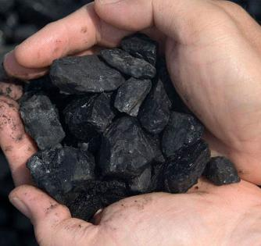
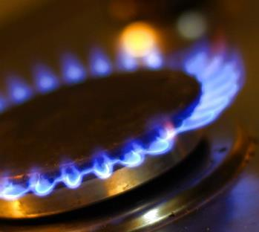
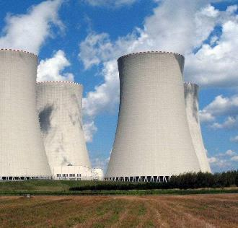
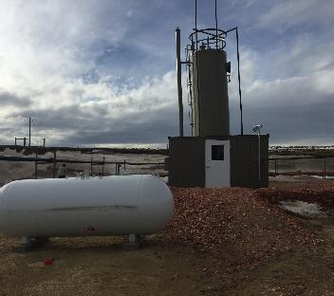
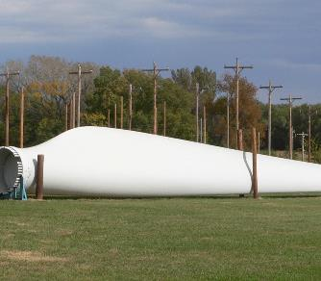
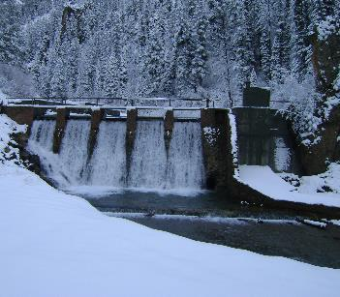
Link to Resource Worksheet
This Photo by Unknown Author is licensed under CC BY-SA-NC
This Photo by Unknown Author is licensed under CC BY
This Photo by Unknown Author is licensed under CC BY-SA
Notes:
Procedure #9

Slide 19
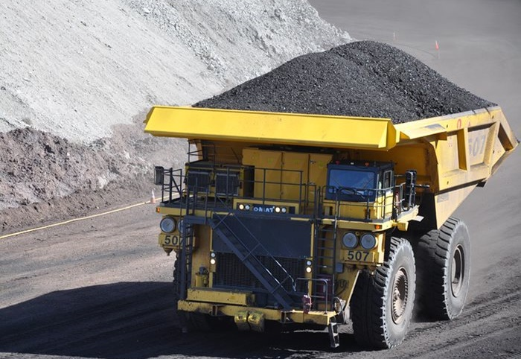
What did we learn from today’s challenge?
Notes:
Provide the students an opportunity to explain their learning.

