Slide 1
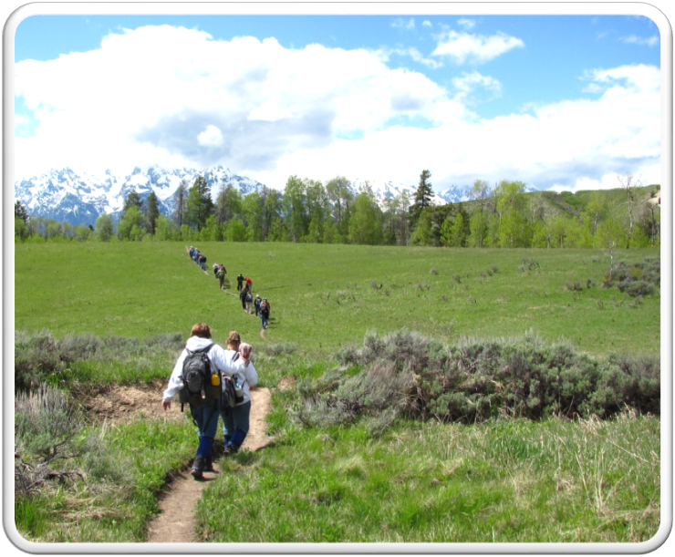
Outdoor Recreation & Tourism
4th Grade
Lesson 4 - Day 1:
Outdoor Recreation and Tourism –
Past, Present, and Future
Notes:
The name of the lesson is a link to the Wyoming Agriculture in the Classroom website where the lesson can be downloaded

Slide 2
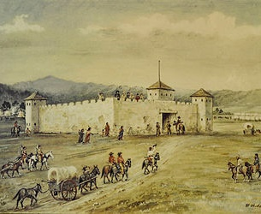
Today’s Challenge:
Students will:
Analyze how outdoor recreation and tourism on Wyoming lands has changed over time, how they may change in the future, and the importance of good stewardship of those lands.
Explain the role of outdoor recreation and tourism on Wyoming’s economy and culture.
This Photo by Unknown Author is licensed under CC BY-SA
Notes:
This is the focus of today’s lesson.

Slide 3
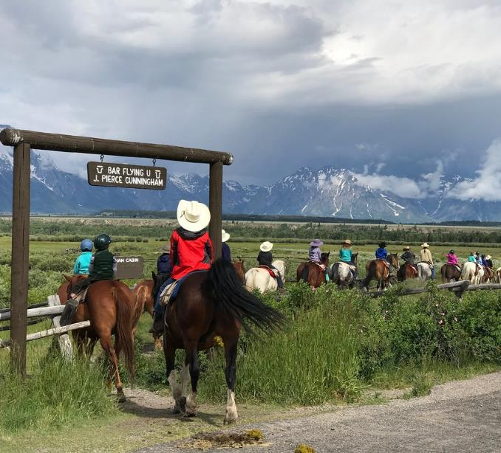
Vocabulary:
Capitalize – take the chance to gain advantage from
Culture – a way of thinking, behaving, or working that exists in a place or organization
Economy – financial system of interaction and exchange
Opportunity – a set of circumstances that makes it possible to do something
Revenue – money that is made by or paid to a business or an organization
Tourism – the activity of traveling to a place for pleasure that can generate revenue from the enjoyment of Wyoming’s land and/or resources
This Photo by Unknown Author is licensed under CC BY-SA-NC
Notes:
These are the new vocabulary words for this lesson. You may need to adjust this list according to the needs of your students.

Slide 4
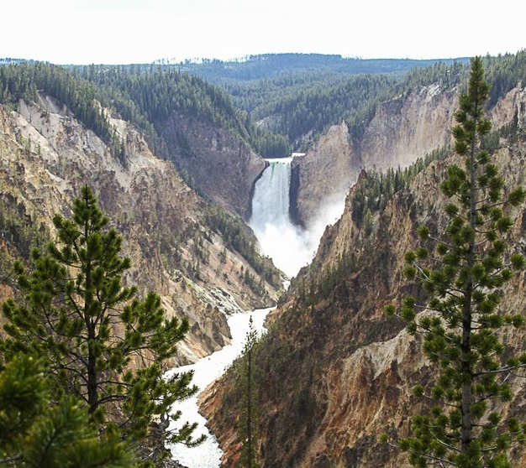
Highlights from our last lesson:
Think back on:
Natural wonders created by erosion
Activities available at the natural wonders
Notes:
Look back on the previous lesson and review the key ideas.

Slide 5
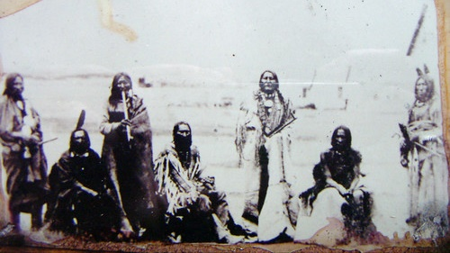
Day 1
This Photo by Unknown Author is licensed under CC BY-SA-NC
Notes:
Treaty of Ft. Laramie, 1868

Slide 6
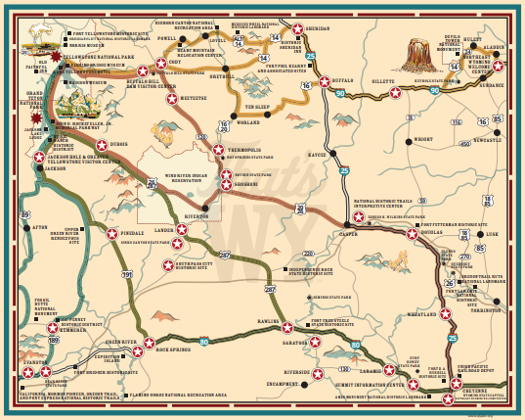
How are the following pictures different from what we experience today?
Comparing Wyoming
Historical Places:
Then and Now
Notes:
Procedure #1

Slide 7
Wyoming Historic Places: Then and Now
Photo Credits:
Wyoming State Historic Preservation Office
American Heritage Center, University of Wyoming
US National Park Service

Slide 8
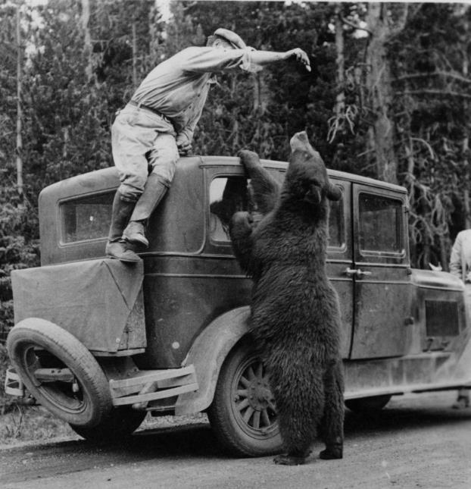
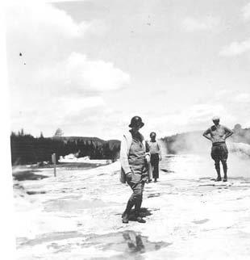
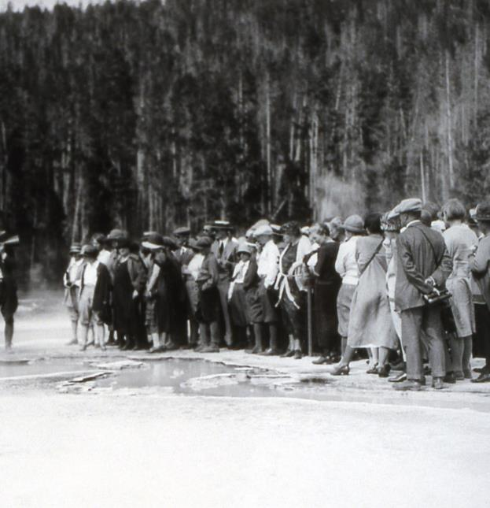
Yellowstone Then
Notes:
http://digitalcollections.uwyo.edu/luna/servlet/detail/uwydbuwy~1~1~319859~185827:Feeding-the-bear,-Yellowstone-Natio?qvq=q:yellowstone&mi=57&trs=723

Slide 9
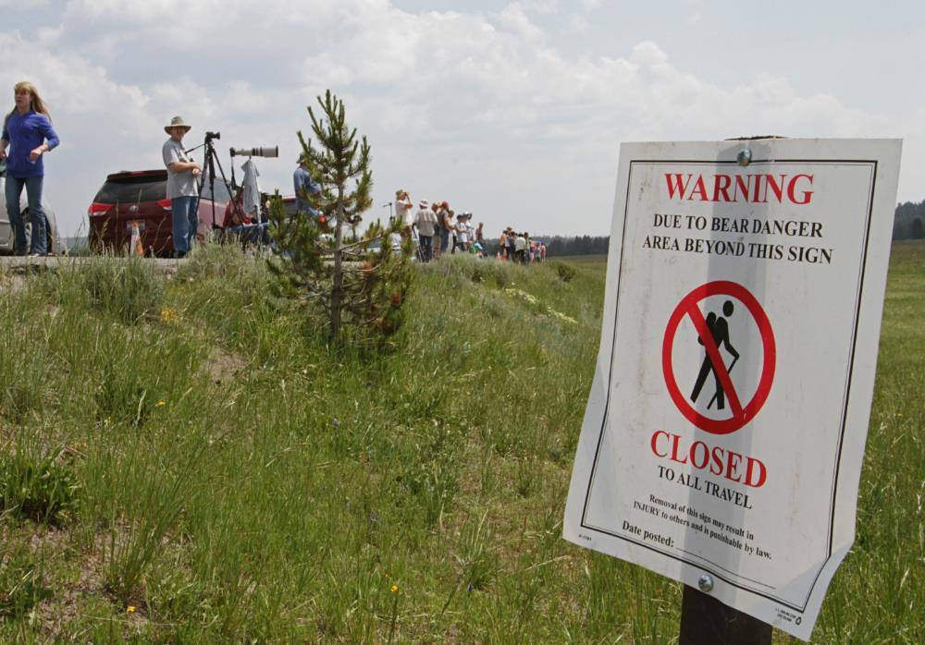
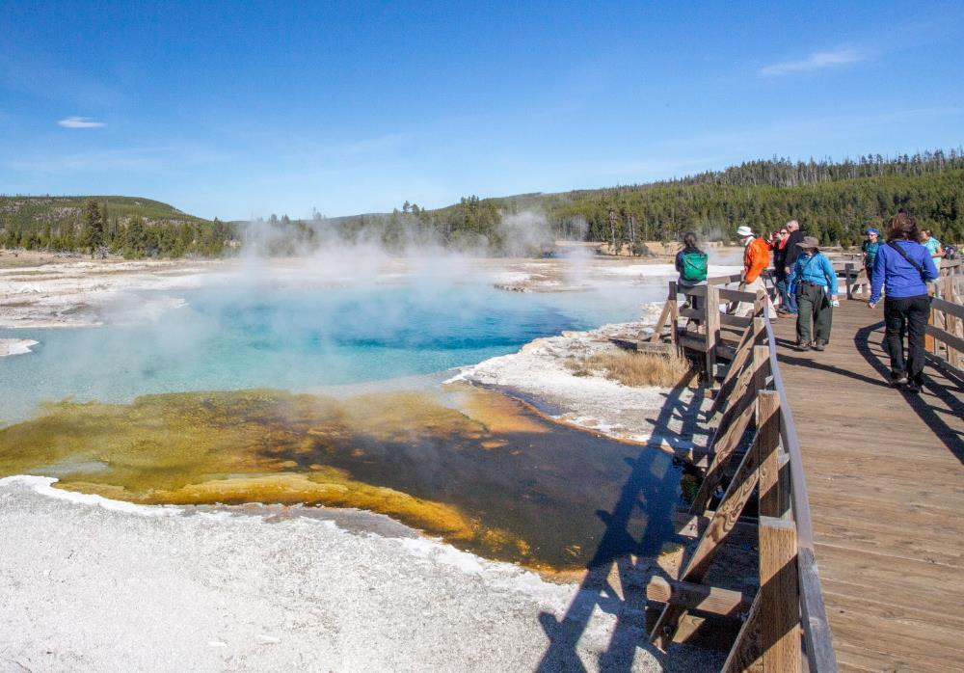
Yellowstone Now

Slide 10
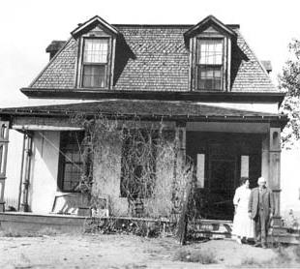
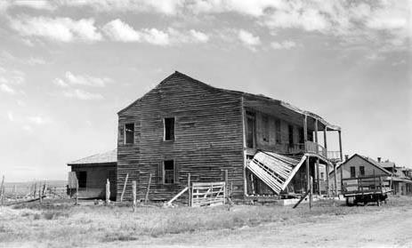
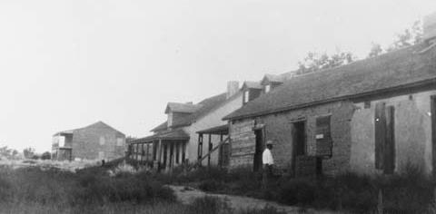
Fort Laramie Then

Slide 11
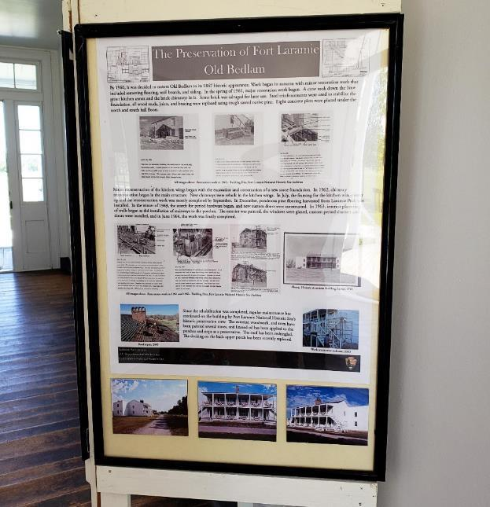
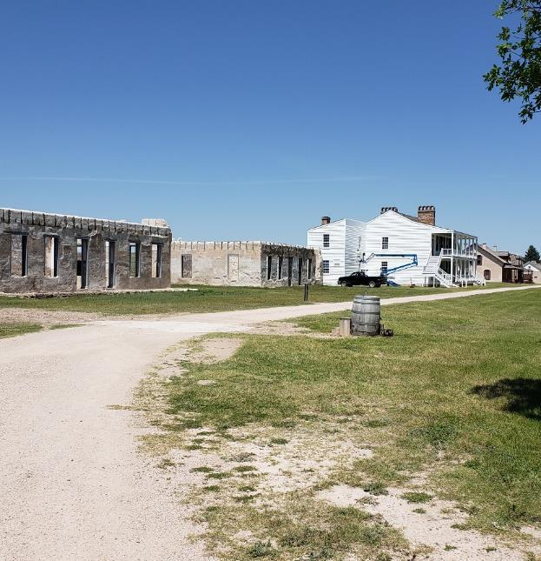
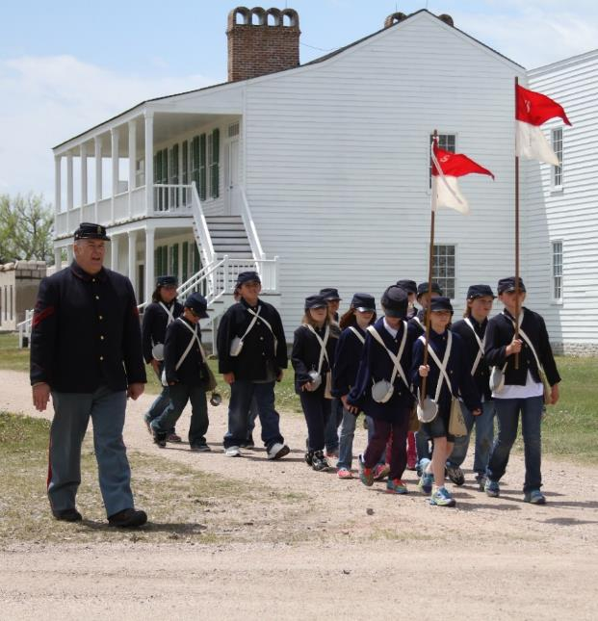
Fort Laramie Now
Notes:
http://www.wyomingtalesandtrails.com/ftlar3a.html

Slide 12
What are the differences you noticed?
Yellowstone National Park
Fort Laramie
Notes:
Procedure #2: You can collect student thoughts on this slide.

Slide 13
Yellowstone Then
Notes:
Procedure #2: Yellowstone National Park slide

Slide 14
Yellowstone Now
Notes:
Procedure #2: Yellowstone National Park slide

Slide 15
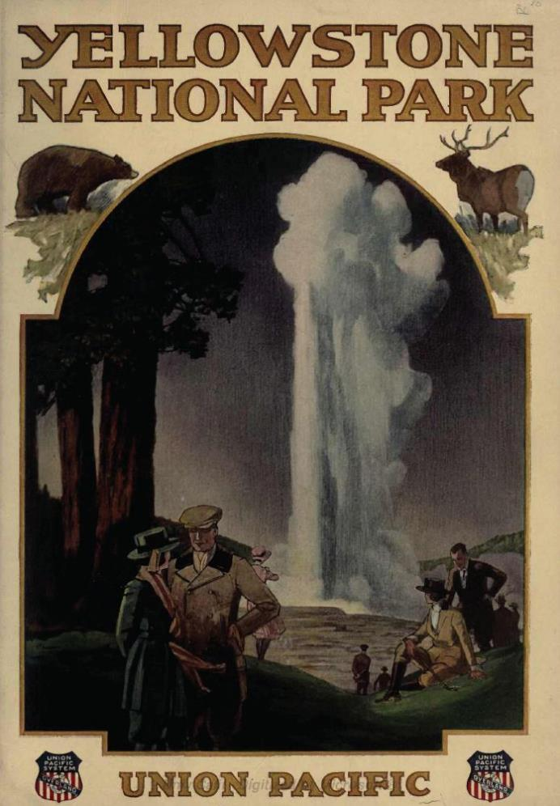
Let’s Discuss
Yellowstone National Park:
Then and Now
How did the pictures differ from each other?
Has the land changed?
Is the management of the land in the present-day picture different from the historical picture? How?
Why would this change happen? What is the cause-and-effect relationship?
This Photo by Unknown Author is licensed under CC BY-SA
Notes:
Procedure #2

Slide 16
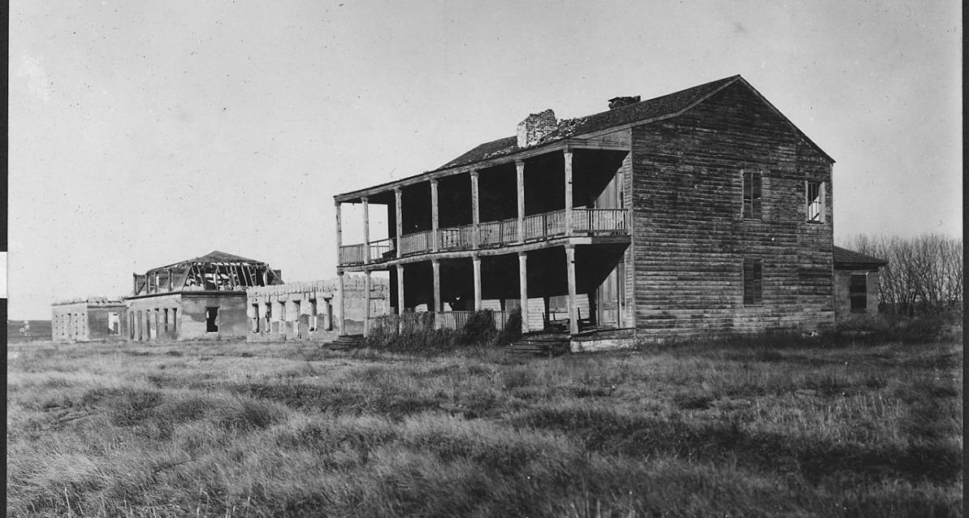
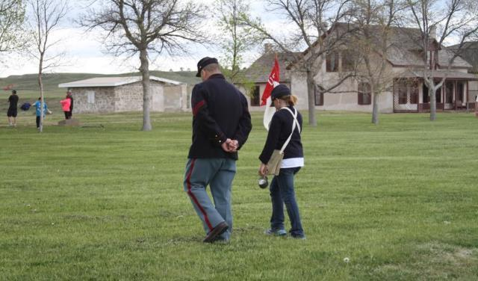
This Photo by Unknown Author is licensed under CC BY-SA
Different public lands are managed in different ways so current and future generations can enjoy them.

Slide 17
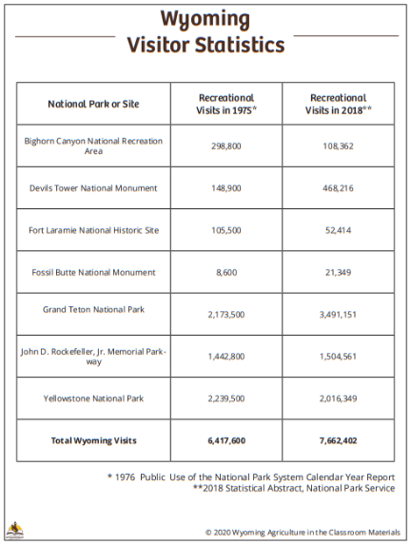
Visitors to Wyoming
What do you notice?
Do you see any surprising information?
Is management of these areas important for future generations?
How might business and private property owners be affected by the increase of the number of visitors to Wyoming?
Wyoming Visitor Statistics resource link

Slide 18
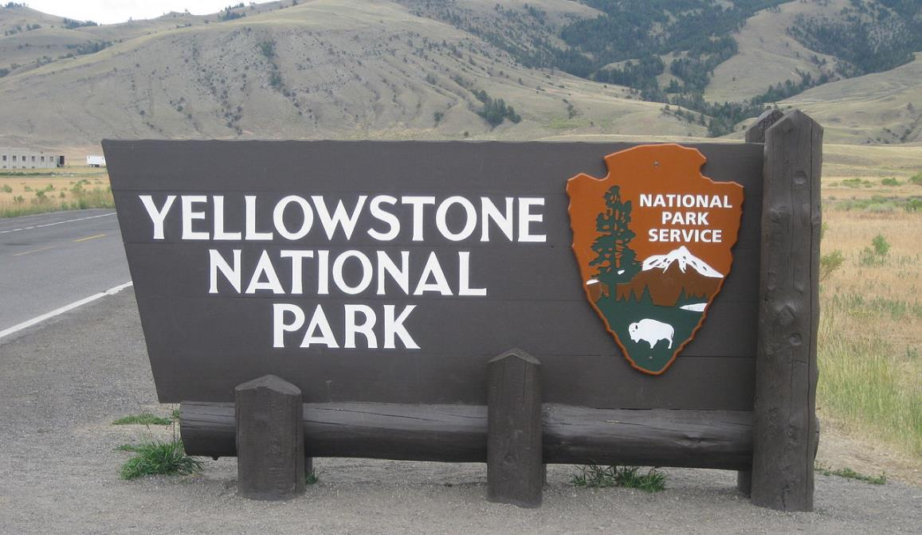
Thinking Ahead:
What will Yellowstone look like in 100 years?
Draw a picture showing your idea of Yellowstone in the future.
Write a caption under your illustration that supports this idea.
This Photo by Guerillero is licensed under CC BY-SA-NC
We are stewards entrusted with the responsible development, care, and use of our public lands to benefit current and future generations.

Slide 19
Thinking Ahead:
What will Fort Laramie look like in 100 years?
Draw a picture showing your idea of Fort Laramie in the future.
Write a caption under your illustration that supports this idea:
This Photo by Unknown Author is licensed under CC BY-SA
We are stewards entrusted with the responsible development, care, and use of our public lands to benefit current and future generations.
Notes:
Day 1/Procedure #8

Slide 20
Let’s Discuss
How do your pictures compare?
How might stewardship for future generations be the same or different in Yellowstone and Fort Laramie?
Notes:
Day 1/Procedure #9

Slide 21
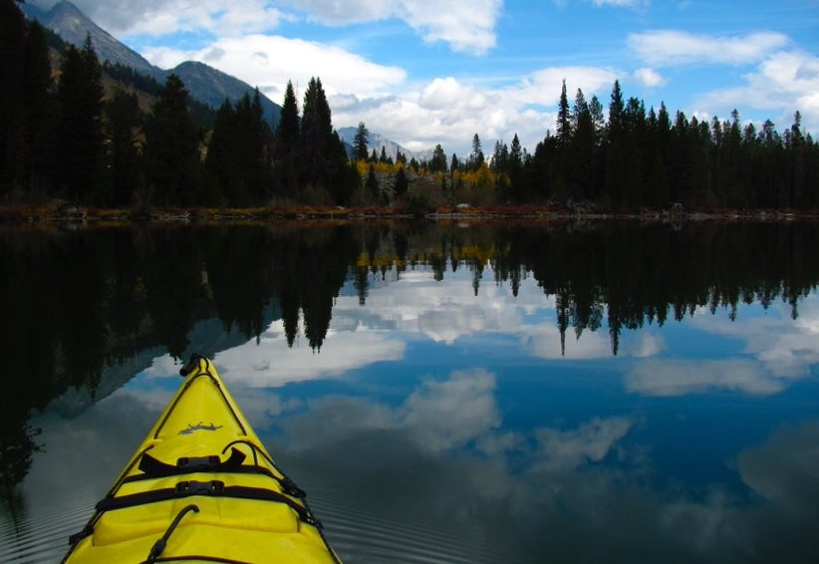
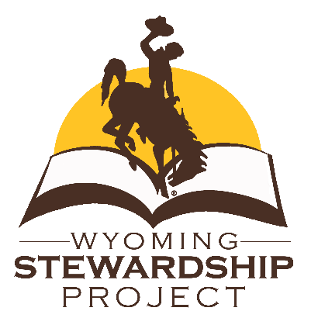
What did we learn from today’s challenge?
Notes:
Provide the students an opportunity to explain their learning.

