Slide 1
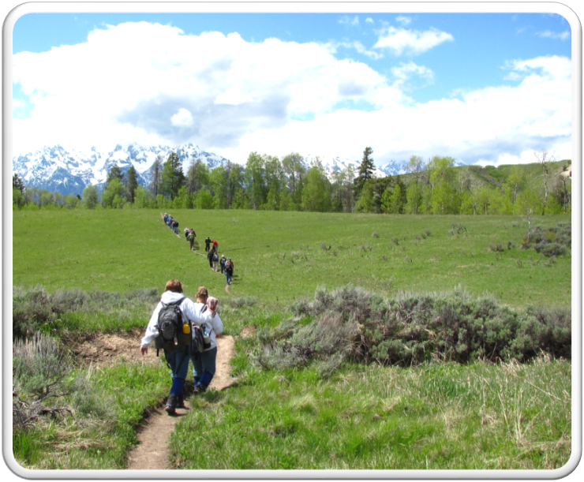
Outdoor Recreation & Tourism
4th Grade
Lesson 4 - Day 2:
Outdoor Recreation and Tourism –
Past, Present, and Future
Notes:
The name of the lesson is a link to the Wyoming Agriculture in the Classroom website where the lesson can be downloaded.

Slide 2
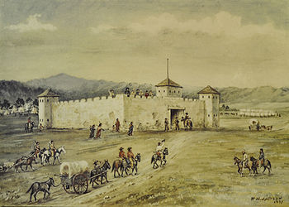
Today’s Challenge:
Students will:
Analyze how outdoor recreation and tourism on Wyoming lands has changed over time, how they may change in the future, and the importance of good stewardship of those lands.
Explain the role of outdoor recreation and tourism on Wyoming’s economy and culture.
This Photo by Unknown Author is licensed under CC BY-SA
Notes:
This is the focus of today’s lesson.

Slide 3
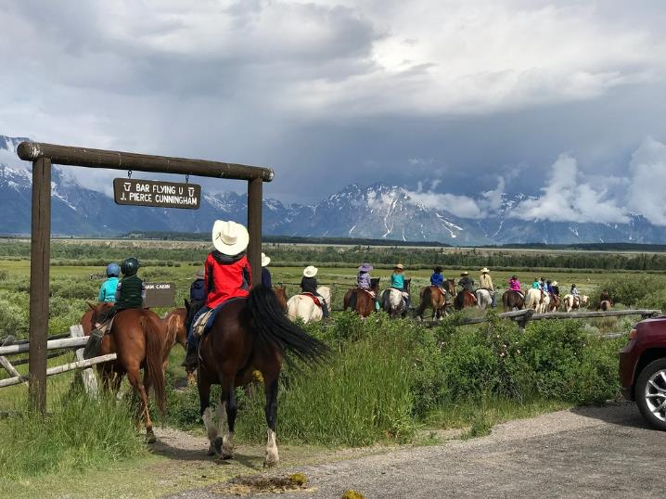
Vocabulary:
Capitalize – take the chance to gain advantage from
Culture – a way of thinking, behaving, or working that exists in a place or organization
Economy – financial system of interaction and exchange
Opportunity – a set of circumstances that makes it possible to do something
Revenue – money that is made by or paid to a business or an organization
Tourism – the activity of traveling to a place for pleasure that can generate revenue from the enjoyment of Wyoming’s land and/or resources
This Photo by Unknown Author is licensed under CC BY-SA-NC
Notes:
These are the new vocabulary words for this lesson. You may need to adjust this list according to the needs of your students.

Slide 4
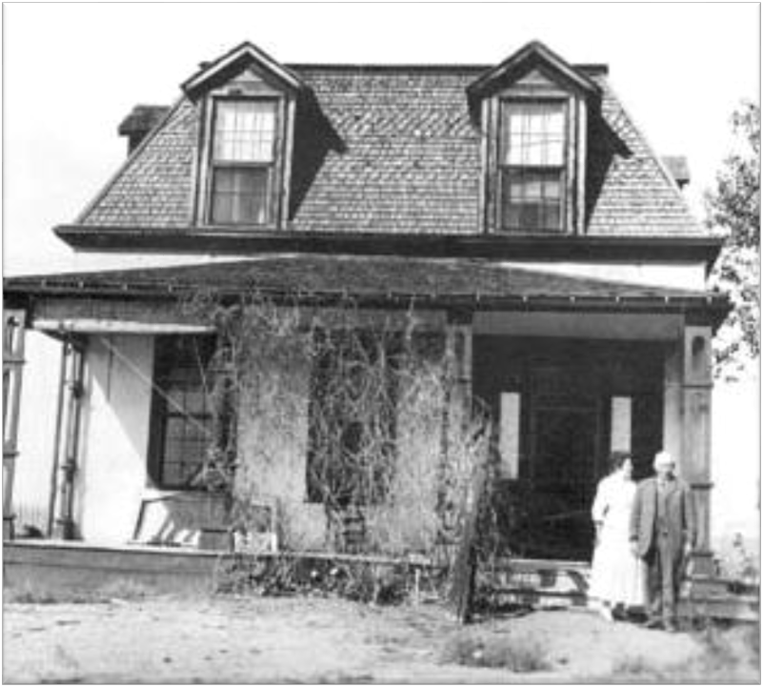
Highlights from our last lesson:
Think back on:
Our public landmarks, past and present
Notes:
Look back on the previous lesson and review the key ideas.

Slide 5
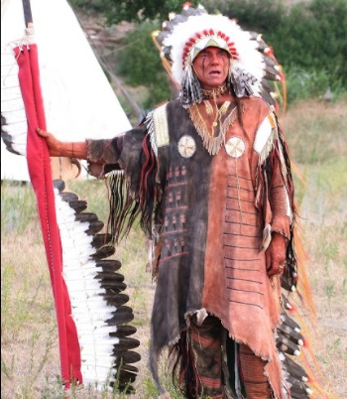
Day 2
Notes:
Michael Bad Hand Terry, Native American author, historian, and living history presenter at Ft. Laramie’s 4th of July celebration.

Slide 6
Wyoming’s Outdoor Recreation & Tourism
Looking through 2 lenses:
Culture and Economics
Notes:
Day 2/Procedure #1

Slide 7
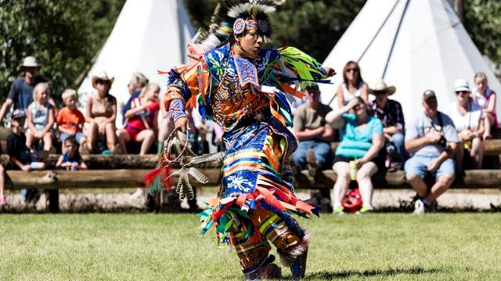
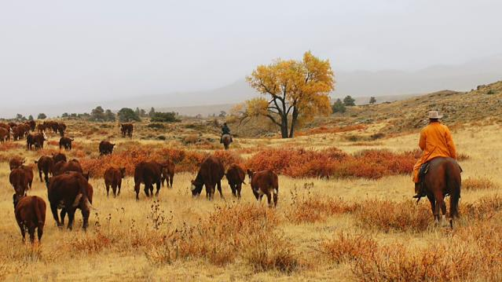
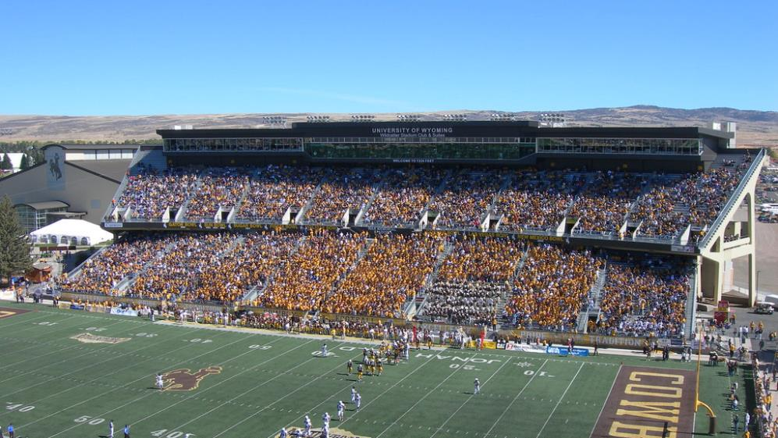
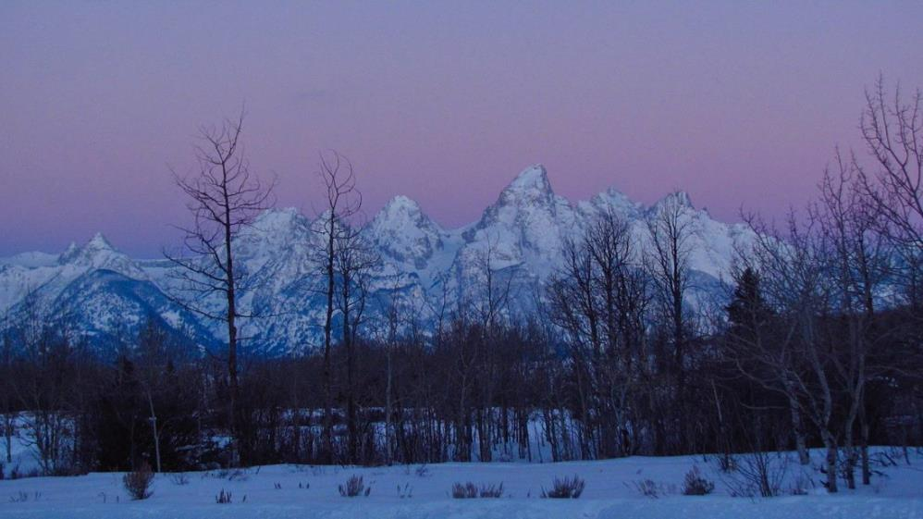
Culture is a way of thinking, behaving, or working that exists in a place or organizations.
This Photo by Unknown Author is licensed under CC BY-NC-ND
Notes:
Day 2/Procedure #1

Slide 8
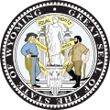
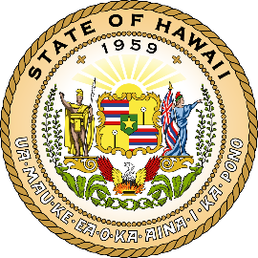
Comparing Cultures
Say what you know about Wyoming:
Say what you know about Hawaii:
This Photo by Unknown Author is licensed under CC BY-SA
This Photo by Unknown Author is licensed under CC BY-SA
Notes:
Day 2/Procedure #1: Student responses can be collected on this slide. A brainstorming tech tool such as MindMeister allows students to brainstorm ideas.

Slide 9
How Culture Impacts Wyoming’s Land Use
What does the text say about how people view our land?
What are some examples about how people in Wyoming behave?
How did the early development of our public land support our current culture and the way we think about the land?
History of Wyoming’s Public Land link

Slide 10
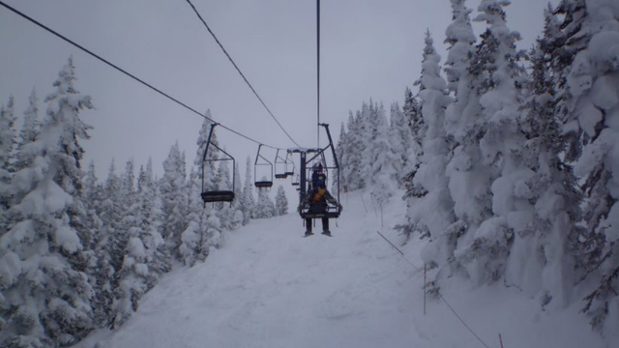
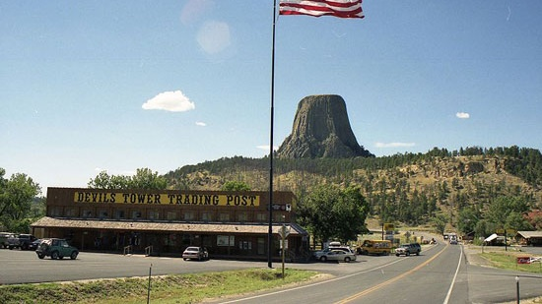
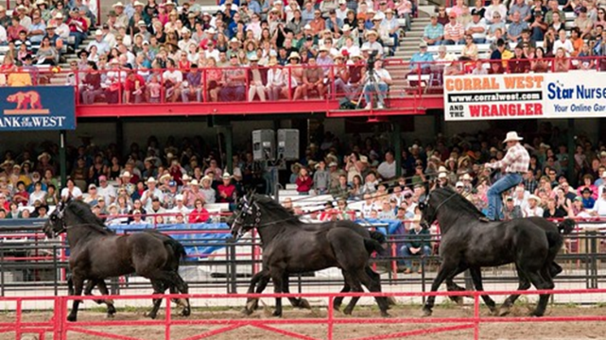
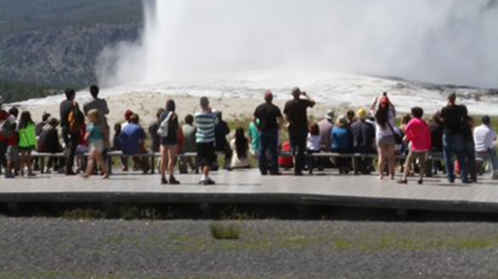
Economy is how many goods and services are produced and how much money people spend on these things.
This Photo by Unknown Author is licensed under CC BY-SA
Notes:
Day 2/Procedure #1

Slide 11
Visitors come from all over the world to experience our open-spaces, landscapes, and western way of life. Tourism impacts both our economy and culture.
This Photo by Unknown Author is licensed under CC BY-SA-NC
Notes:
Day 2/Procedure #3

Slide 12
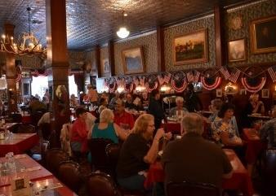
Think About This:
In 2019, 7,400,000 park visitors spent an estimated:
$924,000,000 in local gateway regions while visiting National Park Service lands in Wyoming.
These expenditures supported a total of:
12,300 jobs
$359,000,000 in labor income
$650,000,000 in value added
$1,100,000,000 in economic output in the Wyoming economy
This Photo by Unknown Author is licensed under CC BY-NC-ND
National Park Service Wyoming
Visitor Spending Effects link
Notes:
Day 2/Procedure #3: First bullet – this information is specific to all the National Parks in Wyoming. The numbers are written out as a way to practice reading large numbers as a math practice.

Slide 13
Devil’s Tower
According to the National Park Service:
498,000 people visited Devil’s Tower National Monument in 2016.
These tourists spent $39,646,100 in the local communities.
This money supported 500 jobs in the community.
For every $1 spent at the National Park, $10 is spent in the community.
This Photo by Unknown Author is licensed under CC BY-NC
Notes:
Day 2/Procedure #3: Bullets 2 - 5

Slide 14
Restaurant
Hotel
Gas Station
Let’s Play: Pass the Buck
We can earn revenue (income or money made) from entrance fees and tourist activities.
The chips represent potential revenue (income or money made) in the community.
Each chip represents $5.
Souvenir Shop
$5
National Park Service
Notes:
Day 2/Procedure #4, #5, and #6

Slide 15
Our visitors: A Family on Vacation to Devil’s Tower
Notes:
Day 2/Procedure #7

Slide 16
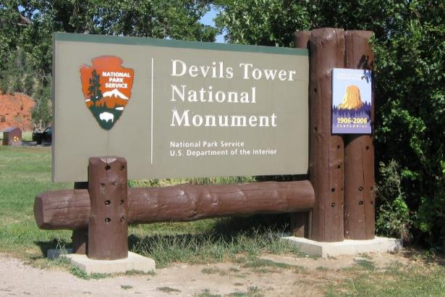
Our family pays a $15 entrance fee to Devil’s Tower to the National Park Service to get into the park.
$5
$5
$5
This Photo by Unknown Author is licensed under CC BY-NC-ND
Notes:
Day 2/Procedure #7: The coins can be stacked in a pile so the students can’t see how many there are, which allows you to incorporate some math into this lesson.

Slide 17
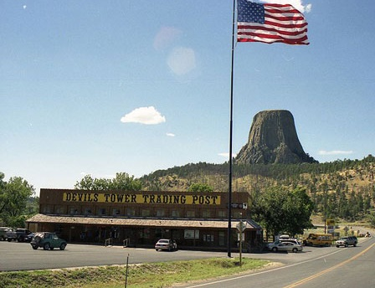
Our family spends $60 for souvenirs at the local gift shop.
$5
$5
$5
$5
$5
$5
$5
$5
$5
$5
$5
$5
This Photo by Unknown Author is licensed under CC BY-SA
Notes:
Day 2/Procedure #8

Slide 18
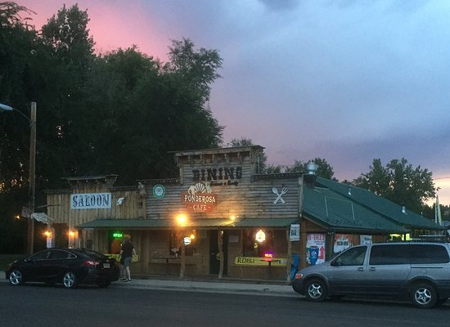
Our family enjoys a delicious dinner at a local restaurant and pays $45.
$5
$5
$5
$5
$5
$5
$5
$5
$5
Notes:
Day 2/Procedure #9

Slide 19
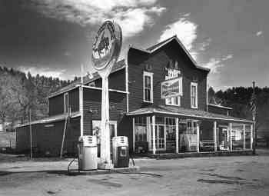
Our family fills up their gas tank at a local gas station and pays $30.
$5
$5
$5
$5
$5
$5
Notes:
Day 2/Procedure #10

Slide 20
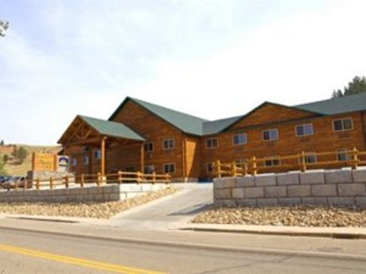
Our family spends the night in a hotel for $100.
$5
$5
$5
$5
$5
$5
$5
$5
$5
$5
$5
$5
$5
$5
$5
$5
$5
$5
$5
$5
Notes:
Day 2/Procedure #11

Slide 21
Let’s Discuss:
How much money did the family spend getting into the park?
How much money did the family spend in the community during their trip?
Where was most of their money spent?
What do you infer about tourism and its effect on the community?
Our family heads down the road after checking out of their hotel.
Notes:
Day 2/Procedure #12 and #13

Slide 22
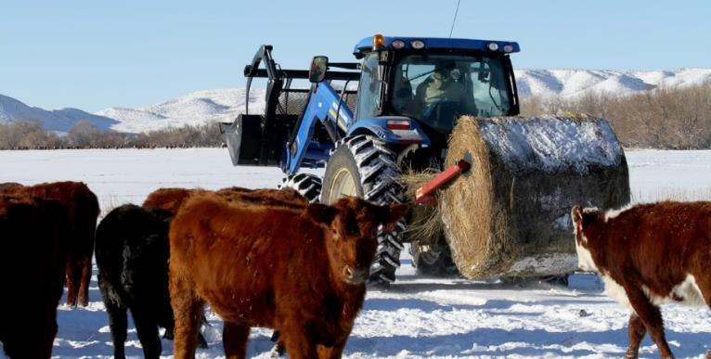
Something to ponder:
What do you think each shop owner will do with the money they get from tourists?
This Photo by Unknown Author is licensed under CC BY
Notes:
Day 2/Procedure #14: Bullet 1

Slide 23
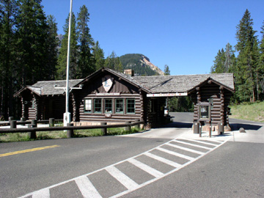
What happens…
If the family has the same amount of money for their next trip, what do you think might happen if the National Parks raise their entrance fees and the family has to pay more money to get into the park?
If less people decide to visit the park or spend less money at the shops, restaurants, and hotels?
This Photo by Unknown Author is licensed under CC BY-SA
Notes:
Day 2/Procedure #14: Bullet 2 and 3

Slide 24
What about our lands?
What happens if our public lands aren’t managed well, and visitors decide it isn’t worth the visit?
What happens if our lands are managed really well, and people enjoy visiting and return again and again?
Notes:
Day 2/Procedure #14: Bullet 4 and 5

Slide 25
What can be done?
What can business owners do to encourage money be spent in their businesses?
Can you think of any examples of what our community does to capitalize on tourism?
Which of these are unique to Wyoming?
Will any of these examples help the Devil’s Tower community encourage tourism?
This Photo by Unknown Author is licensed under CC BY-NC
Notes:
Day 2/Procedure #14: Bullet 6 - 9

Slide 26
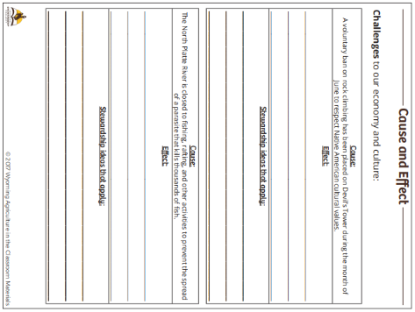
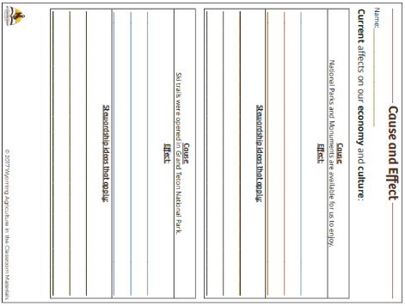
Show What You Know
Cause and Effect resource link
Notes:
Assessment

Slide 27
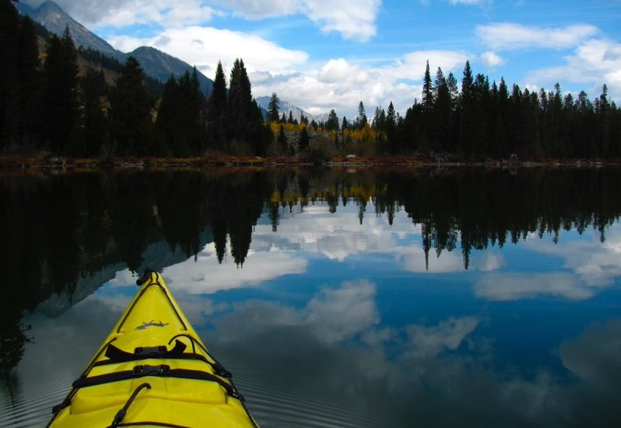
What did we learn from today’s challenge?
Notes:
Provide the students an opportunity to explain their learning.

