Slide 1
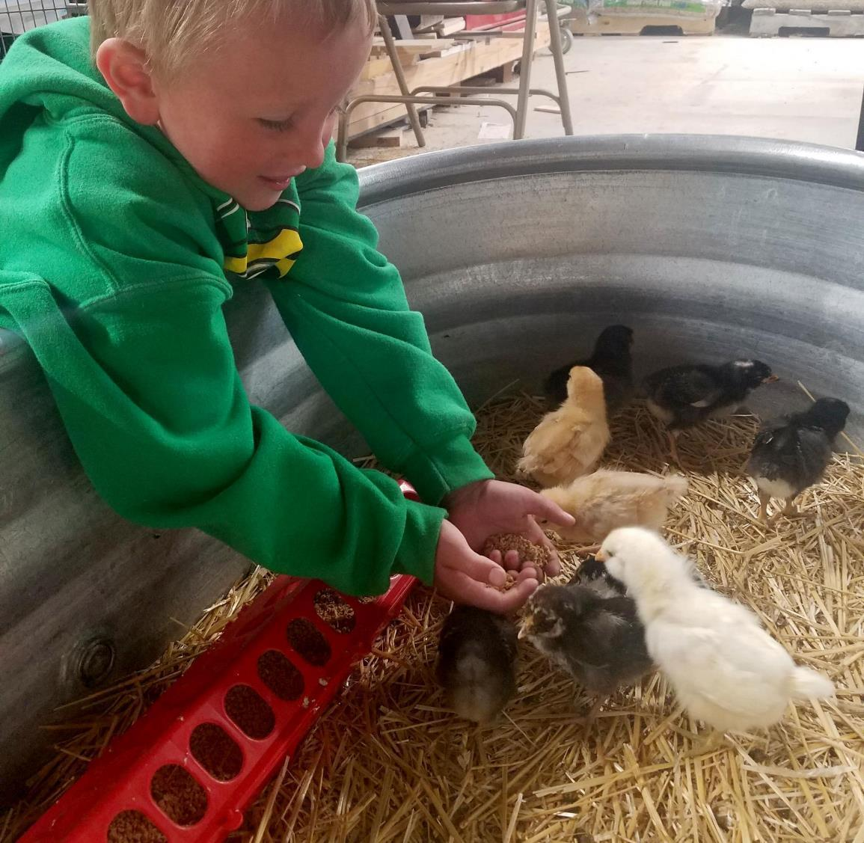
Agriculture
5th grade
Lesson 1:
Complex Considerations
Notes:
The name of the lesson is a link to the website where the lesson can be viewed or downloaded.

Slide 2
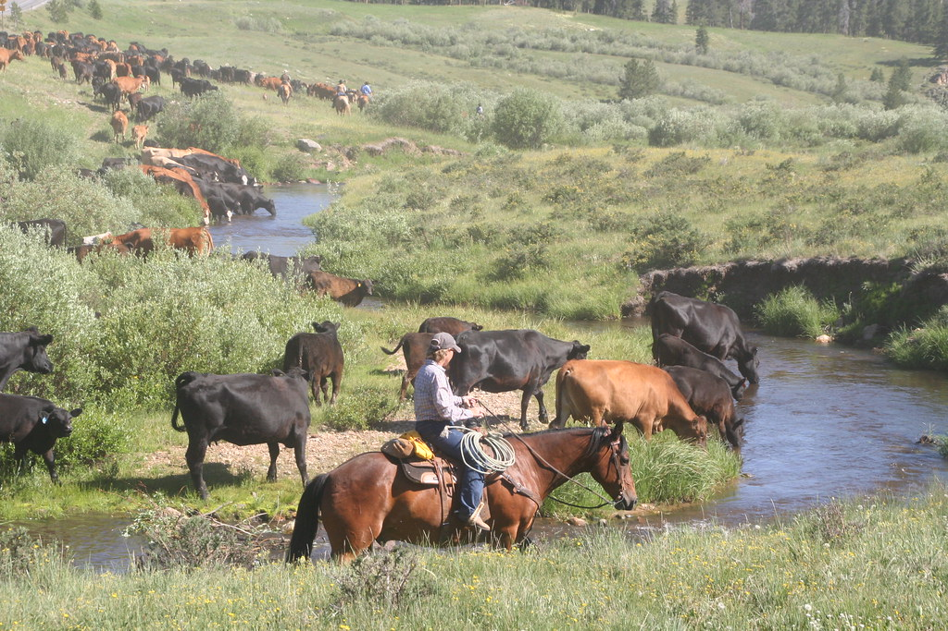
How can we be stewards of Wyoming’s agriculture to benefit current and future generations?
Essential Question
Notes:
This is a chance to share the Essential Question for this unit and have a discussion about their role as stewards of Wyoming’s agriculture.

Slide 3
Today’s Challenge
Students will complete a decision-making table in order to apply the definition of steward while practicing stewardship decisions.
Notes:
Review the lesson objective with students so they understand the focus of the lesson for the day.

Slide 4
Culture - a way of thinking, behaving, or working that exists in a place or organization
Steward - an individual who manages areas or resources
Stewardship - As Wyoming citizens, we are stewards entrusted with the responsible development, care, and use of our resources to benefit current and future generations..
Vocabulary
Notes:
Review the vocabulary words with the students guiding them to develop an understanding for each of the listed words.

Slide 5
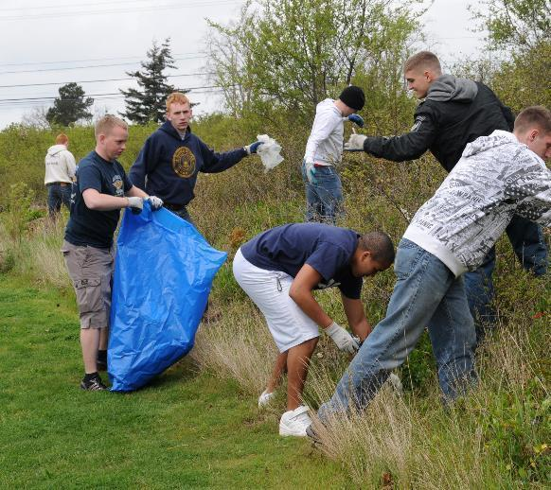
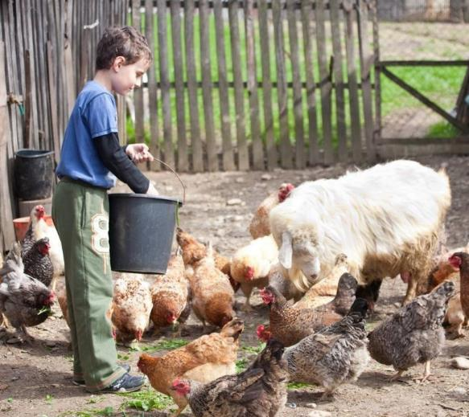
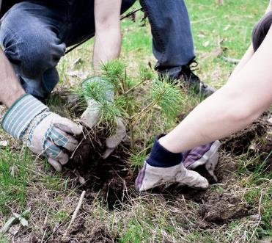
Definition of a steward: an individual who manages areas or resources. A person does this by looking after or caring for someone or something.
This Photo by Unknown Author is licensed under CC BY-SA
This Photo by Unknown Author is licensed under CC BY
Image by Alex Indigo licensed under CC BY 2.0
Tell us about a time you acted as a steward or saw someone acting as a steward.
Notes:
Procedure #1 and #2:
Have students share examples of stewardship. You could do this as a whole group or place students in break-out rooms. Explain that the students are stewards of the school's playground. You can use an area other than the playground, if you wish.

Slide 6
Being a steward:
Share with the class what your partner told you.
Each team will have a chance to share with the class.
Notes:
Procedure #2
Students can share in a discussion or they can use a virtual sticky note tool like Scrumblr or Pinup.

Slide 7
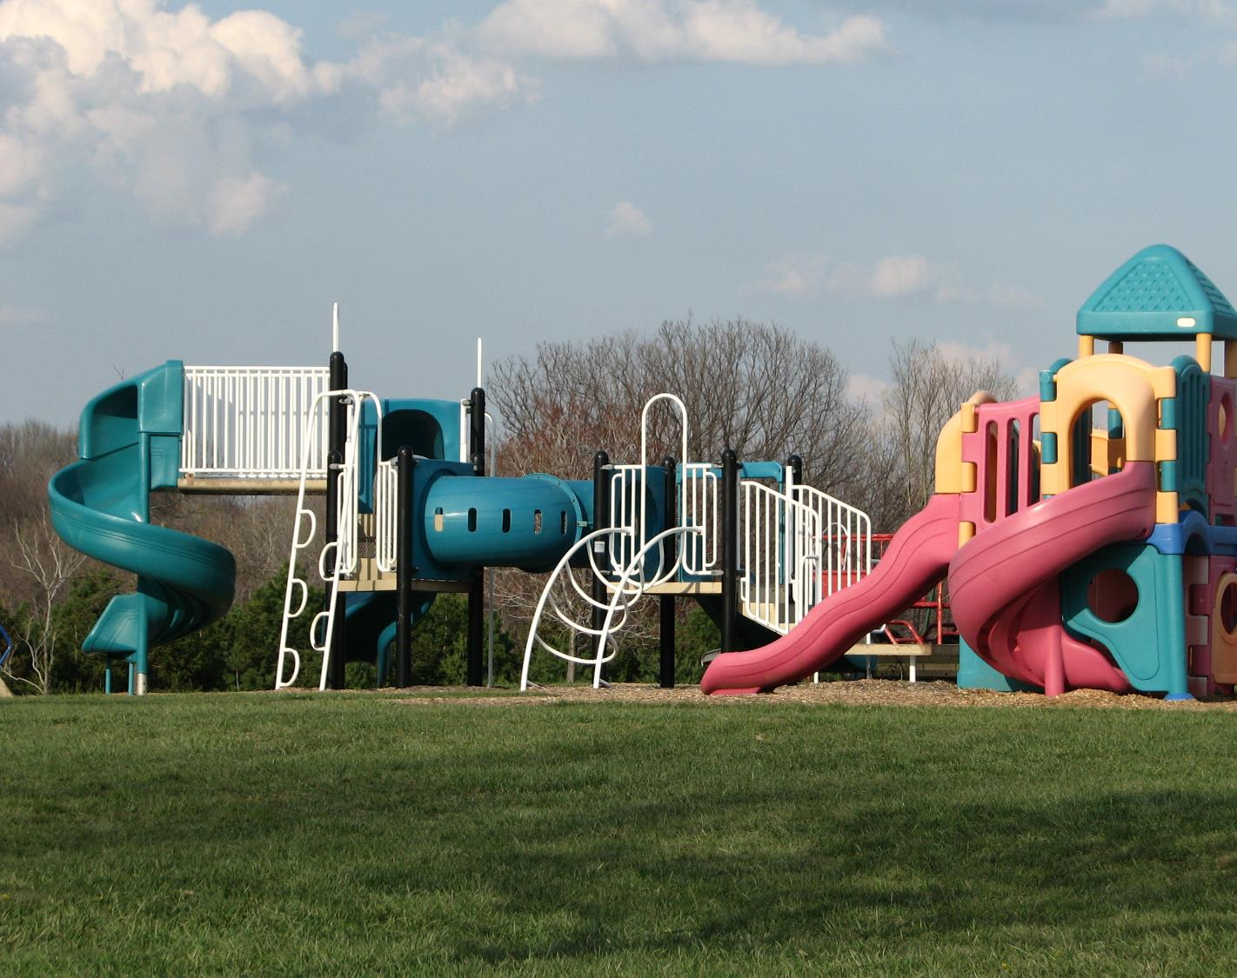
Brainstorming ideas for new playground equipment:
Write down different types of playground equipment.
You will have 5 minutes on your own.
We will share our ideas with the class.
Create a final class list.
This Photo by Unknown Author is licensed under CC BY-SA
Notes:
Procedure #3
This would be a place where you could use a mind mapping tools such as Mindmeister or Kidspiration.

Slide 8
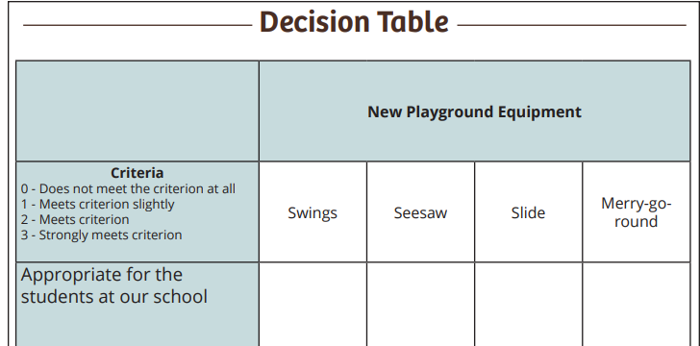
Making decisions: Decision Table for students
Take a moment and choose your items. You will put those on your Decision Table.
Notes:
Procedure #4
Examples of four types of equipment are provided on the next four slides. Your students can use these examples or they can come up with their own. Consider nontraditional playground equipment (grass hill, outdoor classrooms, tables). You will fill this out as a class. You can have the students provide the ideas and you fill it out or allow different students the opportunity to write in the spaces. You can provide students their own copy of the decision table to complete with a partner or follow along as the class develops one together.

Slide 9
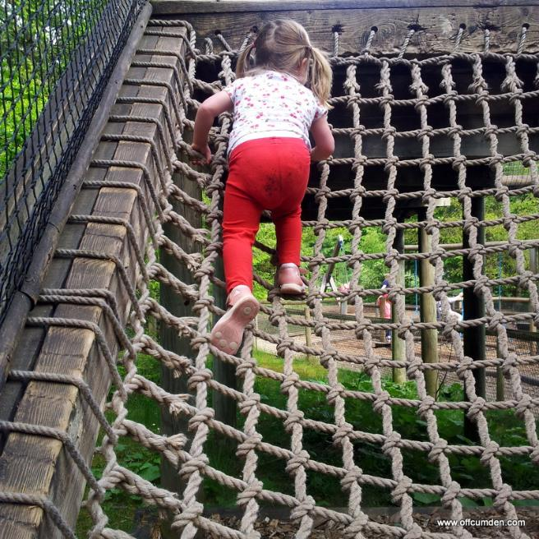
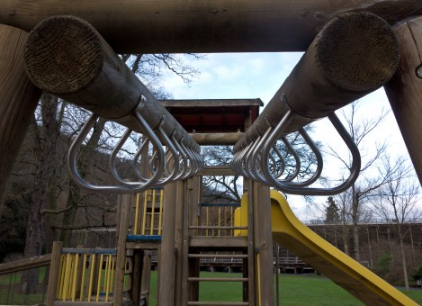
Climbing Activities
This Photo by Unknown Author is licensed under CC BY-ND
Notes:
Procedure #4
Use these examples if needed.

Slide 10
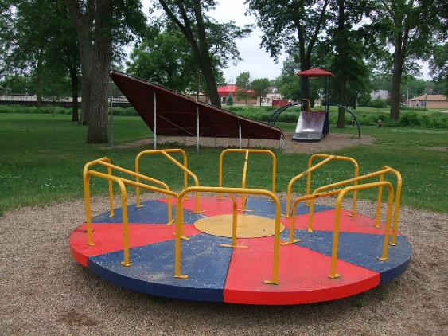
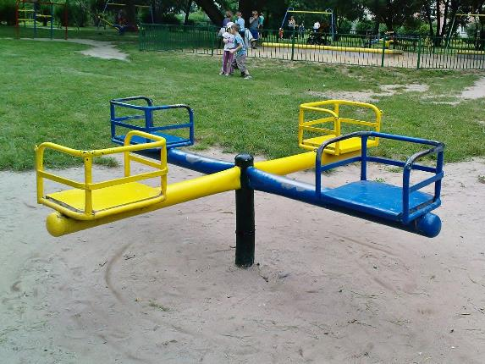
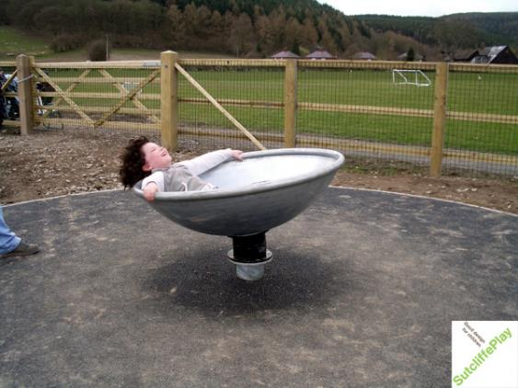
Spinning Activities
This Photo by Unknown Author is licensed under CC BY-SA
This Photo by Unknown Author is licensed under CC BY-SA
This Photo by Unknown Author is licensed under CC BY-SA
Notes:
Procedure #4
Use these examples if needed.

Slide 11
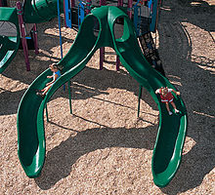
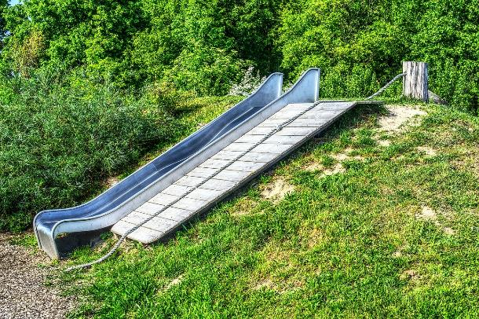
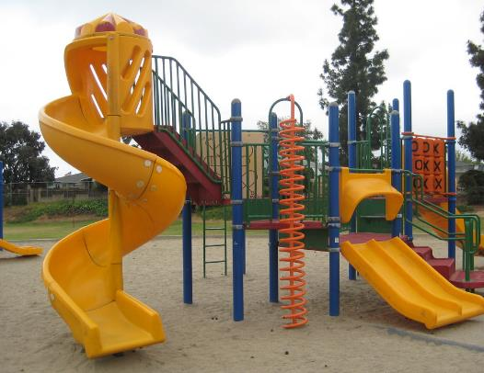
Slides
This Photo by Unknown Author is licensed under CC BY-SA
This Photo by Unknown Author is licensed under CC BY-SA-NC
Notes:
Procedure #4
Use these examples if needed.

Slide 12
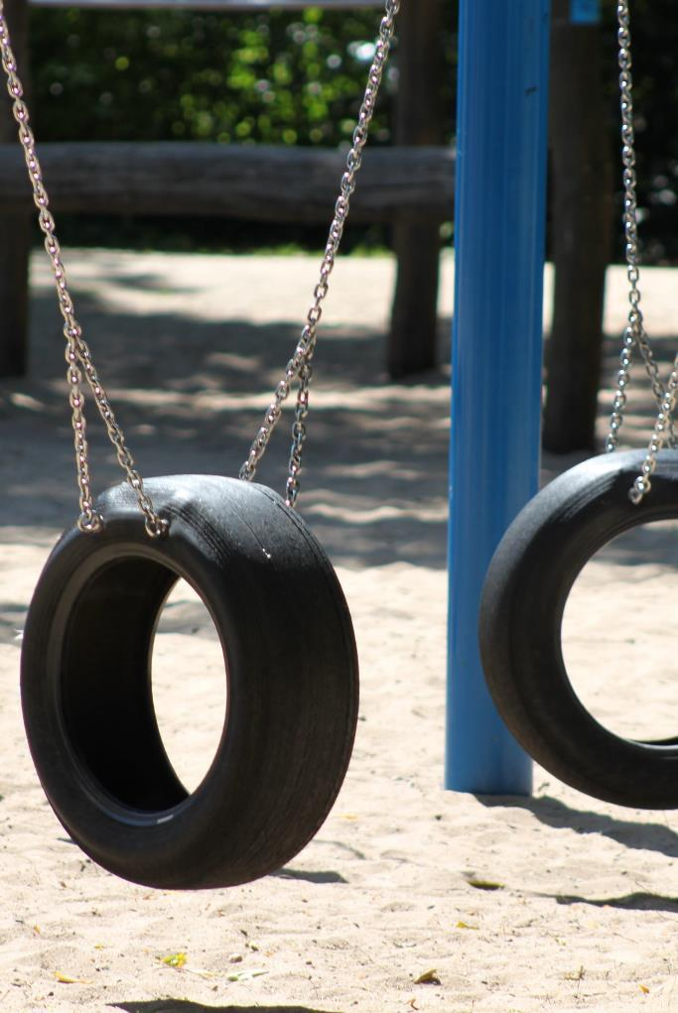
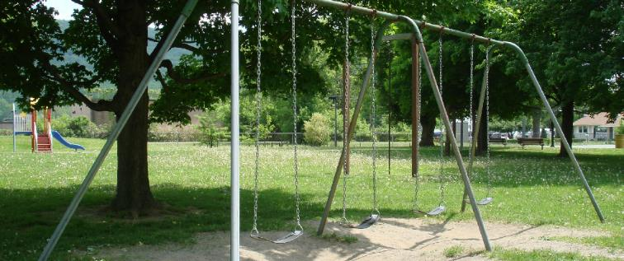
Swings
This Photo by Unknown Author is licensed under CC BY-SA
Notes:
Procedure #4:
Use these examples if needed.

Slide 13
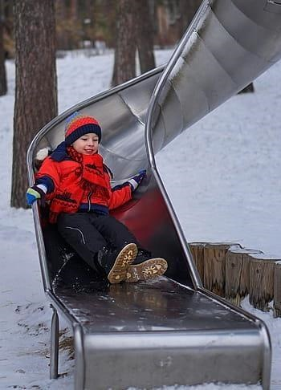
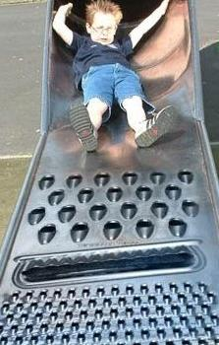
Developing our Criterion: Brainstorm ideas for the criteria to use for choosing your playground equipment. How do we know this equipment will improve our playground? What characteristics do we want our new equipment to have?
Use the example Decision Table.
Example:
The equipment will be safe to use.
This Photo by Unknown Author is licensed under CC BY-SA-NC
Notes:
Procedure #4
The students will decide what criteria should be considered when making a decision about the equipment. You can model this process using the Decision Table Example. Remind the students that the equipment has to be for everyone in the school, which is why this is already on the Decision Table (additional instructions are provided in the lesson).

Slide 14
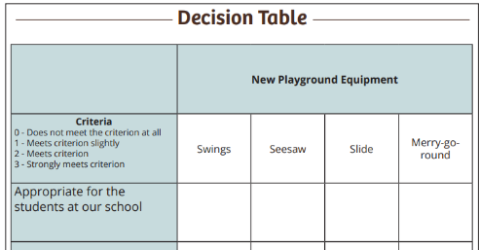
What is your criteria?
You must decide the criteria you will use for choosing the new playground equipment.
Put your criteria in the first column of your Decision Table.
Notes:
Procedure #5
After allowing students to brainstorm ideas for criteria, have them choose the ones they want to use. They will write their criteria in the first column of the Decision Table. As students list their criteria, refer to the TEACHER NOTE at the beginning of the lesson. Environment, culture, current/future generations, and economics will come up later in the lesson.
You will then help the student rate the equipment based on their criteria. You will either work through this whole group or allow groups to share their ideas depending on what approach you took.

Slide 15
Rating Our Playground Equipment
Rate each piece of equipment using your criteria.
Use the rating scale on your Decision Table.
After rating each piece of equipment, add each column up.
Write the total for each column in the bottom row.
Circle the piece of equipment that receives the largest total.
Notes:
Procedure #6
Once students have listed their criteria, they should continue to work through the Decision Table.

Slide 16
Decision making as good stewards: Using criteria to guide us.
What criterion did we use?
What category did each fall under?
Environment
Culture
Current and future generations
Economics
Notes:
Procedure #7
As a whole class, have students share the criteria they used to complete their Decision Table. As students share their criteria, help them decide which category the criterion fall under and why. (Refer to the teacher notes at the beginning of the lesson). Using the polling tech tools would provide another strategy for gathering information.

Slide 17
How many criterion did you use to make your decision about the playground equipment?
Notes:
Procedure #8
Students should realize they used more than one criterion to make a decision.

Slide 18
Write a sentence that describes you as a steward. Your sentence must include the following words:
Steward
Decision
Use
Care
Multiple
Notes:
Procedure #9
Assessment or Check for understanding.
You may complete this either individually, or by having student write their sentence on the whiteboard, or in the platform chat box.

Slide 19
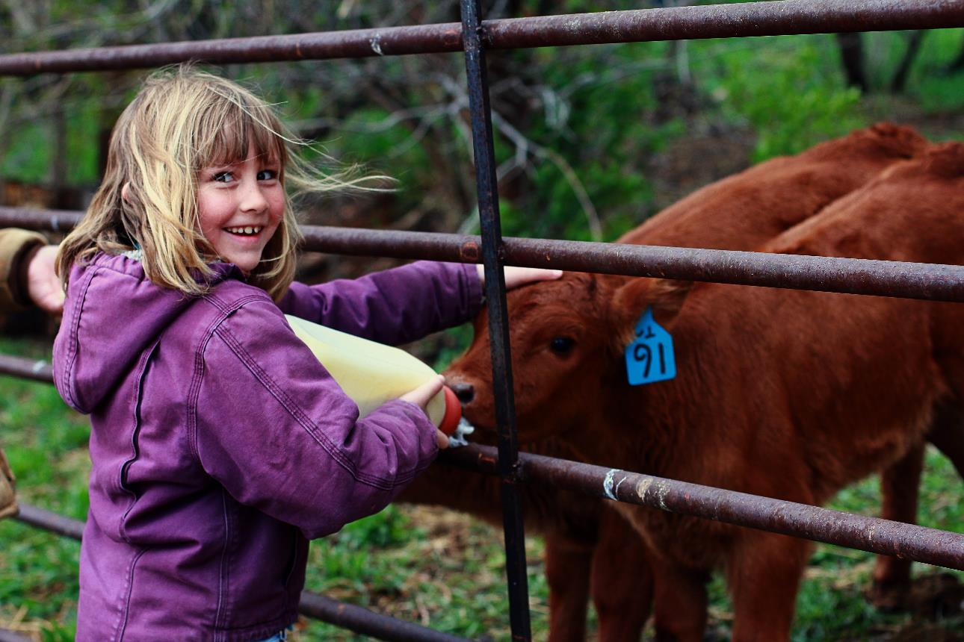
What did we learn from today’s challenge?
Notes:
This question refers back to the lesson objective. Allow the student to discuss their understanding of the day’s lesson.

