Slide 1
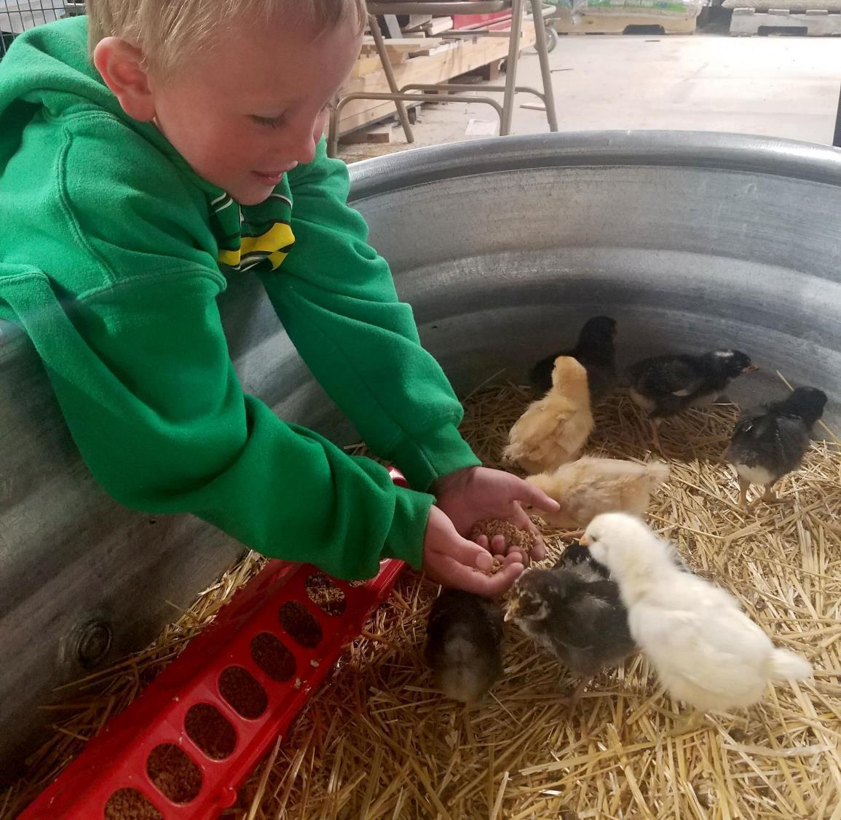
Agriculture
5th grade
Lesson 3: Food Web Frenzy
Notes:
The name of the lesson will be a link to the website where the lesson can be viewed or downloaded.

Slide 2
Today’s Challenge
Students will:
Learn about food webs and how to model them.
Create a model of a food web.
Photo by NPS
Notes:
Review the lesson objective with students so they understand the focus of the lesson for the day.

Slide 3
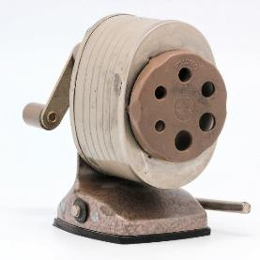
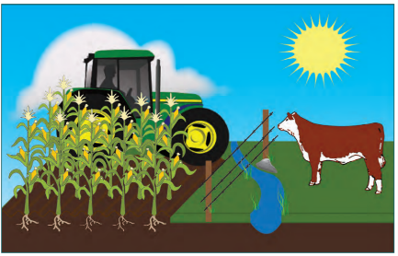
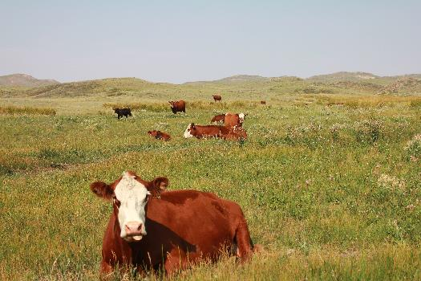
What is a system?
What is an ecosystem?
Describe a Wyoming ecosystem
Highlights from our last lesson
What did you learn from yesterday’s challenge?
Notes:
Before moving on, have the students review what they learned in lesson #2. Using a ‘sticky note’ tool such as Scrumblr or Pinup could be another way to review this information.

Slide 4
Consumer – those organisms within an environment that are nutritionally dependent upon other organisms or their products
Decomposer – organism that breaks down dead organic material
Drought – a period of below average precipitation resulting in shortages of water supply and/or soil moisture and could result in shortage of grass/forage
Food chain – what-eats-what in an ecological community, typically a graphic representation
Food web – the natural interconnection of food chains and generally a graphical representation (usually an image) of what-eats-what in an ecological community
Model – a simplified representation of a system that can explain and help make predictions regarding a phenomenon
Producer – organism on the food chain that can produce its own energy and nutrients
Vocabulary
Notes:
Review the vocabulary words with the students guiding them to develop an understanding for each of the listed words.

Slide 5
Day 1
Overview of Food Webs

Slide 6
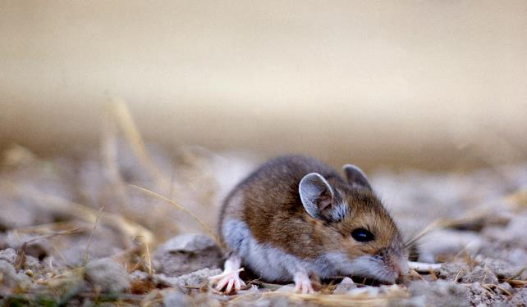
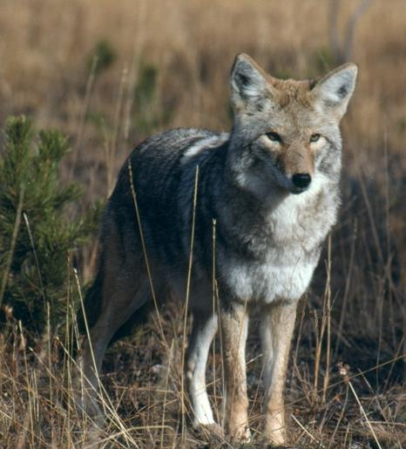
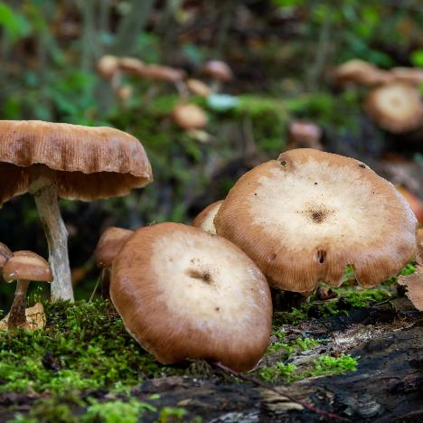
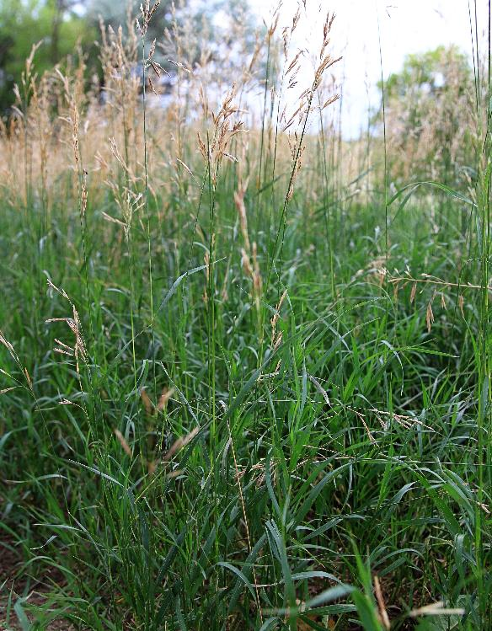
What do you know about food webs?
NPS Photo
NPS Photo
NPS Photo
Notes:
Procedure #2

Slide 7
Food Chain Food Web
Photo courtesy of PMG Biology
Notes:
Procedure #2
Make sure the students understand the difference between a food chain and a food web. A food chain is a linear depiction of how different organisms obtain their food/energy. A food chain typically starts with a producer/plant (an organism that makes its own food) and then shows a series of consumers (organisms that eat other organisms). The arrows in a food chain show the direction of the energy flow. The arrows can be confusing to students, because they think the arrows should show what eats what and should be turned in the other direction. Clarify that when we eat, we obtain energy and that’s why the arrows point the way the do. A food web is a series of food chains in an ecosystem and shows the overlap or interconnections that happen in an ecosystem.

Slide 8
A Food Web Model
A model helps scientists and engineers to quickly represent ideas.
Notes:
Procedure #2 & #3

Slide 9
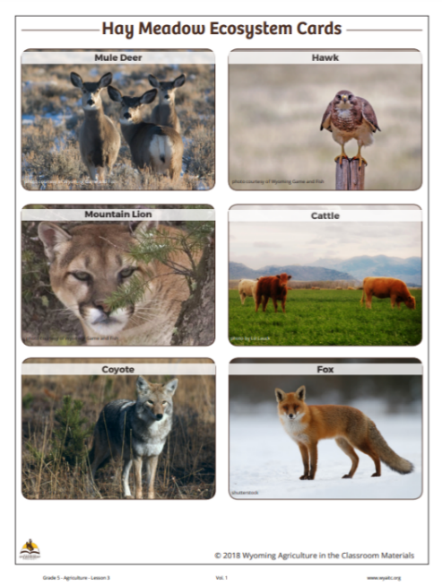
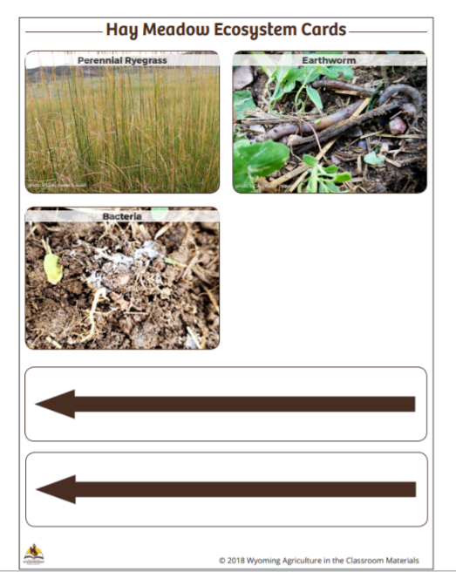
An Agricultural Food Web
Link to Hay Meadow Ecosystem Cards
Notes:
Procedure #3: Students will create a model of an agricultural food web using the Hay Meadow Ecosystem Cards. Students will need a copy of the cards to complete the task. If this is not possible or practical, a word bank of organisms can be found on the next slide.

Slide 10
Create your own food web
Alfalfa Bacteria Cattle Coyote Earthworm | Fox Grasshopper Hawk Jack Rabbit Mountain Lion | Mouse Mule Deer Perennial Ryegrass Sandhill Crane Smooth Brome
Notes:
Procedure #3
Hay Meadow Ecosystem Cards word bank

Slide 11
Food Web Criteria
You will use the ‘Hay Meadow Ecosystem Cards’ to create your food web.
The food web should include arrows to show the directionality of the relationships.
In a food web, the arrow should go from food source to consumer.
The food web should show connections between multiple organisms.
Notes:
Procedure #4
This slide provides the criteria for students as they build their food web. The Food Web model provides guidance if students are struggling to put their webs together.

Slide 12
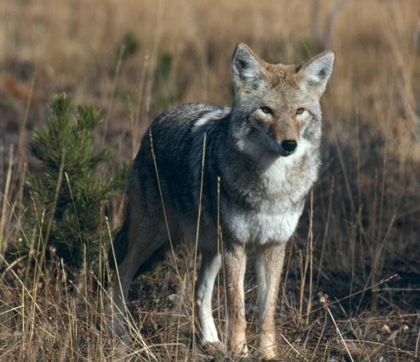
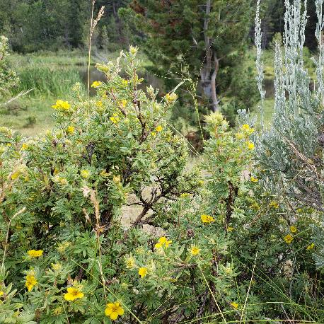
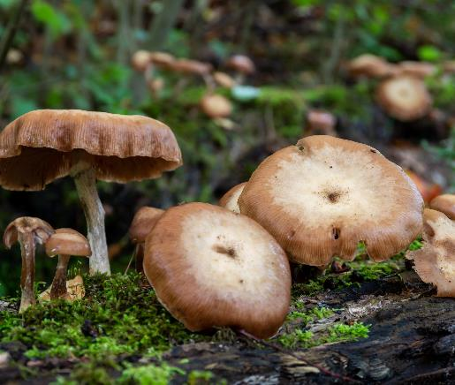
Share your food web model!
Identify the:
Producers
Consumers
Decomposers
NPS Photo
NPS Photo
Notes:
Procedure #5
Students will share which of the organism on their food web are producers, consumers, and decomposers. Remind students that producers make their own food, consumers eat other organisms, and decomposers break down dead organic material (plants and animals).

Slide 13
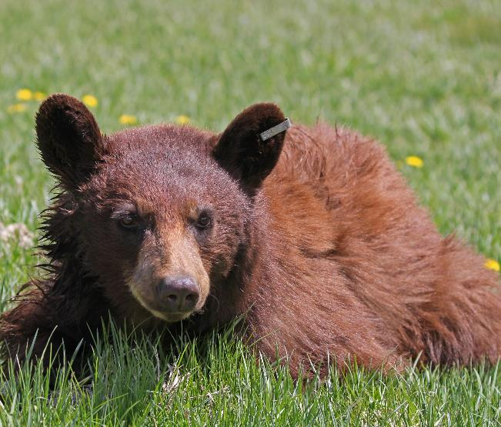
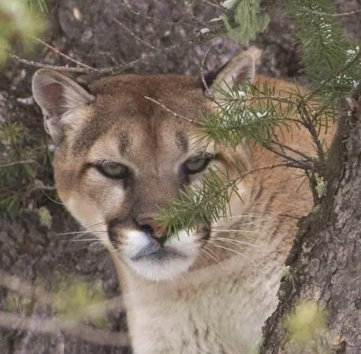
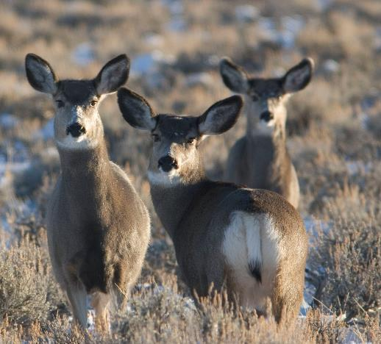
Share your food web model!
Identify the:
Herbivores – consumers that eat plants
Carnivores – consumers that eat other animals
Omnivores – consumers that eat plants and other animals
Notes:
Procedure #5
Students will share which of the organism on their food web are herbivores, carnivores, or omnivores. The definition of these terms are provided, as this is the first time the students will see these words.

Slide 14
Our Food Web Models
Link to Food Web Model
Notes:
Procedure #6

Slide 15
How do changes to one part of the web impact the other parts of the web?
Notes:
Procedure #6
Have students share some of the likely effects. Students can practice removing other organisms to see what happens to the web.

Slide 16
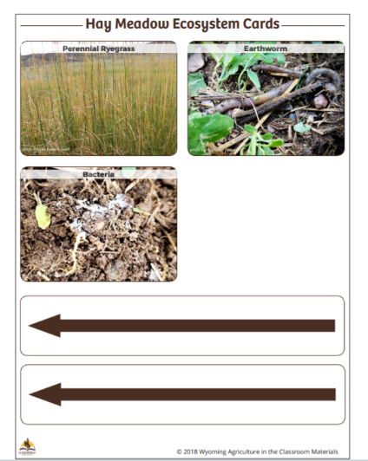
What happens to your Agricultural food web when an organism is removed?
Notes:
Procedure #7 & #8

Slide 17
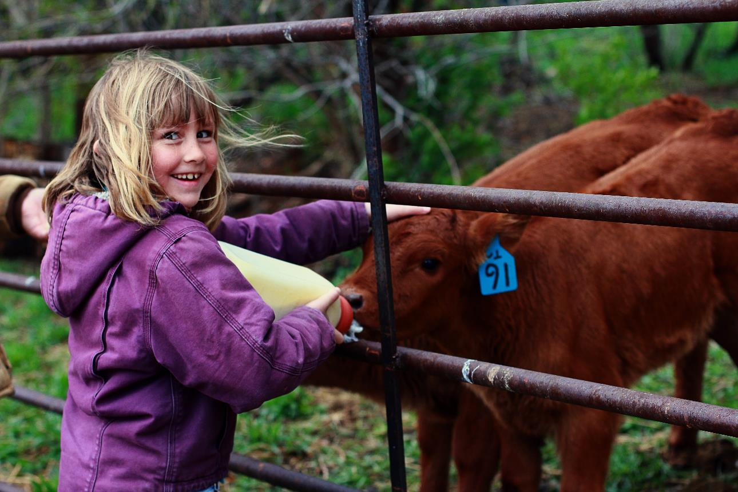
What did we learn from today’s challenge?
Notes:
Wrap up the lesson by reviewing the challenge for the day: Students learned about food webs and how to model them and they created a model of a food web.

Slide 18
Day 2
Stewardship Scenario:
Drought

Slide 19
Today’s Challenge
Students will:
Use their knowledge of food web interactions to make a stewardship decision for a drought scenario.
Notes:
Review the lesson objective with students so they understand the focus of the lesson for the day.

Slide 20
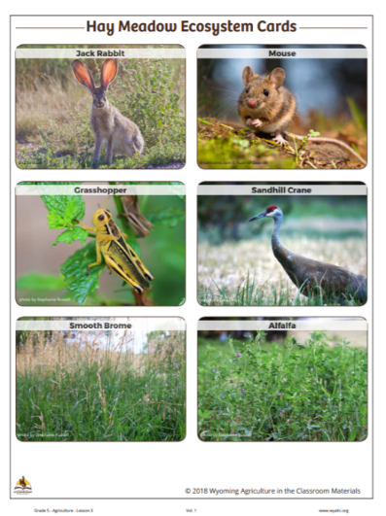
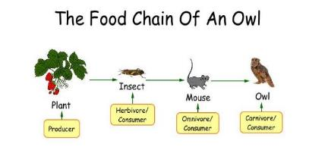
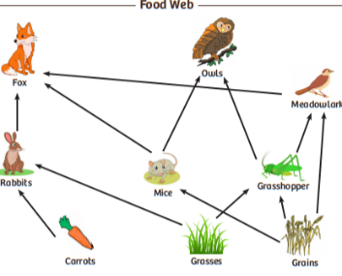
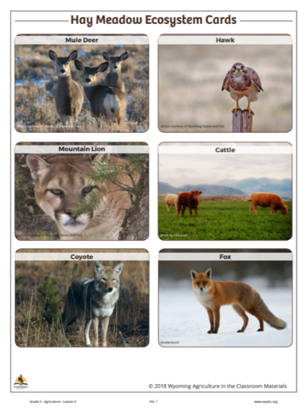
Highlights from our last lesson
What did you learn from yesterday’s challenge?
Notes:
Before moving on, have the students review what they learned in day 1. Using a ‘sticky note’ tech tool could be another way to review this information.

Slide 21
Challenge Scenario
Apply your science knowledge and your problem-solving skills to earn points to move forward on the Master Stewards Board Game!
Using the Scenarios
Notes:
Procedure #1
This is the first of 4 scenarios. For each scenario, refer to Using the Scenarios document to facilitate this part of the lesson.

Slide 22
Scenario #1: Drought
Student Instructions
Read the scenario.
What is happening in this scenario?
Brainstorm solutions to the scenario.
Link to Drought Scenario
Notes:
Procedure #1

Slide 23
Scenario #1: Drought
Student Instructions
Record the components of the ecosystem in your graphic organizer.
Answer the questions on your Student Recording sheet.
Link to Student Recording Sheet
Link to Lesson #3 criteria
Notes:
Procedure #1 & #2
After students finish completing their Scenario 1 recording sheets, review the sheets, and award students points based on the criteria outlined in the lesson.

Slide 24
What did we learn from today’s challenge?
Notes:
To wrap up the lesson, review the challenge for the lesson, “Use their knowledge of food web interactions to make a stewardship decision for a drought scenario.”

