Slide 1
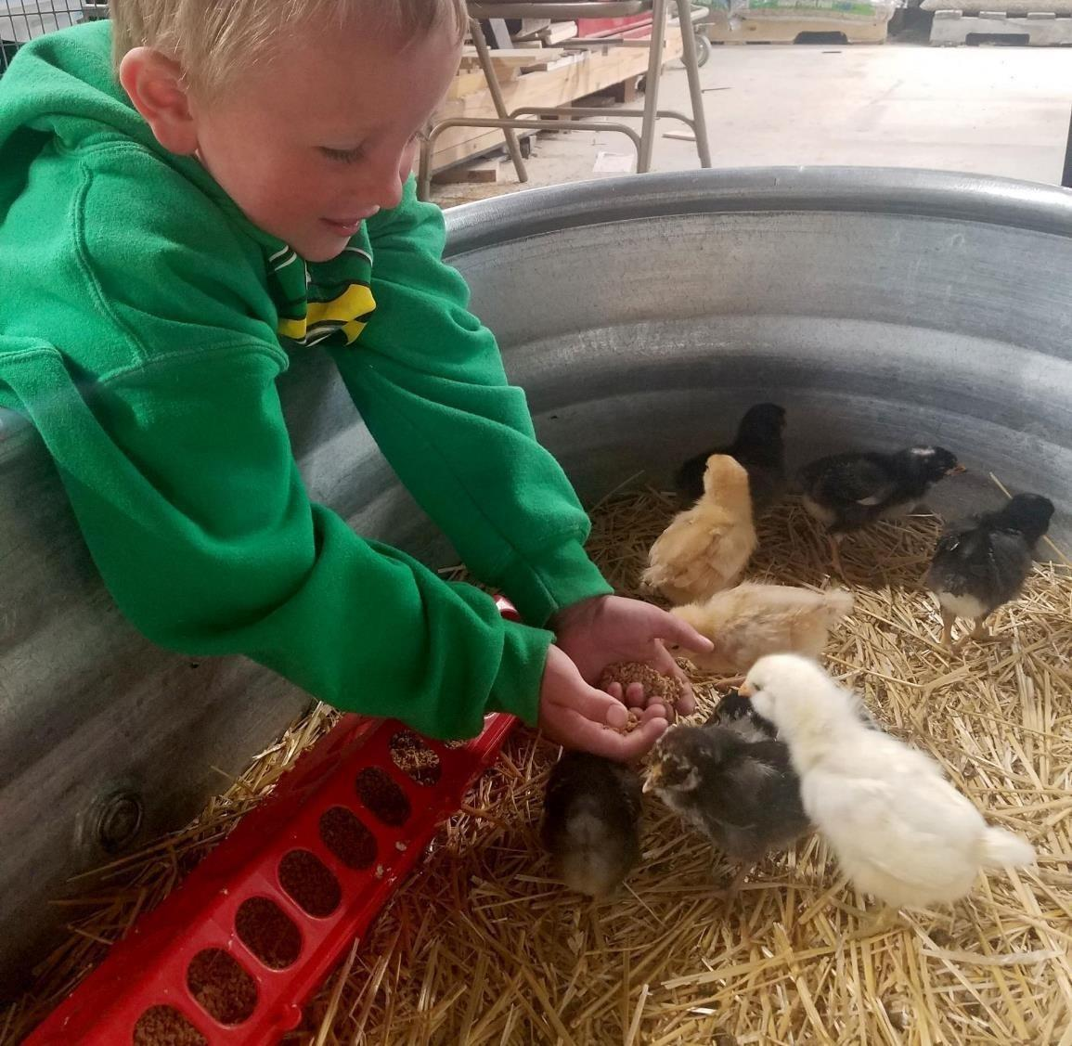
Agriculture
5th grade
Lesson 4: Survival of the Fittest
Notes:
Name of the lesson will be a link to the website where the lesson can be viewed or downloaded.

Slide 2
Today’s Challenge
Students will:
Use previous models to make sense of the needs of animals.
Use a variety of resources to begin to explore plant needs.
Watch a video explanation of photosynthesis to understand that animals get energy from the sun through plants.
NPS Photo

Slide 3
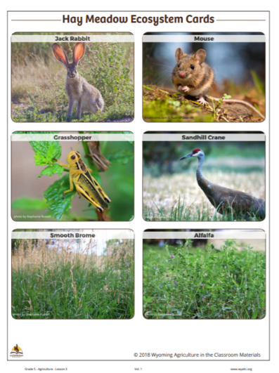
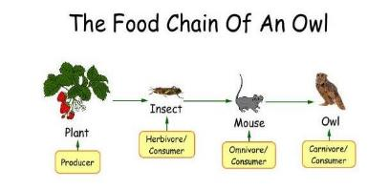
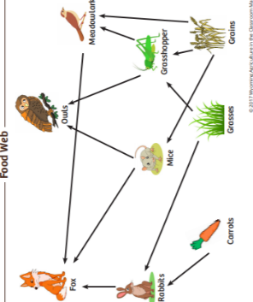
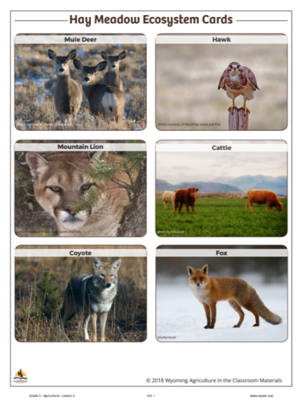
Highlights from our last lesson
What did you learn from yesterday’s challenge?
Notes:
Before moving on, have the students review what they learned in lesson #2. Using a ‘sticky note’ tool such as Scrumblr or Pinup could be another way to review this information.

Slide 4
Herbicide – a substance that is toxic to plants and is used to destroy unwanted vegetation
Photosynthesis – a natural chemical-process by which plants make their own food from the sun’s energy
Chlorophyll in plants' leaves uses the energy of the sun to convert water and carbon dioxide into glucose (sugar/food).
Oxygen is given off as a waste product.
Vocabulary

Slide 5
What do you need to survive?
Notes:
Procedure #1
Use this question as an opportunity to delineate between needs and wants.

Slide 6
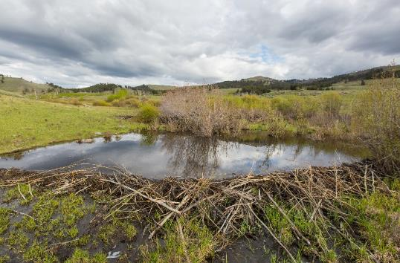
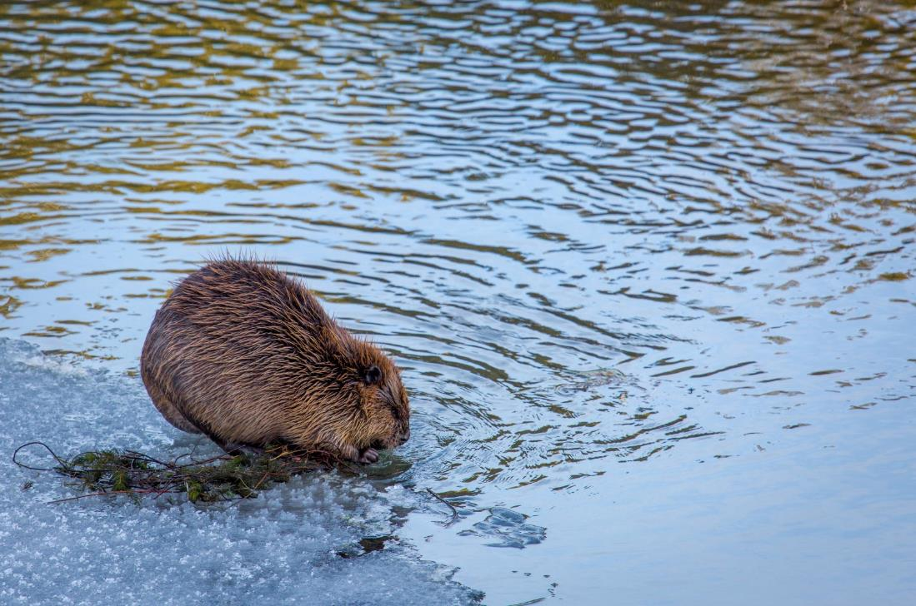
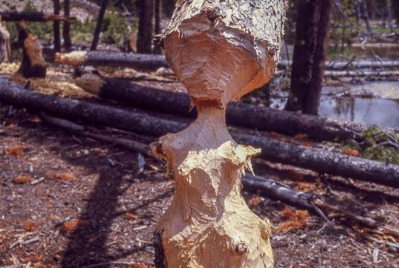
What do animals need to survive?
NPS photo
NPS photo
NPS photo
Notes:
Procedure #1
Animals need water, shelter, space, air (oxygen) and food. Use the next slide to clarify what types of food animals eat.

Slide 7
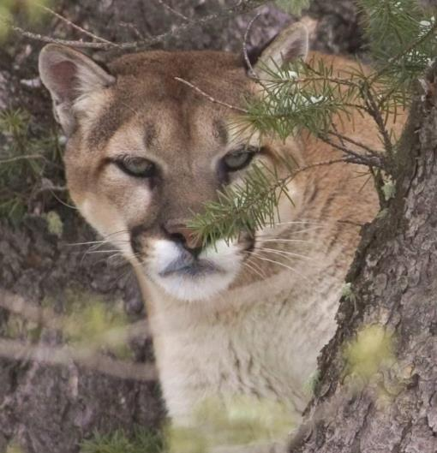
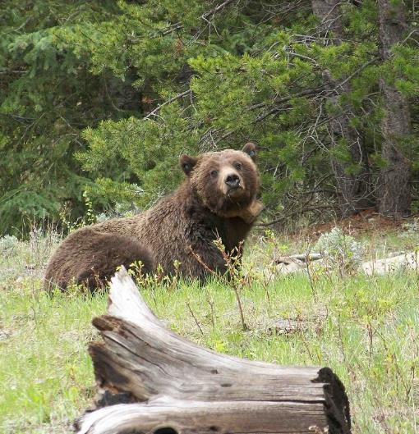
Do all animals eat the same types of food?
Photo courtesy of Wyoming Game and Fish
Photo courtesy of Wyoming Game and Fish
Photo courtesy of Wyoming Game and Fish
Carnivores
Omnivores
Herbivores
Notes:
Procedure # 1
Bring forward the idea that some animals eat plants (herbivores), some animals eat other animals (carnivores), and some animals eat a combination of plants and animals (omnivores).

Slide 8
What do living things need to survive?
Link to Food Web
Notes:
Procedure #2
Students will work to connect the idea of “needs in order to survive” to the concept of the food webs from Lesson 3. On the food web, the path of each individual food chain will be highlighted to show the “starting point” of the chain to the end. This is shown on the next 7 slides (each slide adding to the previous slide).

Slide 9
Use highlighters or colored pencils to trace the arrows on YOUR food web!
Notes:
Procedure #2
Have the students use this mapping process on their own copy of this food web. Students should use a different highlighter/colored pencil to follow each arrow chain.

Slide 10
Trace the arrows in the web to identify the source of energy.
Notes:
Procedure #2
You can continue to show the slides with the paths highlighted or you can have the students use this mapping process on their own copy of this food web. Students should use a different highlighter/colored pencil to follow each arrow chain.

Slide 11
Trace the arrows in the web to identify the source of energy.

Slide 12
Trace the arrows in the web to identify the source of energy.

Slide 13
Trace the arrows in the web to identify the source of energy.

Slide 14
Trace the arrows in the web to identify the source of energy.

Slide 15
Trace the arrows in the web to identify the source of energy.

Slide 16
Trace the arrows in the web to identify the source of energy.

Slide 17
Trace the arrows in the web to identify the source of energy.

Slide 18
Study the Food Web
Notes:
Procedure #3

Slide 19
Class Discussion
What do you notice about the source of each colored chain on your web?
What could we say about what animals need to survive based on your food webs?
What could we say about what plants need to survive based on your food web?
Notes:
Procedure #3

Slide 20
Needs of Living Things
Animal Needs | Plant Needs
Notes:
Procedure #4
To begin, complete the “Animal Needs” column. You will also want to record the other needs that animals have, if students don’t bring them up: water, food, shelter, air (oxygen), and to reproduce (to continue the species). You will return to the “Plant Needs” column after watching a video (next slide).

Slide 21
Let’s watch a video to learn about what plants need to survive!
Notes:
Procedure #5
After watching the video, proceed to the next slide to fill in the “Plant Needs” column.

Slide 22
Needs of Living Things
Animal Needs | Plant Needs
Water
Food
Shelter
Air (oxygen)
To reproduce
Notes:
Procedure #6
Now have the students fill in the “Plant Needs” column based on the video: sunlight, water, nutrients/minerals from soil, carbon dioxide.

Slide 23
Use your Needs of Living Things chart to answer these questions.
Are there any needs that plants and animals have in common?
Which needs are different?
Are there any needs that plants help to meet for animals?
Are there any needs that animals help to meet for plants?
Notes:
Procedure #7 & #8
Students can share their answers with a partner, a group, or as a class discussion. Once students have completed the quick write, have them share their responses.

Slide 24
The Basic Needs of Plants & Animals
Photo by Ranell Taylor
Photo by Stephanie Russell
Notes:
Procedure #9
All students should have an understanding of the basic needs of plants and animals and how these are similar and different.

Slide 25
Do you think that animals are as important to plants as plants are to animals?
Link to Lesson 4
Link to Check for Understanding sheet
Notes:
Procedure #10

Slide 26
Challenge Scenario #2
Apply your science knowledge and your problem-solving skills to earn points to move forward on the Master Stewards Board Game!
Using the Scenarios
Link to Lesson 4 (game points)
Notes:
Procedure #11
Students are introduced to the second scenario in the next two slides. Follow the same protocol as in the previous lesson, including the point system for the game.

Slide 27
Scenario # 2: Weed Infestation
Student Instructions
Read the scenario.
What is happening in this scenario?
Brainstorm solutions to the scenario.
Link to Scenario Reading
Notes:
Procedure #11

Slide 28
Scenario #2: Weed Infestation
Student Instructions
Record the components of the ecosystem in your graphic organizer.
Answer the questions on your Student Recording sheet.
Link to Student Recording Sheet
Notes:
Procedure #11
After students finish completing their Scenario 1 recording sheets, review the sheets, and award students points based on the criteria outlined in the lesson.

Slide 29
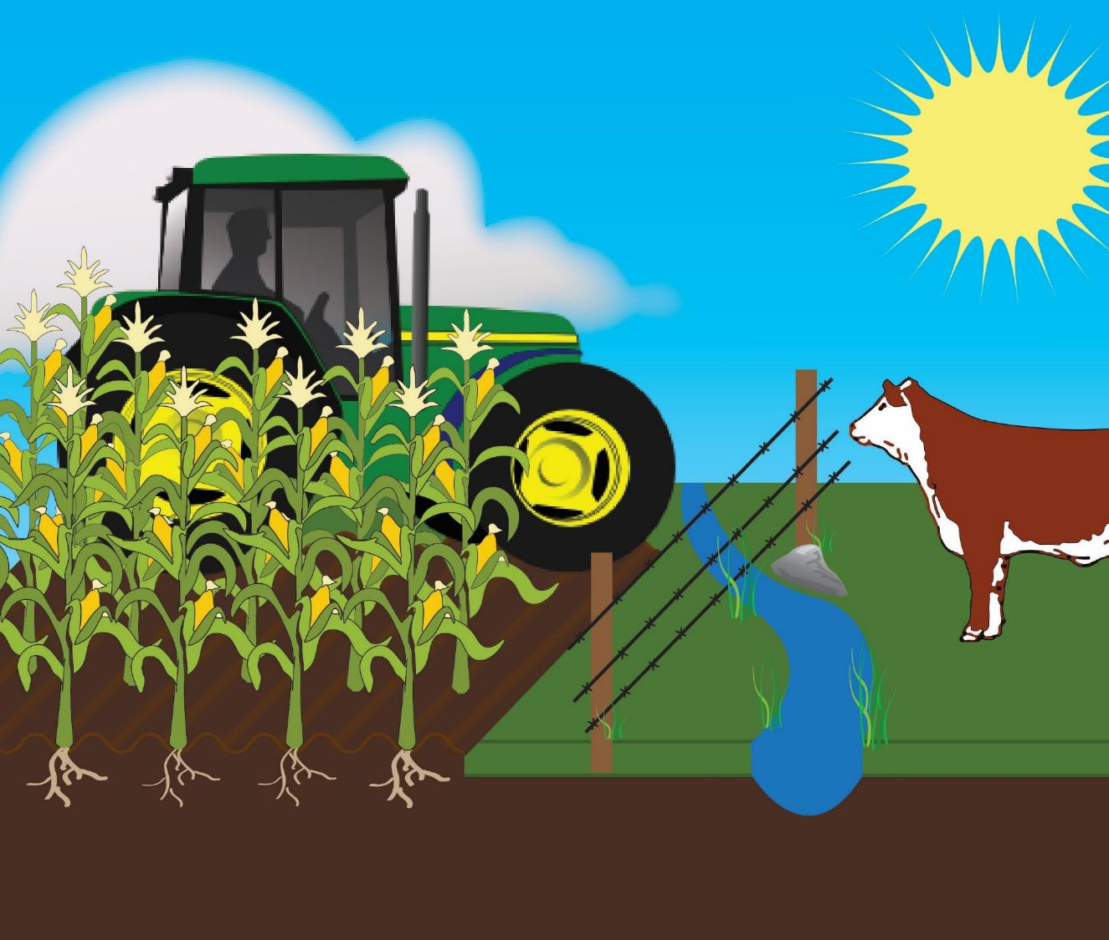
Draw arrows to show the connections between the components of the ecosystem.
Notes:
Procedure #12
Students will need to add a decomposer (fungi, bacteria, worms) to their picture. The next slides show an example of how the arrows should be drawn.

Slide 30
What do you think is the source of ALL the energy in this ecosystem?

Slide 31
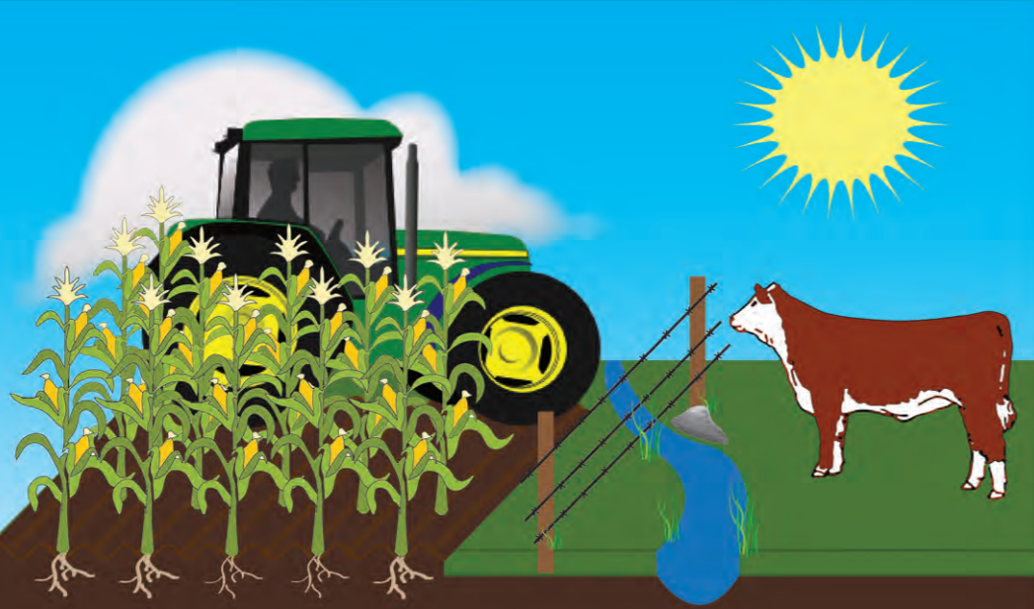
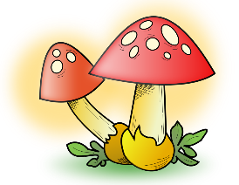
Notes:
Procedure #12
ONE arrow from sun to plants, ONE arrow from plants to animals, ONE arrow from animal to decomposer, ONE arrow from decomposer to soil/back to plant.

Slide 32
Do you think the sun is the source of all energy in any ecosystem we could create?
Link to Ecosystem For Kids
Notes:
Procedure #13
If students are not convinced that the sun IS the source of all energy, remind them of how plants obtain their energy (photosynthesis) and that animals gain their energy from eating plants (or other animals that eat plants). If time allows, students can play the Ecosystem For Kids game.

Slide 33
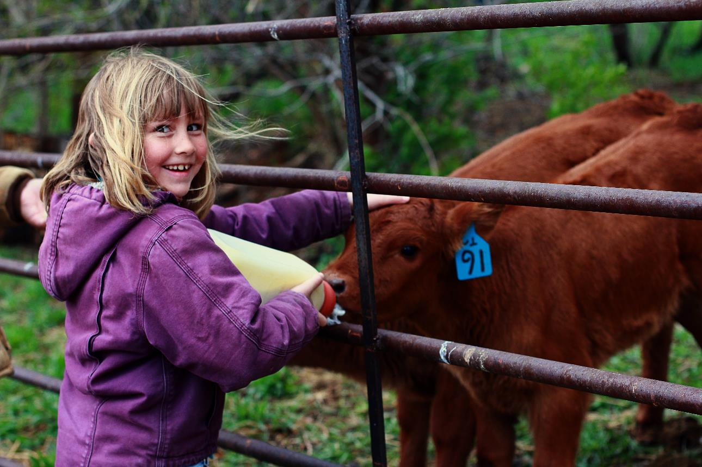
What did we learn from today’s challenge?
Notes:
To wrap up the lesson, review the challenge for the lesson: Identify the needs of animals and plants. Understand animals get energy from the sun through plants.

