Slide 1
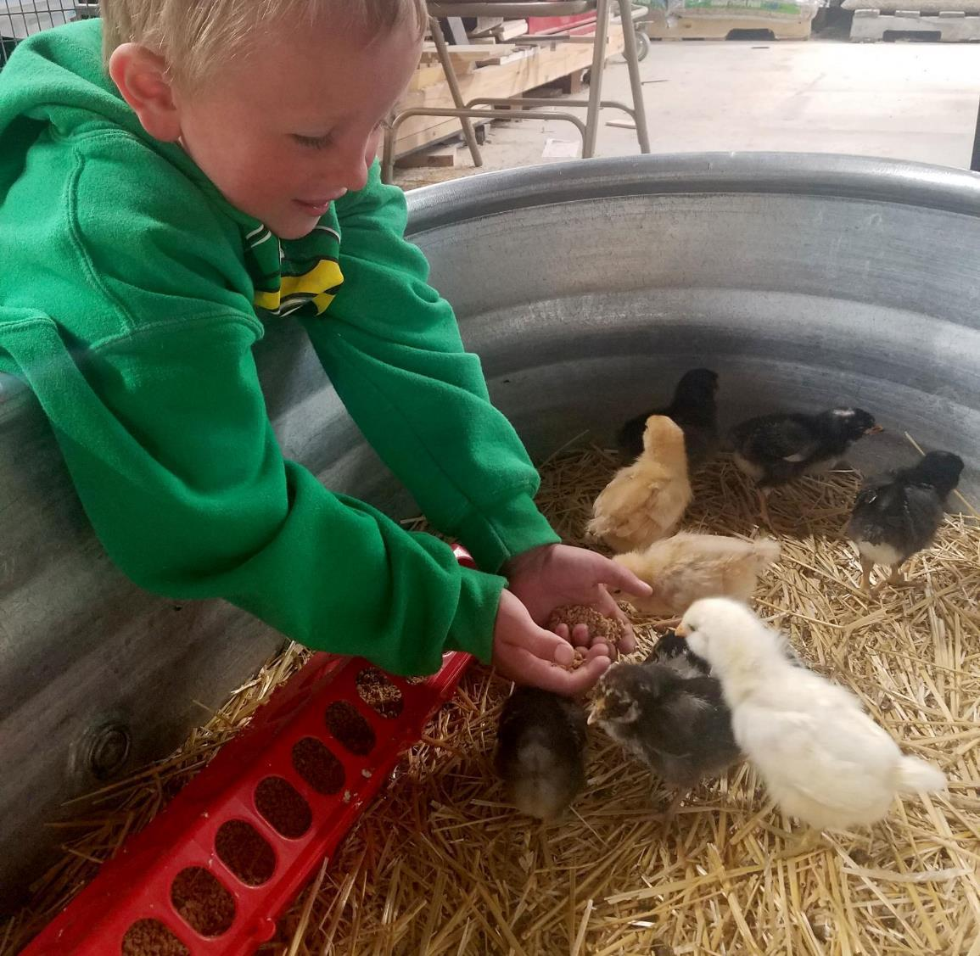
Agriculture
5th grade
Lesson 7: Agricultural Adventure
Notes:
Name of the lesson will be a link to the website where the lesson can be viewed or downloaded.

Slide 2
Today’s Challenge
Students will:
Apply principles of cost-benefit analysis to inform decision-making.
Understand the meaning of economic cost/benefit and cultural cost/benefit.
Notes:
Review the lesson objective with students so they understand the focus of the lesson for the day.

Slide 3
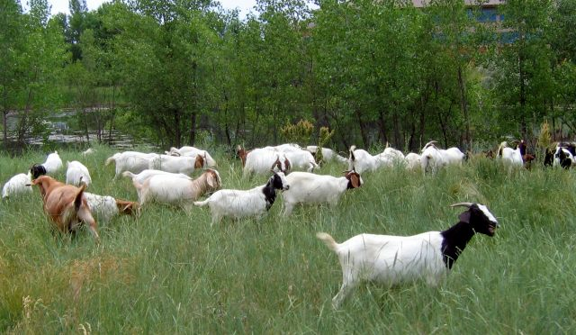
Think back on:
Introducing new organisms into an ecosystem
The effect those organisms can have
Highlights from our last lesson
What did you learn from yesterday’s challenge?

Slide 4
Cost-benefit analysis - a type of thinking in which you carefully consider what will be needed(cost) and what you will gain (benefit) if a certain action is present
Culture - a way of thinking, behaving, or working that exists in a place or organization
Economic cost - the time, money, and resources required for a task or job
Vocabulary

Slide 5
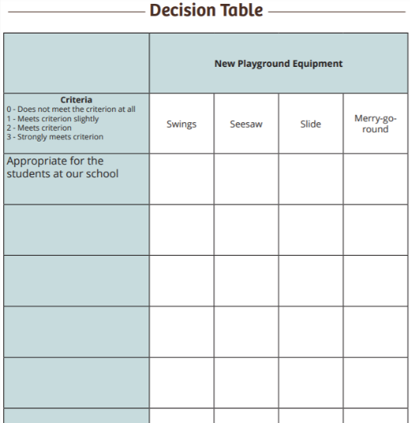
Definition of a steward: an individual who manages areas or resources. A person does this by looking after or caring for someone or something.
Notes:
Procedure #1
In lesson 1, we learned about stewardship. Discuss with the students what stewardship decisions they have made over the lessons. For the remainder of the unit you will be working to become a master steward. Students can share whole group or have them work in break out room.

Slide 6
Vocabulary Introduction
Notes:
Procedure #2

Slide 7
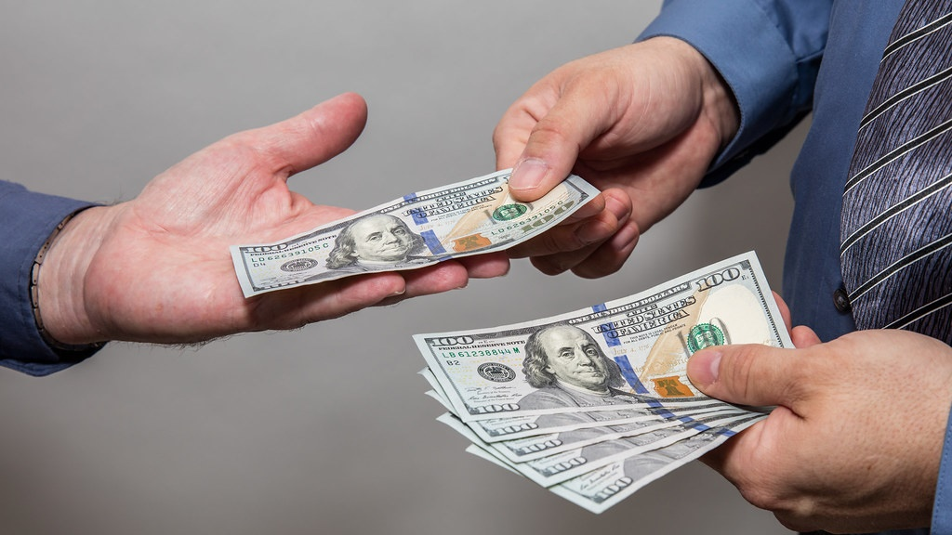
Economic Cost time, money, and resources required for a task or job.
This Photo by Unknown Author is licensed under CC BY
Notes:
Procedure #2
Provide the students with an agricultural example of raising chickens.

Slide 8
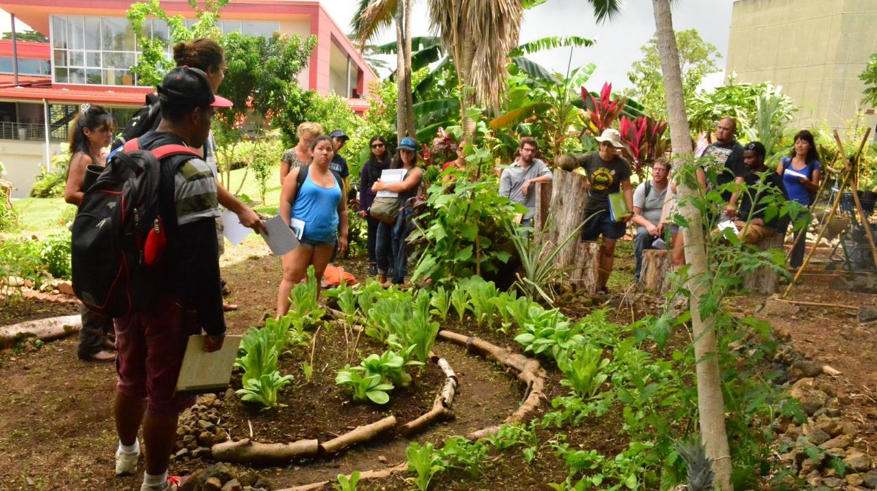
Culture way of thinking, behaving, or working that exists in a place or organization.
This Photo by Unknown Author is licensed under CC BY
Notes:
Procedure #2
Use the culture of the classroom to help support the student’s understanding of culture. Students may need examples of their community culture.

Slide 9
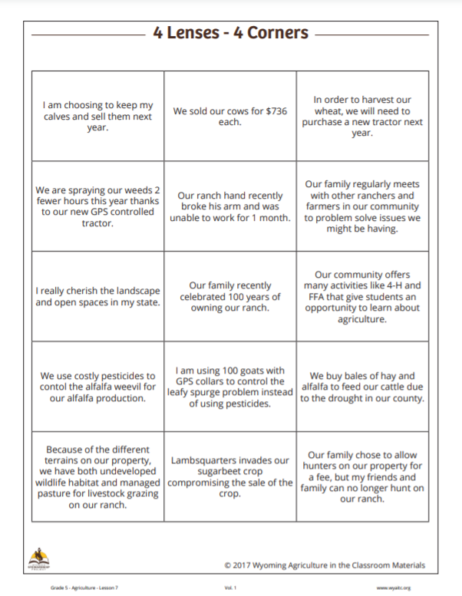
4 Lenses- 4 Corners: You have been given a card to use in this activity.
Notes:
Procedure #3
Provide each student with one of the cards. You can assign each student a card virtually and have them separate into a break-out room. Using a polling tool like Slido would be another option here.

Slide 10
Activity Directions
You will be determining what category your card fits best in.
Categories: economic benefit, economic cost, cultural benefit, or cultural cost.
Before we get started, let us discuss these categories.

Slide 11
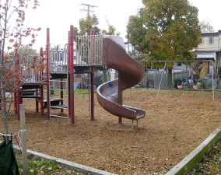
Economic Cost
Our playground equipment required wood chips.
This Photo by Unknown Author is licensed under CC BY-ND

Slide 12
Economic Benefit
We fundraised for new playground equipment.

Slide 13
Cultural Benefit
Our school is offering art and music classes.

Slide 14
Cultural Costs
After school programs are no longer offered.
This Photo by Unknown Author is licensed under CC BY-SA

Slide 15
Culture & Economics
Notes:
If you are completing this in class you can label four corners, but if you are doing this virtually feel free to use this slide or a tool like Slido.

Slide 16
Cost - What is needed
Why did you make this choice?
Benefit - What will be gained
Notes:
Procedure #4
Use this slide to do an example to show the students the process as a whole group.

Slide 17
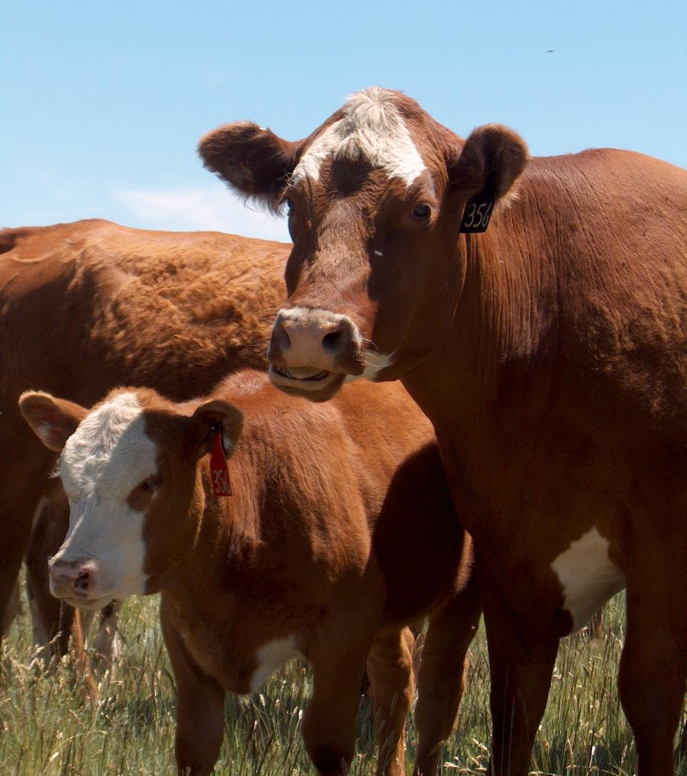
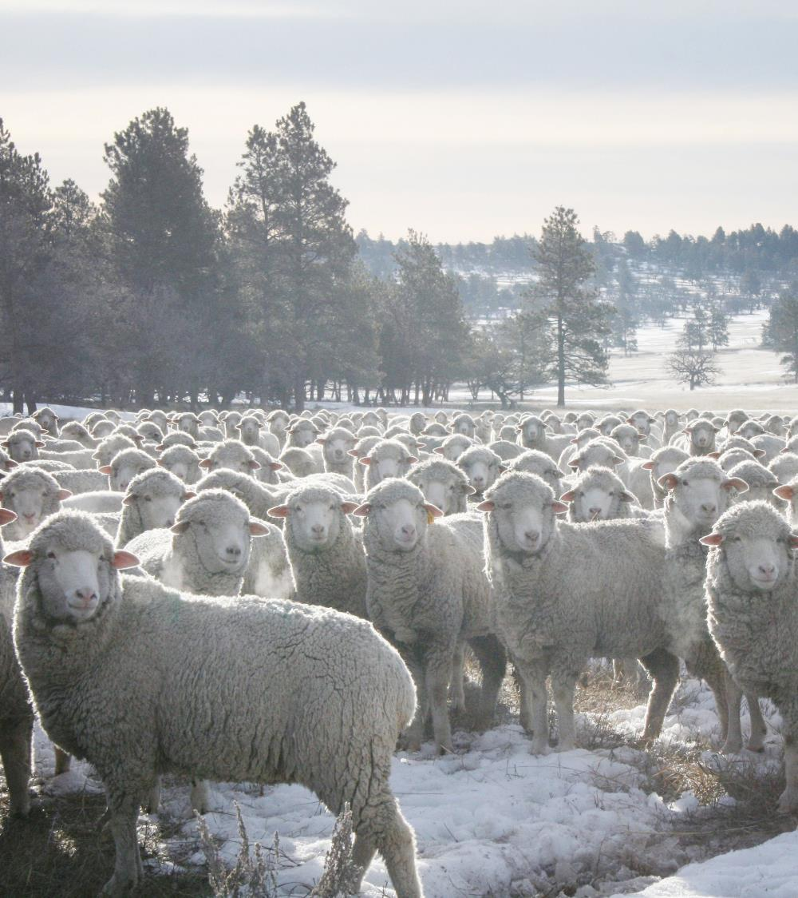
Inheritance: The process of being given property or possessions from another
Notes:
During this activity students will give you a scenario. You have inherited a ranch and will be making decisions to man
age a ranch. The link will allow students to investigate the Ag Adventure slideshow.

Slide 18
Ranch Inheritance Scenario
You are moving to a cattle ranch.
You are excited to live in the mountains.
You are leaving the life you know.
Revenue or money only comes from the sale of calves in the fall, hay production, and the hunters hunting on your land.
What decisions will you make managing the ranch?
Notes:
Procedure #6
The students will be completing a task after the read aloud.

Slide 19
Discussions Decision Making Choices/Criteria
Notes:
Procedure #7
Have students explain the decisions that they made during the scenario. Have the students compare their reasoning and determine how each decision turns out differently.

Slide 20
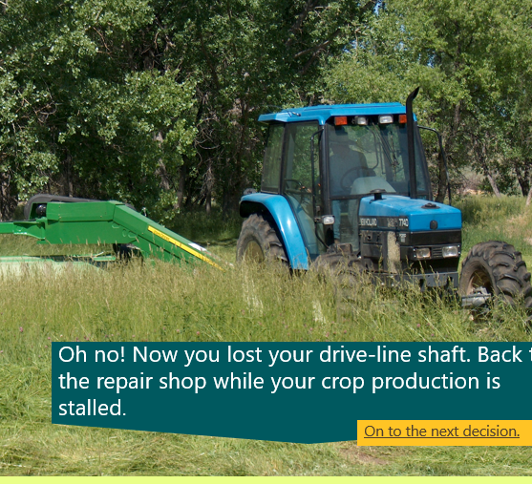
Discussions Decision Making Choices/Criteria
Notes:
Procedure #7
Allow the students the opportunity to discuss their decisions and explain why.

Slide 21
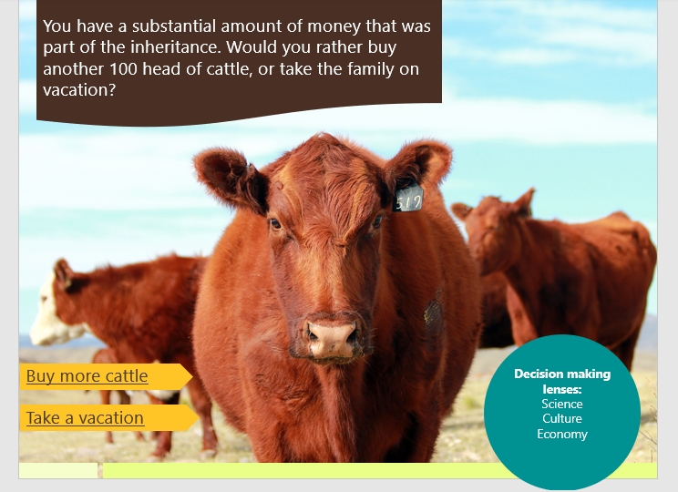
Discussions Decision Making Choices/Criteria
Notes:
Procedure #7
Continue allowing student to discuss their thought process as they made their decisions.

Slide 22
Discussions Decision Making Choices/Criteria
Notes:
Procedure #7
Continue the discussion around educated choice for the different situations.

Slide 23
Discussion
How did thinking about the cultural costs and benefits and the economic costs and benefits help you to make decisions on your ranch?
What lens do you think you used to make your decisions?

Slide 24
Decision making
Notes:
Procedure #9
Remind student that decision making is a complex task and that it all depends on the lenses that each individual is looking through.

Slide 25
Check for Understanding
Which is not a characteristic of culture?
Way of behaving
Way of working
Way of walking
Way of thinking
What is economic cost?
The amount of effort it will take to accomplish a task
The amount of time and money it will take to accomplish a task
The changes that must occur in order to accomplish a task
The resources it will take to accomplish a task
Notes:
Procedure #9
As an assessment or learning check student will develop a conclusion to demonstrate their understanding of Wyoming’s agricultural ecosystem . In person kiddos will complete this on a notebook page or in a journal if you would like. You could copy this to individual break out rooms for them to complete as an exit ticket or you could allow them to answer on this slide. Have them put their name at the end of their sentence. You can also allow them to answer in the chat box. A quiz or gameon Kahoot or Educaplay might provide an engaging assessment activity.

Slide 26
Master Steward Gameboard
Apply your science knowledge and your problem-solving skills to earn points to move forward on the Master Stewards Board Game!
Notes:
Award points if you are using the gameboard.

Slide 27
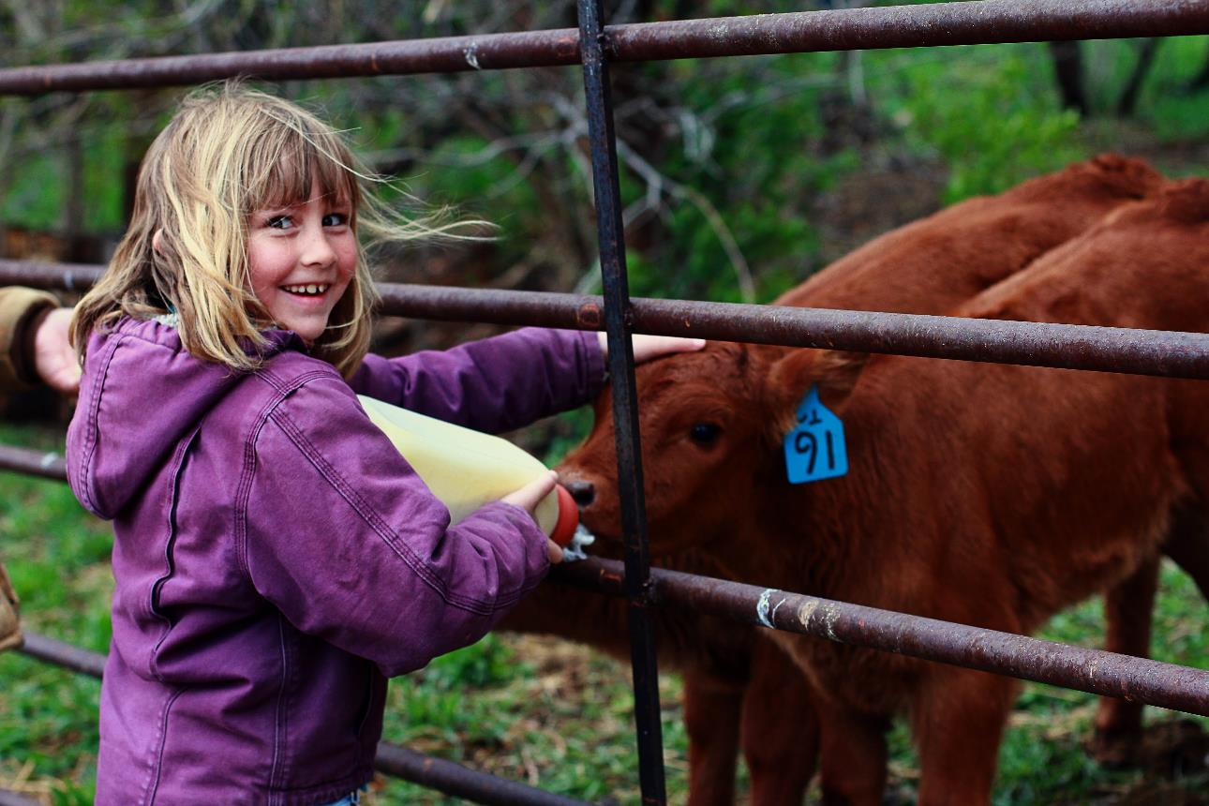
What did we learn from today’s challenge?

