Slide 1
Minerals & Energy 5th Grade Lesson 5: Part 1 Just a Little off the Top
Notes:
The name of the lesson is a link to the Wyoming Agriculture in the Classroom website where the lesson can be downloaded.

Slide 2
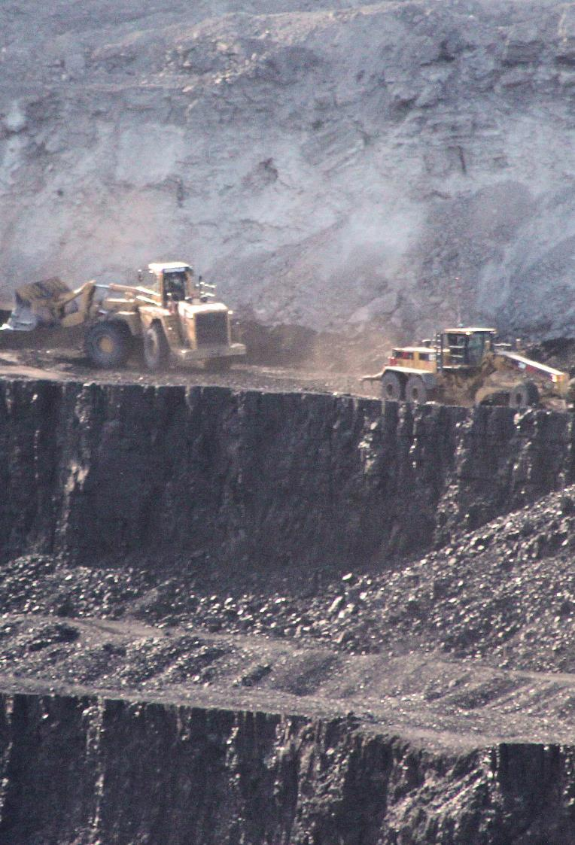
Today’s Challenge
Students will learn what reclamation is and why reclamation is important.
Notes:
This is the focus of today’s lesson.

Slide 3
Cross section – sample of a larger group; a view showing what the inside of a mountain looks like after a cut has been made through it
Geologist – a scientist who studies rocks and minerals
Landscape – all the features of an area of land that you can see
Overburden – rock or soil overlaying a mineral deposit
Reclamation – the act of returning something to a former, better state
Vocabulary
Notes:
These are the new vocabulary words for this lesson. You may need to adjust this list according to the needs of your students.

Slide 4
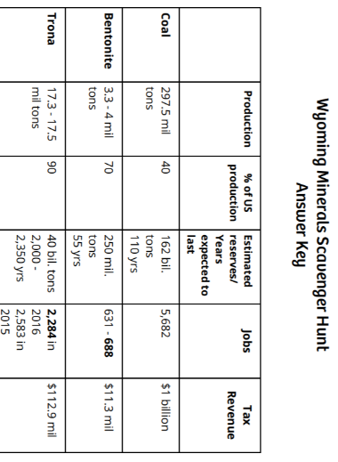
Highlights from our last lesson:
What did you learn from yesterday’s challenge?
Production and Revenue
Notes:
Look back on the previous lesson and review the key ideas.

Slide 5
Part 1

Slide 6
Extract Reclaim
Notes:
Part 1/Procedure #1 & #2

Slide 7
Create a Mine Site
Hide minerals in the base layer
Create a landscape with hills, valleys, and other landforms
Cover your base layer with shaving cream (overburden)
Add sprinkles to represent vegetation
Notes:
Part 1/Procedure #3: If you are unable to do this activity in the classroom, the following slides provide examples of this process.

Slide 8
Base layer with hidden minerals
Notes:
Part 1/Procedure #3

Slide 9
Add the overburden
Notes:
Part 1/Procedure #3

Slide 10
Add vegetation
Notes:
Part 1/Procedure #3

Slide 11
The Mining Process
Take a photo of the landscape model you received
Fold a piece of paper into 4 sections
Label the sections
Notes:
Part 1/Procedure #4

Slide 12
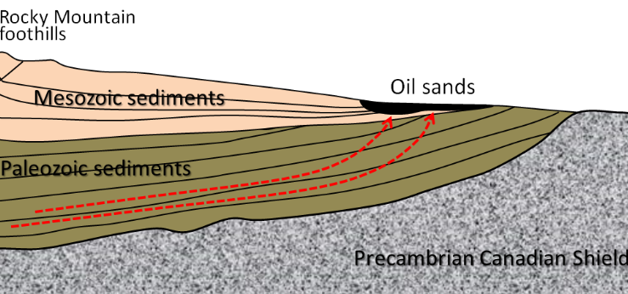
Landscape Sketch & Cross Section
Cross section – Draw what you think your landscape model looks like inside.
Landscape – Draw and label your landscape model.
This Photo by Unknown Author is licensed under CC BY
Notes:
Part 1/Procedure #5: The bottom picture is an example of a cross section of a mountain.

Slide 13
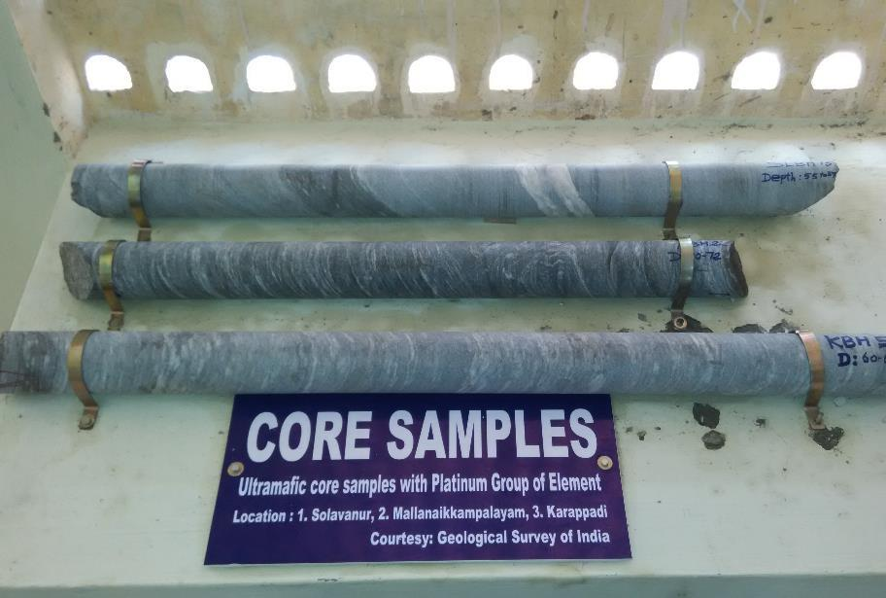
Core Samples
This Photo by Unknown Author is licensed under CC BY-SA
This Photo by Unknown Author is licensed under CC BY-SA
Use a pencil or other tool to “drill” into the landscape.
Push the tool into the dirt.
Did you hit something that might be a mineral?
Notes:
Part 1/Procedure #5

Slide 14
Core Sample Example
Once you’ve done your core samples, redraw your cross section to show where you think the minerals are located.
Label your drawing.
Notes:
Part 1/Procedure #5: Any tool can be used to do core samples. Items that work well are Dairy Queen straws (fat), skewers, plastic knives, etc.)

Slide 15
Extract your minerals!
Remember, you will have to reclaim your landscape when you are done mining to make it look like it did in its original state.
Notes:
Part 1/Procedure #6

Slide 16
All the minerals were found. Yikes! Look at our landscape!
Notes:
Part 1/Procedure 6: Example of activity, if needed

Slide 17
Reclaim Your Mine Site
After reclaiming your landscape, sketch the results on the 4th square of your paper.
Label your sketch.
Notes:
Part 1/Procedure #7

Slide 18
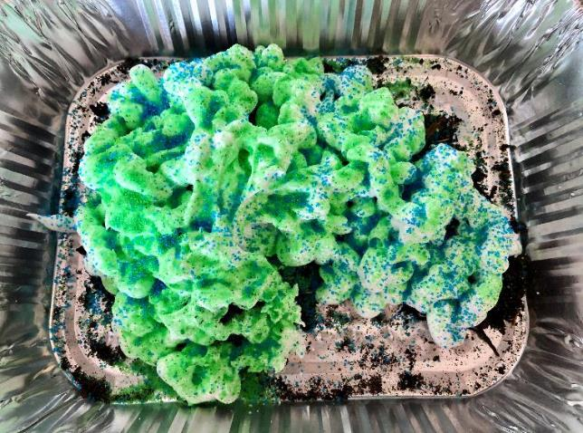
The reclamation of our landscape; not quite what it was before…
Notes:
Part 1/Procedure 7: Example of activity, if needed

Slide 19
Class Discussion
Did everyone’s reclamation process look the same?
Were some students’ reclaimed landscapes closer to their original ones? What did they do differently?
What were some of the problems you had when reclaiming your landscape?
How did you solve them?
What would have made reclaiming your landscape easier?

Slide 20
Class Discussion continued…
How can you connect reclaiming your landscape to what mines must do to reclaiming mine sites?
How is your process of reclamation similar to the process miners use? How is it different?
What happens when all the minerals are mined?
Why is reclamation important?
Is reclamation an important part of stewardship? Why?

Slide 21
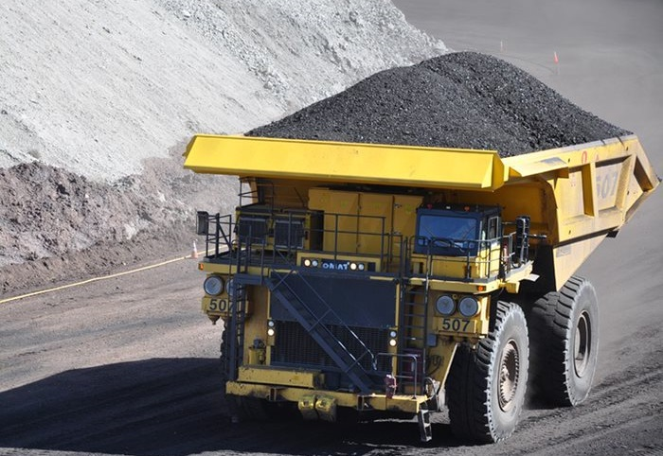
What did we learn from today’s challenge?
Notes:
Provide the students an opportunity to explain their learning.

