Slide 1
Minerals & Energy 5th Grade Lesson 6: Attention, Please!
Notes:
The name of the lesson is a link to the Wyoming Agriculture in the Classroom website where the lesson can be downloaded.

Slide 2
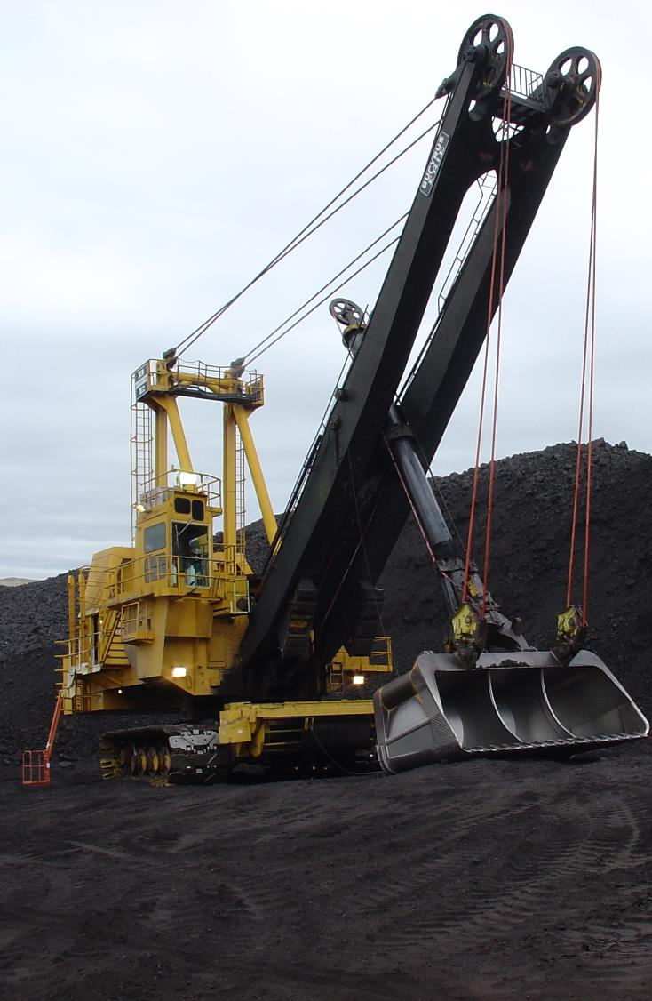
Today’s Challenge
Students will:
Review that Wyoming minerals are nonrenewable.
Explain why we should be good stewards of Wyoming minerals.
Notes:
This is the focus of today’s lesson.

Slide 3
Nonrenewable Resources – a resource that cannot be replenished (made again) in a short period of time
Public Service Announcement (PSA) – a news article or graphic that shares information with the public
Renewable Resource – resources that are capable of being replenished
Vocabulary
Notes:
These are the new vocabulary words for this lesson. You may need to adjust this list according to the needs of your students.

Slide 4
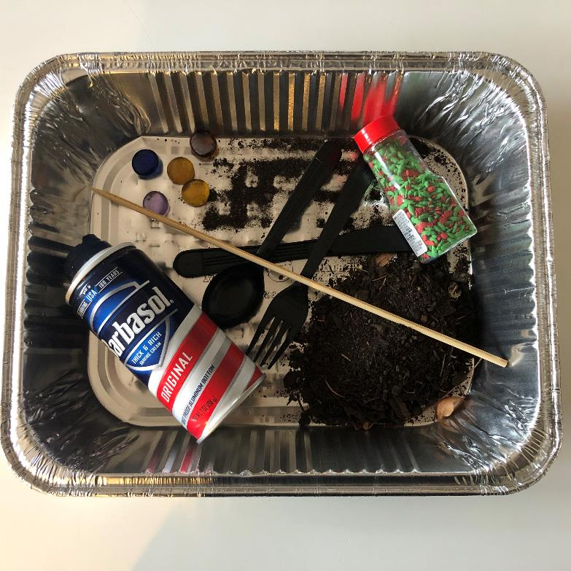
Extraction of minerals
Reclamation of land
Highlights from our last lesson:
What did you learn from yesterday’s challenge?
Notes:
Look back on the previous lesson and review the key ideas.

Slide 5
Part 1

Slide 6
Wyoming Minerals are Nonrenewable
Why is it important for us to be able to continue using these minerals?
How would your life be impacted if Wyoming were to run out of its mineral resources?
Notes:
Part 1/Procedure #1

Slide 7
Being a good steward of resources:
Become informed
Weigh your options
Know the outcomes of decisions
Notes:
Part 1/Procedure #2

Slide 8
New Technologies
Link to Reading Resource
Notes:
Part 1/Procedure #3

Slide 9
A Public Service Announcement…
Link to PSA Assignment
Notes:
Part 1/Procedure #4: See Teacher Note for additional information. Flipgrid can be used as another option for presenting the PSAs.

Slide 10
Part 2

Slide 11
Gallery Walk of our Public Service Announcements
Notes:
Part 2/Procedure #1

Slide 12
Vote for your favorite!
Link to Voting Tickets
Notes:
Part 2/Procedure #2 & #3

Slide 13
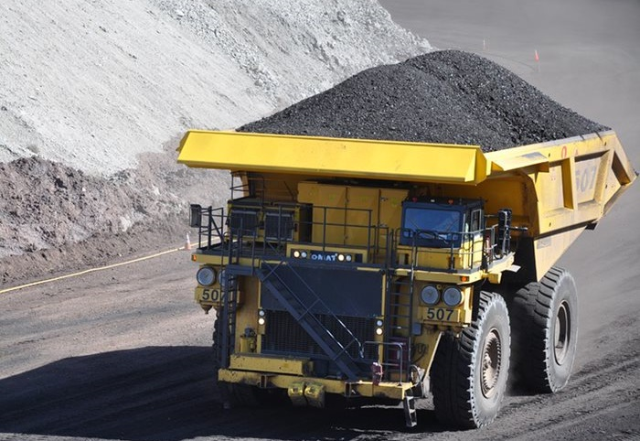
What did we learn from today’s challenge?
Notes:
Provide the students an opportunity to explain their learning.

Slide 14
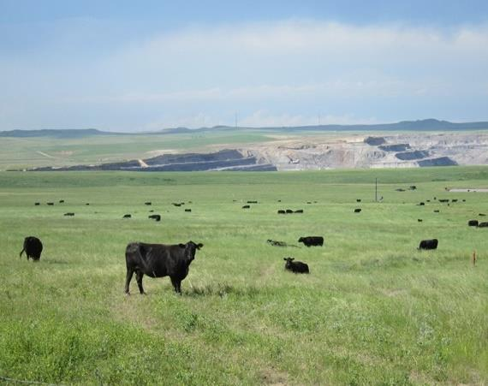
Essential Question:
How can we be stewards of Wyoming’s mineral and energy resources to benefit current and future generations?
Notes:
This is a chance to share the Essential Question for this unit.

Slide 15
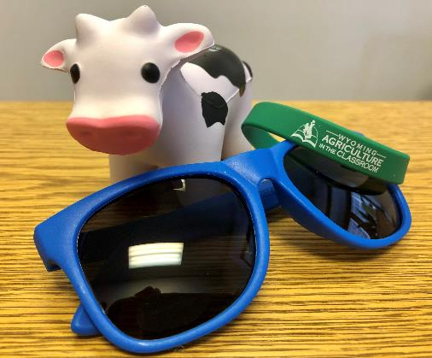
We need your help!
Wyoming Ag in the Classroom is a non-profit organization. Through the generosity of donors and grant providers, we can provide our programs free of charge. For us to continue, we need data from you that we can share with our donors and grant providers.
How you can help:
After completing a unit, please complete our questionnaire:
Feedback Questionnaire
Our way to say thanks:
Once you and your students complete the questionnaire, you will be sent a package with a fun reward for your class.

