Slide 1
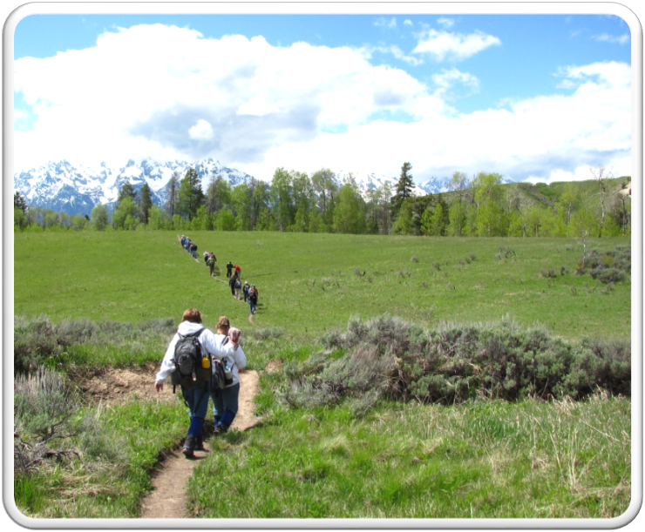
Outdoor Recreation & Tourism
5th Grade
Lesson 3:
School Supplies
Notes:
The name of the lesson is a link to the Wyoming Agriculture in the Classroom website where the lesson can be downloaded.

Slide 2
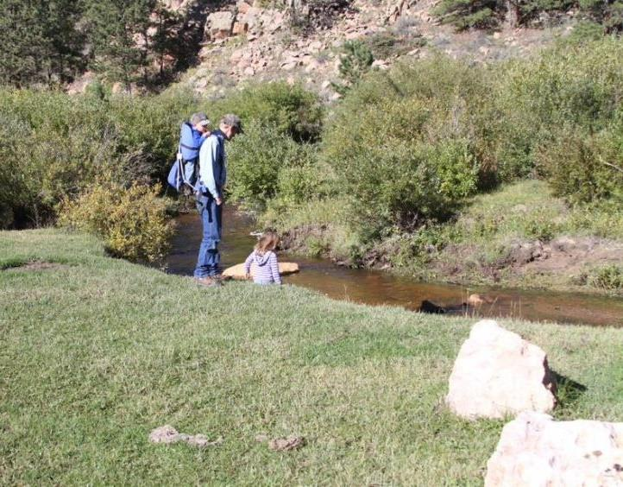
Today’s Challenge:
Students will:
Learn the difference between Wyoming’s State Trust Lands and state parks, how both are used, and how to be stewards of them.
Notes:
This is the focus of today’s lesson.

Slide 3
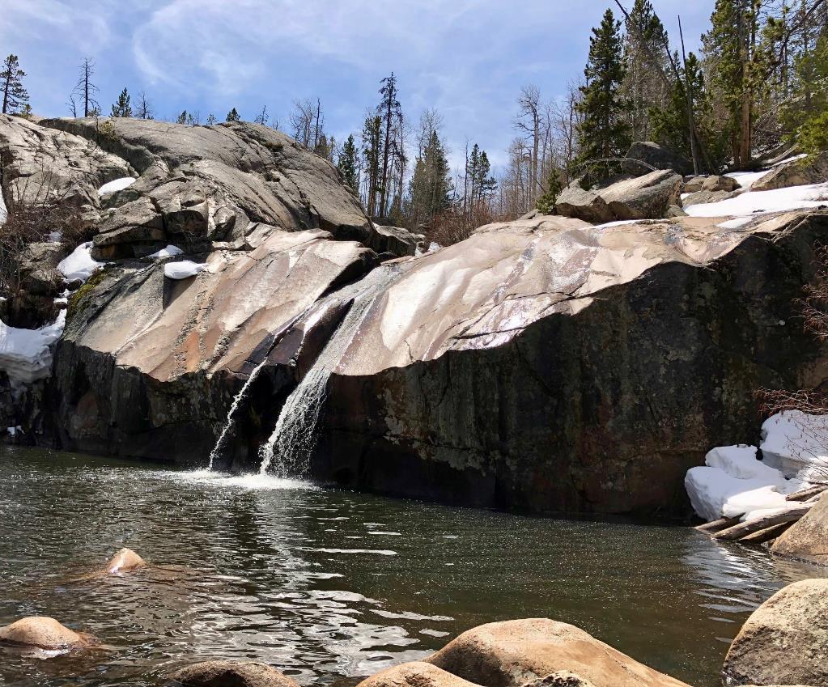
Vocabulary:
State Parks – State lands reserved to be enjoyed by the public for recreation and tourism and do not generate income through development.
State Trust Lands – lands that were granted to Wyoming and designated to generate revenue for public schools and other state institutions
Notes:
These are the new vocabulary words for this lesson. You may need to adjust this list according to the needs of your students.

Slide 4
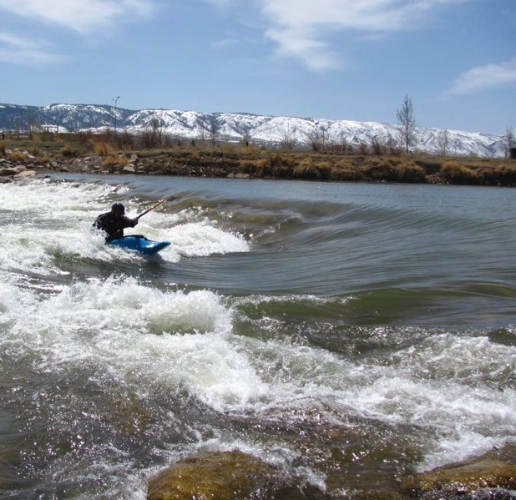
Highlights from our last lesson:
Think back on:
Public and private land
Uses of Wyoming’s lands
Stewards of Wyoming’s lands
Notes:
Look back on the previous lesson and review the key ideas.

Slide 5
Day 1
This Photo by Unknown Author is licensed under CC BY

Slide 6
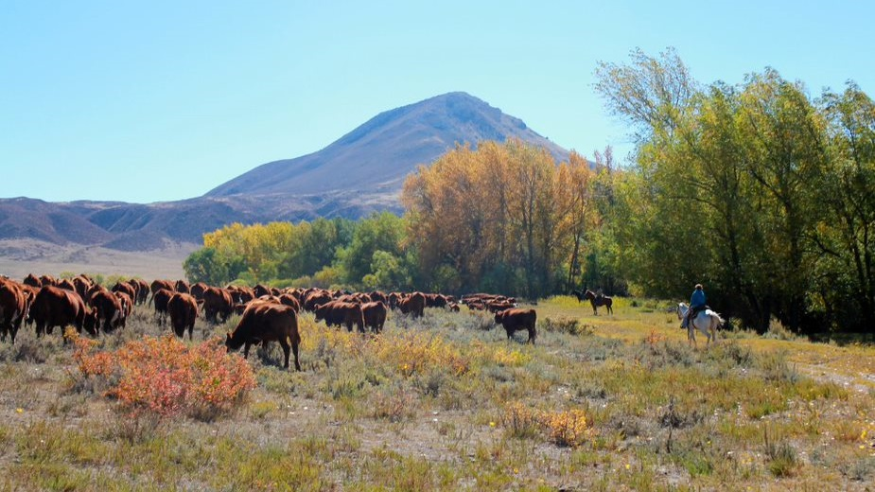
Wyoming State Trust Lands
When it comes to the importance of State Trust Lands and how they benefit education,
Jane says they’re not important.
William says they help our schools.
Whose position is correct?
Let’s find out.
Notes:
Day 1/Procedure #1

Slide 7
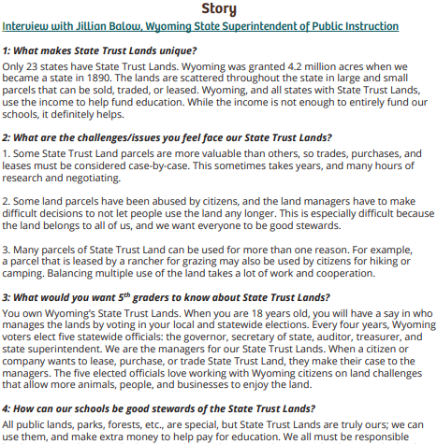
Gathering evidence:
Read the interview with Wyoming State Superintendent of Public Instruction, Jillian Balow.
Highlight the following words:
State Trust Lands
Schools
Benefits
Grazing
Energy
Mineral
Timber leases
Highlight information that supports Jane's or William's position on State Trust Land.
Jillian Balow interview resource
Notes:
Day 1/Procedure #1

Slide 8
Portrait Gallery: Lesson 3
Notes:
Day 1/Procedure #1:

Slide 9
Who was correct, Jane or William?
Our evidence:
Notes:
Day 1/Procedure #2: Main points can be collected in this slide.

Slide 10
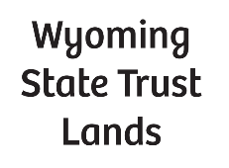
Private Land
Public Land
Tokens
Notes:
Day 1/Procedure #3: If you are virtual, this will represent the classroom with the tape splitting the room.

Slide 11
Using our State Trust Lands
You have 5 tokens each.
When you use our State Trust Lands, you put a token in the container.
When we have 40 tokens, you will purchase an item for our classroom.
We’ll check it at the end of the day.
Keep your tokens in a safe place, so you don’t lose them!
Notes:
Day 1/Procedure #3: You can change “State Trust Lands” for whatever you decide to have to students pay to use. If you are virtual, it could be their microphone or camera. You could create a community document, such as a google slide for this purpose. As a reward, PBS has a wide variety of games and videos that are educational and free. https://pbskids.org/

Slide 12
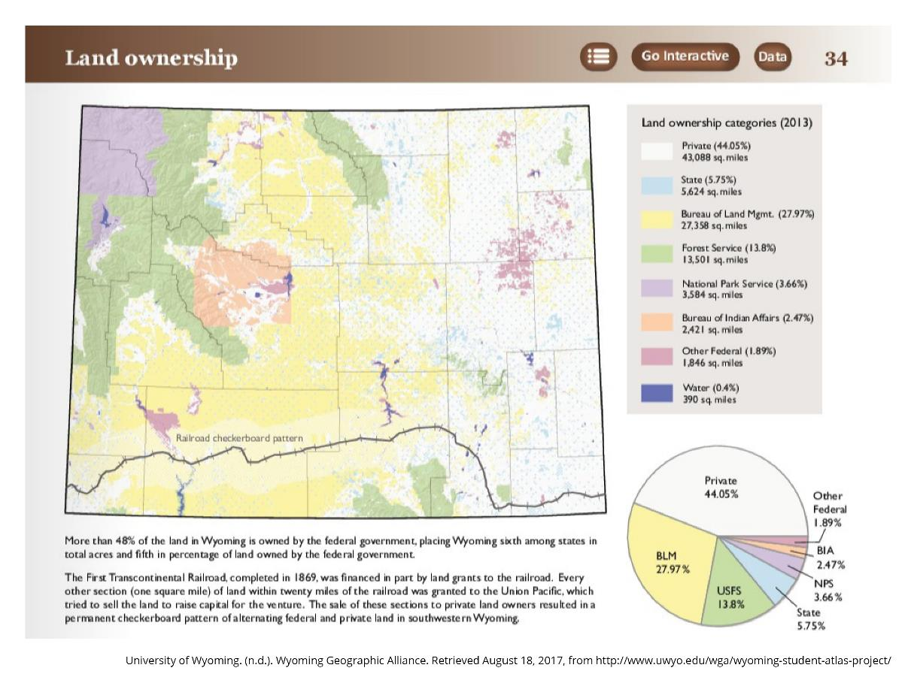
State Trust Land
Makes up 5.75 % of Wyoming land.
Is managed by the Wyoming Board of Land Commissioners.
Generates income from livestock grazing, outfitting, energy, timber, and mineral production.
Land Ownership Map link
Notes:
Day 1/Procedure #4:

Slide 13
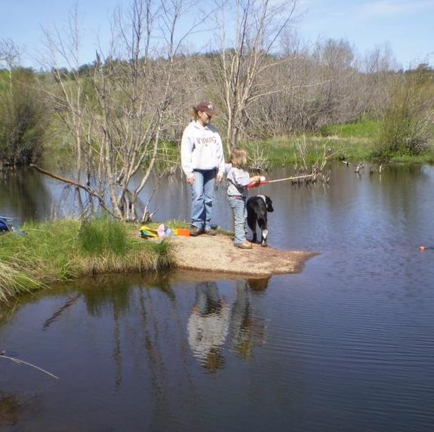
Can YOU enter State Trust Lands?
You can hunt and fish on State Trust Land if you have legal access and follow the regulations.
You are required to get permission from private landowners to cross their land to get to State Trust Land.
You must stay on the roads (no off-road vehicles.)
You can’t camp overnight.
You can’t have an open fire.
You need to be careful; activities that would damage the land, roads, or improvements is prohibited.
Notes:
Day 1/Procedure #4

Slide 14
Just like our tokens, State Trust lands raise money for our schools.
Notes:
Day 1/Procedure #4

Slide 15
3-minute
Walk and Talk
When the music stops, tell the nearest person:
State Trust Lands are important because...
If someone had never heard of State Trust Lands, one thing I would teach them is…
State Trust Lands can be used for…
_________ was correct because State Trust Lands…
Notes:
Day 1/Procedure #5: You can use breakout rooms for this activity if you are virtual.

Slide 16
Let’s count our tokens!
Notes:
Day 1/Procedure #5:

Slide 17
Day 2
This Photo by Unknown Author is licensed under CC BY-SA-NC

Slide 18
Wyoming Public Land: State Parks
Can you name any?
This Photo by Unknown Author is licensed under CC BY-SA-NC
Notes:
Day 2/Procedure #6

Slide 19
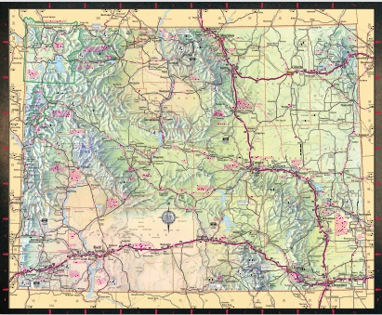
Finding our State Parks:
Look carefully in all parts of your map for any State Parks.
Using your clues to help locate each park.
Place a sticky note on the map near the location of the park.
Learn some State Park facts.
Official Wyoming Road Map link
Notes:
Day 2/Procedure #6:

Slide 20
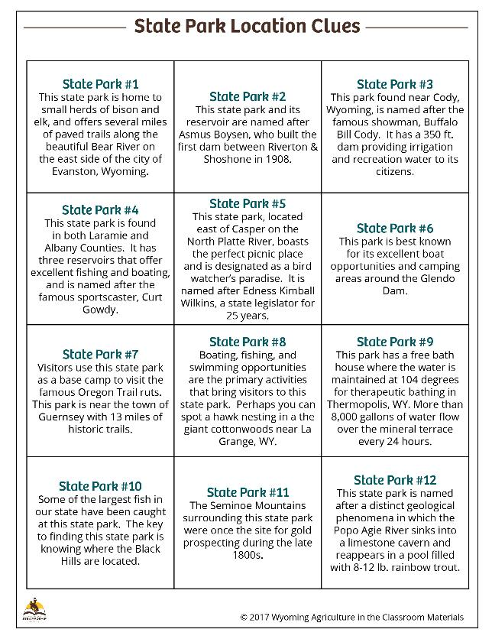
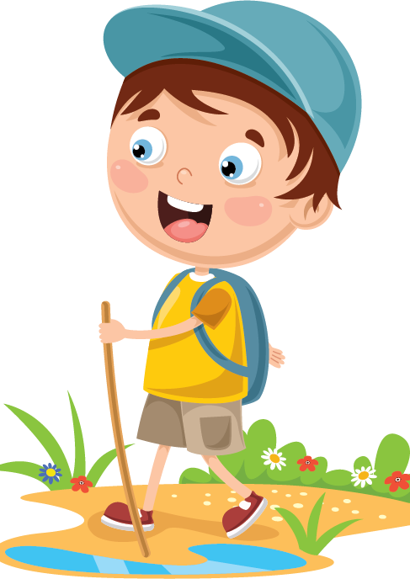
Use these clues to find each State Park on your Wyoming highway map. You have 10 minutes!
State Park Location Clues Resource Sheet
Notes:
Day 2/Procedure 6:

Slide 21
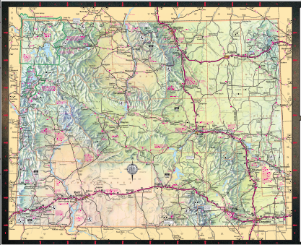
Let’s Discuss:
How did you find the parks?
What information on the map was helpful in locating the parks?
Notes:
Day 2/Procedure #7/Question Set 1: You can use the drawing tool or insert an icon to mark the location of each park.

Slide 22
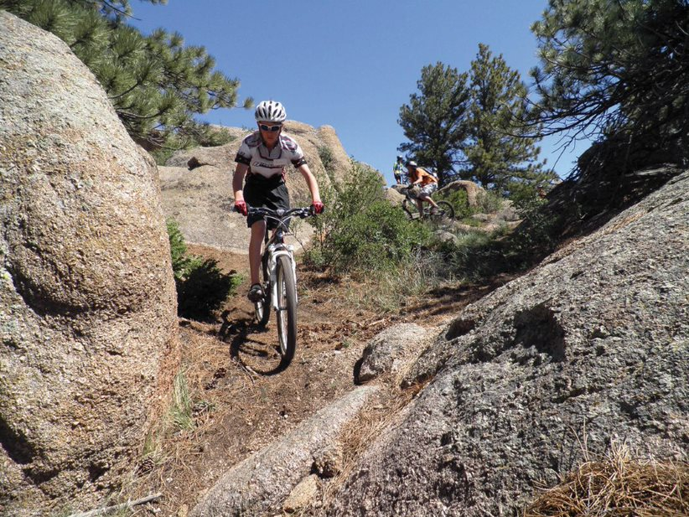
What do you notice about where the parks are located?
What geographic features are in those areas?
What types of recreation do you think visitors would be participating in when they visit these parks?
Notes:
Day 2/Procedure #7/Question set 2

Slide 23
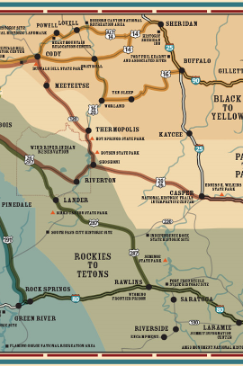
Exploring our Wyoming State Parks
Wyoming State Parks website
Wyoming State Parks interactive map
Notes:
This is not one of the procedures, but if you would like your students to further explore the State Parks, the Wyoming State Parks website is a great place to go. It can be done as a group or as individuals. If you use the interactive map, click on the layers (upper right, looks like 3 stacked squares) and click off the first box and click the second box (it will give you just parks and recreation sites). As an enrichment or if you are virtual and need a home activity, there is a Family Learning Series activity that has students map a family vacation using the maps at https://wyaitc.org/archives/lesson/wyoming-road-trip.

Slide 24
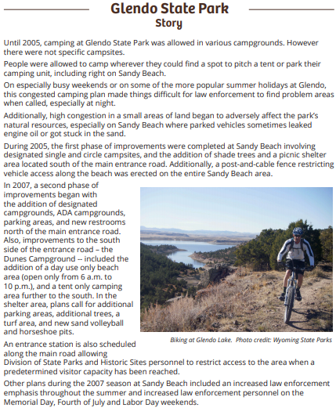
A Stewardship Story: Glendo State Park
Listen to the Glendo State Park Story.
Next, read the article again on your own.
Highlight information about:
State Parks.
Challenges that occurred at Glendo State park.
Be prepared to share
with the class.
Glendo State Park resource
Notes:
Day 2/Procedure #8

Slide 25
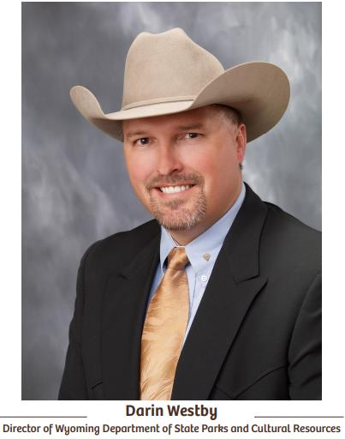
Portrait Gallery: Lesson 3
Notes:
Day 2/Procedure #8

Slide 26
Sharing our Learning
Challenges at Glendo State Park:
Notes:
Day 2/Procedure #8: This slide can be used to collect the students learning. You could also use a bulletin board tech tool.

Slide 27
Stewardship at Glendo State Park
On your paper, write one way that Glendo State Park practiced good stewardship.
Crumple your paper into a snowball.
Throw your snowballs around the room (NOT at each other) until I say stop.
Pick up and read the snowball nearest you.
Add another way Glendo State Park practiced good stewardship to your paper.
Notes:
Day 2/Procedure #9: If you can’t have a snowball fight, students could share their thoughts on a tech tool such as flip grid.

Slide 28
How can we be good stewards of our state lands?
Create your own mini-poster with 15 words or less!
Notes:
Assessment: You can change the “15 words” to whatever count works for you. If you are virtual, students could create a slide for their poster or can hold their poster up during a meeting.

Slide 29
The final count!
Notes:
Assessment: The final count of the tokens.

Slide 30
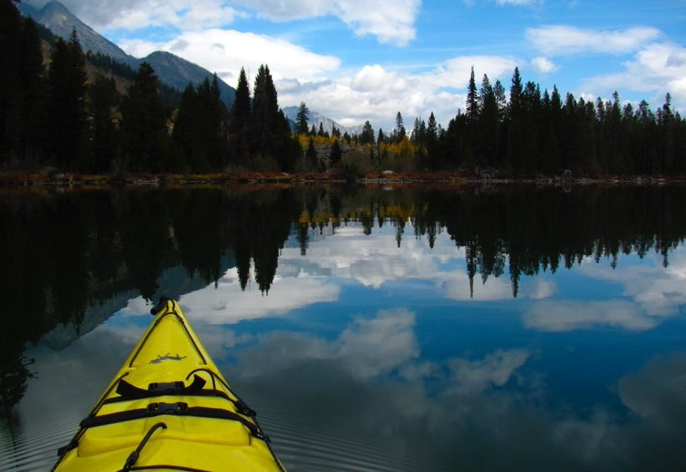
What did we learn from today’s challenge?
Notes:
Provide the students an opportunity to explain their learning.

