Slide 1
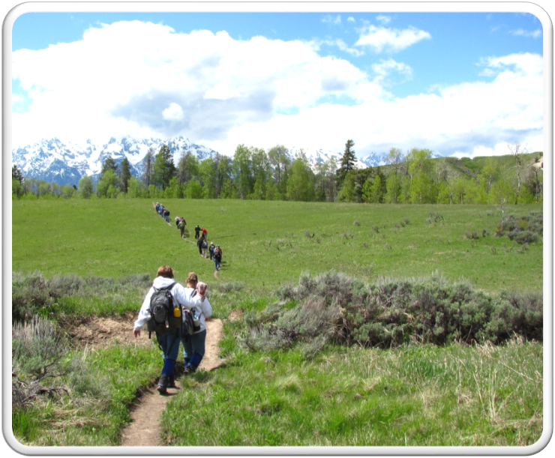
Outdoor Recreation & Tourism
5th Grade
Lesson 7:
You – The Mystery Steward
Notes:
The name of the lesson is a link to the Wyoming Agriculture in the Classroom website where the lesson can be downloaded.

Slide 2
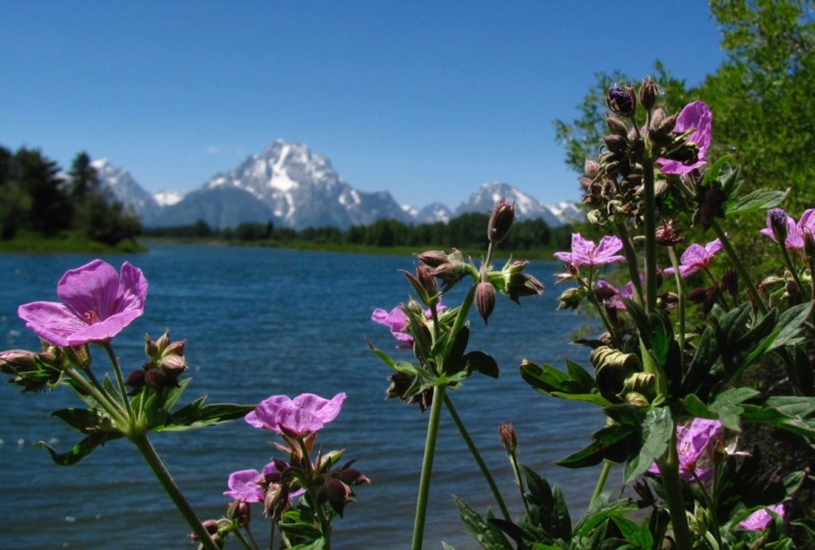
Today’s Challenge:
Students will:
See themselves as a good steward of Wyoming’s public and private lands through the lens of being a responsible citizen.
Notes:
This is the focus of today’s lesson.

Slide 3
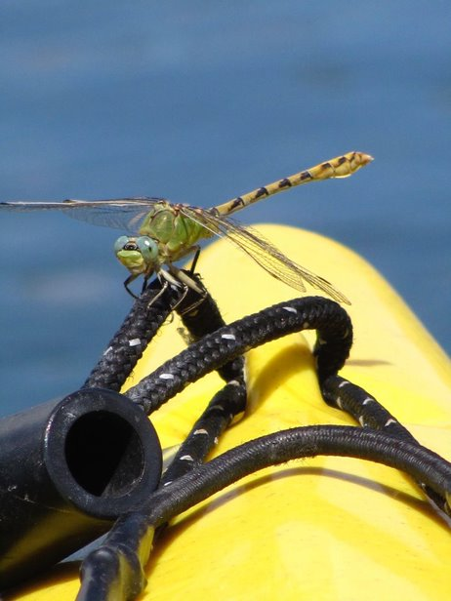
Vocabulary
Agency
Bureau of Land Management (BLM)
Care
Develop
Economy
Ecosystem
Federal Land
Fish and Wildlife Service
Forest Service
Held in trust
Industry
Invasive
Manage
National Park Service
Native
Natural resource
Noxious weeds
Private land
Public Land
Reclaim the land
Resource
State Parks
State Trust Lands
Stewardship
Sustainability
Tourism
Tourist
Use
Glossary link
Notes:
There are no new vocabulary words. A link to the full glossary is there to use as a word bank.

Slide 4
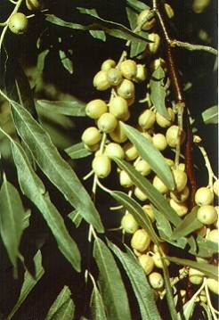
Highlights from our last lesson:
Think back on:
Invasive species
Stewards who help control invasive species
This Photo by Unknown Author is licensed under CC BY
Notes:
Look back on the previous lesson and review the key ideas.

Slide 5
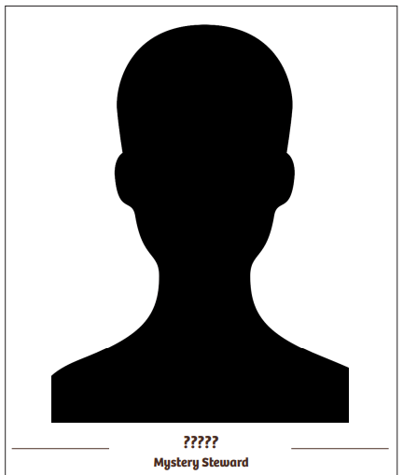
Who is Our Mystery Steward?
Our mystery steward knows:
About Wyoming’s public and private lands.
That Wyoming’s lands have many uses.
That Wyoming’s lands must be cared for in different ways.
That his/her job is to be a responsible citizen.
To follow rules and regulations on all types of land.
To clean up all the different parks and recreation sites.
Notes:
Procedure #1

Slide 6
Our mystery person wants to help take care of our lands, so they are here for current and future generations.
Who is our Mystery Steward?
Notes:
Procedure #1 and #2

Slide 7
YOU are the Mystery Steward!
YOU will have your picture in the Portrait Gallery!
This Photo by Unknown Author is licensed under CC BY-NC
Notes:
Procedure #2

Slide 8
Create Your Portrait
Use this template to create a representation of yourself.
Don’t forget your name!
Portrait template resource
Notes:
Procedure #2

Slide 9
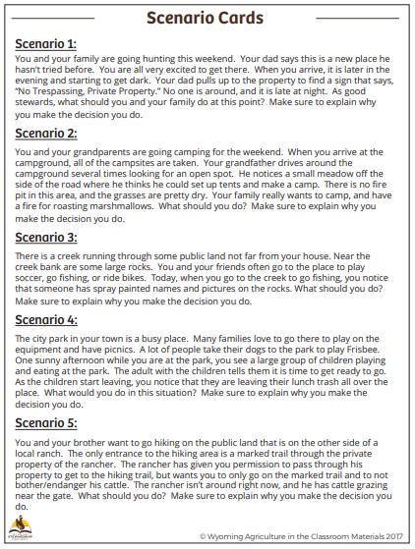
Your Stewardship Story
Choose a scenario you feel strongly about.
Write a paragraph that describes you as a good steward dealing with the challenge in your scenario.
Use your best paragraph writing skills.
Scenario Cards resource
Notes:
Procedure #3/Assessment

Slide 10
Portrait Gallery: Lesson 7
Notes:
Procedure #4 and #5: You can insert student portraits into the frame. Copy the slide as many times as needed to include all the portraits. You could include each student’s paragraph in the 2nd frame, with a slide for each student. You can also do a “virtual” gallery showing by having each student hold up their portrait and read their paragraph.

Slide 11
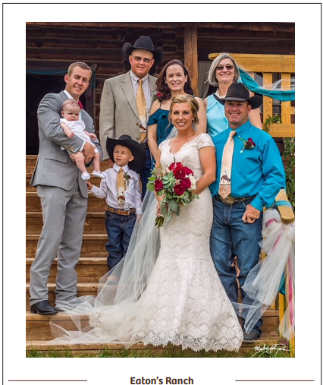
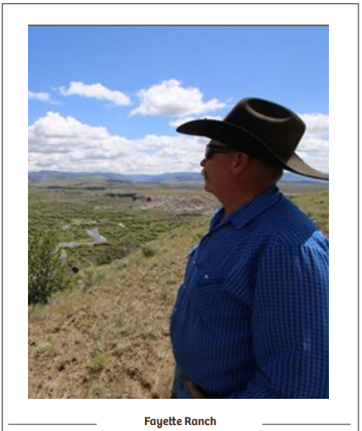
Portrait Gallery: Lesson 2
Notes:
Procedure #5

Slide 12
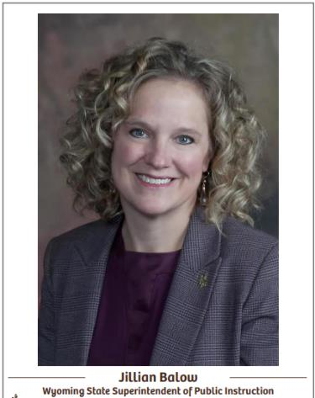
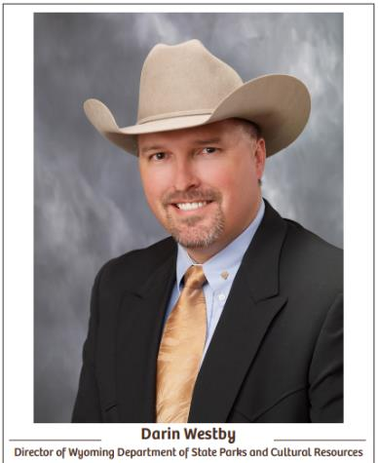
Portrait Gallery: Lesson 3
Notes:
Procedure #5

Slide 13
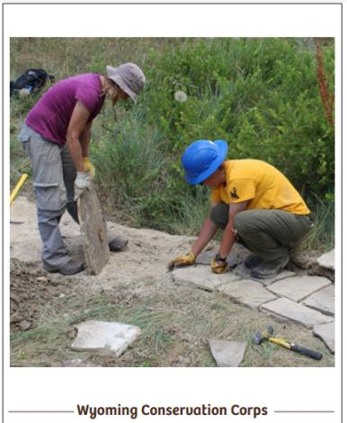
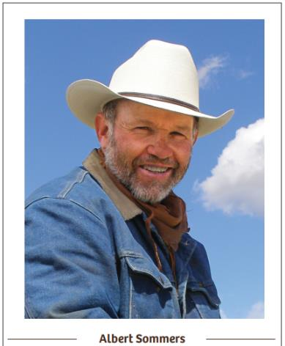
Portrait Gallery: Lesson 4
Notes:
Procedure #5

Slide 14
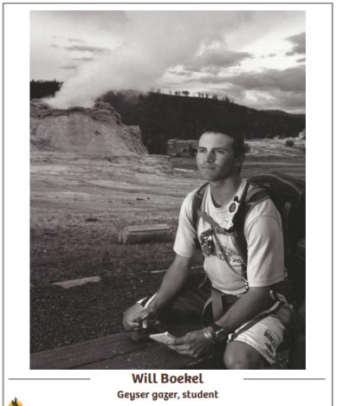
Portrait Gallery: Lesson 5
Notes:
Procedure #5

Slide 15
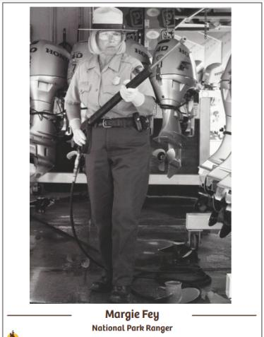
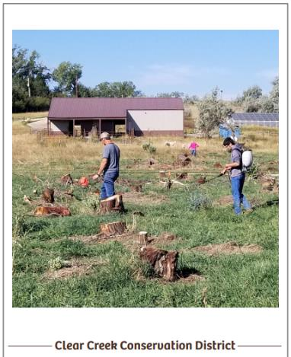
Portrait Gallery: Lesson 6
Notes:
Procedure #5

Slide 16
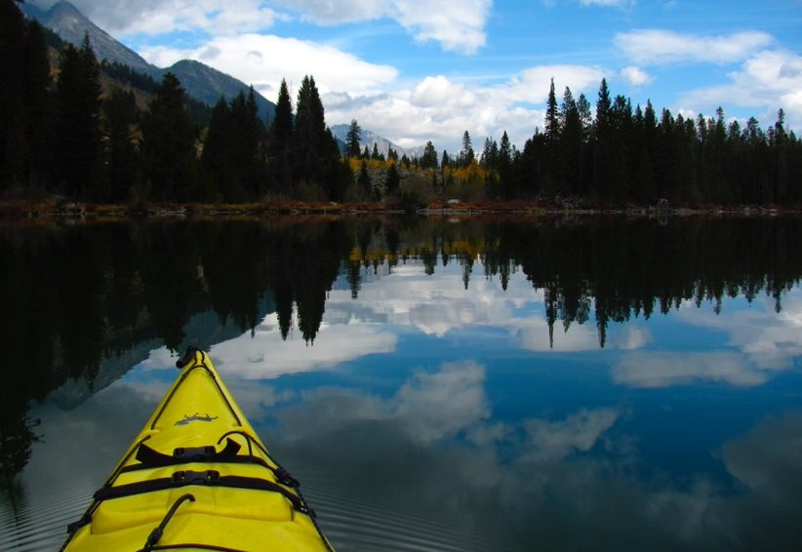
What did we learn from today’s challenge?
Notes:
Provide the students an opportunity to explain their learning.

Slide 17
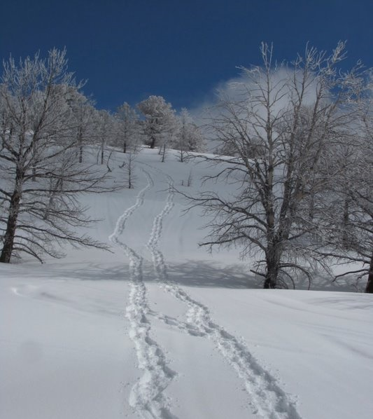
Essential Question:
How can we be stewards of Wyoming’s public and private lands to benefit current and future generations?
Notes:
This is a chance to take students back to the Essential Question for this unit and discuss their role as stewards of Wyoming’s public and private lands.

Slide 18
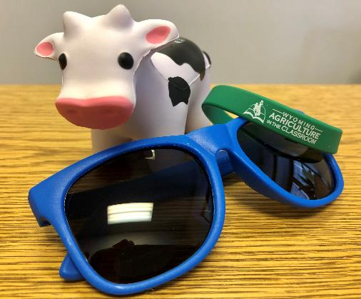
We need your help!
Wyoming Ag in the Classroom is a non-profit organization. Through the generosity of donors and grant providers, we can provide our programs free of charge. For us to continue, we need data from you that we can share with our donors and grant providers.
How you can help:
After completing a unit, please complete our questionnaire:
Feedback Questionnaire
Our way to say thanks:
Once you and your students complete the questionnaire, you will be sent a package with a fun reward for your class.
You will also be entered in a drawing for a Samsung Galaxy Tab A!

